Slide 1
UHR-SIG Signaling for COBF
Date: 2024-11-08
Authors:
Name | Affiliations | Address | Phone | Email
Shengquan Hu | Mediatek | 2840 Junction Ave. San Jose, CA, 95134 |  | Shengquan.hu@mediatek.com
Jianhan Liu |  |  |  | jianhan.liu@mediatek.com
Thomas Pare

Slide 2
Introduction
COBF design for UHR has been discussed in several contributions, such as contributions [1,2] proposes the followings for COBF and some of them were already passed motions:
Limit to 2 APs
Support up to 4 users in COBF
Total Nss <=4 and up to 2ss per-user
Common pre-UHR portion preamble across 2 APs
Define COBF as a new PPDU type and indicated in U-SIG
Carry two BSS Colors in U-SIG
Explicitly differentiate 2 BSS colors by using 1bit indication in per-User field
In this contribution, we will share our thoughts on UHR-SIG signaling to resolve the potential STA-ID collision issue in COBF:
support LDPC only for COBF to free up 1 bit for other signaling
Re-purpose Coding bit to differentiate two BSS colors
Keep the Reserved bit
Reuse existing design as much as possible
Minimize spec modification efforts

Slide 3
Recap: U-SIG for COBF
Contribution [2] proposed high level idea of COBF design & signaling methods in U-SIG for COBF, e.g.
Common preamble for pre-UHR preamble
2 BSS colors carried in U-SIG
COBF PPDU type is indicated in U-SIG
Example of illustration for common U-SIG:
U-SIG1 | B0-B2 | B3-B5 | B6 | B7-B12 | B13-B19 | B20-B25
 | PHY version | PPDU BW | UL/DL | BSS color 1 | TXOP | BSS color 2
U-SIG2 | B0-B1 | B2 | B3-B7 | B8 | B9-B10 | B11-B15 | B16-B19 | B20-B25
 | PPDU Type | validate | Punctured Channel Information | Validate | UHR-SIG MCS | Number of UHR-SIG Symbols | CRC | Tail
Indicate COBF PPDU
Slide 3
Shengquan Hu, Mediatek Inc.

Slide 4
LDPC Only for COBF PPDU
COBF is targeting for non-OFDMA PPDU in UHR:
BCC is only allowed for RU<=242
Most of COBF PPDUs will use LDPC only
Considerations of LDPC only for COBF:
Free up 1 bit for other signaling
Simplify COBF testing
No performance impact
NOTE: It was already agreed to limit LDPC only for UEQM.
Slide 4
Shengquan Hu, Mediatek Inc.

Slide 5
Common Field of UHR-SIG Signaling for COBF
In Common field of UHR-SIG, 3bit subfield of “Number of non-OFDMA Users” is used to indicate the total number of users participating in COBF, similar to the definition for non-OFDMA MU-MIMO.
B0-B3 | B4-B5 | B6-B8 | B9 | B10-B11 | B12 | B13-B15 | B16-B18
Spatial Reuse | GI+LTF Size | Number of UHR-LTF Symbols | LDPC Extra Symbol Segment | Pre-FEC padding Factor | PE Disambiguity | Disregard | Number of non-OFDMA Users
Set to n to indicate n+1 total COBF users.
Slide 5
Shengquan Hu, Mediatek Inc.

Slide 6
User Field of UHR-SIG Signaling for COBF
Based on non-OFDMA MU-MIMO UHR-SIG format
Re-purpose Coding bit (B21) in User field to explicitly differentiate two BSS colors, e.g.
0: user is associated with AP with 1st BSS color carried in U-SIG
1: user is associated with AP with 2nd BSS color carried in U-SIG
Reuse 11ax Spatial Configuration subfield encoding Table 27-30
Keep the existing Reserved bit
Repurpose “Coding bit” to differentiate 2 BSS colors
B0-B10 | B11-B15 | B16-B19 | B20 | B21 | B22
STA-ID | MCS | Spatial Configuration | Reserved | BSS Color Indication: 0: BSS Color 1 1: BSS Color 2 | 2xLDPC
Reuse 11ax Spatial Configuration subfield encoding Table 27-30
Slide 6
Shengquan Hu, Mediatek Inc.

Slide 7
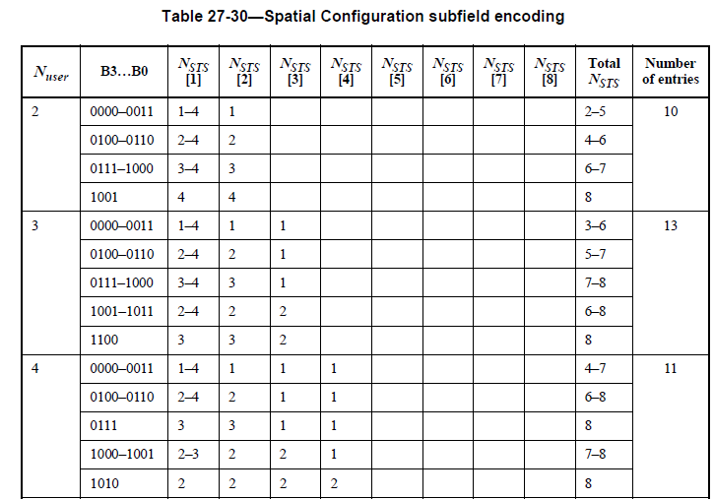
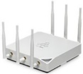
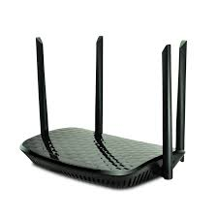
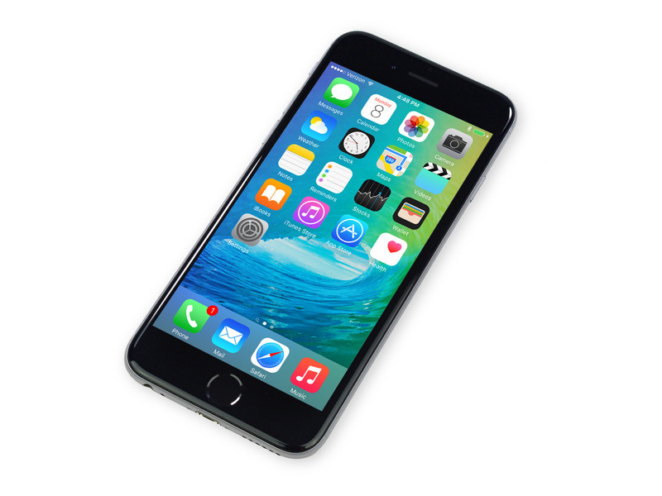
Example of UHR-SIG Signaling for COBF
Example: 2 APs, 3 STAs, total 4ss
AP-a
(BSS-1)
AP-b
(BSS-2)
STA-a1
STA-b1
STA-b2
(1ss)
(1ss)
(2ss)
BSS color 2 indication
BSS color 2 indication
BSS color 1 indication
User fields
STA-b2 | MCS | 0001 | Rsvd | 1 | 2xLDPC
STA-b1 | MCS | 0001 | Rsvd | 1 | 2xLDPC
STA-a1 | MCS | 0001 | Rsvd | 0 | 2xLDPC
User fields belonging to an AP are contiguous
User fields in order of decreasing #SS

Slide 8
Reference
[1]. 24/1452r1 Sounding Schemes for Coordinated Beamforming,
[2]. 24/1822r0 COBF Design for UHR

Slide 9
Straw Poll #1
Do you agree to include the following text to the 11bn SFD?
LDPC is the only coding mode for COBF.

Slide 10
Straw Poll #2
Do you agree to include the following text to the 11bn SFD?
11bn defines an indication to identify the BSS color for COBF transmissions

Slide 11
Straw Poll #3
Do you agree to include the following text to the 11bn SFD?
1-bit indication in the per-user SIG field to resolve the BSS color for COBF transmissions.
The coding bit is re-purposed for this indication

