Slide 1
AMP Downlink Sync Field Options
Date: 2024-11-11
Authors:
Name | Affiliations | email
Steve Shellhammer | Qualcomm | shellhammer@ieee.org
Bin Tian |  | btian@qti.qualcomm.com
Pooria Pakrooh |  | ppakrooh@qti.qualcomm.com
Manideep Dunna |  | mdunna@qti.qualcomm.com

Slide 2
Background
In [1] they described the hardware constraints of the Backscatter Tags, and it impact on the AMP Downlink Sync field design
An analog system is used where a capacitor is charged to capture the RF energy of the On symbols.
Then a 2 MHz clock is used to sample the energy
All of this is based on the strict power consumption constraints of the Backscatter Tags
[1] recommends:
An OOK symbol duration of 2 µs (or longer)
A 16-bit sequence with at most three Off symbols in a row
Provided three example sequences

Slide 3
Options for the AMP Downlink Sync Field
Option #1 – Use the same AMP Downlink Sync field for transmission to all AMP STAs, both Backscatter and non-Backscatter
The Sync field design would be set by the hardware constraints of the Backscatter STAs
Option #2 – Use different AMP Downlink Sync fields for transmission to Backscatter and non-Backscatter STAs
The Sync field design for transmission to Backscatter STA would be set by the hardware constraints of the Backscatter STAs
The Sync field for transmission to non-Backscatter STA could be tuned to the hardware constraints of the non-Backscatter STAs, which is different than the Backscatter STAs
Note, non-Backscatter STA include:
Active TX Uplink STAs
Low-power 802.11b/n STAs

Slide 4
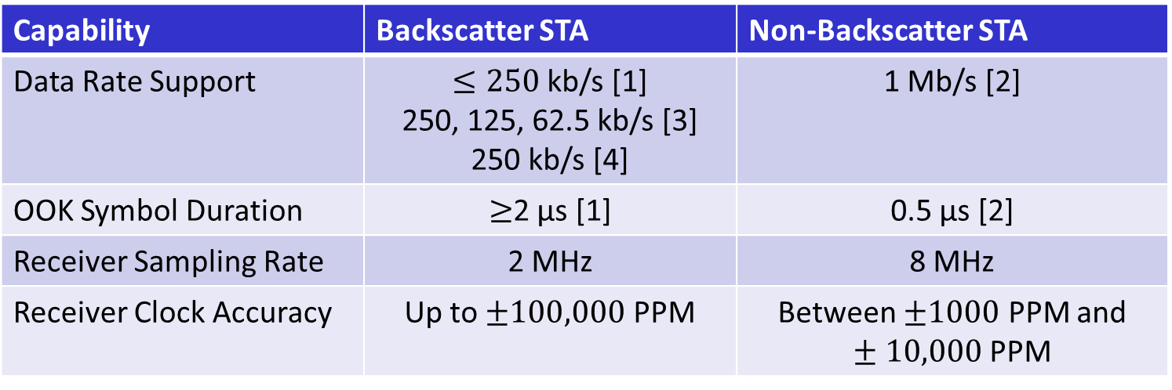
Different Capabilities of Backscatter and Non-Backscatter STAs
Capability | Backscatter STA | Non-Backscatter STA
Data Rate Support | $≤250$kb/s [1] 250, 125, 62.5 kb/s [3] 250 kb/s [4] | 1 Mb/s [2]
OOK Symbol Duration | $≥$2 µs [1] | 0.5 µs [2]
Receiver Sampling Rate | 2 MHz | 8 MHz
Receiver Clock Accuracy | Up to $±100,000$ PPM | Between $±1000$ PPM and $±10,000$ PPM
The Data Rates Support are proposed data rates
The Receiver Sampling Rates are based on discussions
The Receiver Clock Accuracy values are those that have been mentioned in presentation. The Task Group has not yet settled on the final requirements

Slide 5
Task Group Decision
The Task Group needs to decide between two Options for the Direction of the Sync field design:
Option #1
One Sync Field for all AMP STAs
Design based on Backscatter STA capabilities
Option #2
Two Sync Field Designs
One for AMP non-Backscatter STAs
One for AMP Backscatter STAs

Slide 6
Summary
Provided two directions that the Task Group can take for the AMP Downlink Sync field design
Same Sync field for transmission to all AMP STAs
Two different Sync fields:
One for transmission to non-Backscatter STAs
One for transmission to Backscatter STAs

Slide 7
References
Rui Cao, “Design considerations of DL data rate and SYNC,” IEEE 802.11-24/1797r0, November 2024
Steve Shellhammer, Bin Tian and Pooria Pakrooh, “Downlink Data Rates, IEEE 802.11-24/1793r0,” November 2024
Bin Qian, Lei Huang, Panpan Li, David, Xun Yang, “Downlink Data Rates for Bi-static Backscattering,” IEEE 802.11-24/1731r1, November 2024
Weijie Xu, et. al., “Data rates for AMP,” IEEE 802.11-24/1801r0, November 2024

