Slide 1
Evaluation of C-SR Types
Date: 2024-11-29
Authors:

Slide 2
Introduction
Coordinated Spatial Reuse (C-SR) is one of the Multi-AP coordination schemes for TGbn
In this contribution, we evaluated performance of each C-SR type including overhead of C-SR control signals

Slide 3
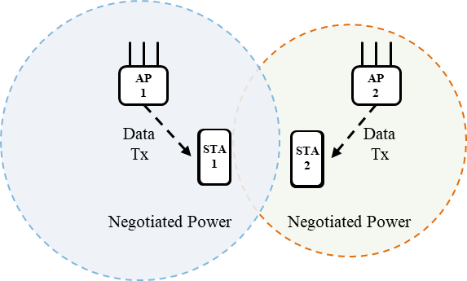
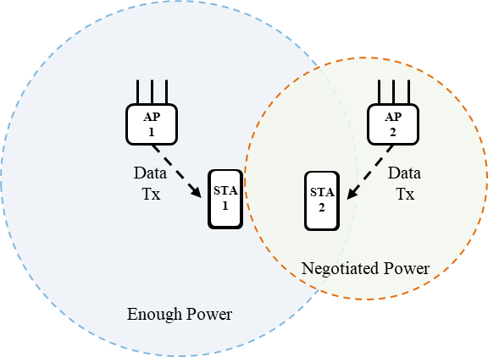
Recap of C-SR types
Optimal coordination[1][2]
  Sharing AP determines Tx power for each AP by using measurement report of OBSS transmitted from associated non-AP STA and OBSS AP
  Prerequisites for maximizing throughput need to be considered
One-way coordination[3]
  Sharing AP determines own Tx power without using measurement report transmitted from OBSS AP
  Shared AP determines own Tx power based on the transmit parameter of sharing AP
  Low overhead compared to optimal coordination
Optimal coordination
One-way coordination

Slide 4
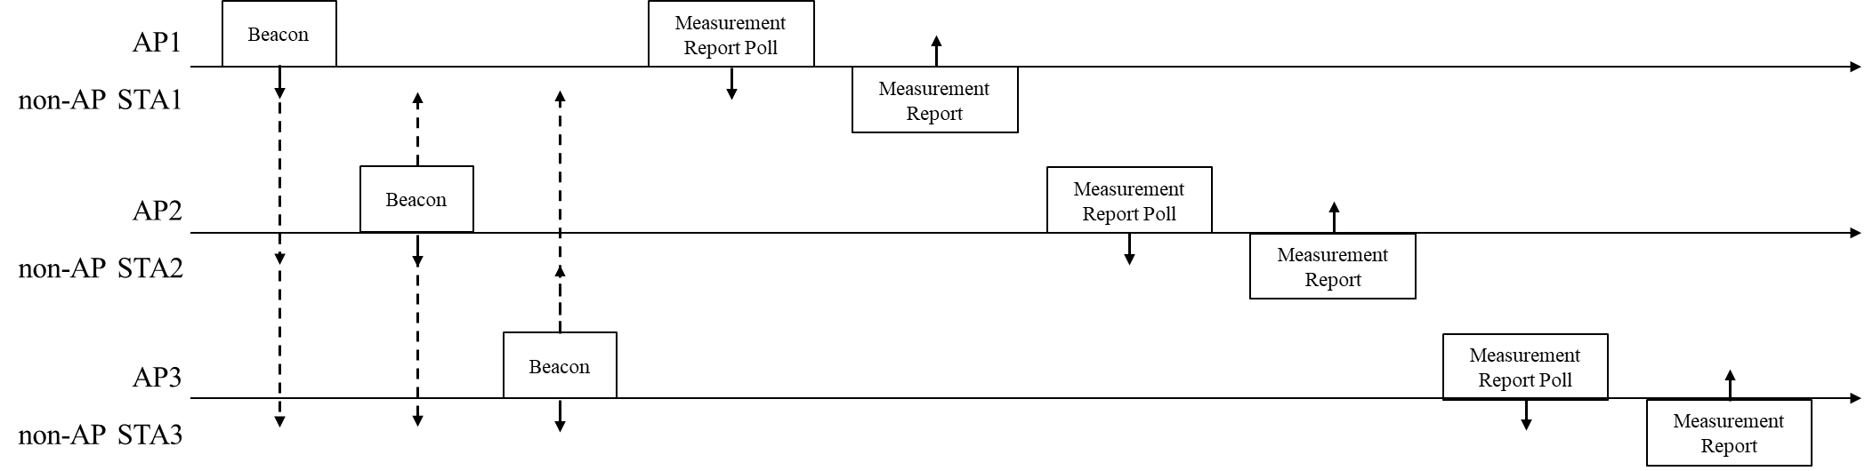
How to obtain SIR in measurement phase
Non-AP STAs measure RSSI from AP by using beacon signal
AP requests non-AP STAs in its BSS to transmit measurement report including RSSI of each AP to calculate SIR of the non-AP STA

Slide 5
Overhead assumption of C-SR
C-SR sequence refer to [4]
Beacon interval is 100[ms] in Measurement phase
In our simulation environment, assuming that the three APs are equally to become TXOP owners, each AP can use a TXOP of 30[ms] before the next measurement phase
Assuming the overhead of each signal below, each AP can send Multi-AP request ~ C-SR data 30 times which based on the most recent SIR measured in the measurement phase
Measurement phase | 1 [ms]
Multi-AP Request | 0.06 [ms]
Multi-AP Response | 0.14 [ms]
Multi-AP Trigger | 0.10 [ms]
C-SR data | 0.65 [ms]
In optimal coordination C-SR, total time from Multi-AP request to C-SR data is approximately 1[ms]
In one-way coordination C-SR, it can skip Multi-AP request and Multi-AP response, total time from Multi-AP Trigger to C-SR data is approximately 0.75[ms]

Slide 6
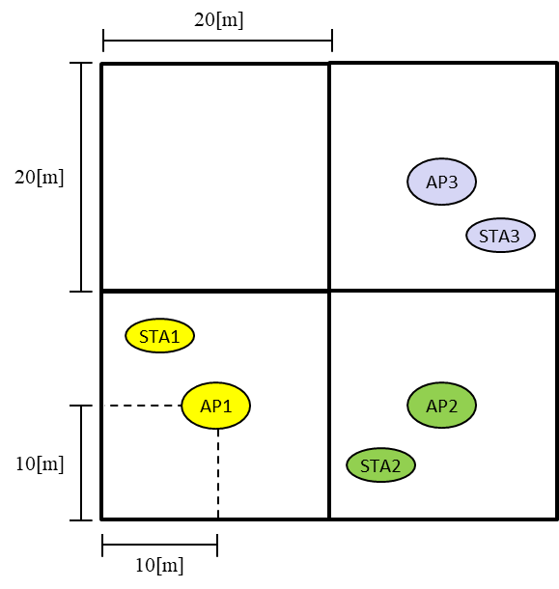
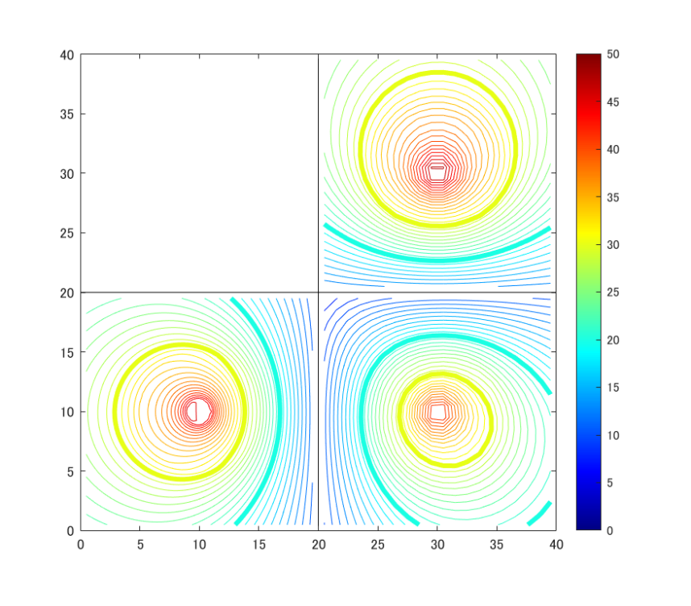
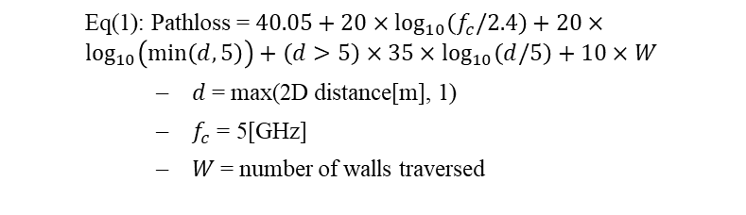
Simulation setup
Simulation Environment
  Layout
    One AP and one STA are placed in each 20[m] x 20[m] room
    STAs are deployed randomly (the number of drop patterns about 25,000)
    Sharing AP is fixed to AP1
  Parameter
Link | DL
Frequency, Bandwidth | 5[GHz], 80[MHz]
Tx Power | -10 ~ 20[dBm]
Tx/Rx Antenna | (AP, STA) = (4, 2)
Stream | 2 per STA
Precoding | SVD
MCS index | 0 ~ 13
Fading Model | Model-D
Noise Figure | 7 [dB]
Path loss model | Eq.(1)
Environment
SIR map
  Eq(1): Pathloss = $40.05+20×\log_{10}\left(f_{c}/2.4\right)+20×\log_{10}\left(min\left(d, 5\right)\right)+\left(d>5\right)×35×\log_{10}\left(d/5\right)+10×W$
    𝑑 = max(2D distance[m], 1)
    $f_{c}$ = 5[GHz]
    𝑊 = number of walls traversed

Slide 7
Simulation result
Our previous evaluations have shown that there are only a limited number of conditions for AP and non-AP STA placement that establish C-SR and are effective in improving throughput among all STA drops
Therefore, we evaluated the CDF throughput of C-SR where the destination non-AP STA meets the high SIR condition (> 30[dB])
Optimal (Sharing AP: all STA drops, Shared AP: all STA drops)
Optimal (Sharing AP: all STA drops, Shared AP: high SIR STA)
Optimal (Sharing AP: high SIR STA, Shared AP: all STA drops)
Optimal (Sharing AP: high SIR STA,, Shared AP: high SIR STA,)
One-way (Sharing AP: all STA drops, Shared AP: all STA drops)
One-way (Sharing AP: all STA drops, Shared AP: high SIR STA)
One-way (Sharing AP: high SIR STA, Shared AP: all STA drops)
One-way (Sharing AP: high SIR STA,, Shared AP: high SIR STA,)

Slide 8
Observation
While one-way coordination has a higher throughput than optimal coordination due to the difference in overhead of negotiation phase, the slope of the graph for one-way coordination is not steep. This is because one-way coordination includes many results with low throughput
The throughput of C-SR for non-AP STAs that satisfy the STA condition increase in the following order, and the slope of the one-way coordination graph also becomes steeper
  High SIR STA at each APs > high SIR STA at Shared AP > high SIR STA at Sharing AP
This is because low SIR non-AP STAs that can only transmit C-SR with low throughput are excluded
Therefore, the STA condition regarding SIR is considered to be an important parameter in C-SR transmission

Slide 9
Summary
In this contribution, we evaluated performance of each C-SR type including C-SR control overhead
We showed that one-way coordination C-SR achieves higher throughput than optimal coordination C-SR when considering the overhead of C-SR control signals transmitted during the beacon interval
On the other hand, optimal coordination C-SR can achieve a more stable throughput than one-way coordination C-SR
Throughput stability improves when the destination non-AP STAs of C-SR are high SIR

Slide 10
References
[1] Kanke Wu (Qualcomm), “Performance of Coordinated Spatial Reuse,” 23/1037r0, June, 2023
[2] Kosuke Aio (Sony), “Evaluation of Coordinated Spatial Reuse - Follow Up,” 23/1972r1, November, 2023
[3] Jonghun Han (Samsung), “Coordinated Spatial Reuse: Focus on Downlink,” 20/590r5, May, 2020
[4] Jun Minotani (Panasonic), “Consideration on C-SR Types,” 24/640r0, May, 2024

Slide 11
Straw poll
Do you agree to add the following text to the TGbn SFD?
Support one-way coordination C-SR as a method of C-SR coordination
  In the one-way coordination,
    Sharing AP determines own Tx power without using measurement report measured by OBSS STA
    Shared APs determine own Tx power based on the transmit parameter of sharing AP
  Whether support for one-way coordination C-SR is mandatory or optional is TBD

Slide 12
APPENDIX

Slide 13
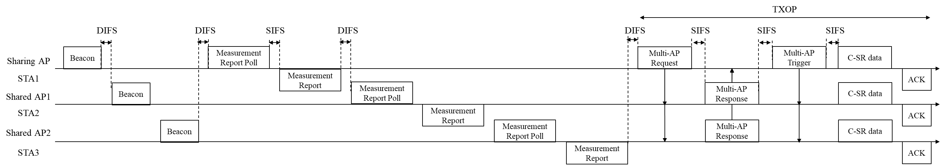
Overhead detail
 | PPDU type |  | Notes
Beacon | Non-HT PPDU | 46 [us] | Beacon interval = 100[ms]
Measurement repot poll | Non-HT PPDU | 56 [us]
Measurement report | EHT TB PPDU | 139 [us]
Multi-AP Request | Non-HT PPDU | 62 [us]
Multi-AP Response | EHT TB PPDU | 136 [us]
Multi-AP Trigger | Non-HT PPDU | 67 [us]
C-SR data | EHT MU PPDU | 580 [us] | OFDM symbol = 36
ACK | Non-HT PPDU | 53[us]
Data rate other than C-SR data = MCS0
EHT PPDU parameters
  4x EHT-LTF
  3.2[us] GI

Slide 14

C-SR of STAs that meets other SIR condition
SIR condition of STA $>$ 25[dB]
Optimal (Sharing AP: all STA drops, Shared AP: all STA drops)
One-way (Sharing AP: all STA drops, Shared AP: all STA drops)
Optimal (Sharing AP: high SIR STA, Shared AP: all STA drops)
One-way (Sharing AP: high SIR STA, Shared AP: all STA drops)
Optimal (Sharing AP: all STA drops, Shared AP: all STA drops)
One-way (Sharing AP: all STA drops, Shared AP: all STA drops)
Optimal (Sharing AP: all STA drops, Shared AP: high SIR STA)
One-way (Sharing AP: all STA drops, Shared AP: high SIR STA)
Optimal (Sharing AP: all STA drops, Shared AP: all STA drops)
One-way (Sharing AP: all STA drops, Shared AP: all STA drops)
Optimal (Sharing AP: high SIR STA, Shared AP: high SIR STA)
One-way (Sharing AP: high SIR STA, Shared AP: high SIR STA)

