Slide 1
OOK generation for AMP DL
Nov. 2024
Doc.: IEEE 802.11-24/1802r0
Date: 2024-11-09
Authors:
Name | Affiliation | Address | Phone | Email
Wang Ke | OPPO |  |  | wangke6@oppo.com
Shengjing Cui
Wang Ke |  |  |  | xuweijie@oppo.com

Slide 2
Abstract
Doc.: IEEE 802.11-24/1802r0
In this contribution, the OOK generation for AMP DL will be discussed.

Slide 3
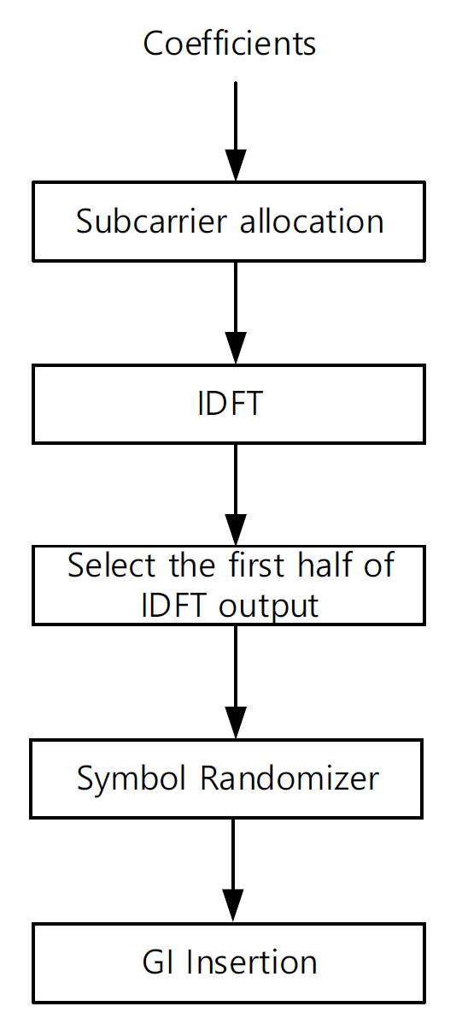
Background
Doc.: IEEE 802.11-24/1802r0
MC-OOK generation in 802.11ba, generally it uses subcarrier equivalent to 625KHz (map 1 in every other subcarrier) to generate 2us OFDM symbol.
The six subcarriers with subcarrier indices k = (-6, -4, -2, 2, 4, 6) are used with nonzero input. Other subcarriers are null.
The coefficients of the nonzero subcarriers are selected from the symbols of any of the following constellations: BPSK, QPSK, 16-QAM, 64-QAM, and 256-QAM.
The first 32 values of the 64-point IDFT output are selected.
Those 32 values are processed by the Symbol Randomizer.
The last 8 samples of those 32 samples are prepended to the 32 samples generating 40 samples, representing the 2 μs duration MC-OOK On Symbol.(GI Insertion)

Slide 4
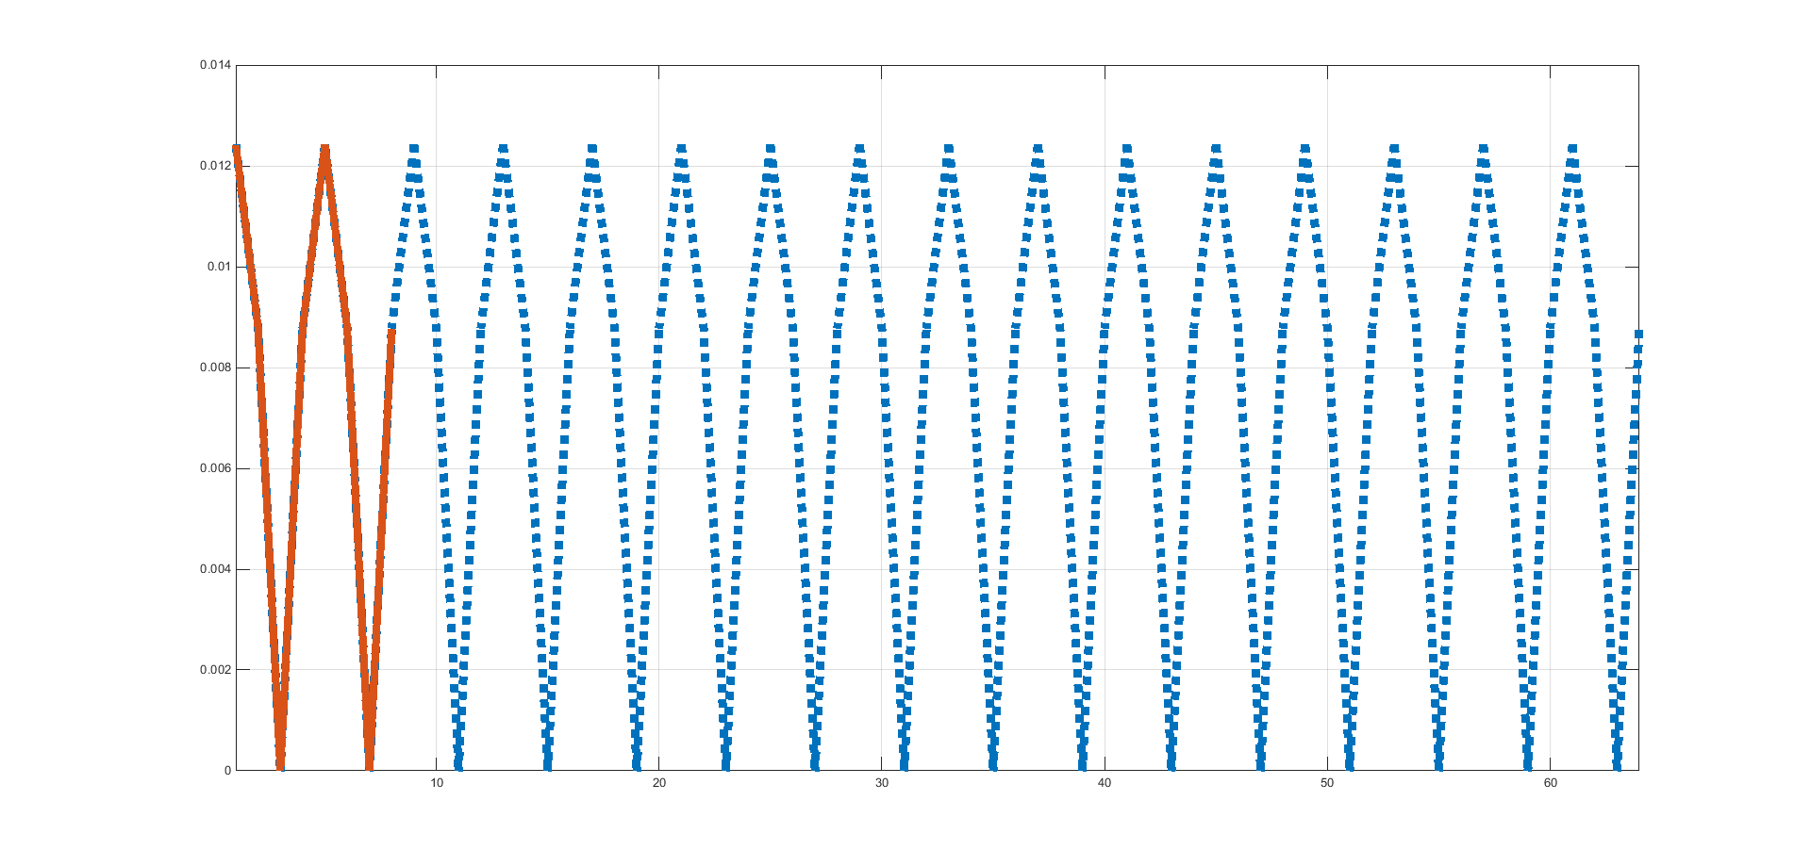
Can 802.11ba MC-OOK extend to AMP?
Doc.: IEEE 802.11-24/1802r0
As discussed in[1], both 250kbps and 1Mbps will be supported for AMP DL. It is not possible to directly use MC-OOK generation mechanism defined in 802.11ba due to the following:
For 1Mbps, only 1 subcarrier in 8 eight subcarrier is 1 and all others are 0
Meaning there is one ON carrier every 2.5MHz, losing frequency diversity
It is not possible to use 13 subcarriers as in 802.11ba since 13 is not integer times of 8.
Maybe it needs to be 16.
If the bandwidth of AMP DL PPDU is ~4Mhz, as defined in 802.11ba, the total power will be only 13dB, which is 3dB lower than 802.11ba.
WUR HDR
1Mbps

Slide 5
Possible OOK generation mechanism
Doc.: IEEE 802.11-24/1802r0
To ease AMP receiver implementation, similar as in WUR, a narrow bandwidth AMP DL signal(e.g. BW is ~4MHz) with guard bands at both sides is required.
It shall try to reuse the existing hardware of the exiting AP when generating OOK waveform for AMP DL.
There are 2 possible methods to generate OOK for an AP:
DSSS based OOK
New OFDM based OOK

Slide 6
New OFDM-OOK for AMP DL
Nov. 2024
Doc.: IEEE 802.11-24/1802r0
The N subcarriers (e.g. N=16 with subcarrier indices k = (1,2,3,…,16) ) are used with nonzero input. Other subcarriers are null.
For the data rate = 1Mbps under the consideration of Manchester Encoding, it needs M=8 OOK symbols within one OFDM symbol duration (0.4us), every 2 OOK symbols mapped to one bit information.
The coefficients of the nonzero subcarriers are the DFT values with truncation (if any) of the upsampling for the M bits transmitted within one OFDM symbol duration.
E.g., ‘1 0 0 1’ transmitted within one OFDM symbol duration, after Manchester encoding, ‘1001’=> ‘01101001’. Then the encoded bit could mapped to 16 bits (0011110011000011)without truncation before IDFT, or 64bits (0000000011111111111111110000000011111111000000000000000011111111) with truncation before IDFT.
The 64 values of the 64-point IDFT output are selected, and processed by the Symbol Randomizer.
The last 16 samples of those 64 samples are prepended to the 64 samples generating 80 samples, representing the 4μs duration OFDM Symbol.(GI Insertion)

Slide 7
Problem of New OFDM-OOK
Nov. 2024
Doc.: IEEE 802.11-24/1802r0
Within each OFDM symbol, multiple OOK symbol can be generated based on the required data rate.
However, there is CP before the OOK symbols, it is difficult for the AMP receiver to remove the CP, especially considering the clock accuracy of AMP device.
Distorted waveform as shown right below
OFDM-OOK symbol with CP
OFDM-OOK signal

Slide 8
Nov. 2024
Doc.: IEEE 802.11-24/1802r0
Simulation assumptions for new OFDM OOK
Link level simulations are performed with the following assumptions.
Parameters | Values
Date Rate | 250kpbs/1Mbps
Waveform | OFDM OOK
Channel model | Channel B/Channel D
Chip duration | 2µs/0.5µs
Sampling rate at AMP AP | 2MHz/8MHz
Coding | Manchester
Slide 8
Wang Ke (OPPO)

Slide 9
Simulation results for OFDM-OOK
Doc.: IEEE 802.11-24/1802r0

Slide 10
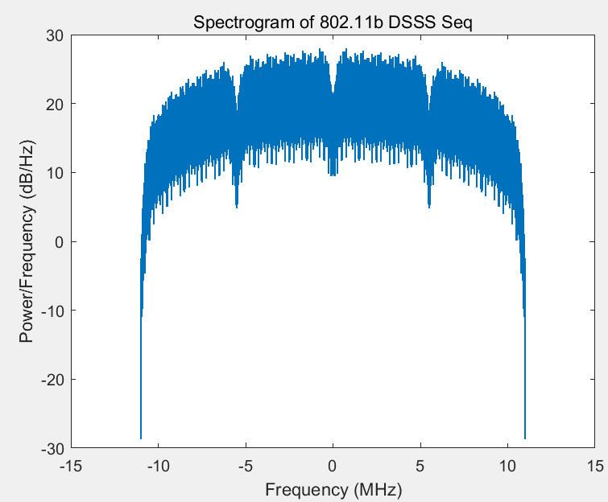
OOK generation with DSSS(1)
Nov. 2024
Doc.: IEEE 802.11-24/1802r0
In 802.11b, Barker code (1,-1,1,1,-1,+1,+1,+1,-1,-1,-1) is used to spread information bits to a wideband DSSS signal with 22MHz spectrum.

Slide 11
OOK generation with DSSS(2)
Nov. 2024
Doc.: IEEE 802.11-24/1802r0
In order to generate a narrow bandwidth DSSS signal, one way is to replace Barker code with another spreading code.
Less randomization than Barker code, one example is [1 1 1 1 -1 -1 -1 -1 -1 -1 -1]
about 3 times spectrum spreading via About 4 times repetition of 1 or -1
The new output DSSS signal is OOK modulated (may has Manchester coding), as shown in the following.

Slide 12
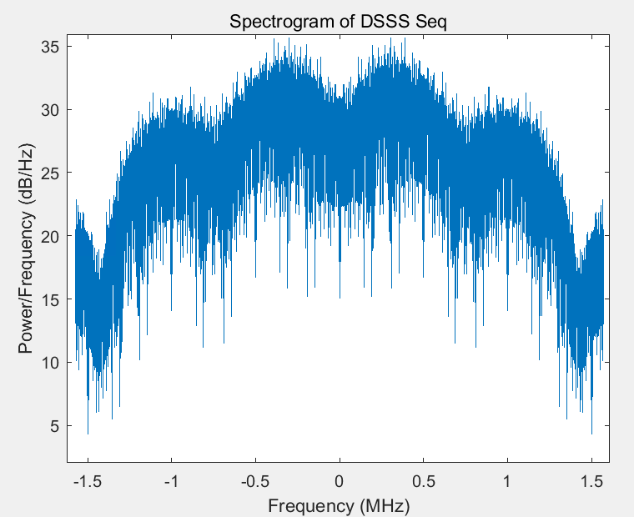
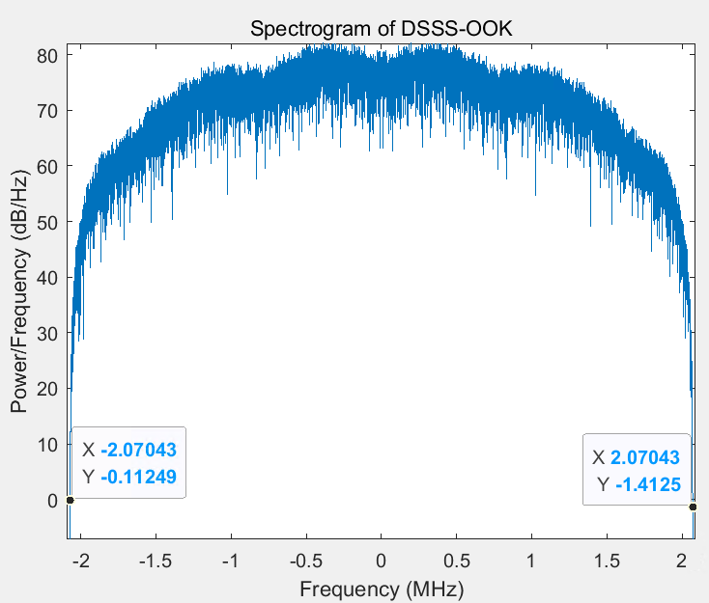
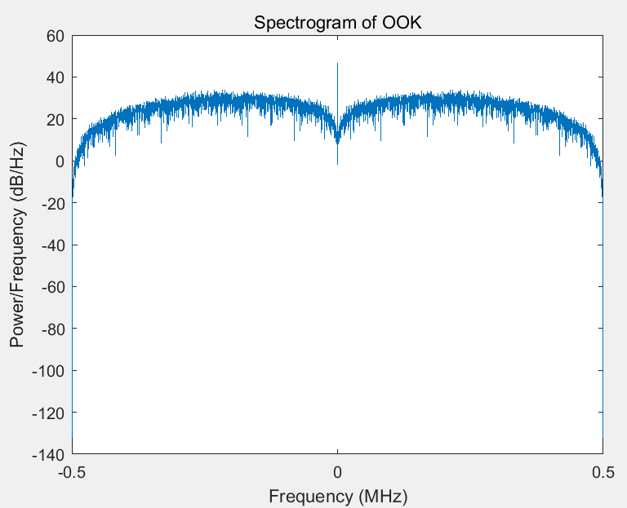
OOK generation with DSSS(3)
Nov. 2024
Doc.: IEEE 802.11-24/1802r0
The new DSSS signal is OOK modulated, the BW of the output DSSS OOK = BW of DSSS + BW of OOK envelope.

Slide 13
Simulation results(1)
Doc.: IEEE 802.11-24/1802r0

Slide 14
Simulation results(2)
Doc.: IEEE 802.11-24/1802r0

Slide 15
Summary
Nov. 2024
Doc.: IEEE 802.11-24/1802r0
In this submission, two methods on OOK generation for AMP DL is discussed. Based on the discussion, it can be seen that DSSS based OOK has the following advantages:
No new hardware requirement on top of 802.11b
Flexible to support different data rates
Better performance than OFDM OOK
So, it is proposed:
DSSS based OOK is supported for AMP DL.

Slide 16
Nov. 2024
Doc.: IEEE 802.11-24/1802r0
Straw Poll #1
Do you agree with the following text:
DSSS based OOK is supported for AMP DL.
Yes
No
Abstain
Slide 16
Wang ke (OPPO)

Slide 17
Reference
Nov. 2024
Doc.: IEEE 802.11-24/1802r0
Doc.: IEEE 802.11-24/1801r0, Data rates for AMP

