Slide 1
Analysis of Free Running Oscillators Accuracy for Active Transmission AMP Devices
Date: 2024-11-10
Authors:

Slide 2
Abstract
During last meeting, clock accuracy of 1000ppm was suggested [1] for uplink active transmission of AMP devices.
We provide some analysis for the feasibility of such clock accuracy for simple and low power devices such as AMP.

Slide 3
Free Running Integrated Oscillators
Definition
  On-chip integrated oscillators that operate independently without frequency-locking to off-chip components like XTAL, MEMS, or BAW devices.
Motivation
  Required for enabling simple AMP devices by eliminating the need for additional external components.
  Required for RF harvesting AMP devices that need to operate with very low energy compared to systems using frequency-locking to external devices.
Focus
  RF integrated LC-type oscillators
Impacting factors that will be discussed
  Noise
  Temperature
  Temperature compensation
  Receiver and preamble requirements

Slide 4
Example: Free-Running Integrated GHz Oscillators
Oscillator Type | Frequency | Temp. Coefficient (un-compensated) | Noise Frequency deviation (Allan deviation) | Power Consumption | Comments
LC² | 2600 GHz | ±95ppm/◦C | σ_{1sec} <15ppm (from graph) | <0.5mW
LC³ | 1380 MHz | ±44.5 ppm/◦C (avg. over 220◦C ) | σ_{1sec} =0.25 ppm (after divider) | 4.25mW
Ring⁴ | 2440MHz | NA | σ_{1sec}>100ppm | 1.25mW | OTA calibration
Quartz Crystal | 8MHz-80MHz | ~±0.25ppm/◦C | σ_{1sec}<0.1ppm | >1mW | Not including GHz LO synthesis
Given their performance advantage, the remaining of this discussion will focus on LC-based free-running integrated oscillators

Slide 5
Temperature-Compensating an Oscillator
Current Solutions:
Academic and commercial solutions achieve about ±250 ppm over the industrial temperature range [4,5]
These solutions typically target systems with power consumption greater than 10 mW
Transient temperature tracking speed is not reported
Discussion:
Further work is needed to enable temperature compensated RF oscillators for ~25°C /sec at X100 lower power/energy consumption
Hence it is recommended to relax temperature compensation requirements to ±1000ppm over the industrial temperature range

Slide 6
Example for Implementation
Manufectured batch shows 15,000ppm without any temperature compensation
When applying temperature compensation resolution of 5⁰C – we get a maximum of 650ppm over entire batch
Measuring temperature with 5⁰C accuracy
(e.g. [7-8], sub 1nJ) consumes about x10-x100
less energy compared to 1⁰C (e.g. [9-10] over 20nJ)
We estimate that 5⁰C accuracy will require
temperature measurement no more than once in
150ms while 1⁰C will require at least 5 times that, once in 30ms.
Thus we estimate energy consumption of 1⁰C accuracy is x50-x500 more compared to 5⁰C accuracy.

Slide 7
Configurable Oscilators
Any approach for using a free-running oscilator would require some control knobes in the oscilator to compensate over process variation and also temperature variations and get to an accuracy of 1000ppm
These knobes are expected to be used also for e.g. channel selection.
Sometimes these control knobes are sensitive to PVT by themselves. One approch to resolve this sensitivity is by including an additional knobless stable oscilator and some simple calibration hardware.
Configurable
LO
Knobless
LO
control
knobs
~
Calibration
~

Slide 8
Receiver Considerations
When decoding OOK with Manchester and convolution code FEC (see [11]), the receiver needs to estimate the clock offset from the AMP transmitter.
The required residual frequency error of that estimation depends on the bandwidth of the transmission. The lower the bandwidth – more SNR gain can be obtained for lower residual frequency error.
E.g. for 4 Mbps, no frequency estimation at all results
with 1.1dB loss while 100ppm residual frequency error
results with <0.2dB loss.
On the other hand, lower bandwidth is more sensitive,
e.g. 0.5MHz will need less than 10ppm for loss < 1dB.

Slide 9
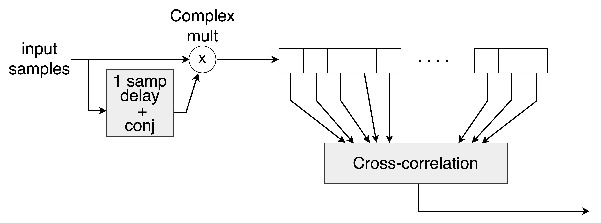
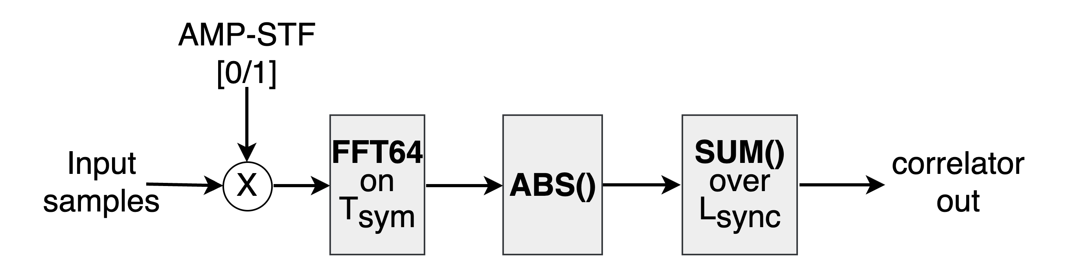
Receiver Considerations [cont.]
An OOK short training field (AMP-STF) is transmitted before the data and then used by the receiver to overcome the ppm difference (AMP-STF is narrower BW vs data).
  No coherency is assumed during the AMP-STF, to allow the AMP-device to shot-down and save power during the OFF times
We considered two types of frequency mismatch estimation algorithms in the receiver
  Simple based on auto-correlation
  More complex assuming the availability of FFT with N=64
Eventhough we present only frequency, the same field and receiver blocks are used also for timing mismatch estimation

Slide 10
Performance
Payload= | 200 | bits
Rate [Mbps] | 0.125 | 0.125 | 1 | 1 | 4 | 4
Payload [us] | 1600 | 1600 | 200 | 200 | 50 | 50
AMP-STF [us] | 128 | 64 | 16 | 8 | 4 | 2
%overhead | 7.41% | 3.85% | 7.41% | 3.85% | 7.41% | 3.85%

Slide 11
Conclusions
Our analysis indicates that a 1000ppm clock accuracy is sufficient in terms of receiver complexity, AMP-STF overheads and AMP-device simple circuitry support and productability
In terms of bandwidth usage, we see no value in reducing this number further, as the bandwidth of base channel of legacy networks in 2.4GHz is 21MHz, while the maximum bandwidth of AMP devices is not expected to go beyond 16MHz

Slide 12
Strawpoll
Do you agree to add the following text to sub-clause 2.1 of FRD:
  When performing transmission, the maximum clock offset is ± 10^3 ppm for AMP device supporting active transmission.
Yes
No
Abstain

Slide 13
References
[1] 11-24-1475-03-00bp-discussion-on-ultra-low-power-timing-clock
[2] Wheeler, Brad, et al. "Crystal-free narrow-band radios for low-cost IoT." 2017 IEEE Radio Frequency Integrated Circuits Symposium (RFIC). IEEE, 2017.
[3] Delke, Alexander S., et al. "A single-trim frequency reference achieving±120 ppm accuracy from− 50° C to 170° C." IEEE journal of solid-state circuits 56.11 (2021): 3434-3444.
[4] Burnett, David C., et al. "CMOS oscillators to satisfy 802.15. 4 and Bluetooth LE PHY specifications without a crystal reference." 2019 IEEE 9th Annual Computing and Communication Workshop and Conference (CCWC). IEEE, 2019.
[5] Si4010-C2 Crystal-Less SoC RF Transmitter Rev. 1.0, Silicon Lab. Inc.
[6] Greiner, Philipp, et al. "A system-on-chip crystal-less wireless sub-GHz transmitter." IEEE Transactions on Microwave Theory and Techniques 66.3 (2017): 1431-1439.
[7] M. Eberlein and H. Pretl, "A No-Trim, Scaling-Friendly Thermal Sensor in 16nm FinFET Using Bulk Diodes as Sensing Elements," in IEEE Solid-State Circuits Letters, vol. 2, no. 9, pp. 63-66, Sept. 2019, doi: 10.1109/LSSC.2019.2938140.
[8] H. Xin, M. Andraud, P. Baltus, E. Cantatore and P. Harpe, "A 174 pW–488.3 nW 1 S/s–100 kS/s All-Dynamic Resistive Temperature Sensor With Speed/Resolution/Resistance Adaptability," in IEEE Solid-State Circuits Letters, vol. 1, no. 3, pp. 70-73, March 2018, doi: 10.1109/LSSC.2018.2827883.
[9] T. -T. Zhang, M. -K. Law, P. -I. Mak, M. -I. Vai and R. P. Martins, "Nano-Watt Class Energy-Efficient Capacitive Sensor Interface With On-Chip Temperature Drift Compensation," in IEEE Sensors Journal, vol. 18, no. 7, pp. 2870-2882, 1 April1, 2018, doi: 10.1109/JSEN.2018.2803203
[10] B. Yousefzadeh and K. A. A. Makinwa, "A BJT-Based Temperature-to-Digital Converter With a ±0.25 °C 3 σ -Inaccuracy From −40 °C to +180 °C Using Heater-Assisted Voltage Calibration," in IEEE Journal of Solid-State Circuits, vol. 55, no. 2, pp. 369-377, Feb. 2020, doi: 10.1109/JSSC.2019.2953834
[11] 11-24-1497-00-00bp Uplink Rates for Active Transmission

