Slide 1
Further Consideration of WPT for AMP
November 2024
Doc.: IEEE 802.11-24/1781r1
Date: 2024-11-11
Authors:
Name | Affiliation | Address | Phone | Email
Yinan Qi | OPPO |  |  | v-qiyinan@oppo.com
Weijie Xu
Chuanfeng He

Slide 2
Abstract
Doc.: IEEE 802.11-24/1781r1
In this contribution, we further discuss Wireless Power Transfer (WPT) including energizer control, AMP devices feedback/reporting, WPT signal waveform, WPT frame, etc., with focus on S1G.

Slide 3
November 2023
Doc.: IEEE 802.11-24/1781r1
Recap of Views
Behaviour of energizers are fully controlled by the AP[1].
Energizers and AP can be connected via either wired or wireless connections;
Controlling mechanisms and how to implement such mechanisms can be left to implementation.
Power related signalling [2].
In some case (e.g. sensors), AP can collect energy related information, e.g., remaining energy, energy harvesting capability, etc., from the AMP STA.
In some case (e.g. sensors), AMP STA can report its energy related information upon request from the AP.
Co-existence with other S1G systems needs to be considered [1]
Slide 3
Yinan Qi (OPPO)

Slide 4
November 2023
Doc.: IEEE 802.11-24/1781r1
Definition of Energizer Type
Integrated Type A: AP and energizer are integrated
AP can operate in both 2.4G and S1G frequency bands
No signalling exchange between AP and energizer
Same deployment density of AP
Independent Type B: energizer is an independent device
Signalling between AP and energizer
Denser deployment for energizer
Low cost/complexity
Slide 4
Yinan Qi (OPPO)

Slide 5
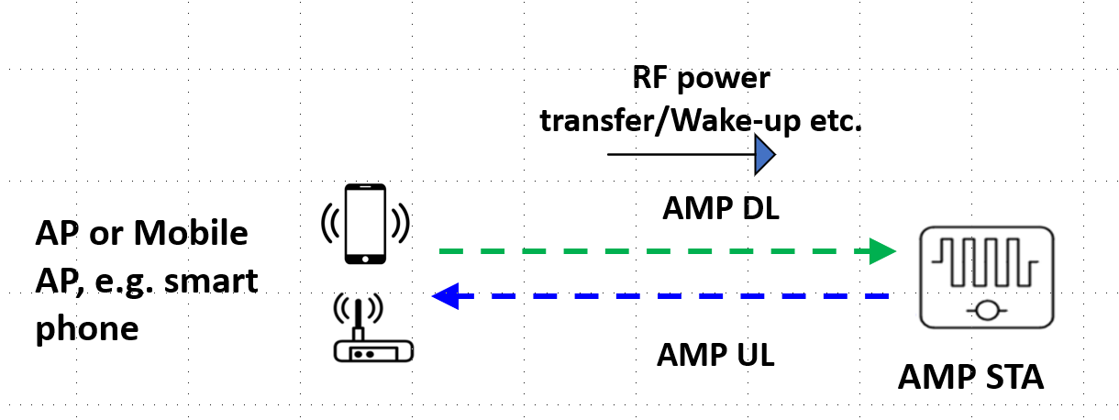
November 2023
Doc.: IEEE 802.11-24/1781r1
Energizer Topology 1
Energizer is physically integrated with the AP/mobile AP, e.g. smart phone.
No control signalling exchange between AP and energizer.
Smart phone can serve as an mobile AP.
All AMP UL/DL, WPT and wake-up signals are exchanged between AP/smart phone and AMP STA
Slide 5
Yinan Qi (OPPO)

Slide 6
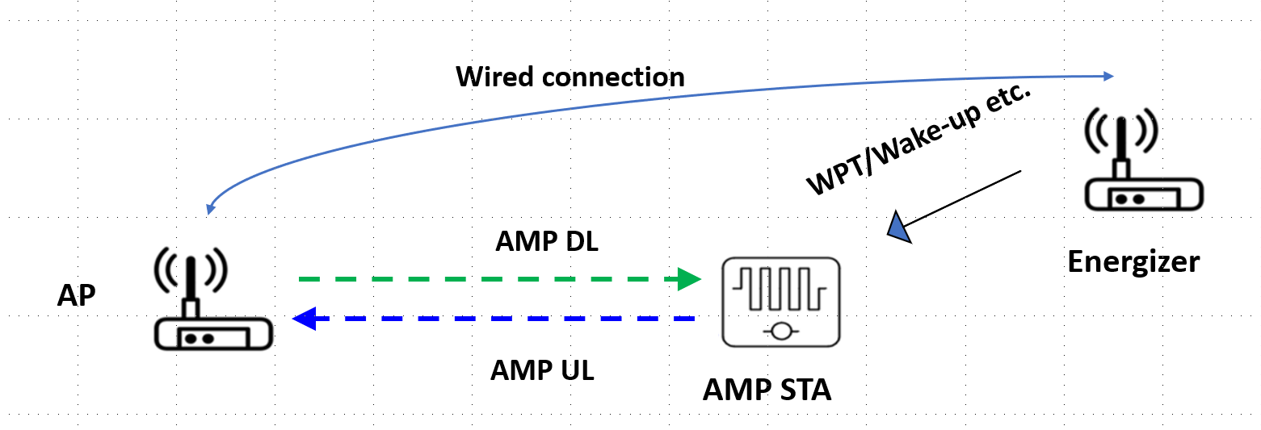
November 2023
Doc.: IEEE 802.11-24/1781r1
Energizer Topology 2
Energizer is connected to the AP with wired connection.
Control signalling between AP and energizer can be via high layer signalling, e.g., application layer.
Energizer can be always on and constantly transmits power transfer signal for AMP device energy harvesting.
WPT signal can be transmitted periodically from the energizer but the period can be configured/controlled by the AP.
WPT signal can be transmitted upon the request of the AP due to, e.g., the emerging DL traffic
Slide 6
Yinan Qi (OPPO)

Slide 7
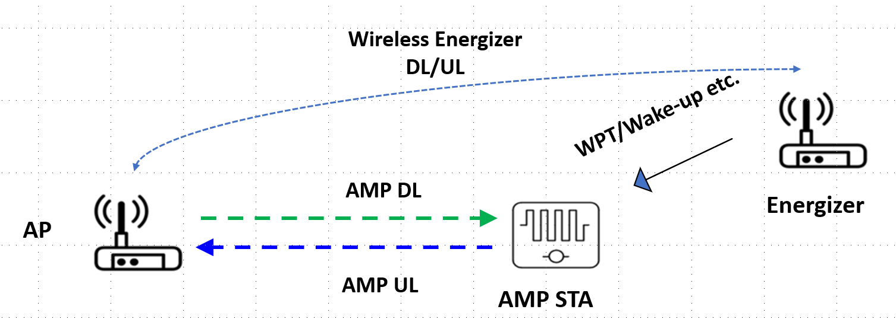
November 2023
Doc.: IEEE 802.11-24/1781r1
Energizer Topology 3
Energizer is connected to the AP with wireless connection.
Control signalling between AP and energizer is via wireless interface.
Considering Wi-Fi as the wireless interface
Case 1: Energizer and AP are independent and energizer is regarded as a non-AP STA associated with the AP
Energizer should indicate to the AP that it is an energizer
AP only activate the energizer when WPT signal or wake-up signal needs to be sent
Case 2: Energizer and AP can be logically integrated
AP does not see the energizer as an associated non-AP STA
Slide 7
Yinan Qi (OPPO)

Slide 8
November 2023
Doc.: IEEE 802.11-24/1781r1
WPT Protocol
Part 1: define the control and signalling between AP and energizer
Can be OOB but some key WPT info elements need to be defined, e.g., on/off indication, duty cycle related, e.g., on time, period, etc.
Part 2: define the reporting signalling between AP and AMP devices
AMP STA
Part 2
Part 1
Energizer
AP
Slide 8
Yinan Qi (OPPO)

Slide 9
November 2023
Doc.: IEEE 802.11-24/1781r1
How/When to initiate WPT?
Option 1: Periodic WPT
Light control and signalling
Can be initiated by Energizer autonomously
On/off, duty cycle can still be controlled by the AP
Consistent and predictable interference to co-existing systems
Option 2: On demand WPT
Initiated by the AP autonomously based on long-term/short term reporting from AMP devices
Requested by the AMP devices
Only for limited use cases, e.g. sensor
Power status reporting may not be no longer needed
Slide 9
Yinan Qi (OPPO)

Slide 10
November 2023
Doc.: IEEE 802.11-24/1781r1
WPT Protocol Part 2
Long-term/Non-periodic feedback
Feedback info
Harvesting capability
Energy storage capability
Etc.
Feedback once during activation or based upon the request of AP
Separate feedback reporting may be inefficient → joint reporting of power category
Applied for all use cases
Short-term/Periodic feedback
Power status/requirements
Feedback more frequently, can be optionally switched on/off
Only for limited use cases, e.g., sensor
Slide 10
Yinan Qi (OPPO)

Slide 11
November 2023
Doc.: IEEE 802.11-24/1781r1
WPT Protocol Part 2: Power Category
Power categories (PC) can be defined based on the power features of the AMP devices [2]
PC0: devices with extremely limited energy harvesting and power storage capability;
PC1: devices with limited energy harvesting and power storage capability;
PC2: devices with reasonable energy harvesting and power storage capability.
The definition of PC can be based on the following features
Energy harvesting capability including
Power source(s)
Energy harvesting efficiency
Energy storage capability
Whether or not energy storage is supported;
The amount of energy that can be stored;
Energy storage draining rate;
Others
RF energy harvesting operation frequency
Slide 11
Yinan Qi (OPPO)

Slide 12
November 2023
Doc.: IEEE 802.11-24/1781r1
WPT Signal Waveform
Need to define waveform?
Specification: recommend one or multiple waveforms for WPT
Can be left to implementation
Proactive v.s. Passive WPT
Proactive WPT: AP, energizer and AMP devices know exactly when and how to start or stop the WPT procedure.
No need to always activate the RF harvesting circuit
Passive WPT: once the AMP devices detect signal strength above certain threshold, RF harvesting begins
RF harvesting circuit needs to be on
Both should be allowed
Legacy waveforms
Pros: easy to implement, minimal specification/implementation efforts
Candidates: OFDM, DSSS, single carrier, etc.
Slide 12
Yinan Qi (OPPO)

Slide 13
November 2023
Doc.: IEEE 802.11-24/1781r1
WPT Signal Waveform
Legacy waveforms
OFDM
High PAPR → High efficiency
Existing tech.
Easy to implement
DSSS
Existing tech.
Easy to implement
Spreading code → noise like signal → Low PAPR
Single Tone/Carrier
Subset of OFDM
Simple implementation
Slide 13
Yinan Qi (OPPO)

Slide 14
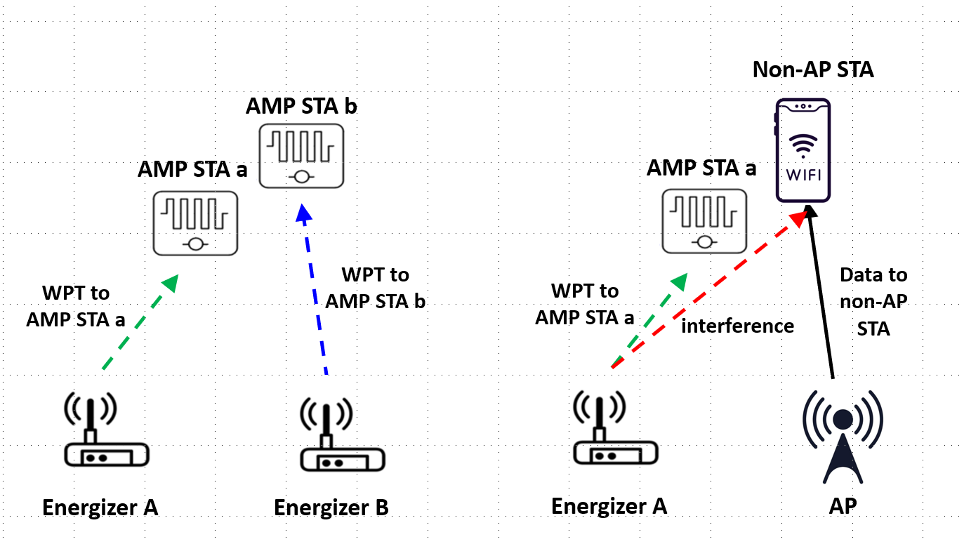
November 2023
Doc.: IEEE 802.11-24/1781r1
Co-existence Issue
Dual frequency operation: WPT in S1G but communication in 2.4G
Difficult for the nodes to coordinate between WPT and communication of AMP devices.
Slide 14
Yinan Qi (OPPO)

Slide 15
November 2023
Doc.: IEEE 802.11-24/1781r1
WPT Frame
Basically, communication signal needs to be avoided by the energizer but WPT signal can co-exist.
Design WPT signal that can be fully or partially understood by the energizer.
WPT signal can contain both WPT preamble and charging segment and the WPT preamble can be understandable to energizers.
Slide 15
Yinan Qi (OPPO)

Slide 16
November 2023
Doc.: IEEE 802.11-24/1781r1
WPT Frame
Co-existence is not only WiFi compliant but also for other S1G systems
Energizer needs to understand not only Wi-Fi PPDU, e.g., 11ah, but also other S1G systems, leading to complicated design of preamble
Smart Utility Networks, 470–510 MHz, 863–870 MHz, 902–928 MHz, and 920–925 MHz
Low Energy, Critical Infrastructure Monitoring, operation frequency similar as SUN
Low-Rate WPANs, operation frequency similar as SUN
RFID, LoRa, etc.
New preamble design only to be understood by energizer
Other systems can detect WPT signal via ED since their power is high
Slide 16
Yinan Qi (OPPO)

Slide 17
November 2023
Doc.: IEEE 802.11-24/1781r1
LBT for Energizers
The energizer can do ED first.
In the case of collision, the energizer needs to keep listening to the channel. If a preamble is detected, the energizer knows the signal is WPT signal and it can transmit its own WPT signal.
Otherwise, it no preamble is detected, the energizer assumes the signal in the air is communication signal and does backoff.
Energy Detection (ED)
Channel occupied (energy level > threshold_{ED})
Energizer does backoff
N
Y
N
WPT preamble detected?
Y
Transmit WPT signal
Slide 17
Yinan Qi (OPPO)

Slide 18
November 2023
Doc.: IEEE 802.11-24/1781r1
Summary
In this submission, we discuss the following issues for WPT:
Energizer definition
WPT protocols
WPT waveforms
WPT frame design
LBT procedure for energizer
Slide 18
Yinan Qi (OPPO)

Slide 19
Reference
November 2023
Doc.: IEEE 802.11-24/1781r1
IEEE 802.11-24/1536r0 Wireless Power Transfer for AMP
IEEE 802.11-24/1381r0 AMP Device Power Status

Slide 20
November 2023
Doc.: IEEE 802.11-24/1781r1
SP1
Do you agree that the following topologies as shown in the below figures for energizer should be considered in 11bp and captured in SFD?
Topology 1: Energizer is physically integrated with the AP.
Topology 2: Energizer is connected to the AP with wired connection.
Topology 3: Energizer is connected to the AP with wireless connection.
The details of the wireless connection are TBD
Topology 1
Topology 2
Topology 3
Slide 20
Yinan Qi (OPPO)

Slide 21
November 2023
Doc.: IEEE 802.11-24/1781r1
SP2
Do you agree to capture the following text to TGbp SFD?
AMP devices shall report power category to the AP during activation or upon the request of the AP?
The details on how to define power category are TBD
Slide 21
Yinan Qi (OPPO)

Slide 22
November 2023
Doc.: IEEE 802.11-24/1781r1
SP3
Do you agree to add the following text to TGbp SFD?
11bp supports OFDM and single carrier as WPT waveforms?
Slide 22
Yinan Qi (OPPO)

Slide 23
November 2023
Doc.: IEEE 802.11-24/1781r1
SP4
Do you agree to add the following text to TGbp SFD?
11bp specifies, in S1G, WPT PPDU format with at least a preamble and a charging field?
Slide 23
Yinan Qi (OPPO)

