Slide 1
Multiple access mechanisms for AMP
Nov 2024
Doc.: IEEE 802.11-24/1776r1
Date: 2024-09-02
Authors:
Name | Affiliation | Address | Phone | Email
Chuanfeng He | OPPO |  |  | hechuanfeng@oppo.com
Weijie Xu |  |  |  | xuweijie@oppo.com
Yinan Qi |  |  |  | v-qiyinan@oppo.com

Slide 2
Abstract
Doc.: IEEE 802.11-24/1776r1
This submission is to discuss multiple access mechanisms for AMP.
TDM operation procedure
Time synchronization during TDM operation
FDM and CDM support

Slide 3
Nov 2024
Doc.: IEEE 802.11-24/1776r1
Background
Burst uplink traffic from large number of AMP device is typical for AMP communication, e.g. in logistics and warehouse scenarios.
Sequential polling/trigger is inefficient for the access of large number of AMP device.
Large overhead of polling/triggering signaling
Large average latency of uplink AMP data collection
Large power consumption of AMP device due to long “waiting” time for target polling/triggering identification.
Multiple access mechanism can address the burst type uplink traffic from large number of AMP device, including TDM, FDM and CDM.[1]
Slide 3
Chuanfeng He (OPPO)

Slide 4
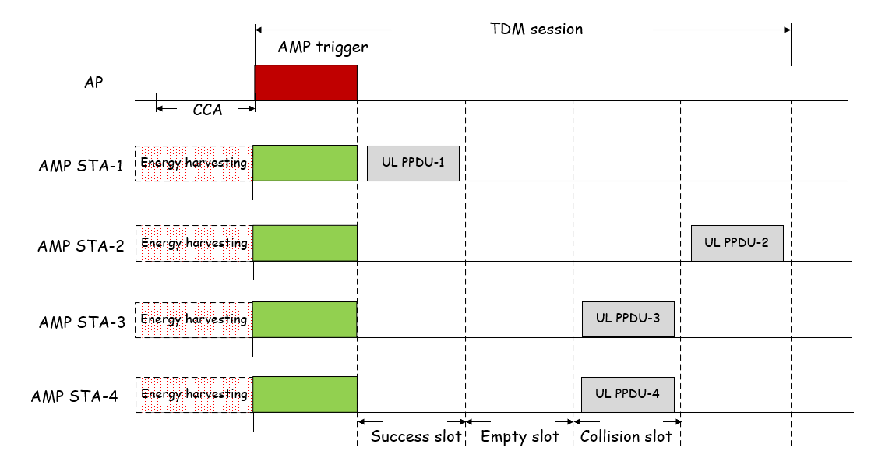
Nov 2024
Doc.: IEEE 802.11-24/1776r1
TDM(1)
One AMP trigger grants multiple slots for multiple AMP STAs to access. There will be three types of TDM slots.
Success slot: AMP transmission from one AMP STA on the slot.
Collision slot: Concurrent AMP transmission on the slot, which may lead to transmission failure.
Empty slot: no AMP transmission on the slot, which may lead to slot waste and idle channel assessed by other devices.
The first slot is success slot since only one AMP STA selects this slot for AMP transmission.
The second slot is empty slot since no AMP STAs select this slot for AMP transmission.
The third slot is collision slot because AMP STA 3 and 4 both select this slot for AMP transmission.
Slide 4
Chuanfeng He (OPPO)

Slide 5
Nov 2024
Doc.: IEEE 802.11-24/1776r1
TDM(2)
TDM of backscatter
Strive to spread AMP transmission among the granted slots to reduce collision.
Empty slot can be avoided since there is always carrier signal (excitation signal) in the air during granted slots.
TDM of active transmitter
Similar schemes with TDM of backscatter to reduce collision slots.
Empty slot should be avoided, which may lead to idle channel assessed by other devices. It can be realized by the assist of AP. For example, AP could send dummy signal once it detects empty slot.
Slide 5
Chuanfeng He (OPPO)

Slide 6
Nov 2024
Doc.: IEEE 802.11-24/1776r1
TDM(3)
Time synchronization during TDM operation
AMP STA is able to support AMP TSF, which means it can support TDM multiple access based on its local TSF time.
The clock accuracy for TDM operation may be higher than that for supporting TSF (i.e. ±10⁴ ppm). If AMP STA is triggered for a TDM operation session, higher clock accuracy (e.g. ±10³ ppm) can be supported during the session.
For instance, to address the timing drifting up to ±10⁴ ppm,
Option 1: Guard intervals are introduced between adjacent slots to minimize the potential collision due to timing drifting.
Guard interval should cover the maximum timing drifting during a TDM session duration. (e.g., GI=TDM session duration*1%=2ms*1%= 20us)
There may be transmission gaps between UL PPDUs of adjacent slots. The maximum transmission gap will be 4 times of the maximum timing drifting, e.g. 80us.
For TDM of active transmitter, idle channel may be assessed by other devices during the transmission gap.
Slide 6
Chuanfeng He (OPPO)

Slide 7
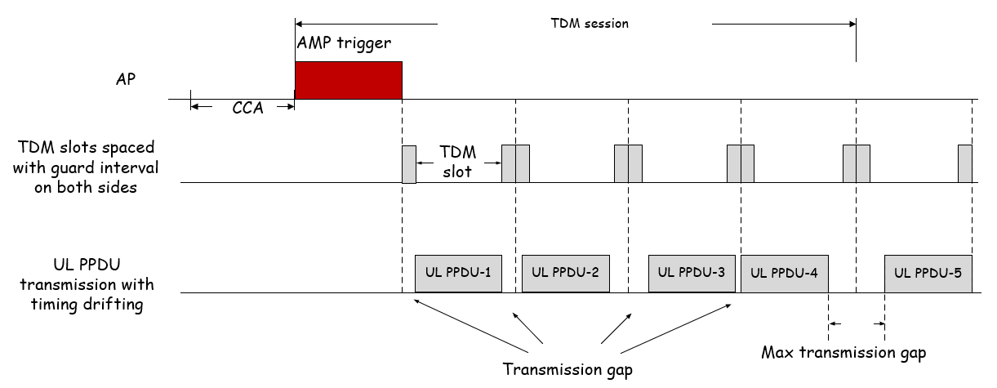
Nov 2024
Doc.: IEEE 802.11-24/1776r1
TDM(4)
It is assumed there are guard intervals(e.g. 20us) on both sides of each TDM slot.
AMP STA starts UL PPDU transmission based on its local timing. Timing drifting within 1% will happen randomly for each AMP STA.
For UL PPDU 4 and 5, the timing drifting is -20us and +20us respectively, which produces a maximum 80us transmission gap.
Slide 7
Chuanfeng He (OPPO)

Slide 8
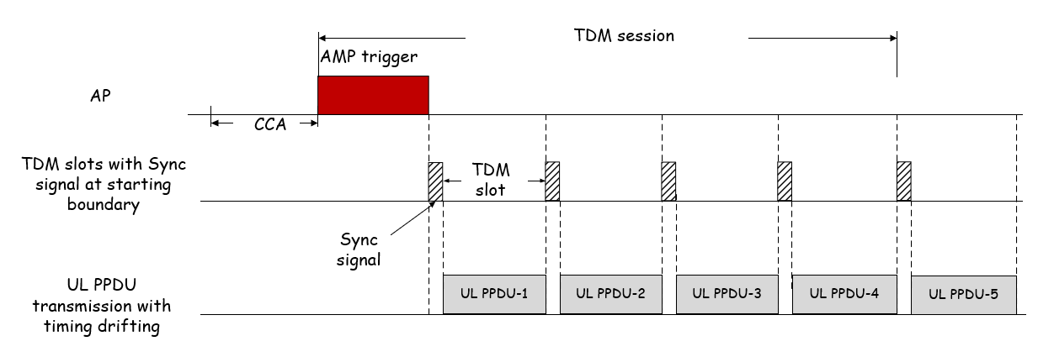
Nov 2024
Doc.: IEEE 802.11-24/1776r1
TDM(5)
Option 2: Sync signal at the TDM slot boundaries to align the AMP transmission on the TDM slots.
The Sync signal is used to eliminate timing misalignment due to timing drifting.
AMP device monitors sync signal of the target TDM slot before UL PPDU transmission.
No guard intervals need to be reserved to address the timing drifting.
No transmission gap exists in a TDM slot, if it is not an empty slot.
Slide 8
Chuanfeng He (OPPO)

Slide 9
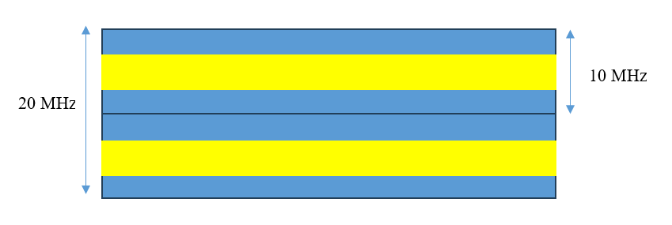
Nov 2024
Doc.: IEEE 802.11-24/1776r1
FDM and CDM
FDM
As discussed in [1], it is feasible to use FDM for AMP device supporting active transmission. For AMP device with clock accuracy of ± 1000ppm, there can be several FDMed uplink channels.
FDM can boost the access capacity at least for active transmission device. Therefore, it can reduce collision and improve the system efficiency.
Whether it is possible to support FDM for backscattering needs further study, especially considering wideband carrier for backscattering is needed in 2.4GHz.
CDM is discussed detailly in [2].
Slide 9
Chuanfeng He (OPPO)

Slide 10
Nov 2024
Doc.: IEEE 802.11-24/1776r1
Summary and proposals
In this submission, multiple access for AMP has been discussed.
We propose to support at least TDM and FDM as multiple access mechanisms for AMP.
Slide 10
Chuanfeng He (OPPO)

Slide 11
Nov 2024
Doc.: IEEE 802.11-24/1776r1
Straw Poll #1
Do you agree with the following text:
At least TDM and FDM are supported as multiple access mechanisms for AMP.
Yes
No
Abstain
Slide 11
Chuanfeng He (OPPO)

Slide 12
Reference
Nov 2024
Doc.: IEEE 802.11-24/1776r1
IEEE 802.11-24/1501r0, multiple access for amp iot
IEEE 802.11-24/1802r0, CDM Access for AMP IoT

