Slide 1
Discussion on Coordinated Sounding
Date: 2024-11-10
Authors:

Slide 2
Introduction
At the July 2024 meeting, it was decided to add Coordinated BF to SFD as one of the Multi-AP Coordination features [1].
To implement Coordinated BF, the AP needs to collect channel state information (such as BF matrix feedback) of the interfering signals received by the oBSS AP from the STA, and several sounding procedures (Coordinated Sounding) have been proposed recently [2] – [4].
In this contribution, we propose an improvement of the Coordinated Sounding procedure.

Slide 3
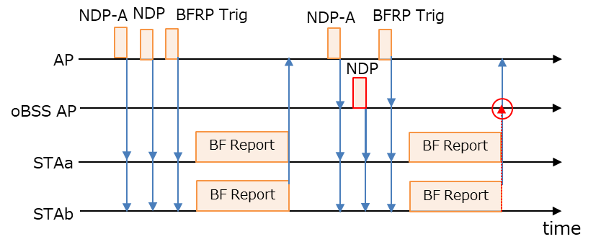
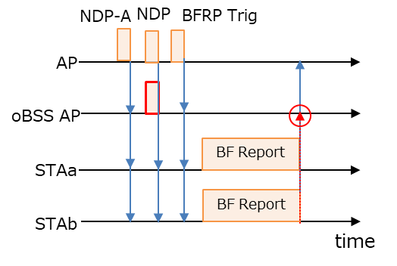
Recap on Coordinated Sounding [2]-[4]
Supports both Sequential and Joint Sounding, which were being discussed at TGbe.
Joint Sounding is better in terms of performance, but there are concerns that the frame length of the BF report will increase, and STA will not be able to handle this as the number of receiving streams increases, so it is desirable to be able to select Sequential Sounding as well.
Considering security risks, control frame exchanges are only performed within BSS.
In this case, oBSS AP needs to receive BF Reports from STAs sent to the AP.
Sequential Sounding
Joint Sounding

Slide 4
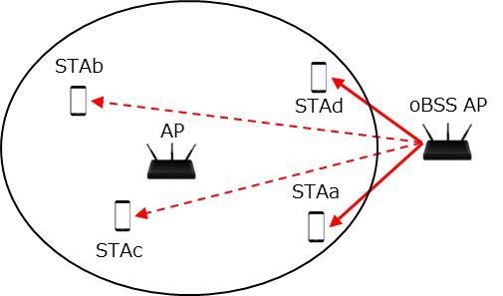
Problems
In Coordinated BF, the CSI needs to be updated frequently, so long sounding duration will reduce throughput due to the high overhead (Sequential Sounding in particular is severely affected).
To reduce the overhead, it is desirable for AP to collect BF Reports only from STAs with high interference levels from oBSS AP.
For example, STAs which are far from oBSS AP (STAb/c in below figure) don’t need to request C-BF, so don’t need to send BF Reports (especially BF Feedback Matrix) measured by NDP sent from oBSS AP
It may be possible to select the STAs with high interference levels before the coordinated sounding, but it is more efficient to check this during the coordinated sounding.
*STAa/b/c/d associate with AP

Slide 5
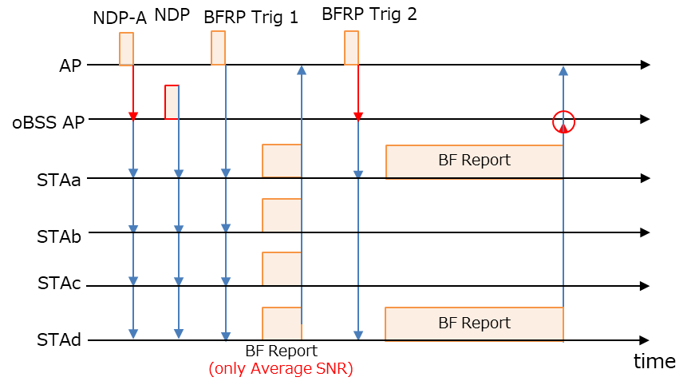
Proposed Coordinated Sounding
UHR AP should be able to collect only SNR feedback of the interference link from UHR STAs first, then select “C-BF target STAs” from which to collect the BF feedback matrix.
Since C-BF is only used for STAs with high interference levels from oBSS AP, the overhead can be reduced by selecting C-BF target STAs to solicit the BF feedback matrix for C-BF.
Efficient operation is achieved by performing the measurement and C-BF target STA selection within the same sounding process.
SNR feedback only may not always be required since sounding interval will be shorter than STA selection interval.
C-BF target STAs
Non C-BF target STAs

Slide 6
How to collect SNR feedback only
Recap on EHT Compressed BF Report field
The field carries “average SNR of each spatial stream” and “compressed beamforming feedback matrices”.
The amount of information in the compressed beamforming feedback matrices is very large because it is needed for some subcarriers.
STA can segment this field, but each feedback segment shall have a length of 11454 octets except the last feedback segment.
To implement the proposed coordinated sounding procedure, UHR STA should be able to segment Compressed BF Report so that only the average SNR of each spatial stream can be transmitted.
First segmentation carries only the average SNR of each spatial stream, and while the other segmentations are used with the same rules for HE/EHT.
STA doesn’t require any new measurement schemes. This needs to change only segmentation rule of the compressed beamforming report.

Slide 7
How to request SNR feedback only
UHR AP sending the BFRP Trigger frame to UHR STA must indicate whether it only requires the SNR feedback segment.
To implement the proposed coordinated sounding procedure, UHR AP should be able to use “Feedback Segment Retransmission Bitmap subfield” of Trigger Dependent User Info subfield to indicate if it only requires the SNR feedback segment.
When soliciting EHT Compressed Beamforming/CQI report, Feedback Segment Retransmission Bitmap subfield is defined to be set to all ‘1’s in the spec.
For instance, when soliciting UHR Compressed Beamforming/CQI report, Feedback Segment Retransmission Bitmap subfield can be set to '0' to request the conventional BF report, set to ‘1’ to only request SNR feedback segment or set to other values to request the beamforming feedback matrices segment from STA.

Slide 8
Summary
We propose that UHR AP should be able to collect SNR feedback of the interference link from the UHR STAs first, then select “C-BF target STAs” from which to collect the BF feedback matrix.
UHR STA should be able to segment Compressed BF Report so that only the average SNR of each spatial stream can be transmitted.
UHR AP should be able to use “Feedback Segment Retransmission Bitmap subfield” of Trigger Dependent User Info subfield to indicate if it only requires the SNR feedback segment.

Slide 9
References
[1] Laurent Cariou (Intel), “UHR proposed PAR,” 23/0480r0, March 2023
[2] Sameer Vermani (Qualcomm), “Sounding Schemes for Coordinated Beamforming,” 24/1542r0
[3] Ron Porat (Broadcom), “Sounding Design for C-BF,” 24/1568r0
[4] You-Wei Chen (MediaTek), “Coordinated Sounding for CoBF,” 24/1582r0

Slide 10
SP #1
Do you agree that UHR AP should be able to collect SNR information first to determine which UHR STAs should be requested to collect the BF Feedback Matrix by BFRP trigger frame during the sounding procedure for Coordinated BF?

Slide 11
SP #2
Do you agree that UHR STA should be able to segment Compressed BF Report so that only the average SNR of each spatial stream can be transmitted?

Slide 12
SP #3
Do you agree that UHR AP should be able to use “Feedback Segment Retransmission Bitmap subfield” of Trigger Dependent User Info subfield to indicate if it only requires the SNR feedback segment?

