Slide 1
Discussion on Transmission of ELR-SIG
Date: 2024-11-14
Authors:
Name | Affiliation | Address | Phone | email
Ke Zhong | Ruijie Networks Co., Ltd. |  |  | zhongke@ruijie.com.cn
Fachang Guo

Slide 2
Abstract
Introduction
Discussion on transmission of ELR-SIG
Conclusion

Slide 3
Introduction
In PAR of P802.11bn, the Ultra High Reliability (UHR) capability has been defined to improve Rate-vs-Range enhancement, reduce latency, and reduce power consumption for AP, compared to Extremely High Throughput (EHT) MAC/PHY operation [1].
To address the Tx power imbalance issue between DL and UL (about 10dB or so), Enhanced Long Range (ELR) has been investigated in UHR study group since the beginning of 802.11bn. The motion for ELR has been passed during the July 2024 Plenary meeting. The detail of the motion is as follows [2]:
The detail of ELR PPDU format is still under study and one motion for ELR-SIG has been recently passed during the September 2024 Interim meeting. The detail of the motion is as follows [2]:
In this contribution, the transmission of ELR-SIG is discussed.
    Move to include the following in the 11bn SFD:
    Define Enhanced Long Range (ELR) PPDU and potentially other Range Extension mechanisms.
Move to add to the TGbn SFD the following:
ELR-SIG is located right after ELR-LTF in ELR PPDU
  Note that ELR-LTF is the short name of UHR-LTF for ELR PPDU

Slide 4
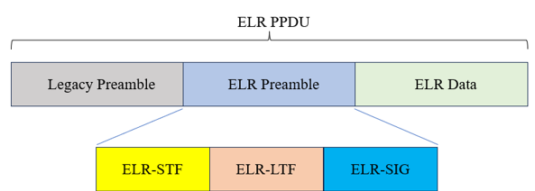
Recap: Current ELR-SIG design
In [3], it was proposed that
  ELR-SIG and ELR-Data have same tone plan and duplication method to reduce implementation complexity.
  Given the low data rate and duplication, one ELR-SIG symbol may not be enough, assuming two symbols for ELR-SIG.
    More tones as ELR-SIG sent at 4x symbol
    Propose separately encoded two symbols for ELR-SIG
  ELR-SIG is BCC encoded with MCS0.
In [4], it was proposed that
  The MCS0 is applied to the ELR-SIG field.
  The ELR-SIG field may consist of one OFDMA symbol.

Slide 5
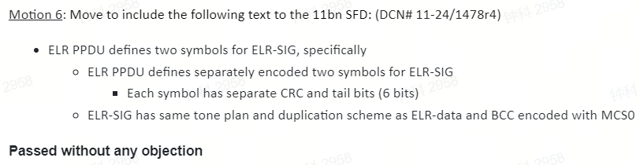
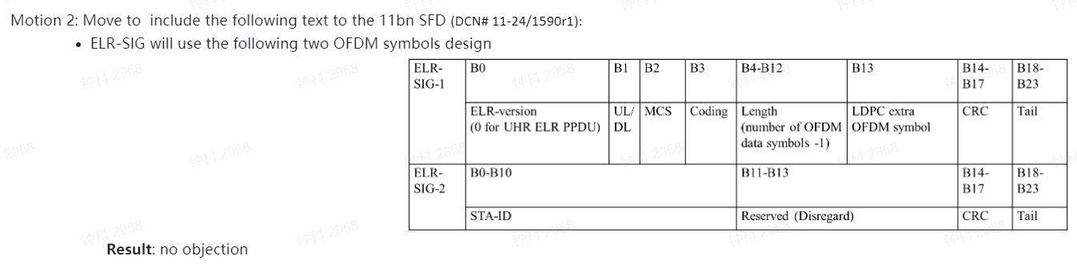
Recap: Passed SPs for ELR-SIG
In this contribution, we provide our views on ELR-SIG transmission based on current EHT-SIG design and meanwhile incorporating the above current proposals and SPs for ELR-SIG design.

Slide 6
Discussion on transmission of ELR-SIG
The U-SIG field in ELR PPDU carries information necessary to interpret ELR PPDU, including indication of ELR PPDU [2].
The ELR-SIG field located right after ELR-LTF in ELR PPDU provides additional signaling to the U-SIG field for STAs to interpret ELR PPDU, e.g., version-independent information of U-SIG.
Based on current EHT-SIG design and incorporating current proposals for ELR-SIG design shown in the previous slide, the following transmission parameters for ELR-SIG are suggested in order to achieve the SNR design target of ELR PPDU:
 | EHT-SIG parameters | Suggested ELR-SIG parameters
MCS | MCS0, 1, 3 and 15 | MCS0 and/or 15 (i.e., only BPSK is suggested)
Number of symbols | 5 bits to indicate the number of EHT-SIG symbols | Select one of the following: Alternative 1: Only one symbol or two symbols without duplication. Alternative 2 (preferred): Only one symbol or two symbols with duplication. Support duplication and with limited duplication number, e.g. 2x, 4x and 8x Indication details including specific bits are for further study
Coding | BCC encoded at R = 1/2 | BCC encoded at R = 1/2
IDFT/DFT period for the pre-EHT(UHR) modulated fields | 3.2us | 3.2us
Guard interval (GI) duration for the pre-EHT(UHR) modulated fields | 0.8us | Select at least one of the following: 0.8us, 1.6us and 3.2us (larger GI for potentially longer range)

Slide 7
Conclusion
Transmission of ELR-SIG is discussed in this presentation.
For ELR-SIG the following transmission parameters are suggested:
 | Suggested ELR-SIG parameters
MCS | MCS0 and/or 15 (i.e., only BPSK is suggested)
Number of symbols | Select one of the following: Alternative 1: Only one symbol or two symbols without duplication. Alternative 2 (preferred): Only one symbol or two symbols with duplication. Support duplication and with limited duplication number, e.g. 2x, 4x and 8x Indication details including specific bits are for further study
Coding | BCC encoded at R = 1/2
IDFT/DFT period for the pre-EHT(UHR) modulated fields | 3.2us
Guard interval duration for the pre-EHT(UHR) modulated fields | Select at least one of the following: 0.8us, 1.6us and 3.2us

Slide 8
Straw Poll
November 2024
Do you agree that TGbn will adopt at least one of the following parameters for ELR-SIG transmission?
 | Suggested ELR-SIG parameters
MCS | MCS0 and/or 15
Number of symbols | Only one symbol or two symbols with duplication. Support duplication and with limited duplication number, e.g. 2x, 4x and 8x
Coding | BCC encoded at R = 1/2
IDFT/DFT period for the pre-EHT(UHR) modulated fields | 3.2us
Guard interval duration for the pre-EHT(UHR) modulated fields | Select at least one of the following: 0.8us, 1.6us and 3.2us
  Yes:
  No:
  Abstain:
Ke Zhong, Ruijie Networks Co., Ltd

Slide 9
References
[1] IEEE 802.11-23/0480r3, UHR proposed PAR, Laurent Cariou (Intel)
[2] IEEE 802.11-24/0209r5, Specification framework for TGBn, Ross Jian Yu (Huawei)
[3] IEEE 802.11-24/1478r2, Enhanced Long Range (ELR) PPDU Design, Lin Yang (Qualcomm)
[4] IEEE 802.11-24/1985r0, Considerations for ELR PPDU format, Dongguk (LG)

