Slide 1
UL Data Transmission for Seamless Roaming
Date: 2024-11-06
Authors:

Slide 2
Abstract
In this contribution, we discuss UL data transmission during seamless roaming procedure.

Slide 3
Background
It has been already agreed to define request/response frame for seamless roaming procedure [1].
Motion 44
Define a request frame sent by a non-AP MLD in state 4 to initiate the roaming procedure
Define a response frame sent to the non-AP MLD to indicate readiness for the non-AP MLD to send class 3 frames to the target AP MLD

Slide 4
UL data transmission after roaming procedure initiation
We have the following two options for the non-AP MLD between sending the request frame and receiving the response frame:
Option 1: The non-AP MLD stops UL data transmission to the current AP MLD [2-4].
Option 2: The non-AP MLD continues UL data transmission to the current AP MLD.

Slide 5
Option 1: The non-AP MLD stops UL data transmission
In Option 1:
Before sending the request frame, the non-AP MLD transmits UL data to the current AP MLD.
After sending the request frame, the non-AP MLD stops UL data transmission to the current AP MLD and does not transmit UL data until the non-AP MLD receives the response frame from the current AP MLD.
After receiving the response frame, the non-AP MLD starts UL data transmission to the target AP MLD.
Non-AP MLD
Current AP MLD
Target AP MLD
DS
UL data transmission via Current AP MLD
Request frame
DS mapping update
Response frame
UL data transmission via Target AP MLD

Slide 6
Option 2: The non-AP MLD continues UL data transmission
In Option 2:
Before sending the request frame, the non-AP MLD transmits UL data to the current AP MLD.
After sending the request frame, the non-AP MLD continues UL data transmission to the current AP MLD and the current AP MLD delivers the UL data to the DS before DS mapping update.
After DS mapping update, the current AP MLD forwards the received UL data to the target AP MLD and the target AP MLD delivers the UL data to the DS.
After receiving the response frame, the non-AP MLD starts UL data transmission to the target AP MLD.
Non-AP MLD
Current AP MLD
Target AP MLD
DS
UL data transmission via Current AP MLD
Request frame
UL data transmission via Current AP MLD
DS mapping update
UL Data forwarding
Response frame
UL data transmission via Target AP MLD

Slide 7
Comparison between Option 1 and Option 2
The following table compares between Option 1 and Option 2.
Both options have different benefit compared to the other option.
UL data can be sent in low latency in Option 2 while Option 1 can make AP MLD to implement easier.
Option 2 will have an essential role for SHARP’s business (e.g. AGV).
Enhanced AGV system requires low latency not only for DL but also for UL.
Option 2 should be supported in addition to Option 1.
 | Option 1 | Option 2
UL transmission delay | Large | Small
Implementation complexity for AP MLD | Low | High

Slide 8
Ref) 3GPP handover
According to the 3GPP specs [5][6], two handover modes have been defined.
In 3GPP Normal handover, the UE stops UL data transmission to the Source gNB at the handover initiation, which is similar to Option 1.
In 3GPP DAPS handover, the UE continues UL data transmission to the Source gNB at the handover initiation, which is similar to Option 2.

Slide 9
Ref) 3GPP Normal handover [5]
UE
Source gNB
Target gNB
AMF
UPF
In 3GPP Normal Handover:
Before the handover initiation, the UE transmits UL Data to the Source gNB.
At the handover initiation, the UE stops UL Data transmission to the Source gNB and does not transmit UL Data until the handover completion.
At the handover completion, the UE starts UL Data transmission to the Target gNB.
UL data transmission via Source gNB
Normal handover initiation
Normal handover completion
UL data transmission via Target gNB
AMF: Access and Mobility Management Function
UPF: User Plane Function

Slide 10
Ref) 3GPP DAPS handover [6]
In 3GPP DAPS handover:
Before the handover initiation, the UE transmits UL Data to the Source gNB.
At the handover initiation, the UE continues UL data transmission to the Source gNB until the handover completion.
At the handover completion, the UE starts UL Data transmission to the Target gNB.
UE
Source gNB
Target gNB
AMF
UPF
UL data transmission via Source gNB
DAPS handover initiation
UL data transmission via Source gNB
DAPS handover completion
UL data transmission via Target gNB
DAPS: Dual Active Protocol Stack
AMF: Access and Mobility Management Function
UPF: User Plane Function

Slide 11
Conclusion
Both the following modes should be supported for Seamless Roaming:
Mode 1: The non-AP MLD stops UL data transmission to the current AP MLD between sending the request frame and receiving the response frame.
Mode 2: The non-AP MLD continues UL data transmission to the current AP MLD between sending the request frame and receiving the response frame.

Slide 12
References
[1] 24/0171, TGbn Motions List - Part 1
[2] 24/0052, Seamless Roaming Details, Duncan Ho
[3] 24/0396, Seamless Roaming within a Mobility Domain – Follow Up, Binita Gupta
[4] 24/0412, Seamless Roaming Procedure Follow-Up, Yelin Yoon
[5] 3GPP TS 38.300 V15.5.0 (2019-03)
[6] 3GPP TS 38.300 V16.5.0 (2021-03)

Slide 13
Appendix: Normal handover in 3GPP [5]
Figure 9.2.3.2.1-1: Intra-AMF/UPF Handover [5]

Slide 14
Appendix: DAPS (Dual Active Protocol Stack) handover in 3GPP [6]
DAPS handover in which the UE connects to the Target gNB without releasing the connection of the Source gNB has introduced in 3GPP.
DAPS handover: a handover procedure that maintains the source gNB (base station) connection (including downlink user data reception and uplink user data transmission) after reception of handover command and until releasing the source cell after successful connection to the target gNB
Source gNB
Target gNB
UE

Slide 15
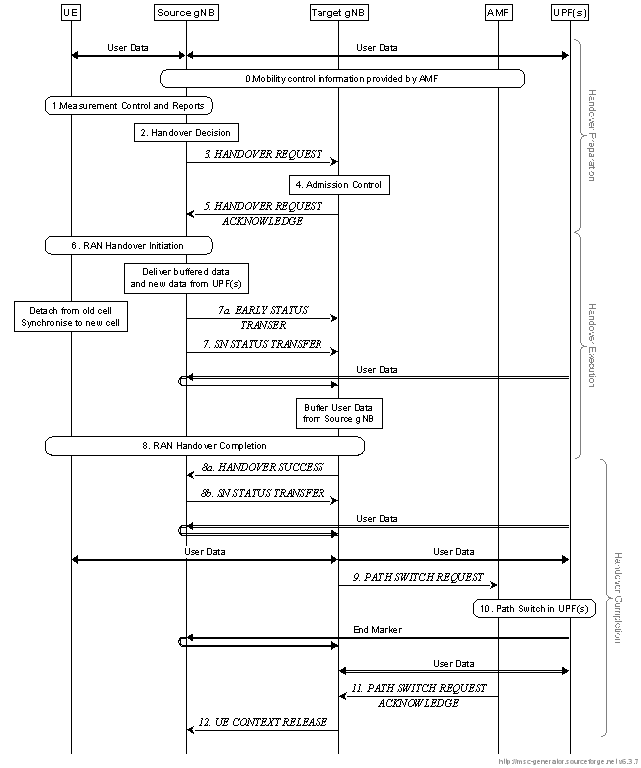
Appendix: DAPS (Dual Active Protocol Stack) handover in 3GPP [6]
Figure 9.2.3.2.1-1: Intra-AMF/UPF Handover [6]

