Slide 1
Multi-user EDCA Parameter Management in NPCA Operation
Date: 2024-11-11
Authors:

Slide 2
Abstract
TGbn agreed NPCA operation for enhancing medium efficiency[1].
TGbn defines a mode of operation that enables a STA to access the secondary channel while the primary channel is known to be busy due to OBSS traffic or other TBD conditions.
The mode of operation shall not assume that the STA is capable to detect or decode a frame and obtain NAV information of the secondary channel concurrently with the primary channel.
A BSS shall only have a single NPCA primary channel (name TBD) on which the STA contends while the primary channel of the BSS is known to be busy due to OBSS traffic or other TBD conditions.
There is the contribution[2] that discussed about EDCA Parameters on Primary and NPCA Primary Channel
The contribution suggests that same EDCA Parameter set shall be applied for both Primary and NPCA Primary Channel
However, there are some details which must be discussed for NPCA operation.
MU EDCA Timer (state variable) management in NPCA has not been discussed.
In this contribution, MU EDCA Timer management for NPCA is discussed

Slide 3
Ambiguousness in MU EDCA Timer Management with NPCA Operation
When MU operation is performed in an NPCA primary channel, MU EDCA parameter shall be applied to non-AP STAs which have participated in MU transmission
MU EDCA Timer[AC] state variable for NPCA Primary channel will be set from MU EDCA Parameter set element
However, there are no sufficient discussions that how MU EDCA Timer[AC] State variable to be applied for Primary channel
This contribution discusses two options for setting MU EDCA Timer for primary channel

Slide 4
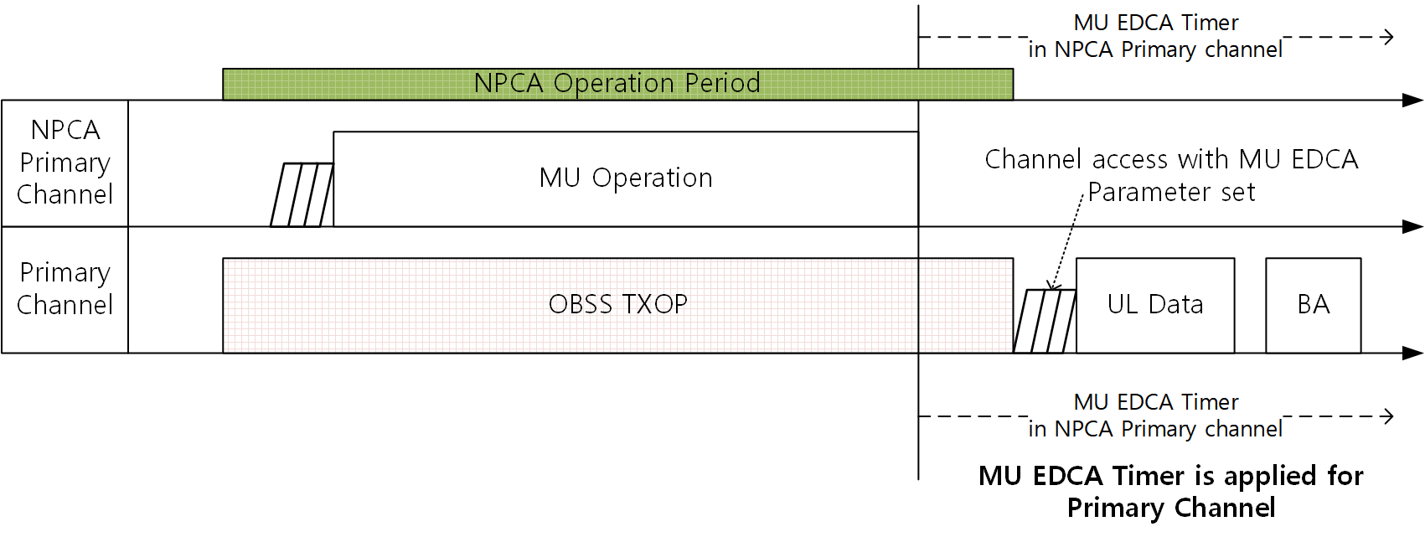
Option 1: Inherited MU EDCA Timer
MU EDCA Timer can be inherited from NPCA primary channel to primary channel
Each non-AP STA can have common MU EDCA timer on Primary and NPCA Primary channel
Or Each non-AP STA can maintain two MU EDCA timers on Primary and NPCA Primary channel
Pros
Fairness can be maintained in Primary channel
Cons
If triggered-only uplink transmission is allowed for NPCA Primary channel, STAs that has transmitted in the NPCA Primary channel will be degraded due to MU EDCA Parameter in the Primary channel

Slide 5
Option 2: Independent MU EDCA Timer
Primary channel and NPCA Primary channel has independent MU EDCA Timers
Each non-AP STA can maintain two MU EDCA timers on Primary and NPCA Primary channel. And these timers are independent.
Pros
STAs that has transmitted in the NPCA Primary channel will not be degraded due to MU EDCA Parameter in the Primary channel
Cons
Fairness can be degraded in the Primary channel due to non-inherited MU EDCA Timer.

Slide 6
Summary
This submission proposed MU EDCA parameter management methods in NPCA operation
Discussions on MU EDCA Timer state variable management in NPCA operation was not sufficient.
This contribution discussed about MU EDCA Timer state variable management in NPCA operation.
First option is inherited MU EDCA Timer method
Second option is independent MU EDCA Timer method
Hope this contribution help the MU EDCA Timer state variable management in NPCA operation for 11bn.

Slide 7
Straw Poll
Straw Poll #1:
Which of the MU EDCA Timer state variable management methods do you support? (from document 24/1706r0)
Option 1: Synchronized MU EDCA Timer for Primary and NPCA Primary Channel
Option 2: Independent MU EDCA Timer for Primary and NPCA Primary Channel
O1: / O2: / Abs:

Slide 8
References
[1] 24/0209r5 Specification Framework for TGbn
[2] 24/0495r0 Non-Primary Channel Access (NPCA) – Follow Up

