Slide 1
October 2024
NAV protection for C-TDMA follow up
Date: 2024-10-17
Authors:
Name | Affiliations | Address | Phone | email
Si-Chan Noh | Newracom |  |  | sc.noh@newracom.com
Joonsoo Lee |  |  |  | js.lee@newracom.com

Slide 2
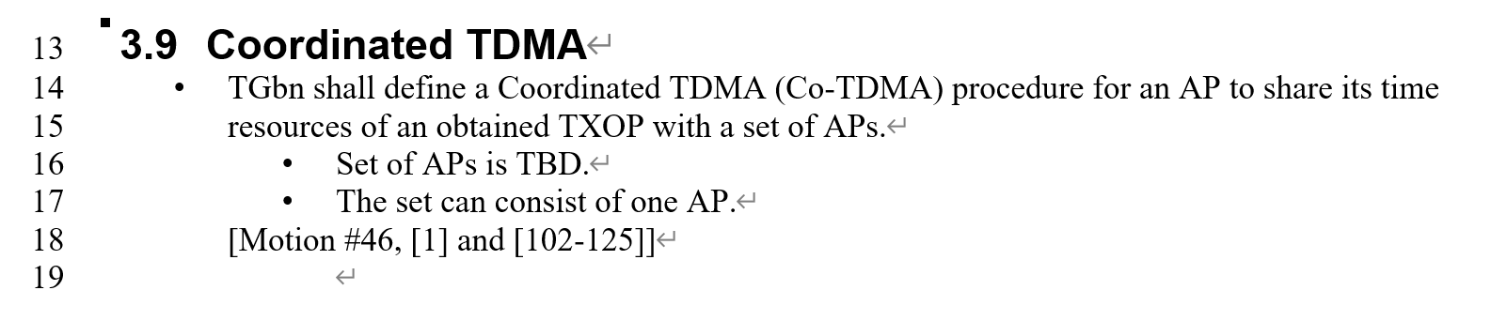
Introduction
To share the time resource of an obtained TXOP between APs, TGbn has been discussing coordinated TDMA (C-TDMA) [1]
The protection of TXOP sharing between APs was discussed in [2]
In this contribution, we discuss the protection aspects in TXOP return scenario within C-TDMA

Slide 3
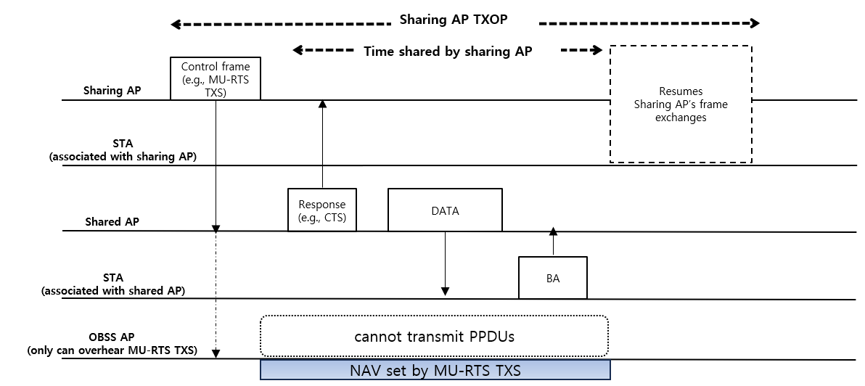
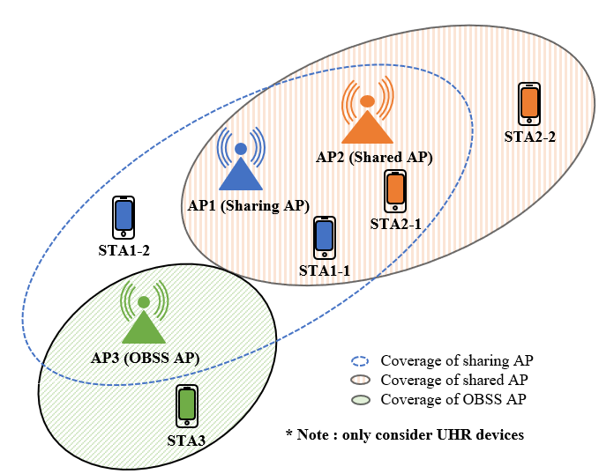
Recap [2] : aspects of protection in C-TDMA
The main goal is to allow UHR STAs to contend for the channel within the allocation time, which are only relevant to the sharing AP and does not affect the shared AP’s BSS
  Based on the TXS procedure in 11be, where STAs should not reset their NAV after the NAVTimeout has expired unless the STA receives a CF-End frame, following TXS in 11be under the C-TDMA protocol could cause a waste of resources
  This means that the domain of TXS issues can be modified, as TXS is extended from a single BSS to multiple APs; Therefore, protecting all STAs during the allocation duration for the shard AP’s BSS could be ineffective
  In here, we assume that the value of duration/ID field within the MU-RTS TXS TF is equal to the value of allocation duration field within user info field in MU-RTS TXS TF

Slide 4
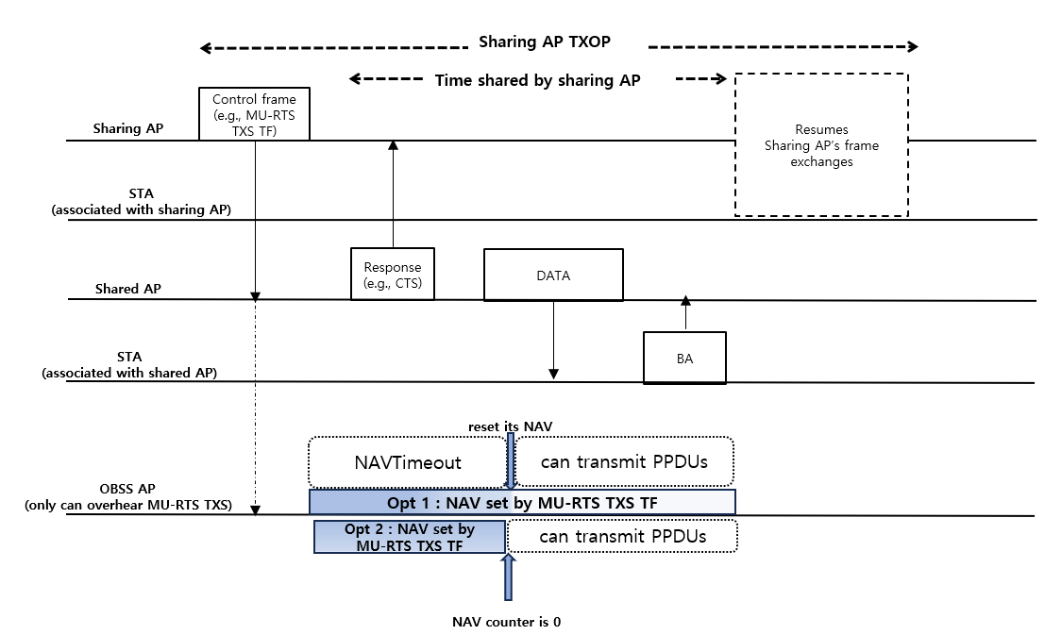
Recap [2] : aspects of protection in C-TDMA
The approaches to addressing modified TXOP sharing issues are as follows :
  Opt 1)
    When duration/ID field of MU-RTS TXS TF is equal
    to the allocation duration field of the frame
    In this case, reset its NAV after the NAVTimeout
    has expired when the UHR device is not associated with
    the sharing AP and only overhears MU-RTS TXS TF
    that is not for its BSS
  Opt 2)
    From the beginning, set the duration field of the
    MU-RTS TXS TF that doesn’t cover all
    the shared AP’s BSS frame exchanges
    The allocation duration field of the frame is different with
    duration field

Slide 5
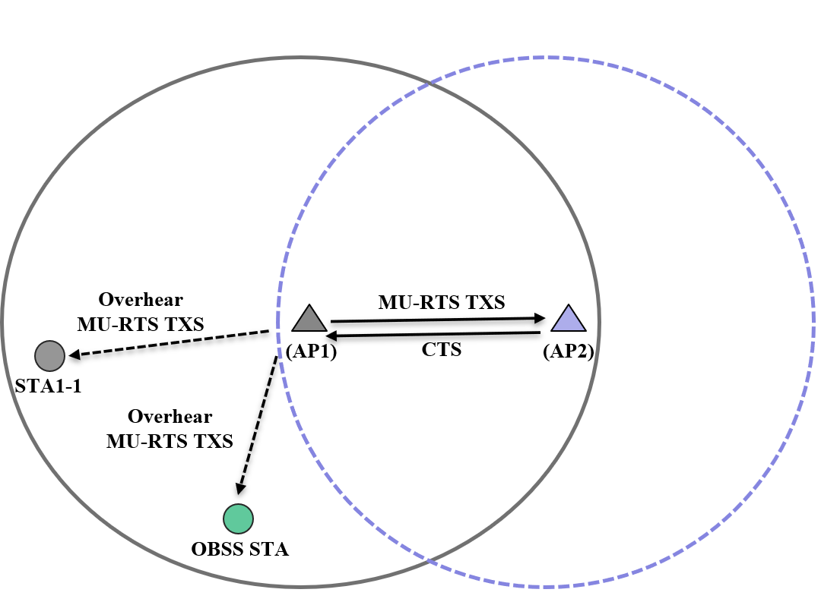
Comparison between Opt1) and Opt 2)
 |  |  | Opt 1) | Opt 2)
Duration field of MU-RTS TXS TF |  |  | -Equal to the allocation duration field | Not equal to the allocation duration field - Ex) Set to the length of time required to transmit the solicited response frame of TXS frame plus one SIFS
Hidden to the shared AP | Associated with the sharing AP (e.g., STA1-1) | Pre-EHT | After the NAVTimeout | At the end of the duration field
 |  | EHT | At the end of duration field | At the end of the duration field
 |  | UHR | At the end of the duration field | At the end of the duration field
 | Not associated with the sharing AP (e.g., OBSS STA) | Pre-EHT | After the NAVTimeout | At the end of the duration field
 |  | EHT | At the end of the duration field | At the end of the duration field
 |  | UHR | After the NAVTimeout | At the end of the duration field
Fairness issues |  |  | Can occur between the EHT STA and other STAs | Not occur between STAs
*More details are in APPENDIX

Slide 6
Considering TXOP return in Opt 2) scenario
Option 2) could be a better approach in terms of fairness issues between STAs
However, it can affect a sharing AP when a shared AP returns its remaining portion of TXOP to the sharing AP
  For example, UHR STA that is associated with the sharing AP can access channel during allocation duration when we apply Opt 2) in MU-RTS TXS TF;
  At the same time, the shared AP returns its remaining TXOP to the sharing AP
  In this case, a collision can occur; therefore, the sharing AP may not be able to identify the returning TXOP
To improve the reception of returned TXOP from the shared AP during C-TDMA, we can consider the following solution :
  TXOP return can be scenario-dependent; therefore;
  If TXOP return is available (e.g., requested from the sharing AP), set the NAV duration of UHR STAs that are associated with the sharing AP during the allocation duration
  The next slide shows an example

Slide 7
Considering TXOP return in Opt 2) scenario
The sharing AP transmits an MU-RTS TXS TF with an indication of requesting the return TXOP
An STA associated with the sharing AP and hidden to the shared AP extends the protection until the end of the allocated duration which is indicated in the user info field of MU-RTS TXS TF
This can increase the probability of grabbing the returned TXOP from the shared AP
Allocated time
Hidden STA to
shared AP
(OBSS STA)
NAV protection of
(MU-RTS TXS/CTS)
Hidden STA’s frame exchange
Hidden STAs to
shared AP
(STA2-1)
NAV protection of
(MU-RTS TXS/CTS)
Extend protection until the end of allocated time
Shared AP
STA1-1
Sharing AP
Sharing AP
Control frame (MU-RTS TXS)
with indication of TXOP return is requested
STA1-2
Shared AP
Response
(CTS)
Return TXOP
STA2-1
Shared AP’s BSS frame exchanges
OBSS STA

Slide 8
Conclusions
In this presentation, we discuss about how to increase reception of returned TXOP from the shared AP during C-TDMA when the duration field of MU-RTS TXS is not set as at the end of allocation duration

Slide 9
Reference
[1] 24/0209r3, Specification Framework for TGbn
[2] 23/1846r1, Protection of Extended TXOP Sharing

Slide 10
SP1
Do you agree that a sharing AP shall send a TXOP allocation frame(exact name TBD) to a single shared AP to share a time portion of its TXOP?
The Duration field of the frame is set to the length of time required to transmit the solicited response frame plus one SIFS

Slide 11
SP2
Do you agree that STAs hidden from a shared AP reuse the allocation duration field within the TXOP allocation frame (exact name TBD) to extend protection, with the purpose of improving the sharing AP’s reception of returned TXOP from the shared AP?
The details are TBD

Slide 12
APPENDIX

Slide 13
STA’s view when applying Opt 1)
Network configuration :
  AP1: sharing AP; AP2 : shared AP
  STA1-1: associated with AP1
  OBSS STA : not associated with AP1
Assumption :
  Duration field
    Equal to allocation duration
  STA format
    Pre-EHT STA : Apply the NAVTimeout
    EHT STA : Not apply the NAVTimeout(i.e., follow current spec rule)
    UHR STA
      Associated with the sharing AP : not apply the NAVTimeout
      Not associated with the sharing AP : apply the NAVTimeout
Description :
  STA1-1 :
    Pre-EHT STA: contend the channel after NAVTimeout
    EHT/UHR STA : Set the NAV until the end of the allocation duration
  OBSS STA:
    Pre-EHT and UHR STA: contend the channel after the NAVTimeout
    EHT STA : Set NAV until the end of the allocation duration
Overhear
MU-RTS TXS
MU-RTS TXS
(AP1)
CTS
(AP2)
STA1-1
Overhear
MU-RTS TXS
OBSS STA

Slide 14
STA’s view when applying Opt 2)
Network configuration :
  AP1: sharing AP; AP2 : shared AP
  STA1-1: associated with AP1
  OBSS STA : not associated with AP1
Assumption :
  Duration field
    Not equal to the allocation duration
      Ex) set to the length of time required to transmit the solicited response
      frame plus one SIFS
  STA format
    Pre-EHT STA : Apply the NAVTimeout
    EHT STA : Not apply the NAVTimeout
    UHR STA : Not apply the NAVTimeout (i.e., if follow current spec rule)
      Associated with the sharing AP : not apply the NAVTimeout
      Not associated with the sharing AP : apply the NAVTimeout
Description :
  STA1-1, OBSS STA :
    Pre-UHR and UHR STA: contend the channel after the end of the duration field (e.g., if the solicited response frame is CTS frame, the ending time is end of the CTS frame)
Overhear
MU-RTS TXS
MU-RTS TXS
(AP1)
CTS
(AP2)
STA1-1
Overhear
MU-RTS TXS
OBSS STA

