Slide 1
The trust model between STA and OBSS AP in MAPC scheme

Slide 2
Introduction
In Co-BF,11bn agreed on two new sounding sequences: Joint sounding and sequential sounding.
  In Joint and cross-BSS sequential sounding, the OBSS AP need to overhear the CSI frame transmitted by the unassociated STA.
  Meanwhile, the 3rd party also can overhear the unprotected CSI frame, and then sense the end-user activity between STA and it’s associated AP, which will bring some user privacy issue.
In this contribution, we would like to discuss the CSI protection between STA and OBSS AP.

Slide 3
Recap: CSI protection in 802.11bi SPEC(baseline of 802.11bn)
The latest 11bi draft defines the protected CSI frame between AP and the associated STA.
  Before 11bi, the 3rd party may overhear the plain text of CSI frame, and then sense the end user activity between AP and the associated STA.
  In the latest 11bi draft,the individual addressed CSI frame is encrypted by the PTK,and thus the user privacy is enhanced.

Slide 4
Problem state and Motivation
CSI protection defined by TGbi conflicts with the overhearing mechanism in sounding procedure proposed by TGbn
  Overhearing by the target OBSS AP in Co-BF sounding is a promising function and is widely discussed in 11bn group.
  But the target OBSS AP can’t decode the overheard CSI frame once it’s encrypted.
  Conclusion: The encrypted CSI frame causes overhearing mechanism become useless.
Motivation
  We propose to define a new protected CSI mechanism between STA and OBSS AP in Co-BF sounding procedure to address the collision issue above.

Slide 5
The proposed CSI protection between STA and OBSS AP
  Opt1: PTK Sharing between AP and OBSS AP
  Pons: Individual addressed protected CSI frame can be reused,e.g. STA sends the protected CSI frame to its associated AP, and the OBSS AP can overhear the CSI and decode it with the shared PTK.
  Cons: The single PTK is used in both MGMT. and data frame, the OBSS AP also can decode the overheard data frame exchange between STA and its associated AP, which causes additional user privacy concern.
  Opt2: PTK negotiation between STA and OBSS AP
  Pons: Compared with the PTK Sharing approach, the user privacy concern can be mitigated. e.g. the STA encrypts the CSI frame via a separated PTK, which is negotiated between STA and OBSS AP.
  Cons: It only wok on cross-BSS sequential sounding procedure. That’s, such solution can’t be applied in Joint sounding procedure.
  Opt3(Preferred): The CSI frame encrypted by a separated group key
  Pons: Compatible with both cross-BSS Sequential sounding and Joint sounding procedure.
  Cons: No.

Slide 6
The mainly procedures of group addressed protected CSI frame
  The AP shares a separated group key(GK) to all the associated STAs.
  The AP share the GK to the OBSS APs that participates Co-BF procedure.
  STA sends the encrypted CSI frame in a group addressed manner in Cross-BSS sequential and/or Joint sounding procedure.
  To avoid the PN reuse issue, the AP may:
    Assign partial PN space to each STA(e.g. a different MSB 24-bit assigns to one STA), and each STA manages it’s own LSB 24-bits(increment the PN after sending a encrypted CSI frame)
    Assign an increasing PN in ICF or BFRP in each sounding procedure, and STA encrypted the CSI frame via the assigned PN and GK.

Slide 7
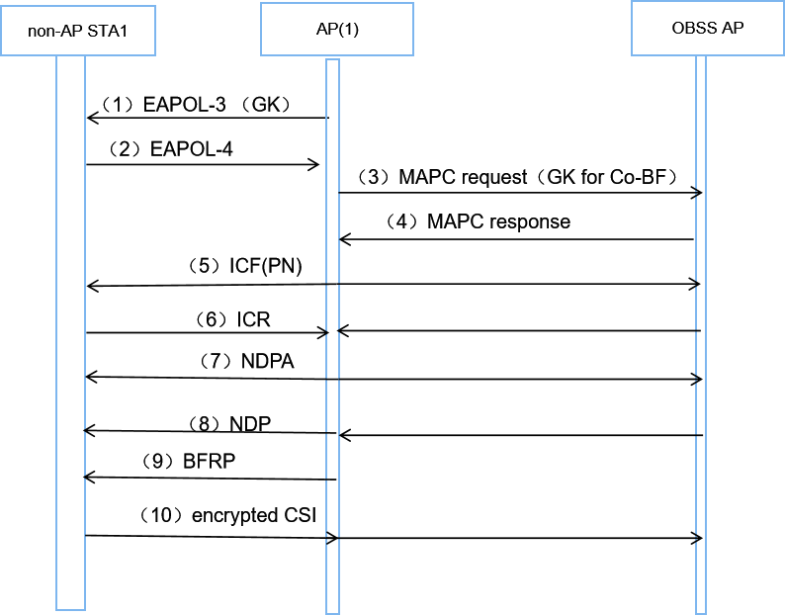
The following figure depicts an example of GK sharing and CSI encryption with the shared GK in Joint sounding procedure

Slide 8
Summary
Analyze the conflict issue between the protected CSI frame and overhearing mechanism.
  Compare all possible solutions and propose to the define the group addressed and protected CSI frame
  Compared with PTK sharing and PTK negotiation mechanism, a separated GTK sharing can be applied in both sequential sounding and Joint sounding procedure, and also it mitigates the end-user privacy concern.
  Propose a general procedure of GTK sharing for CSI protection including the PN assignment.

Slide 9
THANK YOU ☺

Slide 10
Reference
1. 20/0123r0 Channel Sounding for Multi-AP CBF
2. 24/1542r0 Sounding Schemes for Coordinated Beamforming
3. 24/209r5 Specification Framework for TGbn
4. 24/1823r0 CSI in Sounding in CBF
5. 802.11bi draft 1.0

Slide 11
SP1
Do you agree to have a mechanism to protect the CSI frame between STA and OBSS AP in sequential sounding and Joint sounding procedure?

Slide 12
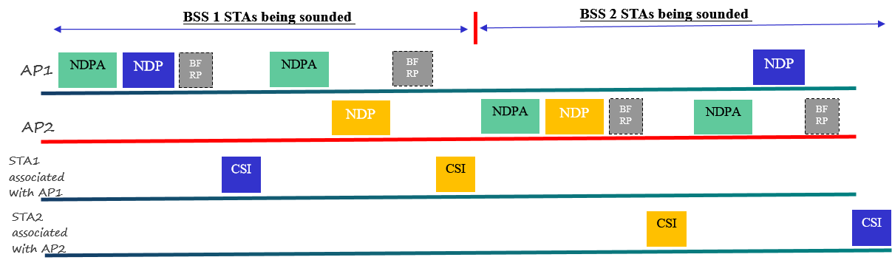
Appendix: Sequential sounding in motion[#100]

Slide 13
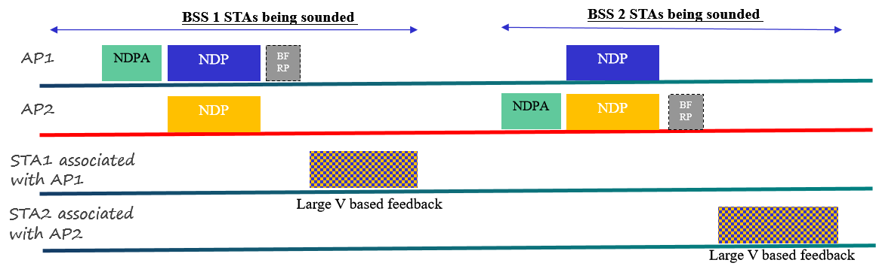
Appendix: Joint sounding sequence in motion[#101]

