Slide 1
802.11 Working Group Opening Report November 2024
Authors:
Date: 2024-11-11

Slide 2
Introduction
This presentation, together with the reports cited herein, forms the opening report of the IEEE 802.11 Working Group for November 2024
“Mx.y.z” terminology indicates that the item was on the tentative agenda for the Monday 802.11 plenary, and was agenda item x.y.z.

Slide 3
M1.3 Meeting Decorum
Please observe proper decorum in meetings
No photography or recording
Press (i.e., anyone reporting publicly on this meeting) must announce their presence
In-person attendees:
Laptop / tablet speakers and cell phone ringers off
Join Webex using the “Don’t connect to audio” option
Wear your badge in the meeting areas (helps hotel staff improve the general security)
Remote attendees must mute when not speaking
All attendees use Webex chat to enter the queue to speak

Slide 4
M2.2.1 Summary of Liaisons
Liaisons since September 2024:
Notified IETF to use IEEE Std 802.11-2024 as reference in draft RFC draft-wkumari-rfc8110-to-ieee (transfers OWE to IEEE 802.11)
Liaisons website, see https://grouper.ieee.org/groups/802/11/Liaisons/Liaisons-and-External-Communications.html

Slide 5
M2.3 Recent and anticipated 802 LMSC actions
November 2024
P802.11bq (Integrated mmWave) PAR
March 2025

Slide 6
M2.3 IEEE SA Standards Board (SASB)
September 24-26, 2024 – NesCom/RevCom/SASB
IEEE Std 802.11-2024
IEEE Std 802.11bh-2024
IEEE Std 802.11be-2024
October 29-30, 2024 – NesCom/RevCom
(September 18, 2024, submission deadline)
P802.11REVmf (Maintenance) PAR
December 9-11, 2024 – NesCom/RevCom/SASB
(October 21, 2024, submission deadline)
P802.11bq (Integrated mmWave) PAR

Slide 7
M3.1 802.11 Working Group Session Documents
WG Session Reports
WG Agenda | https://mentor.ieee.org/802.11/dcn/24/11-24-1663
Opening report | https://mentor.ieee.org/802.11/dcn/24/11-24-1664
Snapshot slides | https://mentor.ieee.org/802.11/dcn/24/11-24-1657
1st vice chair | https://mentor.ieee.org/802.11/dcn/24/11-24-yyyy
2nd vice chair | https://mentor.ieee.org/802.11/dcn/24/11-24-1660
Treasurer | https://mentor.ieee.org/802-ec/dcn/24/ec-24-0007
Chair's Supplementary Material | https://mentor.ieee.org/802.11/dcn/24/11-24-1665
Motions | https://mentor.ieee.org/802.11/dcn/24/11-24-1659
Session report | https://mentor.ieee.org/802.11/dcn/24/11-24-1658
Previous Session Minutes | https://mentor.ieee.org/802.11/dcn/24/11-24-1593

Slide 8
M3.2 Joint meetings and Reciprocal Credit
Reciprocal credit is given to 802.11 voters for attendance at:
802.18 (.11 credit for attending .18 and .18 credit for the attending .11 during the .18 timeslots)
802.19, 802.24, 802.1, and the 802 JTC1 SC.
For the November 2024 session, reciprocal credit is given for other WG/TAG meetings that occur during the WG11 session
Monday November 11, 2024, 10:30 PST to
Friday, November 15, 2024, 12:00 PST
November 2024 session attendance DOES count toward voting credit. NOTE: 13 timeslots required for 75% attendance.

Slide 9
M3.2 802.18 (Radio Regulatory TAG) details
See https://www.ieee802.org/18/
Meeting times: Monday PM2 and Tuesday AM2
Agenda
Review the following consultations:
Japan MIC: Call for opinions on the proposed ministerial ordinance to amend part of the Radio Law Enforcement Regulations: Addition of systems and bands to the special exemption system for non-technical equipment
Saudi Arabia CST: Light Licensing Regulations Annex for the 6 GHz Frequency Band
Draft response is available. Expect to consider approval this week.
EU CEPT ECC: Draft ECC Report 364
Vietnam MIC: Consultation re lower 6 GHz band for Wi-Fi
Discuss the latest topics related to spectrum and regulation in Europe, North America, and Asia Pacific:
ETSI BRAN update
Liaisons from ITU-R Working Party 5D

Slide 10
M3.2 802.19 (Wireless Coexistence WG) details
See https://www.ieee802.org/19/
Meeting times: Monday 6:30pm and Thursday 6:30pm
Agenda

Slide 11
M3.2 Other 802 WG meetings
IEEE 802 website: https://www.ieee802.org/
Includes links to all WG webpages
Consolidated calendar: https://ieee802.org/802tele_calendar.html
Documents: 802.11, 15, 18, 19, 24: https://mentor.ieee.org/802/bp/StartPage

Slide 12
M4.1.1/W2.6 IEEE 802.11 Groups
Type | Group | WG & Infrastructure
WG | WG11 | The IEEE 802.11 Working Group
SC | ARC | Architecture
SC | COEX | Coexistence
SC | PAR | PAR review
802 SC | JTC1 | ISO/IEC JTC1/SC6
Type | Group | Amendments/Revision
TG | BF | WLAN Sensing
TG | BI | Enhanced Data Privacy Protection (EDP)
TG | BK | 320 MHz Positioning
TG | BN | Ultra High Reliability
TG | BP | Ambient Power
TG | MF | Revision (REVmf)
Type | Group | New Work
SC | WNG | Wireless Next Generation
SC | AIML | AI/ML in 802.11
SG | IMMW | Integrated Millimeter Wave
SG | ELC | Enhanced Light Communications
TIG | AUTO | Automotive

Slide 13
M4.1.2/W2.6 PAR Expiration/Renewal Schedule
Project | PAR Expiration Date
P802.11 (REVmf) | Awaiting approval
P802.11bf | 31-DEC 2026
P802.11bi | 31-DEC 2025
P802.11bk | 31-DEC 2026
P802.11bn | 31 DEC 2027
P802.11bp | 31 DEC 2028
http://www.ieee802.org/11/PARs/index.html

Slide 14
M4.1.3 /W2.6 802.11 WG Appointed positions
WG Secretary –Volker Jungnickel
Treasurer – Jon Rosdahl
ANA – Carol Ansley
WG Technical Editor – Emily Qi

Slide 15
M4.1.3 /W2.6 Officers
Cat | Group | Chair | Vice Chair | Technical Editor | Secretary
WG |  | Robert STACEY | Jon ROSDAHL, Stephen MCCANN | Emily QI | Volker JUNGNICKEL
SC | ARC | Mark HAMILTON | Joseph LEVY |  | Joseph LEVY
SC | Coex | Marc EMMELMANN | Sebastian MAX, Manish KUMAR |  | Guido HIERTZ
SC | PAR | Jon ROSDAHL | Michael MONTEMURRO |  | Michael MONTEMURRO
SC | WNG | Jim LANSFORD | Lei WANG |  | Lei WANG
SC | AIML | Xiaofei WANG | Ming GAN, Gaurang NAIK |  | Liangxiao XIN
TG | MF | Michael MONTEMURRO
TG | BF | Tony Xiao HAN | Sang KIM, Assaf KASHER | Claudio DA SILVA | Leif WILHELMSSON
TG | BI | Carol ANSLEY | Jerome HENRY, Antonio DE LA OLIVA | Po-Kai HUANG | Stephane BARON
TG | BK | Jonathan SEGEV | Ali RAISSINIA, Assaf KASHER | Roy WANT | Dibakar DAS
TG | BN | Alfred ASTERJADHI | Laurent CARIOU, Jianhan LIU, Kiseon RYU | Ross Jian YU | Yusuke ASAI
TG | BP | Bo SUN | Steve SHELLHAMMER, Rakesh TAORI | Yinan QI | Sebastian MAX
SG | IMMW | Laurent CARIOU |  |  | Volker JUNGNICKEL
SG | ELC | Nikola SERAFIMOVSKI | Volker JUNGNICKEL |  | Mohamed ISLIM
TIG | AUTO | Jim LANSFORD | Azin NEISHABOORI, Jing MA
New since last session

Slide 16
M4.1.4 /W2.6 IEEE 802.11 Revisions
802.11-1997
802.11-1999
802.11-2003
802.11-2007
802.11-2012
802.11-2016
802.11-2020
802.11-2024
11d
Intl Roaming
11e
QoS
11k
RRM
11s
Mesh
11aa
Video Transport
11aq
Pre-association Discovery
11bc
Broadcast Services
MAC
11h
DFS & TPC
11u
WIEN
11v
WNM
11ae
QoS Mgt Frames
11ak
General Link
11i
Security
11z
TDLS
11r
Fast Roam
11ai
Fast Initial Link Setup
11ax
High Efficiency WLAN
11f
Inter AP
11w
Management Frame Security
11ay
Enhanced mmWave
11az
Enhanced Positioning
11n
High Throughput (>100 Mb/s)
11af
TV Whitespace
PHY & MAC
11ba
Wake-up Radio
11a
OFDM
54 Mb/s in 5 GHz
11g
54 Mb/s in 2.4 GHz
11ac
VHT
> 1 Gb/s in 5 GHz
11p
WAVE
11ah
Sub-1 GHz
11bb
Light Communications
11b
HR/DSSS
11 Mb/s in 2.4 GHz
11j
JP bands
11y
Contention Based Protocol
11ad
VHT
> 1 Gb/s in 60 GHz
11aj
China mmWave
11bd
Next Gen V2X
Notes:
doc.: IEEE 802.11-11/0483r0
May 2011
Bruce Kraemer (Marvell)
Page 16

Slide 17
M4.1.4 /W2.6 IEEE 802.11 Standards Pipeline
MAC
802.11
-2024
AUTO TIG
802.11bi
EDP
802.11bh
RCM
WNG
IMMW SG
802.11bn
UHR
802.11bk
320 MHz Pos
802.11be EHT
ELC SG
802.11bp
AMP
802.11bf SENS
Liaison
MAC & PHY
REVmf
Liaison Topics
Discussion Topics
TIG/Study
groups
TG without
Approved draft
WG
Letter Ballot
SA
Ballot
Published
Amendment
Published
Standard
Notes:
doc.: IEEE 802.11-11/0483r0
May 2011
Bruce Kraemer (Marvell)
Page 17

Slide 18
M4.1.5 /W2.6 Summary of ballots and comment collections
Type | Label | Group | Opened (mm-dd) | Dur (d) | # Comments | Ballot Group | Approve | Disapprove | Abstain | Return % | Approve % | Result
T | SA Recirc 1 | TGbf | 10-23 | 20 | 36 | 162 | 120 | 5 | 2 | 79 | 96 | Pass
T | SA Initial | TGbk | 11-01 | 30+ | 78 | 150 | 103 | 7 | 5 | 76 | 93 | Pass

Slide 19
M4.1.6 /W2.6 Current Membership Status
Updated following September session
Status | Number
Aspirant | 95
Potential Voter | 79
Voter | 576
Ex Officio Voter | 9
Definitions:
Aspirant: a member who has attended 1 qualifying meeting
Potential Voter: a member who has attended 2 qualifying meetings and will become a voter at the start of the next plenary they attend
Ex Officio Voter: a voter who has voting rights by virtue of their membership of the 802 EC and has requested to be recorded as an ex officio voter in 802.11

Slide 21
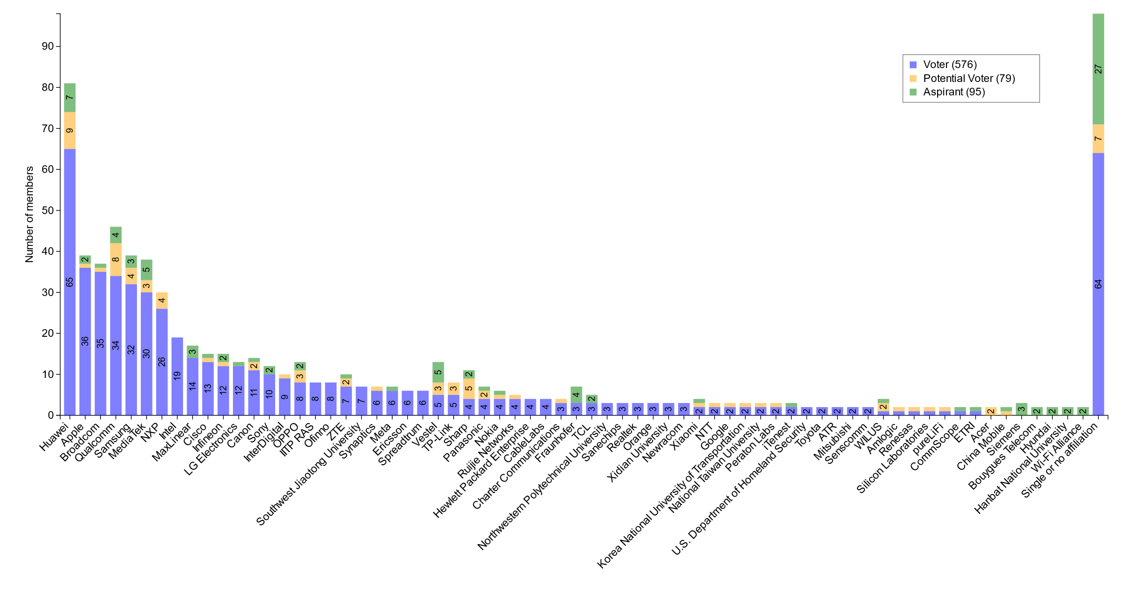
Members by affiliation

Slide 22
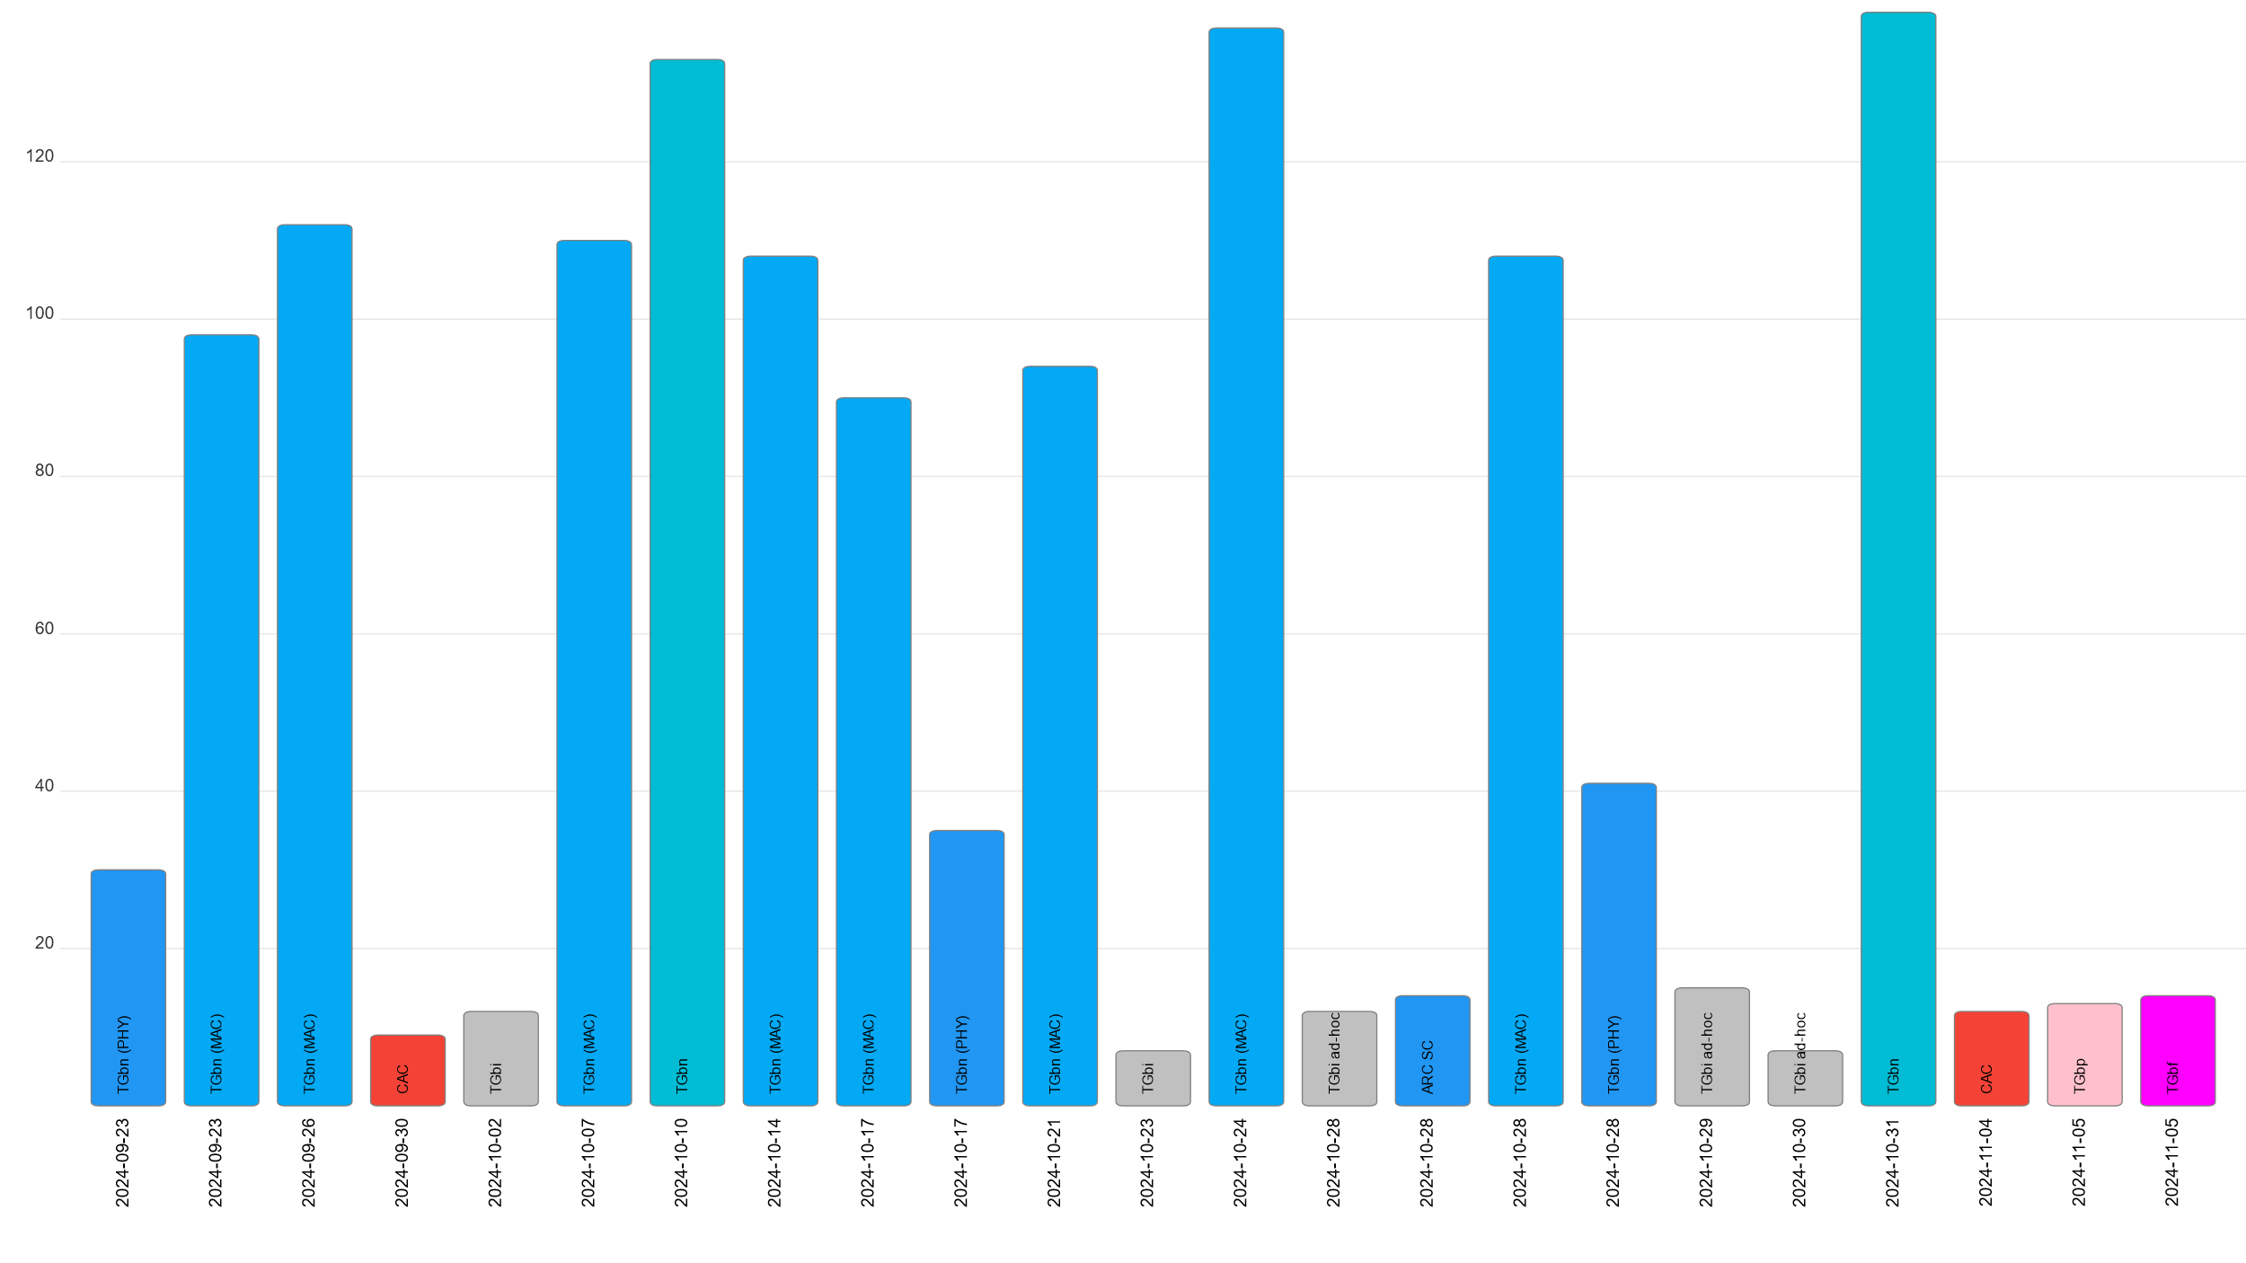
Attendance by subgroup (September to November)

Slide 23
M6.1 Announcements: 2024 September Designation of Individual experts
Individual experts who attend electronically for a specific purpose/presentation can be designated as such by the WG Chair and receive a registration fee waiver and limited attendance rights.
See section 5 in https://mentor.ieee.org/802-ec/dcn/17/ec-17-0090-25-0PNP-ieee-802-lmsc-operations-manual.pdf ,
The Working Group Chair may designate specific individual experts who are allowed to participate in Working Group discussions via electronic means during an in-person meeting for the benefit of the group. These individuals are not considered to be attending the meeting and so they are not required to pay meeting fees and they do not get participation credit. The participation of these individuals should be limited to specific technical topics. Such participation shall be documented in the minutes of the Working Group meeting.
The individuals listed below are hereby designated as specific individual experts on their respective topics and subject to the restrictions and benefits described in the 802 OM.
Emily Qi, Self, Editors (Tue AM0)
Bjørn Ivar Teigen, Domos, WNG (Tue AM1)
For WNG, attendance for each is limited to the WNG timeslot in which the respective presentation is scheduled.

Slide 24
M6.1 Announcements: Straw poll result recording
At the discretion of the chair, a member running a straw poll may request that a record be made of the individual responses (not just the aggregate result)
The objective is to allow the member to get more detail on where other members stand on the question
If a record of the responses is requested and the chair grants the request, the responses are recorded in the minutes
This is so that the result is available to all members
The members responding to the poll must be made aware that the responses are being recorded before the poll is run
This is so that the members are aware of the information being gathered and can respond appropriately
The chair decides whether the responses to a straw poll can be recorded
There may be time constraints on the agenda
There may be constraints on the tools (e.g., the chair is not able to gather the results because of limits on the WebEx account in use)
The chair should be made aware of the intent to run a straw poll with recorded responses ahead of the meeting so that the appropriate account and tools are in place

Slide 25
M6.1 Announcements: reminder about straw polls
Members are reminded that…
Straw polls are for gathering information
Straw polls are NOT for making decisions
Motions are used to make decisions
The information gathered is for the member running the straw poll
The member running the straw poll decides the question asked

Slide 26
Additional Reference material

Slide 27
Comment Resolution Resources
Comment resolution resources
See https://mentor.ieee.org/802.11/dcn/13/11-13-0230-05-0000-comment-resolution-tutorial.ppt
See https://mentor.ieee.org/802.11/dcn/11/11-11-1625-02-0000-comment-resolution-guide.doc
There are many examples of good practice for documentation of comment analysis and resolution; ensures there is a record of comment consideration and agreed resolution
https://mentor.ieee.org/802.11/dcn/18/11-18-0237-00-000m-cid-177.docx
https://mentor.ieee.org/802.11/dcn/18/11-18-0930-00-000m-cid-1007.docx
https://mentor.ieee.org/802.11/dcn/18/11-18-0669-04-000m-revmd-mac-comments-assigned-to-hamilton.docx
https://mentor.ieee.org/802.11/dcn/18/11-18-1410-00-00ax-lb233-cr-spatial-reuse.docx

Slide 28
Motion and other templates
WG11 templates
Motions: see https://mentor.ieee.org/802.11/dcn/22/11-22-1967-01-0000-working-group-motions-templates.pptx
Liaison: see https://grouper.ieee.org/groups/802/11/Rules/2018-03 Liaison submission template.docx
802 LMSC templates
Motions: https://mentor.ieee.org/802-ec/dcn/16/ec-16-0170-04-00EC-802-ec-motion-template.pptx
CSD: https://mentor.ieee.org/802-ec/dcn/18/ec-18-0064-01-0PNP-csd-template-in-doc-format.doc
Liaison: https://mentor.ieee.org/802-ec/dcn/17/ec-17-0012-01-00EC-802-liaison-template.docx

