Slide 1
C-TDMA TXOP Allocation
Date: 2024-08-07
Authors:

Slide 2
Introduction
Coordinated TDMA (C-TDMA) is one of the Multi-AP features to increase throughput and reliability[2]-[6]
Triggered TXOP Sharing (TXS) can be used to allocate TXOP among neighbouring APs
In this contribution, we discuss a mechanism focusing on exchanging information to help schedule TXOP allocation in C-TDMA operation

Slide 3
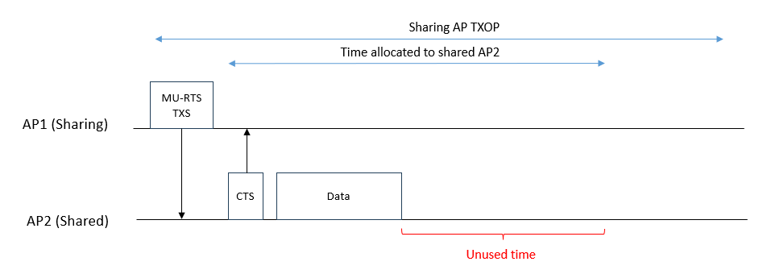
Problem 1: Resource wastage
In C-TDMA, sharing AP obtains the TXOP and allocates part of TXOP to shared AP(s). However, it may not have prior knowledge of how much TXOP a shared AP needs, and whether the shared AP has low latency data. This may cause some problems:
1. Resource wastage: If shared AP finishes transmission in the allocated TXOP, and there’s unused time, this may cause resource wastage problem

Slide 4
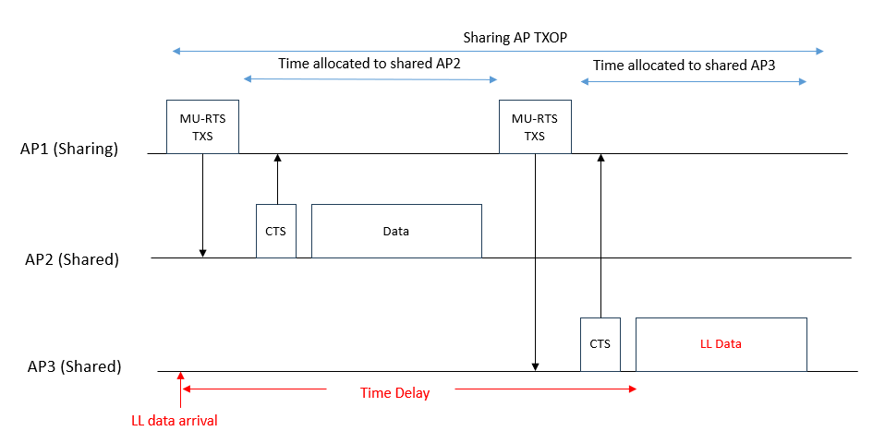
Problem 2: Time delay
2. Time delay: If more than one shared AP are involved in the C-TDMA operation, and sharing AP allocates TXOP to one shared AP first, while another shared AP has low latency data, this may cause time delay for the low latency data

Slide 5
Solution: Information exchange in C-TDMA
Prior to TXS, information is exchanged among APs to help schedule TXOP allocation
AP(s) transmit Required TXOP Report (RTR) frame containing information of required TXOP duration and LL related information (e.g. data urgency level)
RTR may be solicited or unsolicited. For example, in the following operation, sharing AP (AP1) sends Required TXOP Report Poll (RTRP) Trigger frame to solicit RTR from shared AP (AP2)
During TXS, sharing AP shares TXOP using the information in RTR
E.g. time allocated according to the required TXOP duration

Slide 6
Multiple shared APs scenario
In the case of multiple shared APs scenario, each shared APs may send RTR to sharing AP to help schedule TXOP allocation
During TXS, sharing AP shares TXOP using the information in RTRs
The order of TXS may be based on LL related information. For example, if LL data arrives at AP3, AP3 indicates LL data arrival in RTR. AP1 shares TXOP to AP3 first.
E.g. allocated first based on LL related information

Slide 7
Conclusion
In this contribution, we proposed a mechanism focusing on exchanging information to help schedule TXOP allocation in C-TDMA operation
Prior to TXS, information is exchanged (using RTR) among APs to help schedule TXOP allocation
During TXS, sharing AP can use the information in RTR to share its TXOP effectively
RTR: Required TXOP Report

Slide 8
Straw Poll
Do you agree to define an information exchange (such as required TXOP duration, LL related information) process prior to TXOP Sharing in C-TDMA to help a sharing AP make a better scheduling decision?

Slide 9
References
[1] 22/1515r0, A candidate feature: M-AP
[2] 23/1085r0, Thoughts on Coordinated TDMA
[3] 23/0261r0, C-TDMA procedure in UHR
[4] 23/1910r1, Coordinated TDMA (Follow Up)
[5] 23/0041r0, Considerations on Coordinated TDMA (C-TDMA)
[6] 23/0249r0, Extended TXOP Sharing

