Slide 1
Frame Padding Proposal
Date: 2024-09-09
Authors:

Slide 2
Abstract
Proposal for a padding mechanism to better protect privacy.

Slide 3
Background
Our PAR: “This amendment specifies modifications to the IEEE Std 802.11 medium access control (MAC) specification to specify new mechanisms that address and improve user privacy.”
- CPE clients otaMAC rotation is being adopted (whether individual, group or mass rotation)
- MAC Header parameters encryption is being discussed
- However, header obfuscation is not sufficient to improve user privacy

Slide 4
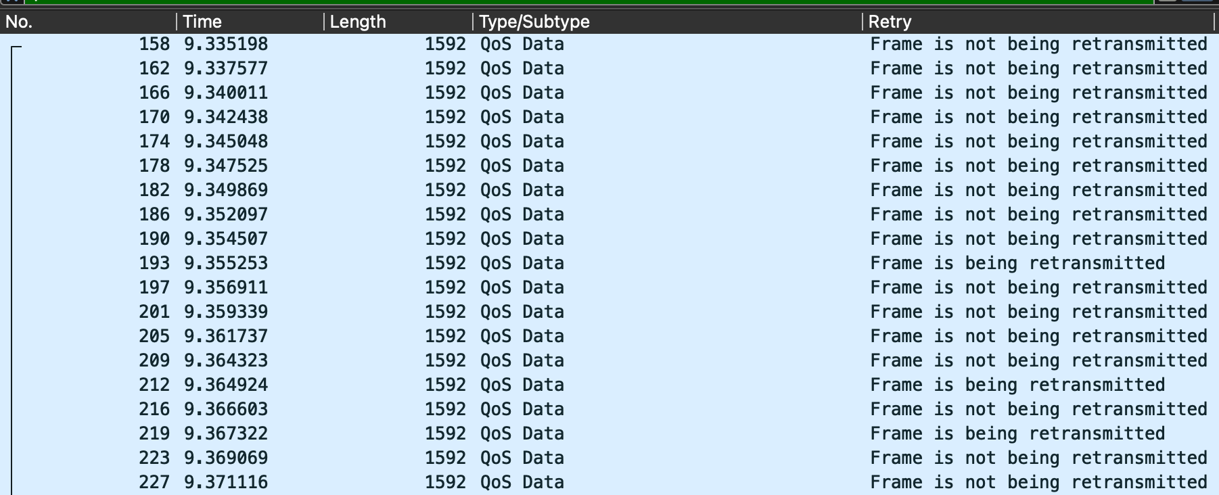
STA Identity and Traffic Pattern
A simple capture on the air with a sniffer and a focus on frame structure easily surfaces any traffic that is inelastic and repeating
E.g. voice, IoT, keepalives to most applications (mDNS, Miracast, Chromecast, UPnP, etc.)
e.g., “well known 3D gaming application” on a smartphone

Slide 5
Traffic Pattern Exposes the STA Identity
Traffic pattern can be sufficient to expose the STA identity, potentially negating the benefits of header obfuscation
This risk does not occur for all STAs and all traffic, but when it occurs, it can be severe
In a BSS, if a single STA is sending a particular traffic type, it does not matter how many other STAs are in the same BSS, it does not matter how often the STA rotates its MAC parameters -> an eavesdropper can follow the STA across time
160-byte frame
OTA MAC1
OTA MAC2
OTA MAC3
OTA MAC4
OTA MAC5

Slide 6
Hiding Traffic Pattern
A good way to hide the traffic pattern is to hide the repeating inelastic traffic
We can’t make it non-repeating, but we can make the repetition less cyclical
We can hide the inelasticity
160-byte frame
OTA MAC1
OTA MAC2
OTA MAC3
OTA MAC4
OTA MAC5

Slide 7
Padding Proposal
An MLD (STA MLD and/or AP MLD) could add padding to existing data frames
We could define ‘padded data’ frames, which could have (or not) a padding element – frame type support could be optional
The (encrypted) padding element, when present, could add a random number of bytes to the data payload
160-byte frame
OTA MAC1
OTA MAC2
OTA MAC3
OTA MAC4
OTA MAC5

Slide 8
Padding Proposal
An MLD (STA MLD and/or AP MLD) could also send empty padded frames at random intervals
The frame would still be ‘padded data’ type, but the (real) data field length is 0
160-byte frame
OTA MAC1
OTA MAC2
OTA MAC3
OTA MAC4
OTA MAC5

Slide 9
Padding Pros, and Cons Fixes
Padding obfuscates the traffic pattern
However, padding increases the traffic in the BSS
Not ideal for high-density scenarios, padding may add a privacy vs. performance catch 22
Luckily, there are several ways to mitigate the possible negative impact of padding
The MLD may modulate padding volume based on perceived (or AP-communicated) BSS CU
The non-AP MLD could ask the AP for a padding percentage recommendation (AP indicates a value based on BSS current CU)
Padding job could a split (non-AP MLD pads data frames, AP adds additional frames based on CU)

Slide 10
Conclusion
Without a provision to address traffic pattern, user privacy is reduced
Padding is an efficient way to address this limitation
The effect of padding on BSS performances can be mitigated

Slide 11
Straw Poll
Do you agree to insert a padding mechanism in 802.11bi?
Yes
No
Abstain

