Slide 1
Power Save Enhancements in UHR
Date: 2024-11-04
Authors:

Slide 2
Background and Motivation
AP Power save
  Mobile APs (Soft APs, Hotspots etc.) are typically power constrained/battery operated devices that employ different mechanisms for power saving
  TGbn is discussing enhancements to these mechanisms and possibly introducing new mechanisms [1-6]
  Expanding power saving methods to regular/Infra APs is also under discussion
AP/Mobile AP power saving schemes fall into two broad categories
  Scheduled mechanisms:
    Mobile AP becomes unavailable at periodic intervals which are announced in advance to associated STAs. E.g., B-TWT with Responder PM which is already in use by some technologies.
  Unscheduled mechanisms:
    Mobile AP may do power save opportunistically
    AP/Mobile AP may be in lower power mode with reduced capabilities (NSS/BW/#links) and requires some ICF to switch to higher power mode/full capability

Slide 3
Problem Statement
AP/Mobile AP power save operation can be hugely disruptive for low latency applications at STAs if not managed properly
  Issues already observed in the field:
    Mobile APs doing unscheduled power save introduces unpredictability in their availability as STAs expect APs to be always available and with full capabilities
    Even with scheduled power save schemes, Mobile APs may not always inquire/consider STA requirements when devising their own schedules
    It is hard for STAs to manage their own power save operation while dealing with unpredictable availability of Mobile APs, may lead to higher power consumption for STAs and longer latency for applications
    Mobile APs may introduce unavailability periods or enter into power saving operation while a low latency application is running (STA did not get heads up at association)
  As we discuss extending power saving mechanisms to infra APs, the problem is expected to become more widespread if not addressed properly
Explicit signaling methods for STAs to request guaranteed availability of APs are crucial for uninterrupted low latency applications support

Slide 4
Existing Solutions and Frameworks (1)
TWT for guaranteed availability
  STA may setup TWT (individual/broadcast/restricted TWT) schedules with an AP/Mobile AP for guaranteed availability of AP/Mobile AP during TWT SPs. However, setting up TWT may not always be possible and/or desirable:
    TWT may not be supported by some Mobile APs and/or STAs, hence it is not the ideal solution for each use case
    STA may just need a guaranteed availability from AP/Mobile AP without setting up additional commitments (STA wake schedules, wake durations and frame exchange requirements) that come with TWT
    AP may ignore i-TWT agreements when using Responder PM mode with unavailability indication

Slide 5
Existing Solutions and Frameworks (2)
SCS procedures with QoS IE
  In 802.11be we expanded SCS procedures to include QoS Characteristics element, which can indicate service intervals and traffic requirements etc.
  SCS procedure requires that AP “should” service the STAs in DL within specified service intervals and facilitate UL traffic delivery.
  Missing aspects:
    No “shall” behavior for guaranteed availability of APs during these intervals is defined in EHT SCS procedures.
    Service intervals may not always translate into a fixed availability schedule (Min/max service intervals and no fixed interval duration)
    AP availability adds another layer of operational details that need to be explicitly negotiated during SCS procedures

Slide 6
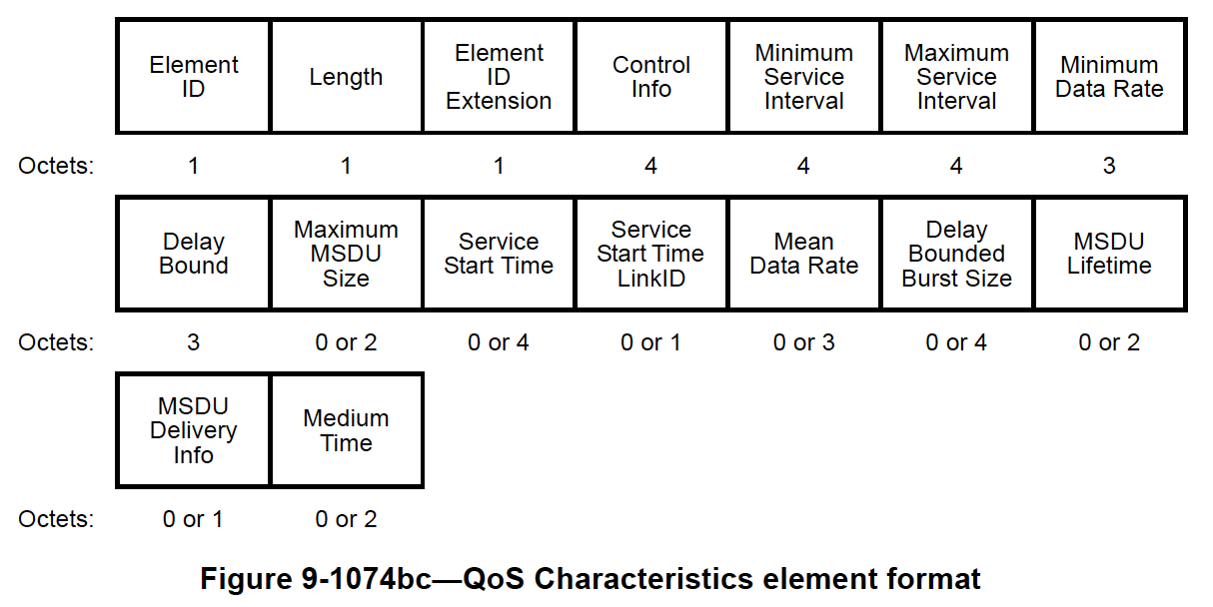
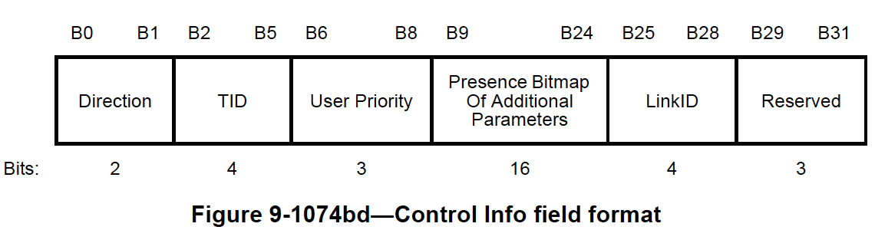
Proposal: Enhancing QoS IE for AP Availability indication
“AP Availability” indication in QoS IE
  Exact field name is TBD
  One of the reserved bits in the Control Info field could be used
  Mechanism could be used with UL and/or DL directions
  Min/Max Service Intervals should be set to the same value for this use case
  Service Start Time field should also be specified
  Optionally indicate specific LinkID if availability is requested on a particular link (LinkID is currently reserved for DL/UL directions)
If SCS procedure is successful with AP Availability indication, AP/Mobile AP “shall” be available at the specified service intervals
Use one of the reserved bits

Slide 7
Some further thoughts
Additional signaling framework for AP Availability
  STA may not always be looking to setup an SCS for requesting AP availability
  New containers/frames may be defined for carrying QoS Char element for the specific purpose of requesting AP availability
    Direction/TID/UP fields may be reserved
    Other fields, not relevant to service interval definition, may also be reserved when QoS IE is carried in the new frame to simplify negotiation procedure

Slide 8
Summary
We discuss issues resulting in disruption of low latency applications when STAs operate with mobile APs doing power saving operations
As TGbn is discussing expanding AP power save and extending to regular/infra APs, the problem is expected to worsen
We evaluate existing signaling/frameworks and make recommendations for enhancements to ensure low latency applications at STAs are not disrupted, or STAs get a “heads up” before setting up services
We also propose to add AP availability indication to QoS characteristics element for STAs to request guaranteed availability of APs during indicated service intervals

Slide 9
References
[1] 24/1502, Discussion on AP Power Save
[2] 24/450, A Proposal for UHR Soft-AP Power Save
[3] 24/659, Thoughts on AP Power Save
[4] 24/813, Discussions on AP Power Save
[5] 24/671, Enhancements on AP Power Save
[6] 23/2040, Enabling AP power save_follow up

Slide 10
SP1
Do you agree add the following text to TGbn SFD:
  TGbn defines a mechanism that enables a STA to request guaranteed availability from AP/Mobile AP during certain time periods
    NOTE 1 – The exact signaling mechanism is TBD
    NOTE 2 – It is AP’s discretion to accept the request or not

