Slide 1
USIG fields in an ELR PPDU
Date: 2024-09-09
Authors:
Name | Affiliations | Address | Phone | email
Hari Ram Balakrishnan | NXP | 350 Holger Way, San Jose, CA 95134 |  | hariram.balakrishnan@nxp.com
Priyanka Bansal |  |  |  | priyanka.bansal@nxp.com
Rui Cao |  |  |  | rui.cao_2@nxp.com
Rong Zhang |  |  |  | rong.zhang_1@nxp.com
Sudhir Srinivasa |  |  |  | sudhir.srinivasa@nxp.com
Hongyuan Zhang |  |  |  | hongyuan.zhang@nxp.com

Slide 2
Introduction
The following format was proposed for ELR-PPDU in [1].
  Supports coexistence with legacy STA
In [2, 3, 4, 5, 6],
  Various options on Legacy preamble in ELR PPDU have been discussed.
  The preferred option in all of them is the following:
  U-SIG is present in most of the design proposals
Legacy Preamble
ELR Preamble
ELR Data
L-STF
L-LTF
L-SIG
RL-SIG
U-SIG-1
U-SIG-2
ELR-Preamble
ELR Data
Notes:
2 – Ross, 3 – Leonardo, 4- Lin

Slide 3
Design Consideration
The SNR design target [1, 7] of the ELR-PPDU is ~6 dB better than 11a/g 6 Mbps.
The Legacy preamble does not have sufficient SNR for it to be decoded properly at the ELR STA at its range.
  U-SIG decoding of an ELR PPDU have high false CRC-PASS, i.e., a valid ELR PPDU at a ELR capable device being detected as a valid non-ELR PPDU.
In this contribution, specific subfields in the USIG of ELR PPDU are defined which alleviate the false CRC passing issue for low SNR receivers, as well as enabling better coexistence and power save for high SNR receivers.

Slide 4
USIG content of an ELR PPDU
Category | Subfield | Bit Pos | Bits | Value
U-SIG-1 | PHY Version identifier | B0-B2 | 3 | 1
 | PPDU BW | B3-B5 | 3 | 0
 | UL/DL | B6 | 1 | -
 | BSS color | B7-B12 | 6 | -
 | TXOP | B13-B19 | 7 | -
 | Disregard | B20-B24 | 5 | -
 | Validate | B25 | 1 | -
Category | Subfield | Bit Pos | Bits | Value
U-SIG-2 | PPDU type & Compression Mode | B0-B1 | 2 | 3
 | STA-ID | B2-B12 | 11 | STA-ID value
 | ELR validate bits | B13-B15 | 3 | 7
CRC & Tail | CRC in U-SIG | B16-B19 | 4 | -
 | Tail in U-SIG | B20-B25 | 6 | 0
PHY version Identifier: Set to ‘1’ – UHR format.
U-SIG-1 is unchanged.
Note: ‘-’ means the value can vary and is Tx dependent

Slide 5
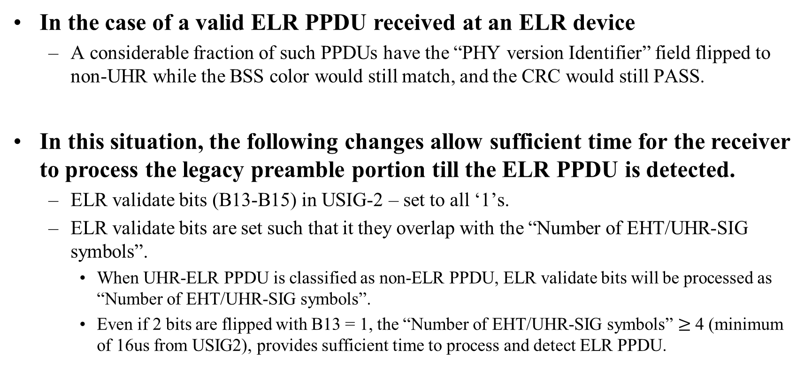
Potential Improvement for ELR devices
In the case of a valid ELR PPDU received at an ELR device
  A considerable fraction of such PPDUs have the “PHY version Identifier” field flipped to non-UHR while the BSS color would still match, and the CRC would still PASS.
In this situation, the following changes allow sufficient time for the receiver to process the legacy preamble portion till the ELR PPDU is detected.
  ELR validate bits (B13-B15) in USIG-2 – set to all ‘1’s.
  ELR validate bits are set such that it they overlap with the “Number of EHT/UHR-SIG symbols”.
    When UHR-ELR PPDU is classified as non-ELR PPDU, ELR validate bits will be processed as “Number of EHT/UHR-SIG symbols”.
    Even if 2 bits are flipped with B13 = 1, the “Number of EHT/UHR-SIG symbols” $≥$ 4 (minimum of 16us from USIG2), provides sufficient time to process and detect ELR PPDU.

Slide 6
ELR PPDU indication in USIG
Field “PPDU Type and Compression Mode” – ‘3’ can be used to indicate ELR PPDU.
  Reuse a reserved (validate) value to indicate the ELR PPDU.

Slide 7
Enabling unintended nearby STAs to abort processing
Unintended nearby STAs (both ELR & Non-ELR capable) should stop processing to prevent unnecessary power consumption.
  OBSS STA reception: BSS color can be used to stop further processing as non-ELR PPDU.
  InBSS STA reception: EHT/UHR non-ELR PPDU stopping criteria is through STA-ID.
Version dependent fields in USIG can be repurposed in ELR-PPDU to
carry STA-ID.
  InBSS STA reception: Phy version ID = 1 (UHR), BSS color matches, PPDU type & compression mode = 3 (ELR), and STA-ID not matching with USIG-CRC PASS.
    Any further processing can be stopped if the received PPDUs RSSI is good.

Slide 8
Summary
In this contribution, we discuss how specific USIG subfields in an ELR PPDU can be set.
Design philosophy:
  Provide sufficient legacy preamble processing time for ELR PPDU detection even when packet is classified as Non-ELR PPDU.
  Reuse a reserved (validate) value to indicate the ELR PPDU.
  Early termination based on STA-ID field.

Slide 9
Straw Poll
Do you agree to define the USIG content of a UHR ELR PPDU as follows?
ELR PPDU indication: PPDU type & compression mode set to ‘11’.
STA-ID (11 bit): B2-B12 bit in USIG-2.
ELR validate bits (B13-B15 of USIG-2): Set to all ‘1’ for ELR PPDU.
  Note: B11-B15 – in EHT MU PPDU indicates “Number of EHT-Sig symbols”, and in UHR MU PPDU indicates “Number of UHR-Sig symbols”
Category | Subfield | Bit Pos | Bits
U-SIG-1 | Version identifier | B0-B2 | 3
 | PPDU BW | B3-B5 | 3
 | UL/DL | B6 | 1
 | BSS color | B7-B12 | 6
 | TXOP | B13-B19 | 7
 | Disregard | B20-B24 | 5
 | Validate | B25 | 1
Category | Subfield | Bit Pos | Bits
U-SIG-2 | PPDU type & Compression Mode | B0-B1 | 2
 | STA-ID | B2-B12 | 11
 | ELR validate bits | B13-B15 | 3
CRC & Tail | CRC in U-SIG | B16-B19 | 4
 | Tail in U-SIG | B20-B25 | 6

Slide 10
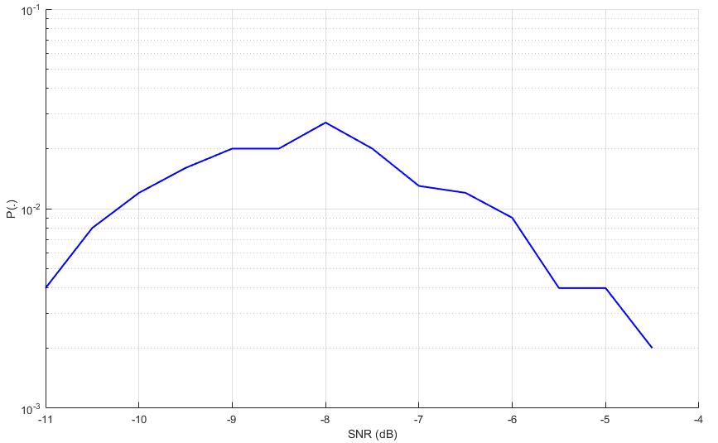
Appendix: Potential Impact at ELR devices
A valid ELR PPDU received at a ELR devices
  Considerable fraction of the PPDU has “Phy version Identifier” field flipped to non-UHR with matched BSS color along with CRC passing.
    The plot shows the probability that the packet is
    classified as non-UHR PPDU when receiving
    UHR-ELR-PPDU.
    Configuration: Ntx = 4, Nrx = 2, ‘D’ channel,
    LSTF, LLTF boosted by 3 dB.
  Consider the following scenario:
    “Phy version Identifier” = x (~=1, decoded falsely), and “number of EHT-SIG symbol” = 1.
    Non-UHR device functionality: Operations related to EHT-STF will start after 4 us from USIG2.
    ELR PPDU is most likely not yet detected.

Slide 11
References
[1] 11-24-0873-02-00bn, “Design Targets and Considerations for Enhanced Long Range”, Jianhan Liu (Mediatek)
[2] 11-24-1410-00-00bn, “Legacy preamble for ELR PPDU”, Ross Jian Yu (Huawei)
[3] 11-24-1232-00-00bn, “Discussions on Extended Long Range PPDU”, Leonardo Lanante (Ofinno)
[4] 11-24-1478-00-00bn, “ELR PPDU design”, Lin Yang (Qualcomm)
[5] 11-24-1571-00-00bn, “Extended Long Range (ELR) Mark Symbol Design”, Rethna Pulikkoonattu (Broadcom Inc)
[6] 11-24-1485-00-00bn, “Considerations for ELR PPDU format”, Dongguk Lim (LG Electronics)
[7] 11-24-0875-01-00bn, “UHR Enhanced Long Range Support”, Rui Cao (NXP).

