Slide 1
An ELR PPDU Follow Up
Date: 2024-09-08
Authors:

Slide 2
Introduction
In [1], [2] and [3], authors proposed to design a PPDU which improve 6 dB link budget over non-HT MCS0 or SU MCS0
In this contribution, how to improve packet detection performance to achieve this goal is discussed

Slide 3
Packet Detection: Case Study (1/3)
In [1], authors mentioned that it is desired to perform packet detection based on the first field, i.e. L-STF, in order not to disrupt CCA procedure
To see the impact of packet detection on different field, a following case study was conducted
Scheme 1: ELR PPDU w/ PD on the first field of a PPDU (e.g. L-STF)
Scheme 2: ELR PPDU w/ PD on the UHR STF (e.g. end of UHR STF at 80 us after the PPDU starts)
Measure time between the first packet (300 us PPDU length) generated by a DUT and received by an AP STA successfully
  Contention including collision + ELR RTS + CTS + ELR PPDU + ACK
Maximum 8 retransmissions
An AP STA and a non-AP STA use default EDCA parameters (Table 9-192 in REVme/D3.1)
There are three non-AP STAs with downlink traffic and one or two non-AP STA(s) with uplink traffic (one of the non-AP STA is a DUT)

Slide 4
Packet Detection: Case Study (2/3)
An AP STA Tx power: 30 dBm, a non-AP STA Tx power: 20 dBm
Center frequency: 5 GHz, Channel B, 4dB Noise Figure
BSS radios: 150 meter, a DUT is at 150 meter from an AP STA, other non-AP STAs (with downlink and uplink traffic) are randomly dropped within a BSS
Packet detection threshold: -87dBm, Edge STA: uplink RSSI is less than packet detection threshold
Traffic model is mix of VI, VO, BE for
  Downlink: Randomly selects traffic pattern from VI, VO and BE
  Uplink non-edge STA: Randomly selects traffic pattern from VI, VO and BE
  Uplink edge STA: Randomly selects traffic pattern from VI and VO

Slide 5
Packet Detection: Case Study (3/3)

Slide 6
Discussion (1/3)
As shown in slide 3-5, it is desired to perform packet detection based on the first field, i.e. L-STF, in order not to disrupt CCA procedure
Typically, a WLAN receiver uses auto-correlation to estimate coarse CFO
  In a very low SNR region, auto-correlation has a limitation
In order to improve PD, a receiver may use cross correlation
  To use cross correlation, the amount of phase difference should be small within the sequence for the correlation
  If a STA can correct CFO before transmission, then the receiver does not need to correct CFO before processing other fields (like TB PPDU transmission)
  At required SNR for downlink SU transmission with MCS0, we can achieve 10 kHz residual CFO at 1%-tile or 6 kHz error at 10%-tile (please refer slide 7)
  Smaller CFO will enable longer sequence to be used for cross correlation

Slide 7
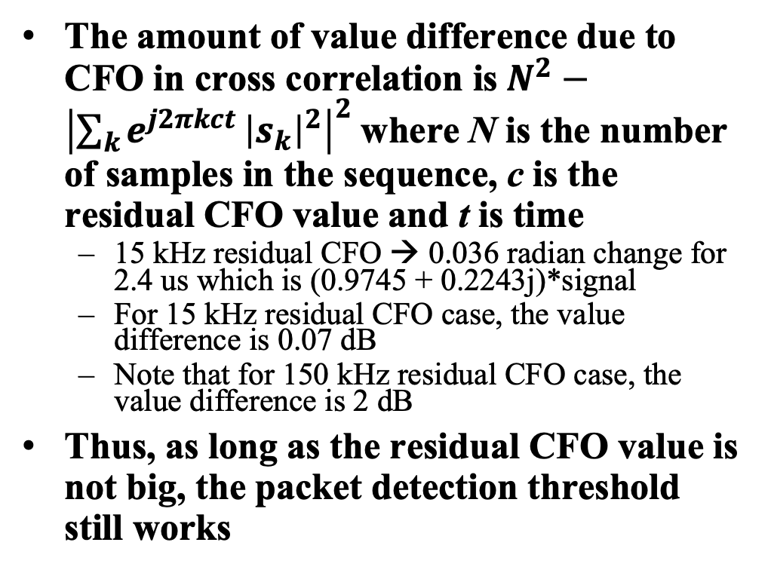
Discussion (2/3)
The amount of value difference due to CFO in cross correlation is$N^{2}−{\left|\sum_{k}{e^{j2πkct}}{\left|s_{k}\right|}^{2}\right|}^{2}$where N is the number of samples in the sequence, c is the residual CFO value and t is time
  15 kHz residual CFO → 0.036 radian change for 2.4 us which is (0.9745 + 0.2243j)*signal
  For 15 kHz residual CFO case, the value difference is 0.07 dB
  Note that for 150 kHz residual CFO case, the value difference is 2 dB
Thus, as long as the residual CFO value is not big, the packet detection threshold still works

Slide 8
Discussion (3/3)
Packet detection algorithm assuming CFO pre-correction meets target performance requirement with 3 dB L-STF and L-LTF boosting
Note that for downlink, non-AP STA can use improved packet detection algorithm (e.g. CFO precorrection at receiver side) which has more than 3 dB margin over MCS0 sensitivity level
 | 1x1 | 2x2 | 2x4
Link Budget Improvement | 8.81 dB | 7.56 dB | 6.34 dB

Slide 9
Conclusion
In this contribution,
  Proposed to perform packet detection based on the first field, i.e. L-STF
  Proposed a preprocessing mechanism for L-STF and L-LTF in ELR PPDU
  Showed that 3 dB boosting with CFO precorrection can achieve 6 dB link budget improvement

Slide 10
SP #1
Do you agree to define an enhanced long range (ELR) PPDU in IEEE 802.11bn with the following targets?
  Downlink and Uplink in 2.4 GHz (within BSS range with 11b beacon)
  Uplink only in 5 GHz and 6 GHz bands
  Minimum data rate is greater than or equal to 1.5 Mbps

Slide 11
SP #2
Do you support adding the following to the spec framework?
  In ELR PPDU, STA boosts L-STF and L-LTF by 3 dB
    For UL, non-AP STA corrects CFO before transmission
    Note: Non-AP STA pre-correction CFO requirement for residual CFO is TBD

Slide 12
References
[1] 11-24/921r0, “An Enhanced Long Range PPDU”
[2] 11-24/873r0, “Design Targets and Considerations for Enhanced Long Range”
[3] 11-24/875r1, “UHR Enhanced Long Range Support”
[4] OFDM Wireless LANs: A Theoretical and Practical Guide 1st Edition by Juha Heiskala (Author), John Terry Ph.D. ISBN-13:978-0672321573
[5] OFDM Baseband Receiver Design for Wireless Communications by Tzi-Dar Chiueh, Pei-Yun Tsai. ISBN: 978-0-470-82234-0

Slide 13
Appendix: Impact of Larger Residual CFO

