Slide 1
Discussion of AMP-SIG Field
Sep. 2024
Date: 2024-09-xx
Authors:
Name | Affiliations | Address | Phone | Email
Bin Qian | Huawei | Shenzhen, China |  | qianbin14@huawei.com
Lei Huang |  | Singapore
Panpan Li |  | Singapore
Wei Lin |  | Shenzhen, China
David, Xun Yang |  | Singapore
Notes:
September 2012

Slide 2
Abstract
Sep. 2024
This contribution aims to discuss the necessity and benefits of including an AMP-SIG field in the AMP PPDU used for downlink data transmission within the 2.4 GHz frequency band

Slide 3
Recap: AMP PPDU for Downlink Data Transmission
Sep. 2024
The AMP PPDU for downlink data transmission has been discussed in [1-4]
This PPDU includes Wi-Fi Preamble field, AMP-Sync field and AMP-Data field, and may include an AMP-SIG field
The Wi-Fi Preamble field is based on OFDM
The AMP-Sync field and AMP-Data field are based on On-Off Keying (OOK)
The potential AMP-SIG field is also based on OOK

Slide 4
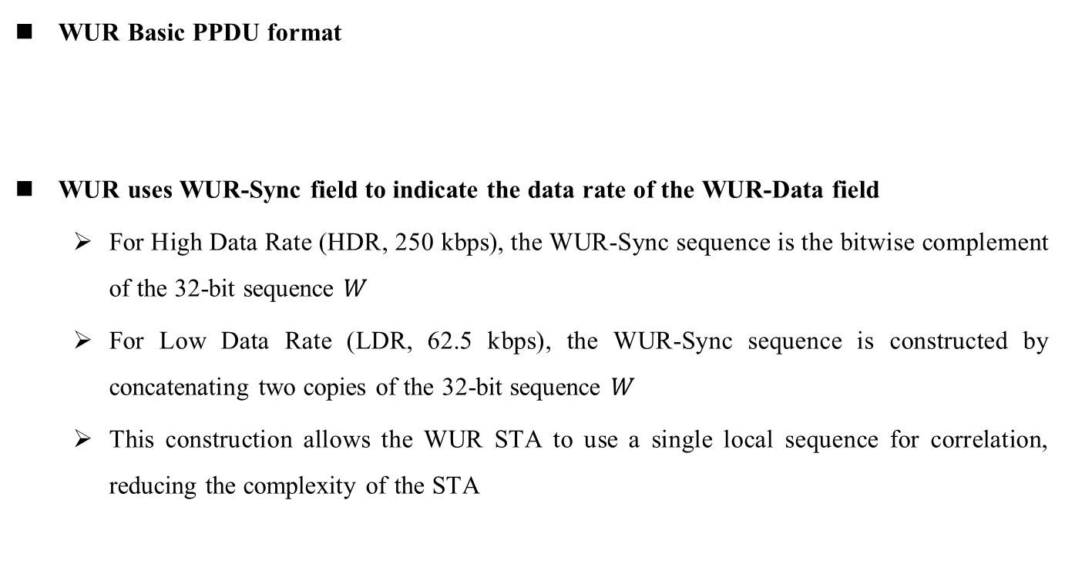
Recap: WUR PPDU
Sep. 2024
WUR Basic PPDU format
WUR uses WUR-Sync field to indicate the data rate of the WUR-Data field
For High Data Rate (HDR, 250 kbps), the WUR-Sync sequence is the bitwise complement of the 32-bit sequence $W$
For Low Data Rate (LDR, 62.5 kbps), the WUR-Sync sequence is constructed by concatenating two copies of the 32-bit sequence $W$
This construction allows the WUR STA to use a single local sequence for correlation, reducing the complexity of the STA

Slide 5
Data Rate Indication Challenges
Sep. 2024
The AMP PPDU for data transmission may support various data rates for different AMP STA capabilities, including enhanced legacy 802.11 devices, active devices, and backscatter devices
Higher data rate (e.g., 1 Mbps) is needed for enhanced legacy 802.11 devices and active devices, especially for integrated energizer deployments [4]
Lower data rates (e.g., 250 kbps and 62.5 kbps) are necessary for backscatter devices, especially for separated energizer deployments to meet the coverage requirement (e.g., several meters) [5]
Increasing the number of supported data rates complicates sync-based data rate indication
This would require more sync sequences, potentially reducing Sync field reliability
The AMP-SIG field can offer clear and reliable data rate indication, surpassing the limitations of sync sequences alone

Slide 6
Benefits of Including AMP-SIG Field
Sep. 2024
Improved data rate indication
Eliminates the need for complex correlation or sequence matching processes, reducing processing requirements and power consumption while enhancing reliability
Inclusion of additional PHY parameters
The SIG field can carry critical parameters like payload length and BSS color, which are essential for accurate interpretation and decoding of the payload by the receiver
A more reliable AMP-SIG field offers better protection for these parameters, minimizing the risk of errors that could occur if these parameters are located in the AMP-Data field
Future proofing
Enables scalability for future updates to the standard, allowing for adaptation without significant hardware changes

Slide 7
Summary
Sep. 2024
We analyzed the necessity and benefit of including the AMP-SIG field in the AMP PPDU for downlink data transmission in the 2.4 GHz frequency band

Slide 8
References
Sep. 2024
[1] 11-24-0847-00bp-initial-thought-on-2.4-ghz-dl-amp-ppdu-design
[2] 11-24-0861-00bp-amp-dl-ppdu-consideration
[3] 11-24-1213-01bp-2.4-ghz-downlink-amp-ppdu-follow-up
[4] 11-24-1345-00bp-high-level-requirements-for-downlink-phy-in-2.4-ghz
[5] 11-24-1215-00-00bp-feasibility-study-on-long-range-backscatter-operation

Slide 9
SP 1
Sep. 2024
Do you support the following text:
The AMP Downlink and Excitation PPDU shall contain an AMP-SIG field for downlink data transmission
Yes:
No:
Abstain:

