Slide 1
Automotive WLAN use case study
Authors:
Name | Affiliation | Address | Phone | Email
Jing Ma | Toyota Motor Corporation | Otemachi Bldg. 6F, 1-6-1 Otemachi, Chiyoda-ku, Tokyo, 100-0004, Japan |  | jing_ma@toyota-tokyo.tech
Jing Ma (Toyota)

Slide 2
Abstract
In the July meeting, IEEE 802.11 WG approved the creation of Automotive (AUTO) TIG to investigate[1]:
Use cases, current and planned mechanisms in 802.11 for vehicle connectivity to external APs
Gaps between requirements and standards for automotive connectivity to external APs
Recommendations to address gaps
An automotive use case study is discussed in this contribution
Jing Ma (Toyota)

Slide 3
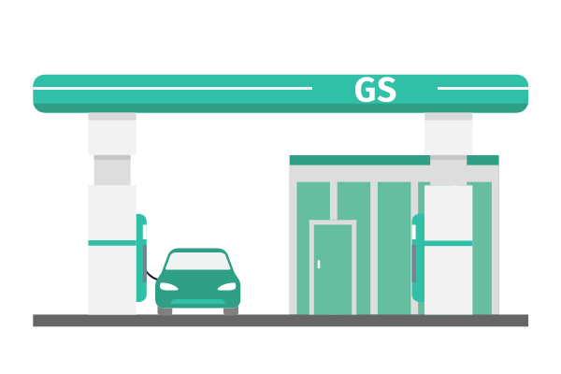
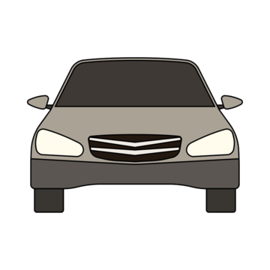
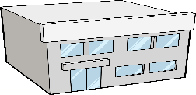
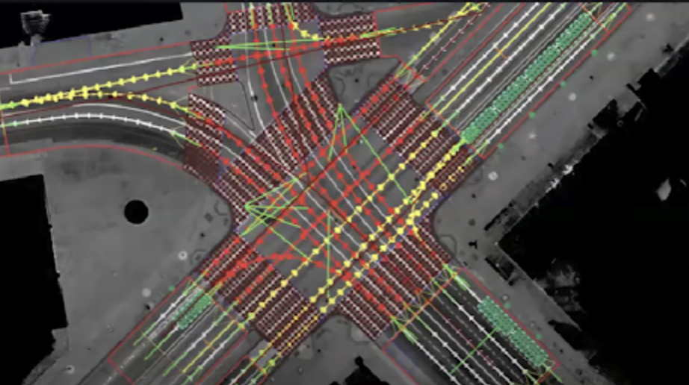
Background
Automotive applications such as Reginal HD Map, remote diagnostics, will need WLAN to provide efficient local connectivity to transfer area of data traffic between vehicles and the cloud
Core & network
Local data exchange between vehicle and WLAN AP
Remote Diagnostics
Data center
Reginal HD MAP
Jing Ma (Toyota)

Slide 4
Use case : Regional HD MAP
This use case focuses on the use of opportunistic Wi-Fi connectivity for vehicles either running or parked within a specific geographic region.
The vehicle connects to local Wi-Fi access points (APs) to transmit environmental data and receive updated high-definition (HD)
map information from the edge cloud.
It can enhance the accuracy and timeliness of
HD maps while utilizing local infrastructure
for efficient data exchange.
Actors: Vehicle, AP, Edge Cloud

Slide 5
Use case : Regional HD MAP
Assumed service level requirement
Scenario 1:
 | Assumed service level requirement
Range | 500m | Urban area
Information requested/ generated [2] | - 100 bytes/ object, - 50 objects detected in vehicle | assumed uplink
 | 5000 objects updates | Assumed downlink
Look-ahead time | 1s prior to entering the interested area
Access network (WLAN)
AP1
16m/s
Upload the detected info.
Download the updated map info.
40kbps
4Mbps

Slide 6
Use case : Regional HD MAP
Assumed service level requirement
Scenario 2
 | Assumed service level requirement
Range | 500m | Urban area
Information requested/ generated[2] | - 100 bytes/ object, - 50 objects detected in vehicle | assumed uplink
 | 5000 objects updates | Assumed downlink
Look-ahead time | 5s
Access network (WLAN)
AP1
16m/s
Upload the detected info.
Download the updated map info.
40kbps
0.34Mbps

Slide 7
Use case : Regional HD MAP
Requirements
Fast & reliable connection setup
Optimize network scanning & selection
Simplify authentication & authentication procedure
Enhance the reliability of frame exchange for
connection setup when vehicle in motion
Fast & seamless AP handover
Connection setup
Data transmission
Access network (WLAN)
AP2
AP1
Wi-Fi
16m/s
AP2
AP1
association
authentication
scanning
Seamless AP handover

Slide 8
Summary
An automotive use case study is discussed in this contribution
We will continue to study the details regarding the requirements of connection setup, handover to support using the opportunistic Wi-Fi connectivity for automotive use case such as regional HD map update
Jing Ma (Toyota)

Slide 9
References
[1] 11-24/415r1 Data offload using WLAN in connected vehicle case, March, 2024
[2] 5gaa-t-200111-tr-c-v2x-use-cases-and-service-level-requirements-vol-i-v3.0

