Slide 1
Seamless Roaming Context Transfer
Date: 2024-11-15
Authors:
Name | Affiliation | Address | Phone | Email
Yelin Yoon | LG Electronics | 19, Yangjae-daero 11gil, Seocho-gu, Seoul 137-130, Korea |  | yl.yoon@lge.com
Insun Jang
 |  |  |  | insun.jang@lge.com
Hongwon Lee
 |  |  |  | hongwon.lee@lge.com
Jinsoo Choi
 |  |  |  | js.choi@lge.com
Sunhee Baek |  |  |  | sunhee.baek@lge.com
Geonhwan Kim |  |  |  | geonhwan.kim@lge.com
Dongju Cha |  |  |  | dongju.cha@lge.com
HanGyu Cho |  |  |  | hg.cho@lge.com
Sanggook Kim |  | 10225 Willow Creek Rd, San Diego, CA, USA |  | sanggook.kim@lge.com

Slide 2
Introduction
The following motion regarding the context transfer has been passed
Define in 11bn that when a non-AP MLD is in the process of roaming from the current AP MLD to a target AP MLD, the context related to the non-AP MLD is transferred to the target AP MLD such that it preserves the data exchange context for the non-AP MLD or the context can be renegotiated with the target AP MLD?
Details on what context can be transferred and what context can be renegotiated are TBD
How to transfer the context is TBD
In this contribution, we want to elaborate on context transfer
We will consider specific context transfer contents and how they can be transferred

Slide 3
Considerations
Non-AP MLD STA re-negotiates with the Target AP MLD after roaming
Some of the features like Block Ack Agreement take some time while re-negotiating which may create an additional delay
Re-negotiation can be avoided if the parameters do not require a further change after roaming
The parameters set at the Serving AP MLD can be transferred to the Target AP MLD
Re-negotiation may be mandatory or optional depending on the situation
As re-negotiation is not a fixed step, an information exchange may be needed to notify what contexts have been transferred and what needs to be re-negotiated
For the discussion on the context transfer, we will focus on the Sequence Number (SN) and the Block Ack Agreement in this contribution
We also want to discuss on two ways of transferring the context which are Over-the-DS and Over-the-Air

Slide 4
Sequence Number (SN)
SN context transfer can be considered in two cases which are DL and UL data transmissions
In a DL data transmission, after roaming, the non-AP MLD needs to receive the packet that corresponds to the next SN value of the lastly received packet from the Serving AP MLD
The Target AP MLD needs to know the next SN value per TID of the lastly transmitted packet
The next SN value is transferred to the Target AP MLD
We think SN context transfer in a DL data transmission should be mandatory
In an UL data transmission, the Target AP MLD needs the next SN value per TID to set the SSN of the Block Ack window size
If the Block Ack Agreement is not re-negotiated
The non-AP MLD does not send the ADDBA Request frame that includes the SN per TID, the SN value needs to be transferred
If the Block Ack Agreement is re-negotiated
The non-AP MLD sends the ADDBA Request. In this case, the SN per TID does not need to be transferred
We think SN context transfer in a UL data transmission can be optional

Slide 5
Block Ack Agreement (1/2)
Block Ack Agreement context transfer can be dealt in two cases where the ADDBA Request is sent from the AP MLD to the non-AP MLD (DL Block Ack Agreement) and where the ADDBA Request is sent from the non-AP MLD to the AP MLD (UL Block Ack Agreement)
If the Block Ack Agreement parameters need to be changed after roaming, re-negotiation is required which means no context transfer and vice versa
In DL Block Ack agreement case, the buffer size and the timeout value are set upon the non-AP MLD STA’s perspective
As the non-AP MLD STA’s features stay the same, a re-negotiation may not be needed after roaming
Transferring the Block Ack parameters per TID for DL such as a buffer size and a timeout value can be a mandatory option
On the other hand, we need more discussion on the case where a non-AP MLD STA wants to change the Block Ack Agreement parameters’ values with the Target AP MLD
In this case, the Block Ack Agreement context transfer needs to be optional
The non-AP STA could notify whether it wants to maintain or update the Block Ack Agreement parameters to the Serving AP MLD in advance

Slide 6
Block Ack Agreement (2/2)
In UL Block Ack Agreement case, the buffer size and the timeout value are set upon the AP MLD’s perspective
The Block Ack parameters of the Target AP MLD can be different from the Serving AP MLD
Assuming that the Serving AP MLD can gather information of the Block Ack Agreement of the Target AP MLD in advance, it can make a decision on the context transfer.
If the Target AP MLD can accept the Block Ack Agreement made between the Serving AP MLD and the non-AP MLD, a re-negotiation may not be needed
The non-AP MLD may also request for the Block Ack Agreement information to the Serving AP MLD to make a decision on the re-negotiation
Context Transfer of the Block Ack Agreement in UL Block Ack Agreement case can be optional

Slide 7
Roaming Request/Response Frames
If the context transfer is optional, the AP MLD and the non-AP MLD may need to exchange information before roaming on what contexts have been transferred
This allows the non-AP MLD and the Target AP MLD to know what needs to be re-negotiated after roaming
This information can be transferred via Roaming Request and Response frames
The information included in the Roaming Request/Response frame
When the Roaming Response frame is sent by the AP MLD, it includes
What contexts have been transferred
What contexts need to be re-negotiated at the Target AP MLD
When the Roaming Request frame is sent by the non-AP MLD STA, it can include
the non-AP MLD’s preference on the context transfer

Slide 8
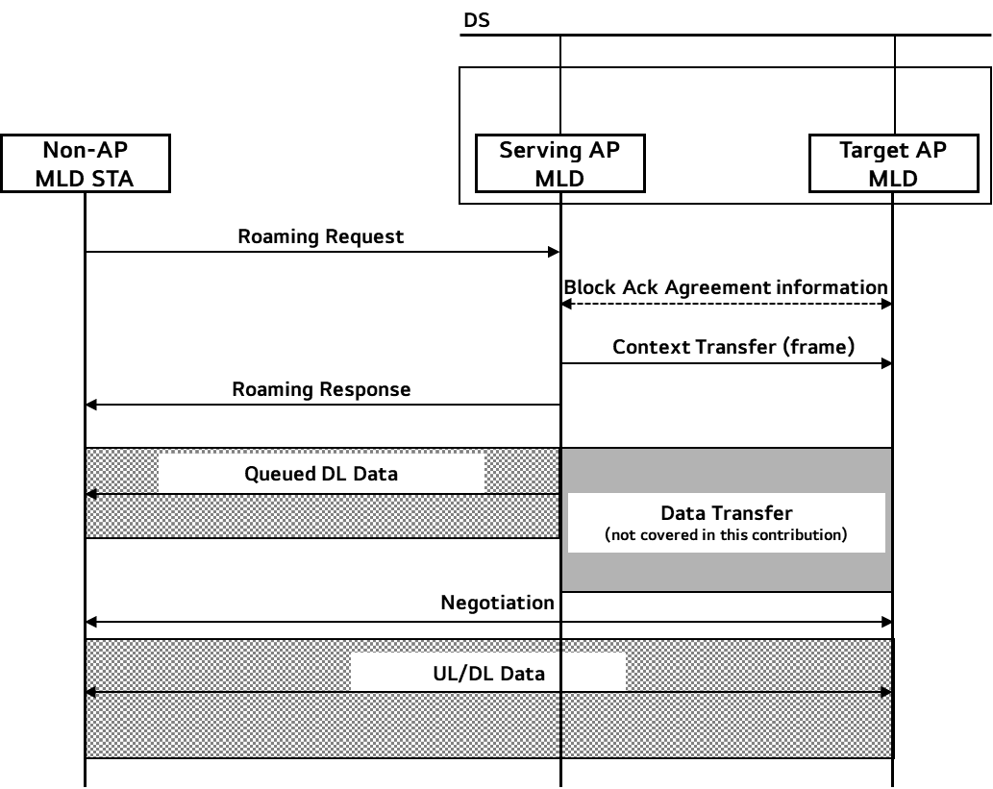
Context Transfer Procedure
The context can be transferred Over-the-Air or Over-the-DS
If the context is transferred Over-the-Air, we need a frame that contains the contexts to be transferred
For the UL Block Ack Agreement case, there may be an additional frame exchanges to provide the current negotiation information of the Target AP MLD to the Serving AP MLD before the context transfer

Slide 9
Conclusion
In this contribution, we have looked at specific parameters that can be transferred through the context transfer
We want to give a flexibility to the context transfer in terms of the type of context that is transferred
The necessity of transferring the context may vary depending on DL and UL scenario and its parameters
We want to use the Roaming Request and Response frames to notify what are transferred through the Context Transfer
We have also considered the scenarios of transferring the context Over-the-Air and Over-the-DS the overall procedure including the context transfer

Slide 10
SP 1
Do you agree to add the following text to the TGbn SFD?
When a non-AP MLD is in the process of roaming from the current AP MLD to a target AP MLD, the SN for DL data shall be transferred to the target AP MLD
The SN value corresponds to the next value of the last SN value of individually addressed data frame per TID assigned at the Serving AP MLD

Slide 11
SP 2
Do you agree to add the following text to the TGbn SFD?
When a non-AP MLD is in the process of roaming from the current AP MLD to a target AP MLD, the SN for UL data can be transferred to the target AP MLD
The SN value per TID of the latest data received from the non-AP MLD STA before the transmission of the Roaming Request frame is transferred
Whether it is mandatory or optional is TBD

Slide 12
SP 3
Do you agree to add the following text to the TGbn SFD?
When a non-AP MLD is in the process of roaming from the current AP MLD to a target AP MLD, the Block Ack Agreement parameters when an ADDBA Request was sent from an AP MLD to a non-AP MLD is transferred
Whether it is mandatory or optional is TBD

Slide 13
SP 4
Do you agree to add the following text to the TGbn SFD?
When a non-AP MLD is in the process of roaming from the current AP MLD to a target AP MLD, the Block Ack Agreement parameters when an ADDBA Request was sent from a non-AP MLD to an AP MLD is transferred
Whether it is mandatory or optional is TBD

Slide 14
SP 5
Do you agree to add the following text to the TGbn SFD?
When a non-AP MLD is in the process of roaming from the current AP MLD to a target AP MLD, after the context transfer, the current AP MLD can inform what contexts have been transferred or what needs to be re-negotiated with the Target AP MLD to the non-AP MLD STA

Slide 15
SP 6
Do you agree to add the following text to the TGbn SFD?
When a non-AP MLD is in the process of roaming from the current AP MLD to a target AP MLD, the non-AP MLD can request what contexts need to be transferred from the Serving AP MLD

