Slide 1
Multi-AP framework for C-SR
Date: 2024-11-11
Authors:
Name | Affiliation | Address | Phone | Email
Geonhwan Kim | LG Electronics | 19, Yangjae-daero 11gil, Seocho-gu, Seoul 137-130, Korea |  | geonhwan.kim@lge.com
Insun Jang |  |  |  | insun.jang@lge.com
Jinsoo Choi |  |  |  | js.choi@lge.com
Sunhee Baek |  |  |  | sunhee.baek@lge.com
Yelin Yoon |  |  |  | yl.yoon@lge.com
Dongju Cha |  |  |  | dongju.cha@lge.com
Hongwon Lee |  |  |  | hongwon.lee@lge.com
Eunsung Park |  |  |  | esung.park@lge.com
Dongguk Lim |  |  |  | dongguk.lim@lge.com
Jinyoung Chun |  |  |  | jiny.chun@lge.com
Insik Jung |  |  |  | insik0618.jung@lge.com
Hangyu Cho |  |  |  | hg.cho@lge.com
Sanggook Kim |  | 10225 Willow Creek Rd, San Diego, CA, USA |  | sanggook.kim@lge.com

Slide 2
Introduction
Based on the high-level motions regarding Multi-AP coordination (MAPC) passed so far [1], we can now move on to defining the Multi-AP framework for each specific scheme.
  We believe that some Multi-AP schemes consist of a common framework and a scheme-specific framework.
    The common framework includes the MAPC discovery procedure and the MAPC agreement negotiation procedure [2].
In this contribution, we focus on a Multi-AP framework for Co-SR.
  The proposed Multi-AP framework for Co-SR consists of common parts and scheme-specific parts.
    The common parts may be implemented/performed in all the schemes (e.g., Co-SR/BF/TDMA).
    On the other hand, the scheme-specific parts may not be performed as needed.
We also present examples of trigger frame formats for Co-SR and potential contents that could be included in those trigger frames.

Slide 3
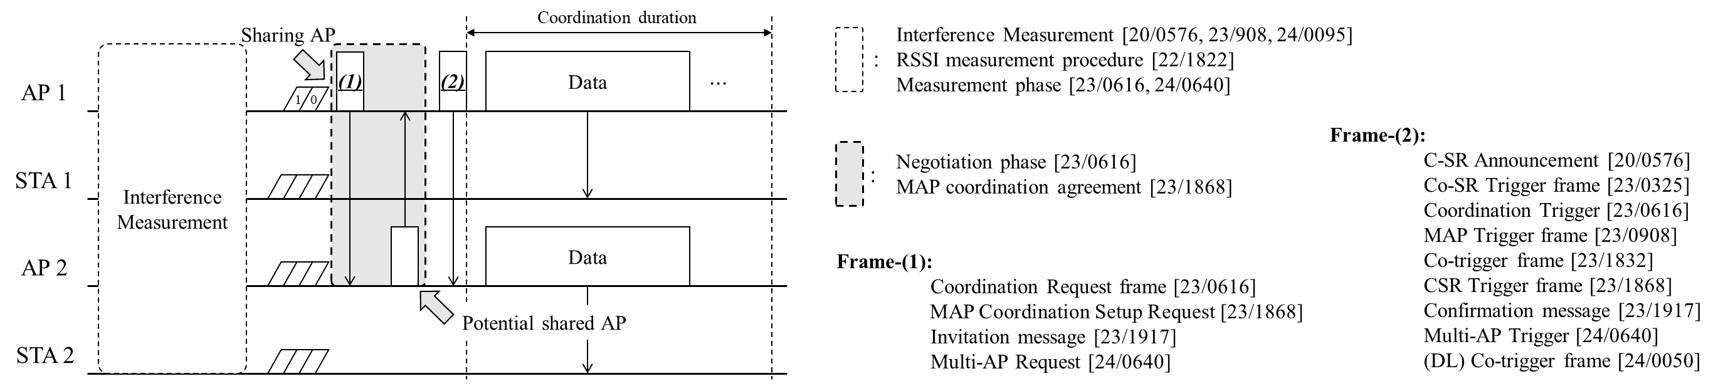

Recap: Coordinated SR
Co-SR is a simpler than Co-BF in that it does not require strict timing synchronization and CSI collection [3, 4].
  The AP only needs to know RSSI information of interference link and estimated SINR of the target In-BSS STA.
  To collect RSSI information, all participating APs perform an interference measurement (IM) procedure [3, 5$−$9].
Beacon request/response [6] and OBSS channel sounding [10] can be considered as interference measurement method for Co-SR, but the details of the IM procedure seem to require further discussion.
The overall Co-SR procedure proposed in several contributions can be described/summarized as follows:
Co-SR/BF are expected to have similar framework except for the details in the IM procedure.

Slide 4
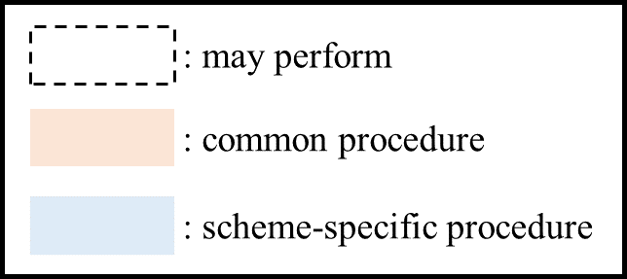
Multi-AP framework for Co-SR (1/2)
Co-SR/BF and Co-TDMA can have a common/scheme-specific Multi-AP framework consisting of multiple procedures.
  Once a common Multi-AP framework is designed, it may be easy to deploy newly designed MAPC schemes in the future.
  Additionally, each AP can dynamically select a more efficient scheme depending on the situations, such as topology.
Below we present a Multi-AP framework that can be commonly applied to TXOP-level MAPC schemes and illustrate it from the operational perspective of Co-SR.

Slide 5
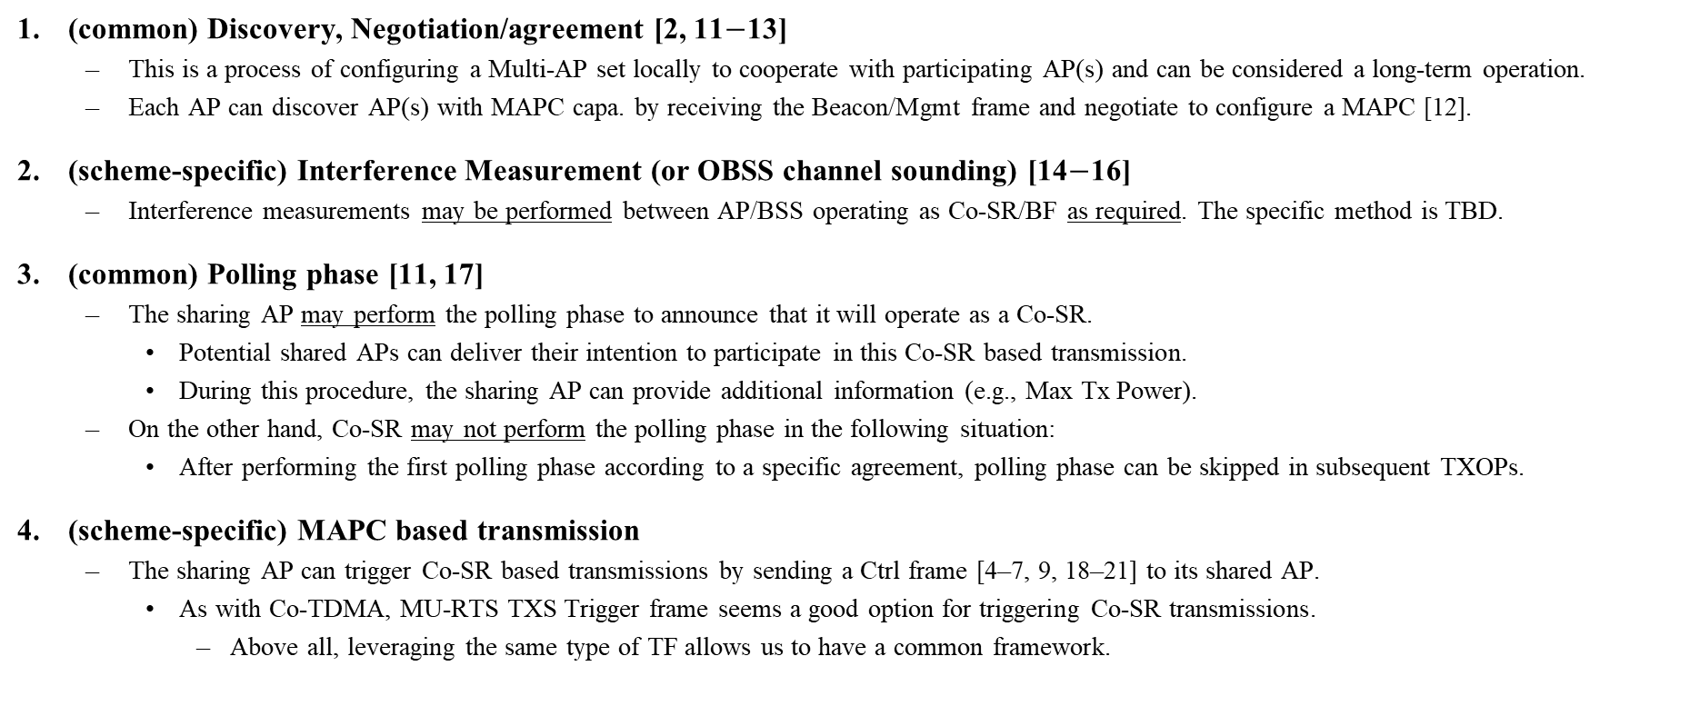
Multi-AP framework for Co-SR (2/2)
(common) Discovery, Negotiation/agreement [2, 11$−$13]
  This is a process of configuring a Multi-AP set locally to cooperate with participating AP(s) and can be considered a long-term operation.
  Each AP can discover AP(s) with MAPC capa. by receiving the Beacon/Mgmt frame and negotiate to configure a MAPC [12].
(scheme-specific) Interference Measurement (or OBSS channel sounding) [14$−$16]
  Interference measurements may be performed between AP/BSS operating as Co-SR/BF as required. The specific method is TBD.
(common) Polling phase [11, 17]
  The sharing AP may perform the polling phase to announce that it will operate as a Co-SR.
    Potential shared APs can deliver their intention to participate in this Co-SR based transmission.
    During this procedure, the sharing AP can provide additional information (e.g., Max Tx Power).
  On the other hand, Co-SR may not perform the polling phase in the following situation:
    After performing the first polling phase according to a specific agreement, polling phase can be skipped in subsequent TXOPs.
(scheme-specific) MAPC based transmission
  The sharing AP can trigger Co-SR based transmissions by sending a Ctrl frame [4–7, 9, 18–21] to its shared AP.
    As with Co-TDMA, MU-RTS TXS Trigger frame seems a good option for triggering Co-SR transmissions.
      Above all, leveraging the same type of TF allows us to have a common framework.

Slide 6
Expected frame exchange sequence for Co-SR
Potential contents in ICF
  MAPC Scheme: Co-SR, Co-BF, Co-TDMA, etc.
  Max Tx Power: Indicates the Tx power of the sharing AP.
    This is used to calculate the interference level caused by the sharing AP at the target STA of the shared AP.
  Bandwidth & Punctured Channel Information: BW/puncturing pattern of DL PPDU transmitted by each AP during Co-SR transmission.
Potential contents in ICR
  Participation Indicator (or Status Code)
  Target STA’s Version (i.e., either EHT or UHR)
Potential contents in Co-Triggering frame
  Co-SR Mode: Indicates Mode 1 or 2 as described in Motion 252 [1].
  Recommended Tx Power: Tx power of the shared AP shall be less than or equal to the Recommended Tx power.
    This is used to limit the interference level caused by the shared AP at the target STA of the sharing AP.
  Common L-SIG & U-SIG Info (TBD): It is required for Co-SR PPDU transmitted during Co-SR transmission.
*The case where EMLSR/DPS non-AP STAs participate in Co-SR transmission is discussed in the Appendix.

Slide 7
ICF format for Co-SR
BSRP TF can be used as ICF in Co-SR as well, and MAPC-related info can be delivered to multiple APs.
To include MAPC-related info, we can define a new (UHR) Special User Info field. ➔ Opt 1
  It consists of AID12 (e.g., 2008), Control Info Type, and Control Info field [22].
    If the Control Info Type indicates that the type is MAPC, the Control Info provides MAPC-related info.
      Or, the Control Info Type indicates that this BSRP TF is sent as an ICF for MAPC, the Control Info provides ICF info for MAPC.
    The Control Info field contains a MAPC Type field, which specifies the MAPC type (i.e., Co-SR).
Alternatively, if the ICF is sent to a single AP or an AP that does not support TB response, reserved fields in Common Info field of the BSRP (GI 3) TF can be used to include theses info. ➔ Opt 2
  Opt 2 is somewhat limited only for single recipient, so it is better to define a new Special User Info field in ICF and use it.
Opt 1) Use a new (UHR) Special User Info field
Opt 2) Use Reserved bits in Common Info field

Slide 8
Co-Triggering frame format for Co-SR
As with Co-TDMA, MU-RTS TXS TF could also be used to trigger Co-SR transmission.
  However, while Co-TDMA solicits a CTS frame, the concurrent Co-SR transmission starts SIFS after the TF [1; M #253].
TXS Mode 3 can be defined not to solicit a response frame (e.g. CTS) for Co-SR/BF purpose.
  The User Info field of MU-RTS (TXS 3) TF is redesigned to include the info. required for Co-SR transmission. ➔ Opt 1
  Alternatively, if there is AP-specific info. (e.g., Recommended Tx Power), both the User Info field and Special User Info fields may be used. ➔ Opt 2
  As a third option, the User Info field is reserved and only Special User Info field can be used.
Opt 1) Redesign User Info field
Opt 2) Use both the User Info & new Special User Info
Opt 3) Use only the new Special User Info field

Slide 9
Summary
In this contribution, we share our views on the procedures required for Co-SR based on a common framework in Multi-AP coordination.
We believe that Co-SR should perform a polling phase to deliver its intention to participate in the coordination-based transmission of the polled AP.
Also, some examples of ICF/Co-Triggering frame formats for Co-SR are presented.
  Co-SR sharing AP transmits BSRP TF as an ICF.
  Co-SR sharing AP transmits MU-RTS TXS TF as Co-Triggering frame.
Further discussion is needed regarding the detailed signaling method and TBD information.

Slide 10
References
[1] 25/14, “TGbn Motions List - Part 2”
[2] 23/1871, “M-AP Coordinated Transmission framework”
[3] 22/1822, “Recap on Coordinated Spatial Reuse Operation”
[4] 23/325, “Coordinated Spatial Reuse for UHR”
[5] 20/576, “Coordinated Spatial Reuse Protocol”
[6] 23/616, “Overhead Analysis of Coordinated Spatial Reuse”
[7] 23/908, “Efficient Coordinated Spatial Reuse”
[8] 24/95, “Efficient Coordinated Spatial Reuse Follow Up”
[9] 24/640, “Consideration on C-SR Types”
[10] 20/123, “Channel Sounding for Multi-AP CBF”
[11] 23/1912, “Coordinated TDMA Procedure”
[12] 24/842, “Multi-AP set configuration for C-TDMA”
[13] 24/1220, “A Framework for Coordinated Access Points”
[14] 24/1542, “Sounding Schemes for Coordinated Beamforming”
[15] 24/1568, “Sounding Design for C-BF”
[16] 24/1582, “Coordinated Sounding for CoBF”
[17] 24/843, “Some details on TXOP sharing in C-TDMA”
[18] 23/1832, “Multi-AP Coordinated Spatial Reuse”
[19] 23/1868, “Coordinated-Spatial-Reuse-Design”
[20] 23/1917, “Coordinated Spatial Reuse”
[21] 24/50, “Coordinated Spatial Reuse Types”
[22] 24/1464, “Discussion on ICF”

Slide 11
Straw Poll 1
Do you agree to add the following text to the TGbn SFD?
  A TXOP owner AP announces its intention to initiate Co-SR in an Initial Control frame (exact ICF and name TBD) sent at the beginning of the TXOP. The frame polls AP(s) that can operate together as a Co-SR to determine their interest.
    A TXOP owner AP that intends to initiate Co-SR is referred to as a sharing AP.
    A candidate AP identified (polled) in the Initial Control frame is referred to as a polled AP.
    The Duration field of the frame is set to the length of time required to transmit the solicited response frame plus one SIFS.
    Whether or not the sharing AP is mandated to send the Initial Control frame that announces that intention is TBD.
Reference: based on Motion #156

Slide 12
Straw Poll 2
Do you agree to add the following text to the TGbn SFD?
  As part of the Co-SR/BF procedure, to trigger Co-SR/BF PPDU transmissions, a sharing AP shall send an MU-RTS TXS Trigger frame to another non-collocated AP.
    The MU-RTS TXS Trigger frame does not solicit a response from that another non-collocated AP.
Reference: based on Motion #159

Slide 13
Appendix:
Co-SR sequence considering EMLSR/DPS STA
When an EMLSR/DPS non-AP STA participates in a Co-SR transmission, additional ICF/ICR exchanges may be required to transition from listen/low capability mode to frame exchange/high capability mode.
If the polling phase is performed only between two APs, each AP can exchange ICF/ICR sequentially with its target EMLSR/DPS In-BSS STA in SIFS interval.
However, if the sharing AP polls more than one AP, the polled APs cannot know which AP will become the shared AP.
There may also be a situation where STA 1 is hidden from the shared AP and cannot overhear the ICR.
Therefore, in Co-SR transmission:
  Opt 1) An EMLSR/DPS non-AP STAs may be excluded.
  Opt 2) Each AP transmits an ICF or Co-Triggering frame based on an estimate that takes into account the hidden node problem.

