Slide 1
Downlink link budget of passive receivers
Date: 2024-09-09
Authors:

Slide 2
Abstract
We present an example for link budget of downlink reception of AMP-only devices along with RF energizing and energy storage
We present the passive receiver as an example. We do not consider active receivers in this contribution.
This is purposed mainly for AMP-only devices with active transmitters and long distance backscatters that have RF harvesting and energy storage capabilities

Slide 3
Downlink Sensitivity Requirements of AMP-Only Devices
We assume integrated energizer for this sensitivity analysis
  Other cases can be considered as well
We use Friis channel:
  Other flat fading
  channels can be
  considered as well
  Outage probability
  requirements need to be
  agreed for fast/slow fading
  channels
We suggest that at least one tag reception mode to have communication receive sensitivity of -54dBm
  Lower RF harvesting sensitivity of -45dBm is achievable, taking longer charge times – but we suggest to focus on higher sensitivity
 | Communication Link | RF Harvesting
Reader EIRP[dBm] | 20 | 30
Frequency [GHz] | 2.4 | 0.9
distance [m] | RSSI [dBm] | Pin [dBm] @ tag
1 | -20 | -2
4 | -32 | -14
10 | -40 | -22
50 | -54 | -36

Slide 4
Downlink Reception Energy Budget
Downlink should not use much more energy than uplink - avoid longer charging times
Considering interference and protocol limitations, we assume that AMP device will need to receive more messages than to transmit
Thus we suggest budgeting no more than 1/5 of uplink energy per downlink reception
From examples for uplink energy budget ([1]) we budget the downlink reception energy to
0.4-0.8nJ
Uplink bitrate [Mbps] | 1 | 2 | 4 | 8 | 16
Energy uplink [nJ] | 31.62 | 15.81 | 7.91 | 3.95 | 1.98
Energy downlink budget [nJ] | 6.4 | 3.2 | 1.6 | 0.8 | 0.4

Slide 5
Passive Reception of OOK-Manchester
Many receiver architectures have been suggested for low energy reception.
See [2] for a recent survey, as well as [3-4] for some examples.
We propose the use of passive reception for downlink in AMP-only devices.
Our analysis showed these receivers can reach the lowest energy consumption per bit, while still providing ballpark sensitivity.
We use OOK-Manchester since it is robust and symmetric.

Slide 6
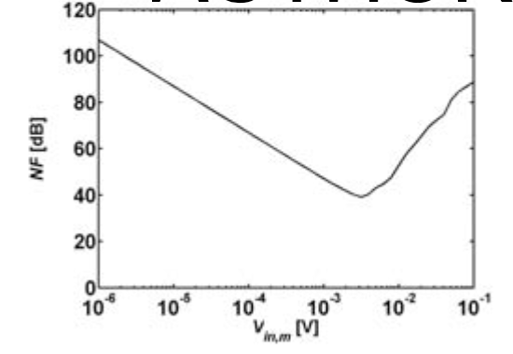
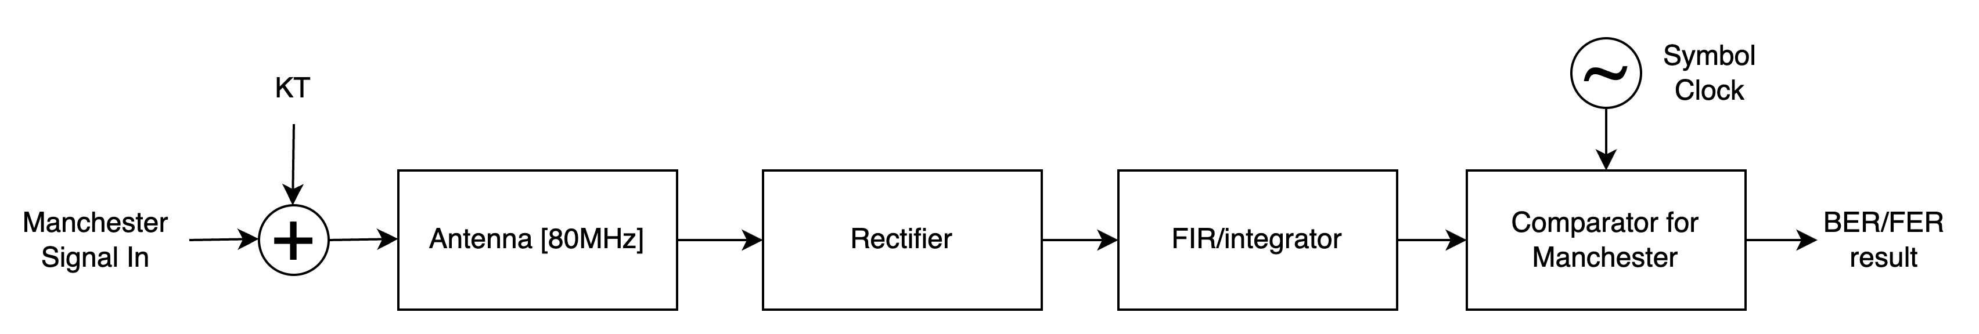
Passive Reception Properties
Very few active components, no low noise amplifiers (LNAs), no mixers, no LO
Amplifications comes from voltage amplification.
→ Noise figure (NF) depends on input signal power (e.g. [5])
Passive mixing done by a rectifier.
Baseband is done by a passive FIR or an Integrator.
Modest filtering in RF

Slide 7
Example for Passive Reception Link Budget
KT | -174 | dBm/Hz
SNR | 12 | dB
Noise figure changes as
function of input power
3dB loss due to Manchester encoding is also included
No phase noise or clock instabilities were assumed for the link budget
Estimated energy budget for reception of 32 bits: 0.4nJ
DataRate [Mbps] | 0.0625 | 0.25 | 0.5 | 1
BW [MHz] | 0.125 | 0.5 | 1 | 2
sensitivity [dBm] | -58.69 | -54.67 | -52.67 | -50.66
NF [dB] | 52.34 | 50.34 | 49.33 | 48.33

Slide 8
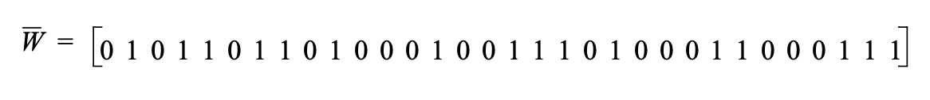
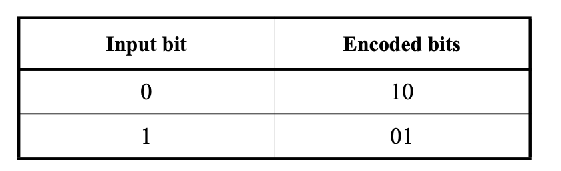
Sync Field Processing
802.11ba used different coding for the sync and the data fields
For data it used Manchester encoding while for the sync, no such encoding was used.
Since AMP-only receiver is expected to be very simple, it is suggested to keep the same modulation for the sync field and to avoid the need to implement new receiver circuitry for sync processing.
Thus we suggest to use Manchester coding also for the sync field.
802.11ba HDR-sync
Non Manchester
802.11ba HDR-data

Slide 9
References
[1] 11-24-1497-00-00bp Uplink Rates for Active Transmission
[2] David D. Wentzloff, “Low Power Radio Survey,” [Online]. www.eecs.umich.edu/wics/low_power_radio_survey.html
[3] Moody et al. Interference Robust Detector-First Near-Zero Power Wake-Up Receiver, IEEE JSSC, VOL. 54, NO. 8, AUGUST 2019
[4] Yang et al. A ULP Long-Range Active-RF Tag with Automatic Antenna- Interface Calibration Achieving 20.5% TX Efficiency at -22dBm EIRP, and -60.4dBm Sensitivity at 17.8nW RX Power, ISSCC 2023
[5] Ou et al, A CMOS Envelope Detector for Low Power Wireless Receiver Applications. 2018 16th IEEE International New Circuits and Systems Conference (NEWCAS), Jun 2018, Montréal, Canada. 10.1109/newcas.2018.8585458 . hal-01789807

Slide 10
Strawpoll #1
Do you agree that 11bp defines a new sync field for downlink PHY with the same modulation and coding as the data field?
Answer:
Y
N
Abstain

