Slide 1
PPDUs in AMP
Sep. 2024
Date: 2024-09-03
Authors:
Name | Affiliations | Address | Phone | Email
Bin Qian | Huawei | Shenzhen, China |  | qianbin14@huawei.com
Lei Huang |  | Singapore
Panpan Li |  | Singapore
Wei Lin |  | Shenzhen, China
David, Xun Yang |  | Singapore
Notes:
September 2012

Slide 2
Abstract
Sep. 2024
This contribution provides an overview of the PPDU categories to be utilized by enhanced legacy 802.11 devices, active devices, mono-static backscatter, and bi-static backscatter within TGbp

Slide 3
AMP Downlink and Excitation PPDU (DE-PPDU)
Sep. 2024
The AMP DE-PPDU unifies downlink data transmission and the provision of excitation signals for backscatter communication in a single, versatile PPDU format
Key components of AMP DE-PPDU example
Legacy Preamble: Detected by third party devices for better coexistence
AMP-Sync: Provides synchronization for the entire PPDU
AMP-SIG: Contains control information, such as MCS and payload length, crucial for decoding the AMP-Data
AMP-Data: Carriers the actual data payload, with its specific design depending on the AMP STA’s capability
Excitation Symbols: Provides the carrier signal for backscatter communication

Slide 4
AMP DE-PPDU (1/3)
Sep. 2024
Scenario 1: Downlink data transmission
The AMP DE-PPDU could be used solely for downlink data transmission from the AP to AMP STAs [1-4]
Applicable Devices: Enhanced 802.11 legacy devices, active devices, and backscatter devices
In this use case, the Excitation Symbols are not present, focusing exclusively on data transmission

Slide 5
AMP DE-PPDU (2/3)
Sep. 2024
Scenario 2: Excitation Signal Provision
The AMP DE-PPDU serves as the input carrier for backscatter devices, enabling communication by reflecting this carrier
Only the Legacy Preamble and Excitation Symbols are present; AMP-SYNC, AMP-SIG and AMP-Data fields are not present
Applicable to both mono-static and bi-static backscatter scenarios
In bi-static backscatter case, the carrier source (i.e., non-AP STA), separate from the AP, transmits the AMP DE-PPDU

Slide 6
AMP DE-PPDU (3/3)
Sep. 2024
Scenario 3: Combined downlink Data and Excitation Signal Transmission
The PPDU includes the Legacy Preamble, AMP-SYNC, AMP-SIG, AMP-Data, and Excitation Symbols
This use case integrates all fields, making it suitable for comprehensive communication and backscatter needs
Applicable to both mono-static and bi-static backscatter scenarios
In bi-static backscatter case, the carrier source (i.e., non-AP STA), separate from the AP, transmits the AMP DE-PPDU

Slide 7
AMP Uplink PPDU
Sep. 2024
The UL PPDU is used for data transmission from the AMP STAs to the AP, primarily applicable to active devices
For enhanced 802.11 legacy devices, the uplink data transmission relies on existing 802.11 standards [6]
For backscatter devices, the uplink data transmission is not independent but depends on the input carrier symbols (i.e., Excitation Symbols)
UL PPDU example
Active devices may not be able to transmit the Legacy Preamble

Slide 8
AMP WPT PPDU
Sep. 2024
The WPT PPDU facilitates wireless power transfer to various devices, including enhanced 802.11 legacy devices and active devices
The WPT PPDU operates in sub-1 GHz frequency range
The specific format of the WPT PPDU is TBD

Slide 9
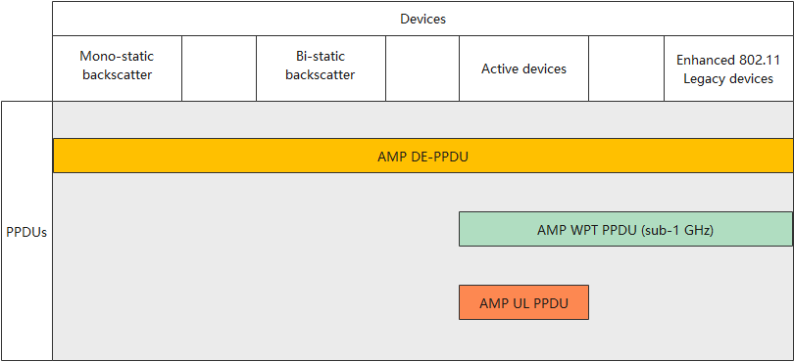
Device Capabilities and Their PPDUs
Sep 2024

Slide 10
Summary
Sep. 2024
In this contribution, we aim to illustrate the relationship between different AMP STA capabilities and the specific PPDUs they utilize

Slide 11
References
Sep. 2024
[1] 11-24-0847-00bp-initial-thought-on-2.4-ghz-dl-amp-ppdu-design
[2] 11-24-0861-00bp-amp-dl-ppdu-consideration
[3] 11-24-1213-01bp-2.4-ghz-downlink-amp-ppdu-follow-up
[4] 11-24-1345-00bp-high-level-requirements-for-downlink-phy-in-2.4-ghz
[5] 11-24-1236-00bp-close-range-backscattering-waveform-and-modulation
[6] 11-24-1263-00-00bp-amp-supported-legacy-mode

Slide 12
SP 1
Sep. 2024
Do you agree with the following text:
IEEE 802.11bp shall specify, in 2.4 GHz, an AMP Downlink and Excitation PPDU that contains a Legacy Preamble field, and optionally one or more of an AMP-Sync field, an AMP-Data field, and an Excitation field. Inclusion of an AMP-SIG field is TBD.
Note, the details of the Legacy Preamble field are TBD
For combined downlink data and excitation signal transmission, there can be multiple segments of the AMP-Data field and the Excitation field
Yes:
No:
Abstain:

Slide 13
SP 2
Sep. 2024
Do you agree with the following text:
IEEE 802.11bp shall specify, in 2.4 GHz, an AMP uplink PPDU that contains an AMP-Sync field and an AMP-Data field. Inclusion of an AMP-SIG field in AMP uplink PPDU is TBD
Yes:
No:
Abstain:

Slide 14
SP 3
Sep. 2024
Do you agree with the following text:
IEEE 802.11bp shall define an AMP wireless power transfer (WPT) PPDU in sub-1 GHz frequency band
The AMP WPT PPDU format is TBD
Yes:
No:
Abstain:

