Slide 1
PPDUs in AMP
Sep. 2024
Date: 2024-09-03
Authors:
Name | Affiliations | Address | Phone | Email
Bin Qian | Huawei | Shenzhen, China |  | qianbin14@huawei.com
Lei Huang |  | Singapore
Panpan Li |  | Singapore
Wei Lin |  | Shenzhen, China
David, Xun Yang |  | Singapore
Notes:
September 2012

Slide 2
Abstract
Sep. 2024
This contribution provides an overview of the PPDU categories to be utilized by enhanced legacy 802.11 devices, active devices, mono-static backscatter, and bi-static backscatter within TGbp

Slide 3
AMP Downlink and Carrier PPDU (DC-PPDU)
Sep. 2024
The AMP DC-PPDU unifies downlink data transmission and the provision of a carrier signal for backscatter communication in a single, versatile PPDU format
Key components of AMP DC-PPDU example
Wi-Fi Preamble: Detected by third party devices for better coexistence
AMP-Sync: Provides synchronization for the entire PPDU
AMP-SIG: Contains control information, such as MCS and payload length, crucial for decoding the AMP-Data
AMP-Data: Carriers the actual data payload, with its specific design depending on the AMP STA’s capability
Energizer Symbols: Provides the carrier signal for backscatter communication

Slide 4
AMP DC-PPDU (1/3)
Sep. 2024
Scenario 1: Downlink data transmission
The AMP DC-PPDU could be used solely for downlink data transmission from the AP to AMP STAs [1-4]
Applicable Devices: Enhanced 802.11 legacy devices, active devices, and backscatter devices
In this use case, the Energizer Symbols are not present, focusing exclusively on data transmission

Slide 5
AMP DC-PPDU (2/3)
Sep. 2024
Scenario 2: Carrier Signal Provision
The AMP DC-PPDU serves as the input carrier for backscatter devices, enabling communication by reflecting this carrier
Only the Wi-Fi Preamble and Energizer Symbols are present; AMP-SYNC, AMP-SIG and AMP-Data fields are not present
Applicable to both mono-static and bi-static backscatter scenarios
In bi-static backscatter case, the carrier source (i.e., non-AP STA), separate from the AP, transmits the AMP DC-PPDU

Slide 6
AMP DC-PPDU (3/3)
Sep. 2024
Scenario 3: Combined downlink Data and Carrier Signal Transmission
The PPDU includes the Wi-Fi Preamble, AMP-SYNC, AMP-SIG, AMP-Data, and Energizer Symbols
This use case integrates all fields, making it suitable for comprehensive communication and backscatter needs
Applicable to both mono-static and bi-static backscatter scenarios
In bi-static backscatter case, the carrier source (i.e., non-AP STA), separate from the AP, transmits the AMP DC-PPDU

Slide 7
AMP Uplink PPDU
Sep. 2024
The UL PPDU is used for data transmission from the AMP STAs to the AP, primarily applicable to active devices
For enhanced 802.11 legacy devices, the uplink data transmission relies on existing 802.11 standards [6]
For backscatter devices, the uplink data transmission is not independent but depends on the input carrier symbols (i.e., Energizer Symbols)
UL PPDU example
Active devices may not be able to transmit the Wi-Fi Preamble

Slide 8
AMP WPT PPDU
Sep. 2024
The WPT PPDU facilitates wireless power transfer to various devices, including enhanced 802.11 legacy devices and active devices
The WPT PPDU operates in sub-1 GHz frequency range
The specific format of the WPT PPDU is TBD

Slide 9
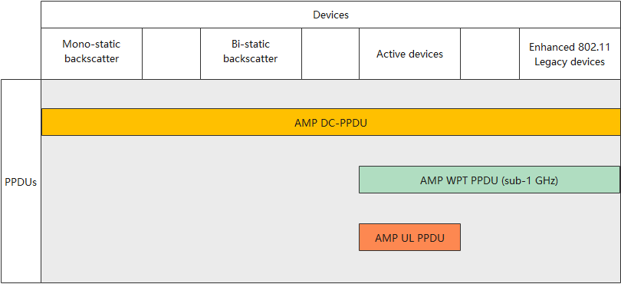
Device Capabilities and Their PPDUs
Sep 2024

Slide 10
Summary
Sep. 2024
In this contribution, we aim to illustrate the relationship between different AMP STA capabilities and the specific PPDUs they utilize

Slide 11
References
Sep. 2024
[1] 11-24-0847-00bp-initial-thought-on-2.4-ghz-dl-amp-ppdu-design
[2] 11-24-0861-00bp-amp-dl-ppdu-consideration
[3] 11-24-1213-01bp-2.4-ghz-downlink-amp-ppdu-follow-up
[4] 11-24-1345-00bp-high-level-requirements-for-downlink-phy-in-2.4-ghz
[5] 11-24-1236-00bp-close-range-backscattering-waveform-and-modulation
[6] 11-24-1263-00-00bp-amp-supported-legacy-mode

Slide 12
SP 1
Sep. 2024
Do you support that 11bp shall define an AMP Downlink and Carrier PPDU (DC-PPDU) applicable to enhanced 802.11 legacy devices, active devices, and backscatter devices in 2.4 GHz frequency band
Yes:
No:
Abstain:

Slide 13
SP 2
Sep. 2024
Do you support that 11bp shall define an AMP uplink PPDU applicable to active devices in 2.4 GHz frequency band
Yes:
No:
Abstain:

Slide 14
SP 3
Sep. 2024
Do you support that 11bp shall define an AMP wireless power transfer (WPT) PPDU applicable to enhanced 802.11 legacy devices and active devices in sub-1 GHz frequency band
Yes:
No:
Abstain:

