Slide 1
More Consideration of ICR/CRF for in-device-coexistence
Date: 2024-11-13
Authors:
Name | Affiliation | Address | Phone | Email
Hongwon Lee | LG Electronics | 19, Yangjae-daero 11gil, Seocho-gu, Seoul 137-130, Korea |  | hongwon.lee@lge.com
Insun Jang |  |  |  | insun.jang@lge.com
Geonhwan Kim |  |  |  | geonhwan.kim@lge.com
Jinsoo Choi |  |  |  | js.choi@lge.com
Sunhee Baek |  |  |  | sunhee.baek@lge.com
Yelin Yoon |  |  |  | yl.yoon@lge.com
Dongju Cha |  |  |  | dongju.cha@lge.com
HanGyu Cho |  |  |  | hg.cho@lge.com
Sanggook Kim |  | 10680 Treena St, San Diego CA 92131 , USA |  | sanggook.kim@lge.com

Slide 2
Introduction
The Motion related to defining mechanism for a non-AP STA to report unavailability at TXOP level, which is related to aperiodic in-device-coexistence(IDC) signaling, was passed in July F2F meeting
Enhancing Multi-STA BA(M-BA) is one of the good options for ICR/CRF to perform aperiodic IDC signaling due to it’s flexibility [1]~[5]
We believe that M-BA with in-device coexistence is option not only for ICR but also CRF. We are considering additional options for ICR and/or CRF in various use cases
This contribution discusses several options for ICR/CRF in multiple use cases

Slide 3
Recap: ICR Considerations [1]
In terms of Multi-STA BA, it should be carefully designed due to AID TID Info
Depending on values of AID TID Info field, Per AID TID Info length is determined
Therefore, we can use a special AID (e.g., 2007) while keeping existing values of TID/Ack type fields that will determine a container size including IDC Info (e.g., 2 octets + 4 octets)
If we consider SU only, TID/Ack type can have other special values
Different control information as well as IDC Info could be delivered if we generalize it
Allow a frame including one or more Control Info(s) (e.g., Action frame, BA)
E.g., By having an Action frame for Control Info in response to BSRP TF, the Action frame can include BSR in A-control and other control info(s) in Body

Slide 4
Recap: ICR Frame Choice [2]
By reviewing the structure of the existing control frames, Multi-STA BA (M-BA) is seen to be the best candidate frame:
Includes the “Per AID TID Info” field which have plenty of room in replacement of the BA bitmap information.
Very flexible with capability to include multiple “Per AID TID Info” fields each having a variable size “BA Bitmap” subfield.
An already existing frame.

Slide 5
More consideration of ICR for in-device-coexistence
Some Trigger frame such as BSRP can be ICF, and M-BA or new Action frame can be ICR to report unavailability
We need to consider including the Trigger frame response(e.g. BSR) and unavailability information (IDC Info) together in some cases
There are several options for including response information(e.g. BSRP + BSR and/or IDC Info) in M-BA
Option 1: new Ack Type + TID combination in AID TID Info + Fragment Number
It is applicable only to UHR devices and is not backward compatible (SU Only)
Option 2: Special AID value in AID TID Info + Fragment Number (Preferred)
It can be used with both UHR and legacy devices in multi-user case (SU and MU)
New Action frame can be one option of ICR
Option 3: New Action frame with A-Control to include control information and IDC Info together
It is applicable only to UHR devices and is not backward compatible (SU Only)
This option cannot be used in the specific case(e.g. BlockAck response)
The size of an Action frame may be larger than the size of a Control frame (30 octets + IDC Info vs 20 octets + Control Information(e.g. BSR) + IDC Info)
√

Slide 6
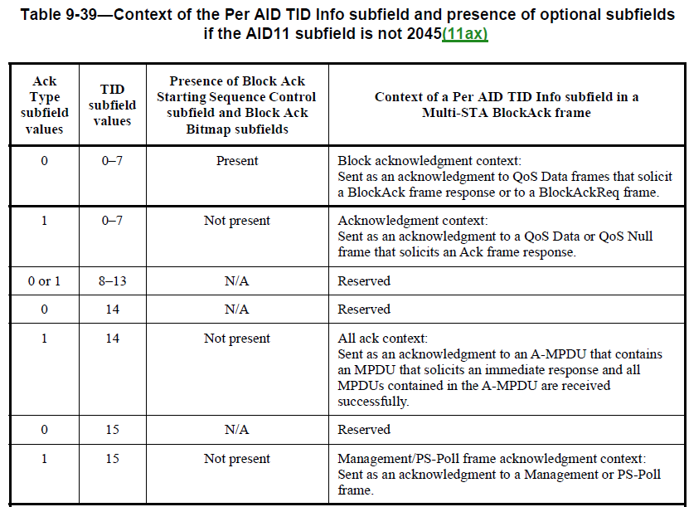
Option 1 (M-BA with Ack Type / TID)
AID TID Info
AID11 – not changed, Ack Type / TID – new values (e.g. 0 / 14)
This option cannot cover legacy devices because they do not understand new Ack Type + TID combination. As a result, legacy devices do not recognize whether Block Ack Starting Sequence Control and Block Ack Bitmap are present or not)

Slide 7
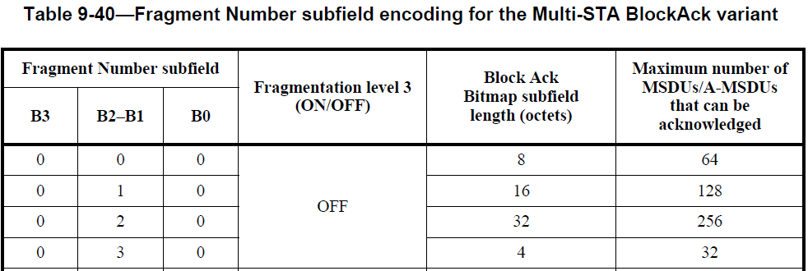
Option 2 (M-BA with AID11)
AID TID Info
AID11 – Special value (e.g. 2046)
Ack Type / TID – Existing value (e.g. 0 / 0 - Block Ack Starting Sequence Control subfield and Block Ack Bitmap subfields are present)
The size of the AID TID info can be determined by the Fragment Number subfield in the Block Ack Starting Sequence Control subfield(up to 128 octets)
This option can be used with both UHR and legacy devices in multi-user case
…..

Slide 8
Multiple Control Info example in the case Option 2
How to include one or more Control information in the example below
The AID11 subfield in the AID TID info is set to 2046
The Fragment Number subfield is set to ‘0 0 0 0’ to indicate that the size of the Block Ack Bitmap as 8 octets
Control information(e.g. BSR) + Additional Control Information (e.g. IDC Info) can be included in the Per AID TID Info(Starting Sequence Number + Block Ack Bitmap)
This option can be used not only ICR but also CRF
Per AID TID Info
AID11 2046
AID TID Info
Block Ack Starting
Block Ack Bitmap
Sequence Control
Octets:
2
2
8
Fragment
(Length) | Presence Bit | Control Info 1 | Control Info 2 | … | Control Info n
Number
Bits:
4
IDC Present,
BSR Present,
etc.
Control Info 1 – IDC Info
Control Info 2 - BSR
B3 0, B2-B1 0, B0 0
12 bits + 8 octets
(including Starting Sequence Number)

Slide 9
CRF from non-AP STA (IDC Info + BSR)
AP’s TXOP
DATA
DATA
UHR AP
MU-RTS
BSRP
STA1
(Legacy)
BSR
CTS
BA
QoS Null
BA
X
STA2
(UHR)
IDC event recognized
CTS
BA
M-BA
Unavailable Time
BA
Frame Control | Duration | RA | TA | BA Control | BA Information | FCS
AID11 = 2046 | Ack Type = 0 | TID = 0 | Fragment Number = 0 0 0 0 | (Length) | Presence Bit | IDC Info | BSR Information
12 bits + 8 octets

Slide 10
CRF from non-AP STA (BA + IDC Info)
AP’s TXOP
DATA
DATA
UHR AP
MU-RTS
STA1
(Legacy)
CTS
BA
BA
X
IDC event recognized
STA2
(UHR)
CTS
M-BA
Unavailable Time
BA
Frame Control | Duration | RA | TA | BA Control | BA Information | FCS
Per AID TID Info (BlockAck) | AID11 = 2008 | Ack Type = 0 | TID = 0 | Fragment Number = 0 1 1 0 | (Length) | Presence Bit | IDC Info
AID – for UHR AP
12 bits + 4 octets

Slide 11
CRF from Mobile AP (IDC Info)
DATA
STA1
(Legacy)
CTS
DATA
STA2’s TXOP
STA2
(UHR)
CTS
RTS
TXOP
Basic Trigger
M-BA
X
UHR
Mobile AP
IDC event recognized
MU-RTS
Unavailable Time
CTS
Frame Control | Duration | RA | TA | BA Control | BA Information | FCS
Per AID TID Info | Per AID TID Info | AID11 = 2046 | Ack Type = 0 | TID = 0 | Fragment Number = 0 1 1 0 | (Length) | Presence Bit | IDC Info
AID – for STA1
AID – for STA2
12 bits + 4 octets

Slide 12
Conclusion
We’ve discussed three options of ICR and/or CRF to include multiple control information such as BSR and IDC Info together
Option 1: new Ack Type + TID combination in AID TID Info + Fragment Number
Option 2: Special AID11 value in AID TID Info + Fragment Number
Option 3: New Action frame with A-Control to include control information and additional control information(e.g. IDC Info) together
Option 2 for ICR/CRF can include multiple control information, and can be used with both UHR and legacy devices in multi-user case
ICR/CRF include multiple control information to support legacy mechanism
ICR/CRF are backward compatible for legacy devices, especially in the case of Mobile AP

Slide 13
Straw Poll 1
Do you agree to include the following into the 11bn SFD?
11bn allows Multi-STA BA to carry one or more feedback (e.g. unavailability) information
How to include feedback information is TBD

Slide 14
Straw Poll 2
Do you agree to include the following into the 11bn SFD?
11bn allows a Multi-STA BA frame to include both Block Ack Bitmap and Feedback information if the preceding PPDU includes QoS Data frame(s) that solicit an immediate response (e.g., Ack or BlockAck context) and the non-AP STA is operating in a mode that allows inclusion of feedback information(e.g. DUO mode)

Slide 15
References
[1] 11-24/834r0, Some Details on In-Device Coexistence
[2] 11-24/543r1, Coexistence Protocols for UHR – Follow Up
[3] 11-24/1221r1, ICF ICR follow up
[4] 11-24/1226r0, ICF-ICR design
[5] 11-24/1247r0, ICF ICR Design For Coex

Slide 16
Appendix. Option 3 (New Action frame) A-Control + Additional Control info.
Defining new Action frame for IDC Info
Management frame format
Code | Meaning
… | …
38 | IDC
… | …
Value | Meaning
0 | IDC Info
1-255 | Reserved
Value | Meaning
0 | Category
1-255 | One or more IDC Info
Category values
IDC Action field values
IDC Info Action field format
Octets: | 2 | 2 | 6 | 6 | 6 | 2 | 0 or 4 | variable | 4
 | Frame Control | Duration | Address 1 | Address 2 | Address 3 | Sequence Control | HT Control | Frame Body | FCS
HE Variant(B0, B1 – 1 1), Control ID 3
ACI Bitmap | Delta TID | ACI High | Scaling Factor | Queue Size High | Queue Size All
A-Control(e.g. BSR)
(Length) | Presence Bit | Control Info 1 | Control Info 2 | … | Control Info n
Additional Control Information(e.g. IDC Info)

