Slide 1
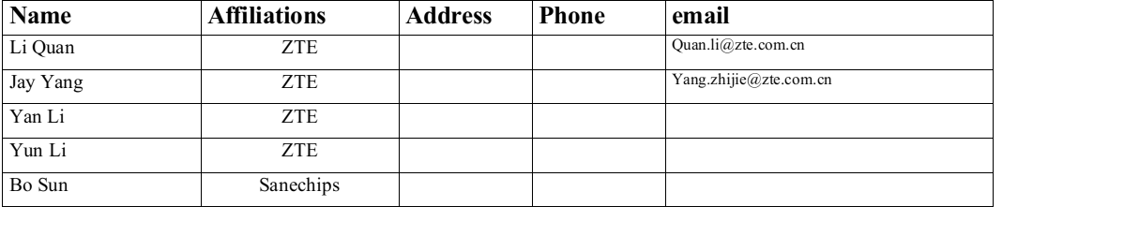
Some thoughts on Dynamic Sub-band Operation

Slide 2
Introduction
Several contributions discussed on DSO with the following merits:
  Improve the performance when serving multiple smaller bandwidth(like 20MHz) devices
  Dynamically schedule multiple non-AP STAs in parallel to meet their LL traffic requirement.
In this contribution, we would like to discuss other problems and the possible solutions on DSO feature.

Slide 3
Recap: The calibration delay
Although 802.11 doesn’t define calibration delay in the draft but implementation does.
  Initial calibration will be done to achieve the maximize performance when the STA operates on a certain channel in the implementation.
  Additional calibration with new parameters may be required when the STA switches to a new operating channel.
  But, in some implementation, the older calibration parameters still can be used without new additional calibration even if the STA switches to a new operating channel.
  The additional calibration delay may be up to millisecond level in the different implementations.
  Before calibration finished, the STAs can exchange frames in a certain MCS, like basic data rate, but can’t be maximize performance.

Slide 4
The problem on DSO
Why NO additional calibration requirement on OFDMA/NPCA but DSO has?
  STA doesn’t switch its center frequency in OFDMA and NPCA mechanism, that’s, the two features allow the STA operating on the sub-channel of the operating channel in a certain time.
  But DSO may require a narrow band ( like 20MHz-only) STA switches to its operating channel to another sub-channel of the AP ( like another 20MHz). That’s, DSO may cause the STA switching the center frequency of the operating channel.

Slide 5
Motivation
To compatible with different capabilities of the narrow band STAs in DSO, the additional calibration delay should be took into account with the follow aspects:
  Define different modes in the initial control frame to compatible with different capabilities of STAs
  The method of MCS selection before the calibration is done.
  Calibration delay of a STA may be beyond one TXOP
  Frequently forcing STAs with addition calibration requirement to switch their operation channel will cause TP drop issue.

Slide 6
Proposal-1: Define different modes
AP indicates the operation mode in the initial control frame
  E.g. mode1 to indicate the STA back to the primary channel after the current TXOP
  E.g. mode2 to indicate the STA still in current sub channel after the current TXOP
    Need further signaling from the AP to indicate when the STA can back to the primary channel

Slide 7
Proposal-2: STA capability indication
  STA indicates whether the additional calibration is required on certain sub channels,the calibration delay and the maximum MCS before calibration is done in a MGMT frame(e.g. association request frame).
  Also, STA can dynamically indicate the calibration finished in a TBD frame.
  For MCS selection, AP may adapt the basic data rate to exchange frame with STA if the STA doesn’t indicate the MAX MCS explicitly.

Slide 8
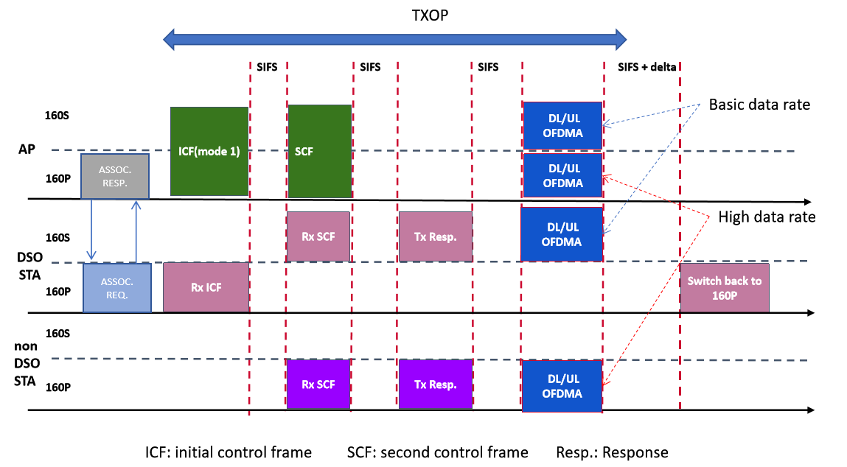
The following figure depicts the proposed DSO frame exchange sequence in mode1

Slide 9
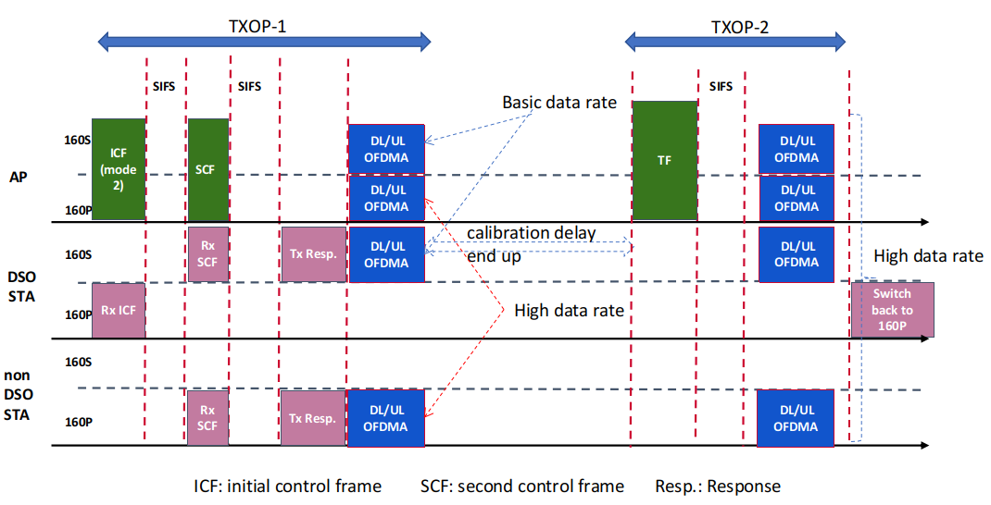
The following figure depicts the proposed DSO frame exchange sequence in mode2

Slide 10
Summary
Analysis the calibration issue in DSO feature
Propose to consider the calibration requirement on some narrow bands STA.
  Defining mode 1 to allow STA to switch back immediately after current TXOP or
  Defining mode 2 to allow STA stay longer than one TXOP to meet the calibration requirement.
  MCS selection issue before calibration is finished.

Slide 11
THANK YOU ☺

Slide 12
Reference
1. 22/2204r0 Dynamic Subband Operation
2. 23/2141r3 Further discussion on Dynamic Subband Operation
3.

