Slide 1
Discussion on aspects in DRU operation – follow up
Date: 2024-07-10
Authors:
Name | Affiliations | Address | Phone | email
Arik Klein | Huawei |  |  | Arik.Klein@huawei.com
Genadiy Tsodik |  |  |  | Genadiy.tsodik@huawei.com
Shimi Shilo |  |  |  | Shimi.Shilo@huawei.com
Oded Redlich |  |  |  | Oded.Redlich@huawei.com

Slide 2
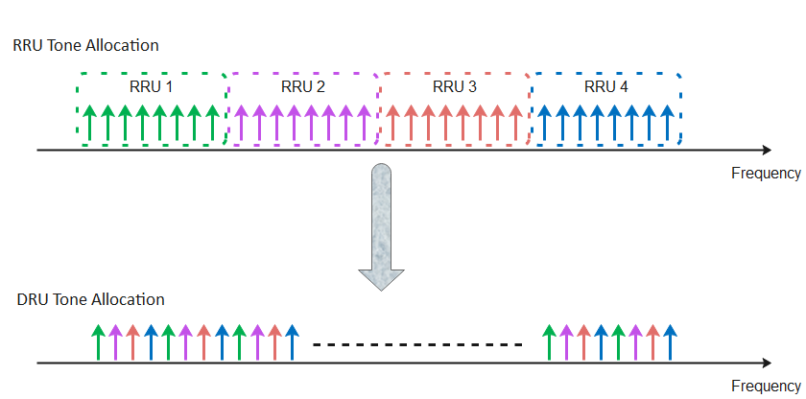
Recap – Distributed RU (DRU)
The Distributed tone RU (DRU) feature is widely discussed in TGbn PHY and has been accepted as a solution for the limit of maximal EIRP PSD regulation in the 6GHz band (TGbn SFD, Motion #1)
DRU is currently defined for UL transmissions (TB PPDUs)
This results in smaller number of tones within each 1MHz and thus the total transmitted power of the STA may increase while keeping the maximal (regulated) EIRP PSD value

Slide 3
Recap – DRU allocation Problem Statement
In [1], [2] it has been shown that:
In an uplink MU transmission, the HE STA sets its actual transmit power, as the minimal value between the calculated Tx power ${Tx}_{pwr}^{STA}$ and the maximum Tx power defined by the Max EIRP PSD within the allocated BW (we denote it as ${Tx}_{max_pwr_PSD}^{STA}$)
The transmit power calculations are carried out only at the non-AP STA side whereas the AP has no indication that the STA’s transmit power is uniquely bounded by the Max EIRP PSD
The UL Power Headroom is 0 in this case.
Target RSSI setting is bounded and may affect optimal <MCS, NSS> setting.

Slide 4
Inefficient RU allocation options for UHR AP
DRU allocation mandates all triggered UHR non-AP STAs to use this mode.
It is preferred to efficiently allocate the DRU, only if is really needed by the UHR non-AP STA (i.e. the maximal TX power of the UHR non-AP STA is limited by the Max EIRP PSD within the allocated BW).
However, if we keep maintaining the AP unaware of the case when the UHR non-AP STA’s TX power is limited by the Max EIRP PSD, the following inefficient options can be considered by the UHR AP for RRU or DRU allocation:
Option 1: Always DRU - Simple and inflexible
Drawbacks:
The same TF can’t include non-UHR non-AP STAs (that do not support DRU allocation).
Less flexible for channel conditions and real traffic needs of each UHR non-AP STA
Option 2: trial and error for DRU allocation - Increase flexibility of link adaptation mechanism
Drawbacks:
Complicates the AP scheduling, while convergence is not assured
Sub optimal solution: long convergence to the optimal size of DRU for the UHR non-AP STAs.
If not converged – it is not clear if the transition to DRU is the factor (for non-convergence).

Slide 5
Indication for a DRU allocation
In order to allow flexibility in RRU and DRU allocation and efficiently allocate the DRU only if it is required by the UHR non-AP STA, we propose to add an indication to support the allocation of a DRU type (instead of an RRU type)
Adding the “EIRP PSD limit flag” field (exact name – TBD)
Set to 1, if the maximal allowed transmit power equals to the value o$f {Tx}_{max_pwr_PSD}^{STA}$ (maximum Tx power defined by the Max EIRP PSD within the allocated BW ):
${{Tx}_{max_pwr_PSD}^{STA}=MAX_EIRP}_{PSD}+10log10RU_Size[MHz]$
Otherwise, this field should be set to 0.
If the value of the UPH (as reported by the non-AP STA) is very low, this field indicates the AP that a DRU allocation for that non-AP STA may be considered if Target RSSI needs to be increased

Slide 6
Indication for a DRU allocation
Suggestion: use 1 bit (B6) of a “reserved” subfield in UPH A-Control
Note: B7 still remains a reserved subfield for future extensions.

Slide 7
Summary
The DRU feature is accepted in TGbn PHY as a solution for bounded uplink transmit power due to Maximal EIRP PSD regulation in the 6GHz band
In order to assist the UHR AP in allocating the DRU for a UHR non-AP STA efficiently, we suggest to add an indication to support the AP with a DRU allocation:
EIRP PSD limit flag
The field may be added in UPH A- control field.

Slide 8
SP1
Do you support adding the following to the TGbn SFD?
The 802.11bn amendment defines a mechanism for a UHR non-AP STA to assist a UHR AP with a DRU allocation.
Supporting submissions: 11-24/1405r2

Slide 9
SP2
Do you support adding the following to the TGbn SFD?
The 802.11bn amendment defines indication for "EIRP PSD limit flag" of a UHR non-AP STA in the UPH A-Control field
Set to 1, if the maximal allowed transmit power equals to the value of ${Tx}_{max_pwr_PSD}^{STA}$ (maximum Tx power defined by the Max EIRP PSD within the allocated BW in the preceding TF): ${{Tx}_{max_pwr_PSD}^{STA}=MAX_EIRP}_{PSD}+10log10RU_Size[MHz]$
Otherwise, this field should be set to 0.
Supporting submissions: 11-24/1405r2

Slide 10
Reference
[1] 11-24/1058r0 Discussion on aspects in DRU operation - Arik Klein, Huawei
[2] 11-24/1124r2 Headroom Reason Reporting– B. Hart et al., Cisco
[3] IEEE 802.11 REVme D6.0, section 27.3.15.2 Power Precorrection

Slide 11
SP2a
Do you support adding the following to the TGbn SFD?
11bn defines indication for assisting an UHR AP with DRU allocation for a UHR non-AP STA that is allocated with Regular RU (RRU)
The indication will be set to 1 if the maximal allowed transmit power equals to the value of the power of max EIRP PSD value within the allocated BW
The indication field - TBD

