Slide 1
Discussion on aspects in DRU operation – follow up
Date: 2024-07-10
Authors:
Name | Affiliations | Address | Phone | email
Arik Klein | Huawei |  |  | Arik.Klein@huawei.com
Genadiy Tsodik |  |  |  | Genadiy.tsodik@huawei.com
Shimi Shilo |  |  |  | Shimi.Shilo@huawei.com
Oded Redlich |  |  |  | Oded.Redlich@huawei.com

Slide 2
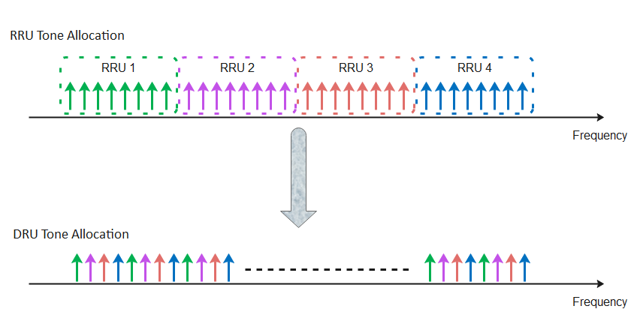
Recap – Distributed RU (DRU)
The Distributed tone RU (DRU) feature is widely discussed in TGbn PHY and has been accepted as a solution for the limit of maximal EIRP PSD regulation in the 6GHz band (TGbn SFD, Motion #1)
  DRU is currently defined for UL transmissions (TB PPDUs)
This results in smaller number of tones within each 1MHz and thus the total transmitted power of the STA may increase while keeping the maximal (regulated) EIRP PSD value

Slide 3
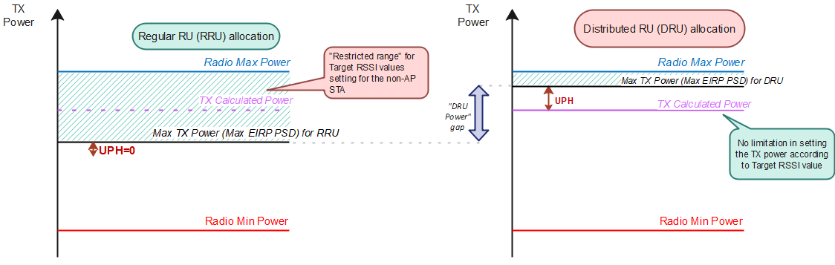

Recap – DRU allocation Problem Statement
In [1], [2] it has been shown that:
  In an uplink MU transmission, the HE STA sets its actual transmit power, as the minimal value between the calculated Tx power ${Tx}_{pwr}^{STA}$ and the maximum Tx power defined by the Max EIRP PSD within the allocated BW (we denote it as ${Tx}_{max_pwr_PSD}^{STA}$)
  The transmit power calculations are carried out only at the non-AP STA side whereas the AP has no indication that the STA’s transmit power is uniquely bounded by the Max EIRP PSD
    The UL Power Headroom is 0 in this case.
    Target RSSI setting is bounded and may affect optimal <MCS, NSS> setting.

Slide 4
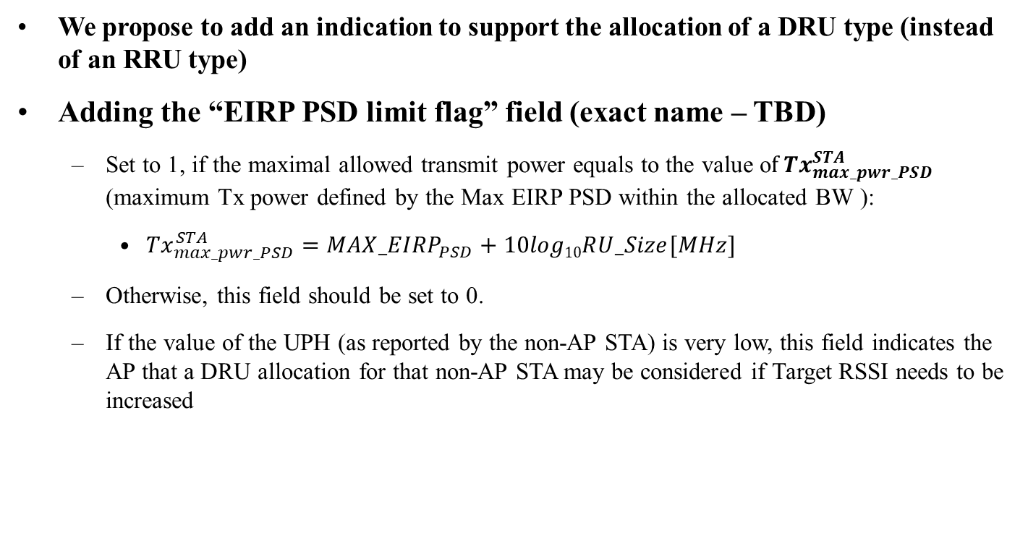
Indication for a DRU allocation
We propose to add an indication to support the allocation of a DRU type (instead of an RRU type)
Adding the “EIRP PSD limit flag” field (exact name – TBD)
  Set to 1, if the maximal allowed transmit power equals to the value o$f {Tx}_{max_pwr_PSD}^{STA}$ (maximum Tx power defined by the Max EIRP PSD within the allocated BW ):
    ${{Tx}_{max_pwr_PSD}^{STA}=MAX_EIRP}_{PSD}+10log10RU_Size[MHz]$
  Otherwise, this field should be set to 0.
  If the value of the UPH (as reported by the non-AP STA) is very low, this field indicates the AP that a DRU allocation for that non-AP STA may be considered if Target RSSI needs to be increased

Slide 5
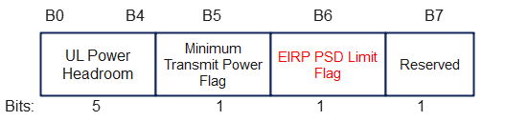
Indication for a DRU allocation
Suggestion: use 1 bit (B6) of a “reserved” subfield in UPH A-Control
  Note: B7 still remains a reserved subfield for future extensions.

Slide 6
Summary
The DRU feature is accepted in TGbn PHY as a solution for bounded uplink transmit power due to Maximal EIRP PSD regulation in the 6GHz band
Suggest to add an indication to support the AP with a DRU allocation:
  EIRP PSD limit flag
The field may be added in UPH A- control field.

Slide 7
SP1
Do you support adding the following to the TGbn SFD?
  The 802.11bn amendment defines a mechanism for a UHR non-AP STA to assist a UHR AP with a DRU allocation.
Supporting submissions: 11-24/1405r1

Slide 8
SP2
Do you support adding the following to the TGbn SFD?
  The 802.11bn amendment defines a way for a non-AP STA to notify an AP when the STA’s 0 dB of UL power headroom is due to the STA’s Local max TX power level
Supporting submissions: 11-24/1124r2

Slide 9
SP3
Do you support adding the following to the TGbn SFD?
  The 802.11bn amendment defines indication for "bounded output TX power" of a UHR non-AP STA in the UPH A-Control field for the following cases:
    Case 1: the maximal allowed transmit power equals the value of the power of max EIRP PSD value within the allocated BW
    Case 2: the UL Power Headroom value is 0 due to the non-AP STA’s Local max TX power level.
  NOTES:
  The "bounded output TX power" (TBD field name) uses B6-B7 reserved bits in UPH A-control.
  Other Cases - TBD.
Supporting submissions: 11-24/1405r1, 11-24/1124r2

Slide 10
Reference
[1] 11-24/1058r0 Discussion on aspects in DRU operation - Arik Klein, Huawei
[2] 11-24/1124r2 Headroom Reason Reporting– B. Hart et al., Cisco
[3] IEEE 802.11 REVme D6.0, section 27.3.15.2 Power Precorrection

Slide 11
SP2a
Do you support adding the following to the TGbn SFD?
  11bn defines indication for assisting an UHR AP with DRU allocation for a UHR non-AP STA that is allocated with Regular RU (RRU)
    The indication will be set to 1 if the maximal allowed transmit power equals to the value of the power of max EIRP PSD value within the allocated BW
    The indication field - TBD

