Slide 1
NPCA Operation Issue
Date: 2024-10-04
Name | Affiliations | Address | Phone | email
Seongho Byeon | Samsung Electronics |  |  | sh.byeon@samsung.com
Jack Jonghyo Lee
Jaheon Gu
Jinho Choi
Jonghoe Koo
Jungjun Kim
Mingyu Lee
Suhwook Kim
Taeyoung Ha
Youngwan So

Slide 2
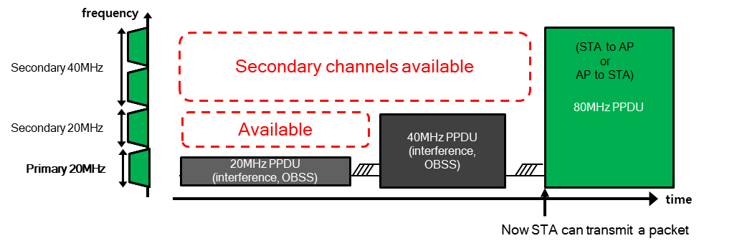
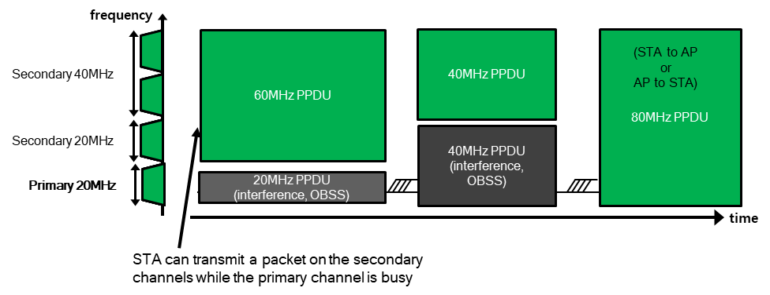
Introduction
One of main objectives for UHR PAR
At least one mode of operation capable of improving efficient use of the medium
Non-Primary Channel Access (NPCA) agreed in TGbn [1-12]
TGbn defines a mode of operation that enables a STA to access the secondary channel while the primary channel is known to be busy due to OBSS traffic or other TBD conditions.
The mode of operation shall not assume that the STA is capable to detect or decode a frame and obtain NAV information of the secondary channel concurrently with the primary channel.
A BSS shall only have a single NPCA primary channel (name TBD) on which the STA contends while the primary channel of the BSS is known to be busy due to OBSS traffic or other TBD conditions.

Slide 3
Introduction
NPCA Triggering Condition
When an OBSS TXOP and/or a PPDU transmission is detected on the primary channel in the BSS, NPCA-capable STAs will switch to the 20 MHz anchor channel within the secondary channel (i.e., non-primary channel, NPCH), not overlapping with the OBSS transmission
Details are still under the discussion, but generally NPCA is triggered when OBSS TXOP or long OBSS pre-HE/HE/EHT/UHR PPDU is observed
OBSS TXOP is obtained by receiving HE-SIG-A in HE PPDU, U-SIG in EHT/HUR PPDU, or ICF-ICR exchange such as RTS/CTS
Considering the NAV reset issue, STAs need to switch after receiving the responding frame (e.g., CTS) or frame followed by the responding frame (e.g., Data frame) [10]
In this presentation, we examine an issue on NPCA operation in the situation where only CTS is received by a NPCA STA

Slide 4
Problem Statement
Identification of OBSS transmission and its BW
Example 1) OBSS AP is hidden to NPCA STAs
NPCA AP (160 MHz)
ICF
Data
ICF
…
OBSS
AP
ICF
ICF
NPCA STA (80 MHz)
ICR
ICR
…
OBSS
STA
ICR
- 68 dBm
ICR
NPCA operation
- 65 dBm
…
ICR
OBSS TXOP
set by ICR only due to hidden
OBSS STA
(80 MHz)
ICR
NPCA
AP
ICR
ICR
NPCA operation
…
OBSS AP
(160 MHz)
ICR
OBSS TXOP
set by ICR only due to hidden
ICR
NPCA
STA
ICR
ICR

Slide 5
Problem Statement
Identification of OBSS transmission and its BW
Example 2) NPCA STA and OBSS AP are hidden each other
NPCA AP
(160 MHz)
ICF
Data
…
ICF
OBSS
AP
ICF
ICF
ICR
…
ICR
NPCA STA
(80 MHz)
OBSS
STA
ICR
ICR
NPCA operation
…
ICR
OBSS AP
(160 MHz)
ICF
OBSS TXOP
set by ICF/ICR exchange
ICF
ICR
OBSS STA
(80 MHz)
NPCA
AP
ICF
ICR
ICF
ICR
NPCA operation
…
ICR
OBSS TXOP
set by ICR only due to hidden
ICR
NPCA
STA
ICR
ICR

Slide 6
Problem Statement
Identification of OBSS transmission and its BW
If ICR in the previous examples is CTS, is NPCA STA able to perform NPCA?
OBSS indetermination
When STA 1 send RTS and AP responds to it, CTS sent by the AP does not include TA address (BSSID or AP MAC address)
[Recap]
STA 1 has no way to recognize whether CTS frame is sent by OBSS STA or the associated AP
➔ Therefore, when only CTS frame is received under hidden situation, the STA cannot perform NPCA as it cannot determine it comes from OBSS or the same BSS
STA 2
AP
STA 1 and STA 2 are hidden each other
STA 1

Slide 7
Problem Statement
Identification of OBSS transmission and its BW
If ICR in the previous examples is CTS, is NPCA STA able to perform NPCA?
OBSS BW indetermination
Using duplicate non-HT format control frame, its whole bandwidth is known by setting the TA field to a bandwidth signaling TA
If NPCA STA receives CTS frame sent by OBSS STA without preceding RTS frame due to hidden situation, the STA has no way to know the BW of OBSS transmission
➔ Therefore, when only CTS frame is received under hidden situation, the STA cannot perform NPCA as it cannot know the BW occupied by OBSS transmission
NPCA STA and OBSS AP are hidden each other
NPCA
AP
STA
OBSS AP
CTS
OBSS TXOP (BasicNav set)
NPCA
STA
(80 MHz Operating BW)
CTS
…
OBSS STA
CTS
CTS

Slide 8
How to Improve
Proposal: There is currently no complete solution yet, however,
Option 1) A STA uses ICF not requiring CTS responses when it initiates TXOP
ICF may become BSRP trigger, NFRP trigger, BQRP trigger frame, for example, then ICR sent by the non-AP STAs would have room to indicate the bandwidth and OBSS information it belongs to
Further discussion is still needed regarding how to handle CTS sent by the legacy STAs
Option 2) Since STAs cannot participate in the transmission after receiving CTS due to BasicNAV setting, it may go to the anchor channel, performing NPCA
NPCA coordination issue becomes more challenging
No spatial reuse can be utilized
Option 3) We need to look for other ways to resolve the issue in community (i.e., FFS)
Option 4) If only CTS is received, NPCA is not allowed

Slide 9
Conclusion
In this presentation, we pointed out that there are problems in performing NPCA when only receiving CTS
OBSS transmission cannot be specified
The size of bandwidth used by OBSS cannot be specified

Slide 10
Straw Poll
To resolve the difficulty of performing NPCA solely based on CTS reception, which of the following options would you most prefer?
Option 1) A STA uses ICF not requiring CTS responses when it initiates TXOP
Option 2) A STA goes to the anchor channel, performing NPCA
Option 3) FFS
Option 4) NPCA is not allowed

Slide 11
References
[1] 11-23/2005r1 Non-primary channel access (NPCA) (Minyoung Park, Intel)
[2] 11-24/0070r2 Some details about non-primary channel access (Yunbo Li, Huawei)
[3] 11-24/0426r0 EDCA for Non-Primary Channel Access (Dongju Cha, LGE)
[4] 11-24/0427r0 Enabling Non-Primary Channel Access (Dongju Cha, LGE)
[5] 11-24/0458r2 Considerations on Non-Primary Channel Access (Salvatore Talarico, Sony)
[6] 11-24/0498r0 Non-Primary Channel Access (NPCA) – Follow Up (Minyoung Park, Intel)
[7] 11-24/0496r1 Secondary Channel Usage Follow Up (Liwen Chu, NXP)
[8] 11-24/1104r0 Some details on NPCA (Seongho Byeon, Samsung)
[9] 11-24/1115r0 Channel Switching Rules for NPCA (Vishnu V. Ratnam, Samsung)
[10] 11-24/1125r0 Considerations on switching for NPCA (Dongju Cha, LGE)
[11] 11-24/1155r0 Further discussions on NPCA (Shawn Kim, WILUS)
[12] 11-24/1218r0 NPCA – Next level discussions (Gaurang Naik, Qualcomm)

