Slide 1
NPCA Operation Issue
Date: 2024-08-27
Name | Affiliations | Address | Phone | email
Seongho Byeon | Samsung Electronics |  |  | sh.byeon@samsung.com
Jack Jonghyo Lee
Jaheon Gu
Jinho Choi
Jonghoe Koo
Jungjun Kim
Mingyu Lee
Suhwook Kim
Taeyoung Ha
Youngwan So

Slide 2
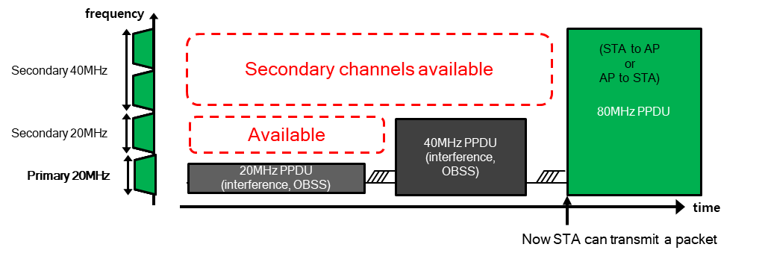
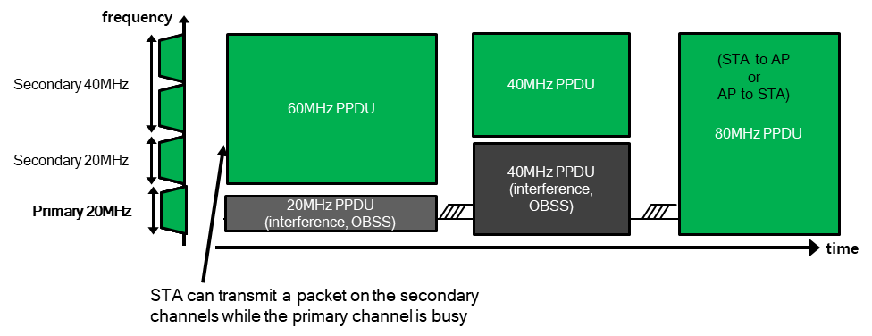
Introduction
One of main objectives for UHR PAR
  At least one mode of operation capable of improving efficient use of the medium
Non-Primary Channel Access (NPCA) agreed in TGbn [1-12]
  TGbn defines a mode of operation that enables a STA to access the secondary channel while the primary channel is known to be busy due to OBSS traffic or other TBD conditions.
    The mode of operation shall not assume that the STA is capable to detect or decode a frame and obtain NAV information of the secondary channel concurrently with the primary channel.
    A BSS shall only have a single NPCA primary channel (name TBD) on which the STA contends while the primary channel of the BSS is known to be busy due to OBSS traffic or other TBD conditions.

Slide 3
Introduction
NPCA Triggering Condition
  When an OBSS TXOP and/or a PPDU transmission is detected on the primary channel in the BSS, NPCA-capable STAs will switch to the 20 MHz anchor channel within the secondary channel (i.e., non-primary channel, NPCH), not overlapping with the OBSS transmission
  Details are still under the discussion, but generally NPCA is triggered when OBSS TXOP or long OBSS (pre-HE)/HE/EHT/UHR PPDU is observed
    OBSS TXOP is obtained by receiving HE-SIG-A in HE PPDU, U-SIG in EHT/HUR PPDU, or ICF-ICR exchange such as RTS/CTS
    Considering the NAV reset issue, STAs need to switch after receiving the responding frame (e.g., CTS) or frame followed by the responding frame (e.g., Data frame) [10]
In this presentation, we examine issues on NPCA operation in the situation where only CTS is received by a NPCA STA

Slide 4
Problem Statement
Identification of OBSS transmission and its BW
  Example 1) OBSS AP is hidden to NPCA STAs
ICF
NPCA AP
ICF
ICF
Data
…
OBSS
AP
ICF
NPCA STA
ICR
- 68 dBm
OBSS
STA
ICR
NPCA operation
- 65 dBm
…
OBSS STA
ICR
OBSS TXOP
set by ICR only due to hidden
NPCA
AP
ICR
NPCA operation
…
OBSS AP
ICR
OBSS TXOP
set by ICR only due to hidden
NPCA
STA
ICR

Slide 5
Problem Statement
Identification of OBSS transmission and its BW
  Example 2) NPCA STA and OBSS AP are hidden each other
ICF
ICF
NPCA AP
ICF
Data
…
OBSS
AP
ICF
ICR
NPCA STA
OBSS
STA
ICR
ICF
NPCA operation
OBSS AP
ICF
…
ICF
ICR
OBSS TXOP
set by ICF/ICR exchange
OBSS STA
NPCA
AP
ICF
ICR
NPCA operation
…
ICR
OBSS TXOP
set by ICR only due to hidden
NPCA
STA
ICR

Slide 6
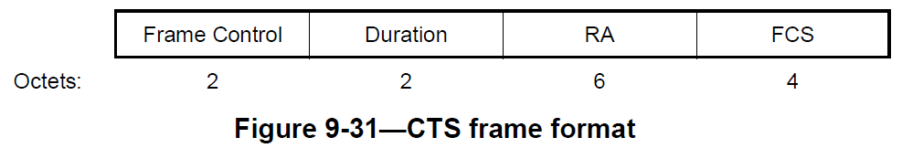
Problem Statement
Identification of OBSS transmission and its BW
  If ICR in the previous examples is CTS, is NPCA STA able to perform NPCA?
    OBSS indetermination
      When STA 1 send RTS and AP responds to it,
      CTS sent by the AP does not include
      TA address (BSSID or AP MAC address)
      [Recap]
      STA 1 has no way to recognize whether CTS frame is sent
      by OBSS STA or the associated AP
  ➔ Therefore, when only CTS frame is received under hidden situation, the STA cannot perform NPCA as it cannot determine it comes from OBSS or the same BSS
STA 2
AP
STA 1 and STA 2 are hidden each other
STA 1

Slide 7
Problem Statement
Identification of OBSS transmission and its BW
  If ICR in the previous examples is CTS, is NPCA STA able to perform NPCA?
    OBSS BW indetermination
      Using duplicate non-HT format control frame,
      its whole bandwidth is known by setting the TA field
      to a bandwidth signaling TA
      If NPCA STA receives CTS frame sent by OBSS STA
      without preceding RTS frame due to hidden situation,
      the STA has no way to know the BW of OBSS transmission
  ➔ Therefore, when only CTS frame is received under hidden situation, the STA cannot perform NPCA as it cannot know the BW occupied by OBSS transmission
NPCA STA and OBSS AP are hidden each other
NPCA
AP
STA
OBSS AP
CTS
OBSS TXOP
(BasicNav set)
NPCA
STA
(80 MHz Operating BW)
CTS
…
OBSS STA
CTS
CTS

Slide 8
How to Improve
Proposal: There is currently no complete solution yet, however,
  Option 1) A STA can use ICF not requiring CTS responses when it initiates TXOP
    ICF may be BSRP trigger, NFRP trigger, BQRP trigger frame, for example
    Loss of advantages due to the overlapping transmission of CTS
    This might not legacy compatible
  Option 2) Since a STA cannot participate in the transmission after receiving CTS, it may go to the anchor channel and listen passively for a specific time period
    Difficulty level of NPCA coordination increases
    No spatial reuse can be utilized
  Option 3) A STA may use another control frame instead of CTS for the response of MU-RTS and RTS
    Strong modification on the existing protocol is required
    This might not legacy compatible
  Option 4) We need to look for other ways to resolve the issue in community (FFS)
  Option 5) If only CTS is received, NPCA is not allowed

Slide 9
Conclusion
In this presentation, we pointed out that there are problems in performing NPCA when only receiving CTS
  OBSS transmission cannot be specified
  The size of bandwidth used by OBSS cannot be specified

Slide 10
References
[1] 11-23/2005r1 Non-primary channel access (NPCA) (Minyoung Park, Intel)
[2] 11-24/0070r2 Some details about non-primary channel access (Yunbo Li, Huawei)
[3] 11-24/0426r0 EDCA for Non-Primary Channel Access (Dongju Cha, LGE)
[4] 11-24/0427r0 Enabling Non-Primary Channel Access (Dongju Cha, LGE)
[5] 11-24/0458r2 Considerations on Non-Primary Channel Access (Salvatore Talarico, Sony)
[6] 11-24/0498r0 Non-Primary Channel Access (NPCA) – Follow Up (Minyoung Park, Intel)
[7] 11-24/0496r1 Secondary Channel Usage Follow Up (Liwen Chu, NXP)
[8] 11-24/1104r0 Some details on NPCA (Seongho Byeon, Samsung)
[9] 11-24/1115r0 Channel Switching Rules for NPCA (Vishnu V. Ratnam, Samsung)
[10] 11-24/1125r0 Considerations on switching for NPCA (Dongju Cha, LGE)
[11] 11-24/1155r0 Further discussions on NPCA (Shawn Kim, WILUS)
[12] 11-24/1218r0 NPCA – Next level discussions (Gaurang Naik, Qualcomm)

Slide 11
Straw Poll
Which of the following options would you most prefer?
  O1) To avoid using ICF soliciting CTS
  O2) Passive listening in the anchor channel
  O3) Replacement of CTS with (MU-)RTS response
  O4) FFS
  O5) No NPCA operation

