Slide 1
SP-based Non-Primary Channel Access Follow-Up Triggering Event
Date: 2024-07-02
Authors:

Slide 2
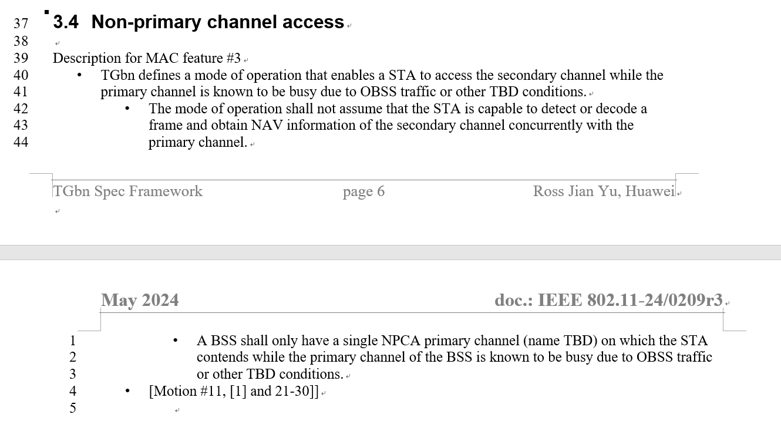
Motivation
To meet throughput and latency requirements mentioned in the UHR PAR [1], non-primary channel access (NPCA) was proposed as a potential method
[1]
The general idea of SP-based NPCA was introduced in [2]

Slide 3
Recap: SP-based NPCA
The main intention is to avoid frequent switching due to the crowded primary channel
Within OBSS TWT SPs, the primary channel will be frequently occupied by OBSS, leading to frequent switching between primary channel and non-primary channel if TXOP-level NPCA is used
Within OBSS TWT SPs, it is hard to obtain TXOP on the crowded primary channel
➔ SP-based NPCA: Switch to a non-primary channel without switching back and forth during an OBSS SPs
The basic idea is for BSS to park on a non-primary channel during the OBSS SP
[2]
frequency
Non-primary channel | BSS parking |  | BSS parking
Primary channel | OBSS TWT SP | BSS parking | OBSS TWT SP | BSS parking
time

Slide 4
Triggering Event
Within the OBSS TWT SP, if the OBSS PPDU is detected on the primary channel, then switch
The OBSS PPDU belongs to an OBSS whose ongoing TWT SP is announced by the BSS AP
This is not within any of BSS 2’s TWT agreements announced by BSS 1, so it won’t cause BSS 1 switching if TXOP-based NPCA is not used outside.
TWT 2 SP of BSS 2
BSS 1 announces TWT 2
of BSS 2
BSS 1 could park on the primary channel until BSS 2’s PPDU is detected within TWT 2
BSS 1
(my BSS)
BSS 1 switches to a non-primary channel
BSS 2
(OBSS)
Although BSS 3 is an OBSS, it has no ongoing TWT SP announced by BSS 1 at the time, so this PPDU won’t cause BSS 1 switching
BSS 3
(OBSS)
* for convenience, contention is omitted, frame exchange within a BSS is simplified

Slide 5
If Switching, …
When parking on a non-primary channel, the BSS (i.e., PPDUs transmitted by AP and non-AP in the BSS) is recommended to switch to a non-primary channel that is not adjacent from current OBSS transmission
This is an implicit signaling of “I am on a non-primary channel”
Accessing the channel on the non-primary channel until the end of the SP
TWT 2 SP of BSS 2
BSS 1
(my BSS)
BSS 1 announces TWT 2
of BSS 2
Accessing the medium on the non-primary channel until the end of the SP
BSS 2
(OBSS)
BSS 3
(OBSS)
* for convenience, contention is omitted, frame exchange within a BSS is simplified

Slide 6
Example
Scenario:
BSS 1 announces TWT 2 and 3;
BSS 2 announces TWT 1 and 3;
BSS 3 announces TWT 1 and 2;
TWT 1,2, and 3 are aligned.
TWT 1,2,3 can be a coordinated TWT, or non-coordinated TWT with overlapping SPs
The BSS that transmits the first PPDU within the SP (e.g., BSS 1 in the figure below) claims the primary channel, and the remaining BSSs (e.g., BSS 2 and 3 in the figure) switch to non-primary channel.
SP of TWT 1, 2, 3
……
BSS 1
BSS 1
TWT 1
BSS 2
Accessing the medium on the non-primary channel until the end of the SP
BSS 3
Accessing the medium on the non-primary channel until the end of the SP
BSS 2
TWT 2
BSS 3
TWT 3
* for convenience, contention is omitted, frame exchange within a BSS is simplified

Slide 7
Summary
Within OBSS TWT SPs, a BSS (both AP and non-AP STAs)
Parks on the primary channel until a PPDU from the OBSS is detected,
switch to a non-primary channel that is not adjacent from current OBSS transmission, and
Switches back to the primary channel at the end of the OBSS TWT SP
The triggering event is the same as a TXOP-based NPCA except
within a predefined field, and
with source check for the OBSS PPDU
To see if the OBSS PPDU is from an OBSS which has an ongoing (TWT) SP
(Main Difference – SP-based NPCA lasts till the end of the SP while TXOP-based NPCA lasts till the end of the TXOP)

Slide 8
References
[1] 11-24/0209r3, “Specification Framework for TGbn,” Ross Jian Yu
[2] 11-24/0538r1, “SP-based Non-Primary Channel Access,” Yue Zhao

