Slide 1
Ultra Low Power Features For Active Devices
Date: 2024-07-14
Authors:

Slide 2
Abstract
In this presentation we would like to discuss some ultra low power features for active devices

Slide 3
Recap on Suggested Devices for 802.11bp
In [1] 4 solutions were envisioned to enable market for 802.11bp
    Solution 1: active transmission;
    Solution 2: close range backscatter with full duplex;
    Solution 3: long range backscatter with bi-static;
    Solution 4: legacy 802.11 devices enhanced with AMP features, e.g., extremely low power consumption, energy harvesting capability
In [3], two devices were clearly defined:
  RF-harvesting AMP-only device was defined to be one with <1mW
  AMP-assisted device with <10-100mW
Solution 1-3 from [1] are for RF-harvesting AMP-only device while Solution 4 from [1] is only for AMP-assisted device - as defined in [3]
In this presentation we would like to provide some capabilities requirements for Solution 1 for RF-harvesting AMP-only device (active transmission)

Slide 4
Ultra Low Power Features for RF-Harvesting AMP Only Active Devices
Device/Solution | CFO/SFO PPM | UL Waveform | MAC Capabilities | Range
Active (S1) | 1e3 | CE | Control + Sense, ID | 50m
Ultra low power consumption can be 100s-10s uW
CE – Constant Envelope Waveform (OOK, FSK , PSK)

Slide 5
Active Transmission Devices (S1)
These devices are expected to work out of RF energy harvesting (zero energy)
These devices are expected to fit into a sticker or a tag form factor and cost
Some features that enable 802.11bp expectations were discussed [1-3]
Clock can be implemented without a crystal - with fast, simple & efficient internal circuits that can reach e.g. 1000ppm
Constant envelope transmission is easy to implement using highly efficient non-linear components
Limited payload to ID plus some additional sensing and control information
  Only trigger based traffic (no device originated traffic)
  Limited message length/types and waveform reception processing capabilities
Very simple functionality that requires minimal processing/memory
Uplink data rate of few Mbps allows lower energy and longer range for RF harvesting devices

Slide 6
Recap for 1000ppm Active TX Advantage From [2]
For active transmitter AMP-STAs, we would like to reduce the need for a crystal based stable clock with accuracies in the orders of 40ppm
Stable crystal-based clocks usually consume non-neglectable power and also take some time to turn on, until reaching stability
In addition, they require an external component on top of the silicon chip. Requiring a crystal results in excessive complexity and power consumption, which limits massive deployments with a sticker form factor
Depending on exact system design, it is possible to use a simpler, lower power, internal oscilators (see ref. 1-3 in [2]). Such oscilators are usually characterized with lower clock accuracies. However, by using various internal low power calibrations based on temperature and process, they can reach an accuracy of 1000ppm without needing a crystal

Slide 7
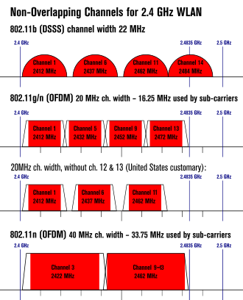
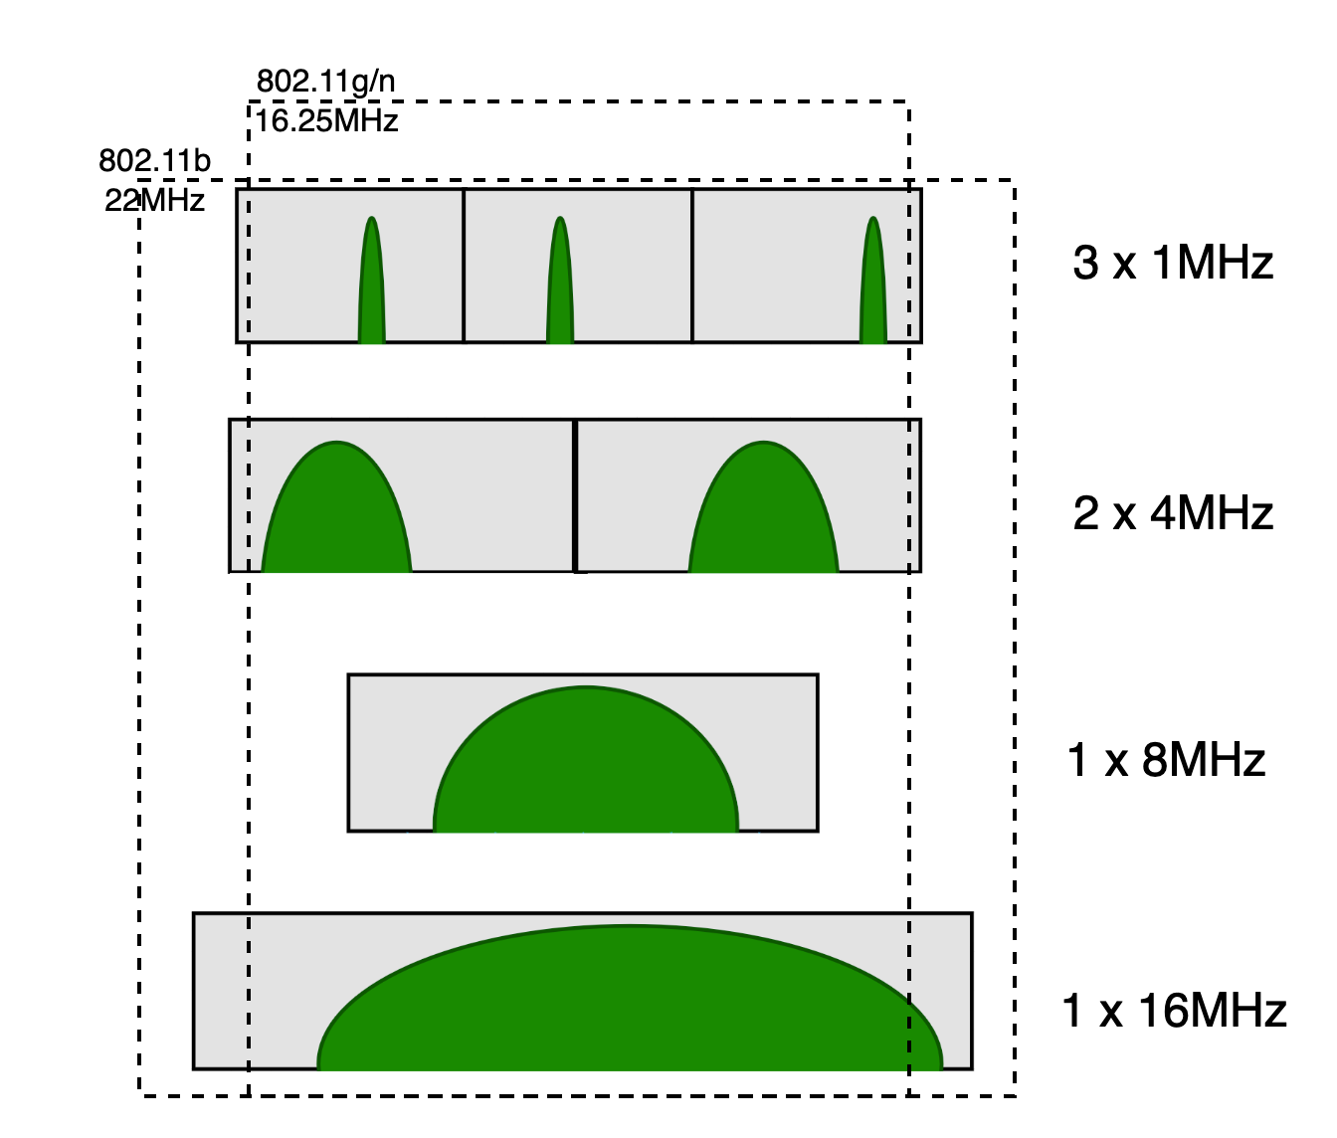
Example for 1000ppm Uplink Spectrum Impact
±1000ppm over the 2.4 channel (2.4-2.48GHz) results with frequency ambiguity of no more than ±2.48MHz [4.98MHz].
Several options are possible to fit the 20MHz channel –
depending on data-rates
# of 802.11bp FDM channels | Total occupied band [MHz] | TX-BW [MHz] | 200 bit TX time [us]
3 | 17.88 | 1 | 200
2 | 17.92 | 4 | 50
1 | 12.96 | 8 | 25
1 | 20.96 | 16 | 12.5

Slide 8
Example for 1000ppm Uplink RX Impact
As uplink receiver is less limited, estimating a
1000ppm CFO can be done by many approaches
We checked one examplary approach of
autocorrelation (1 complex multiplication)
By using L data symbles (no special preambles
in this approach) simulations suggest we can
reach sufficient performance
More study is required to determine the exact modem requirements and if we need additional preambles or increased reader Trx2tx (SIFS) time.

Slide 9
Modes of Operation of AMP Devices
Active devices that operate on ultra low power mode – reach ultra low complexity and can achieve energy harvesting (zero power)
AMP-assisted legacy devices can operate in both ultra low power mode and low power mode - thus save power/complexity based on application
This requires to focus on new ultra low power mode in the 802.11bp amandmant

Slide 10
SP#1
Do you agree that 11bp defines at least one mode of MAC/PHY that support active transmission in 2.4GHz for AMP-only RF-harvesting device?
Yes
No
Abstain

Slide 11
SP#2
Do you agree that 11bp defines at least one PHY/MAC mode that allows crystaless devices to actively transmit?
Yes
No
Abstain

Slide 12
SP#3
What clock accuracy can active devices use on 2.4GHz?
a) 1000 ppm
b) 2000 ppm
c) 10,000 ppm
d) abstain

Slide 13
SP#4
Do you agree that 11bp defines at least one mode of MAC/PHY with clock offset requirement of ±1000ppm for the uplink active transmission at 2.4GHz?
Yes
No
Abstain

Slide 14
References
[1] 11-24-0849-01-00bp-harmonization-of-waveform
[2] 11-23-1140-00-0amp Considerations for AMP Devices
[3] 11-23-0436-00-0amp-technical-report-on-support-of-amp-iot-devices-in-wlan

