Slide 1
Close-Range Backscattering Waveform and Modulation
Date: 2024-07-14
Authors:

Slide 2
Introduction
Close range backscattering communication is proposed [1]
AMP tag for close-range backscattering has strong synergy with UHF RFID, the waveform and modulation should share common definition [1, 2].
In this presentation, the tag read and write waveform and modulation modes are discussed.

Slide 3





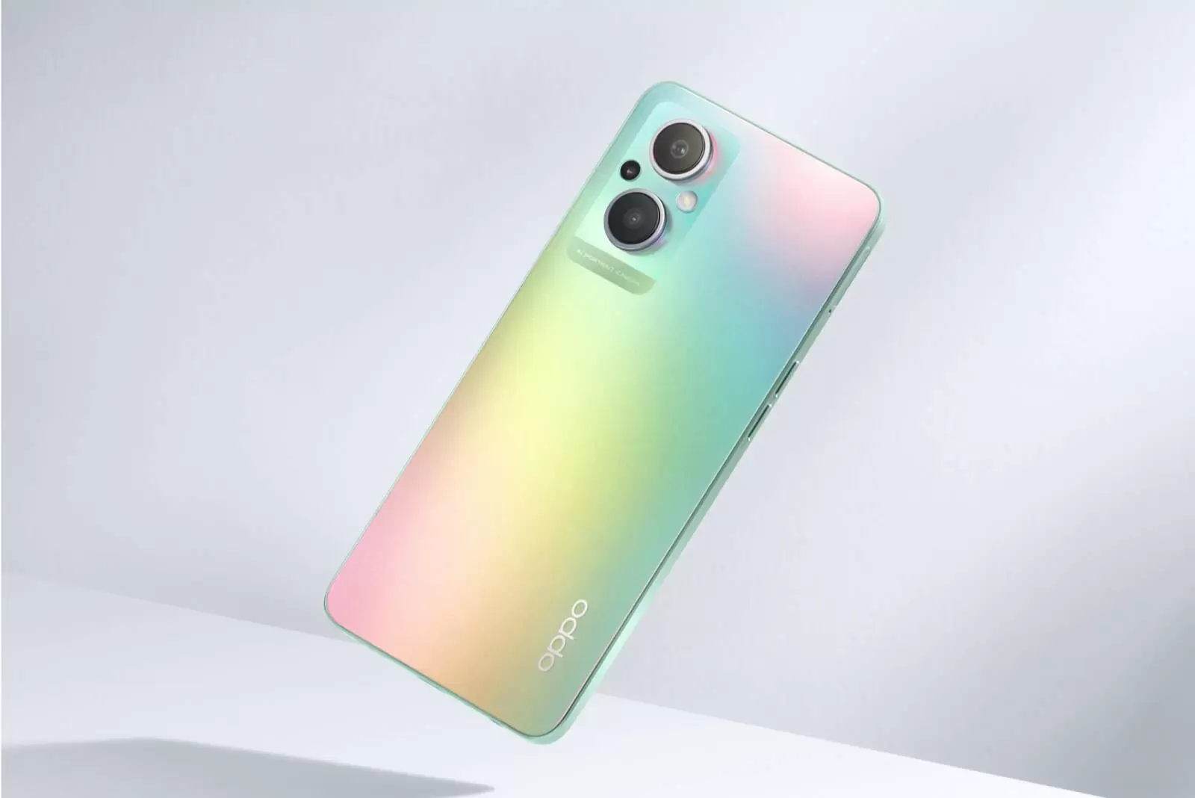




Recap: use cases [1]
10’s of billions of AMP+UHF tags can be read with a mobile device?
  UHF operation in sub-1GHz for 2B scenarios with 10+m range
  Consumer usage in 2.4GHz with WiFi device in close range
Read range requirement: 5~10cm

Slide 4
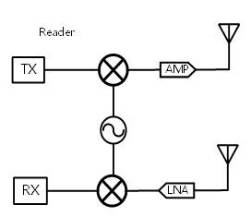
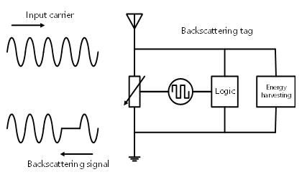
Recap: WiFi AMP
WiFi AMP reader
AMP tag
Downlink:
  AMP reader sends control signal to AMP tag
  AMP reader sends energizing signal to AMP tag for backscattering
Uplink (Backscatter):
  AMP reader sends energizing waveform for AMP tag to backscatter the information to the reader

Slide 5
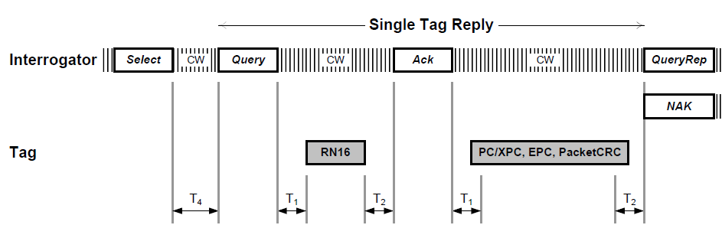
UHF RFID Reading Sequence: Example [3]
Reader sends CW waveform for entire read sequence
Reader to modulate control info. on CW to Tag.
Tag to backscatter and modulate info. on CW back to Reader

Slide 6
AMP DL PPDU: Structure
Wakeup portion
Read control Exchange
Backscattering data read
WiFi reader
Tag
Control Frame
Control Frame
Control Frame
AMP DL PPDU
Control Response
Data backscattering
WiFi reader sends DL PPDU with all ON energy.
DL PPDU with the following functions:
  Wake up portion:
    Energy to wake up an AMP tag to prepare for backscattering, ~1ms
  Read control exchange:
    Ping the AMP tag with request signal, and control info
    e.g. acknowledge the request, identify the tag ID, exchange security key, etc.
  Backscattering data read:
    Energize the AMP tag to send backscattered data
    Acknowledge the data

Slide 7
AMP DL PPDU: Format
WiFi-preamble | Energizer symbols | AMP SYNC and Control payload | Energizer symbols | AMP SYNC and Control payload | Energizer symbols | AMP SYNC and Control payload | …
DL PPDU can be an existing WiFi PPDU format
  11b waveform with constant energy (preferred)
  OFDM PPDU can be an option
  A new PPDU format with OFDM preamble and single-carrier payload
WiFi preamble:
  Provide medium protection and better coex with legacy WiFi STAs in 2.4GHz
Energizer symbols:
  Wake up the tag
  Provide carrier waveform for tag backscattering modulation
AMP SYNC and control payload
  Send DL control information to the tag(s)

Slide 8
DL TXOP Sequence
Energizer PPDU
Control+Energizer PPDU
Control+Energizer PPDU
Control PPDU
WiFi reader
Tag
CTS2Self
Control Frame
Control Frame
Control Frame
Control Response
Data backscattering
TXOP based reading sequence may be needed for the use cases that need longer TXOP, e.g. multi-tag reading
  Medium protection frame (e.g. CTS2self) to be sent to protect the entire sequence
  The TXOP consists of a sequence of Energizer PPDUs and Control PPDUs
More flexibility at the cost of more overhead
  Any intermediate failure can retry by WiFi reader with better efficiency
  Overhead increase due to preamble of each PPDU

Slide 9
DL TXOP: PPDUs
WiFi-preamble | Energizer symbols
WiFi-preamble | AMP SYNC | Control payload
WiFi-preamble | AMP SYNC | Control payload | Energizer symbols
Energizer PPDU:
  Energize the tag for wakeup and/or backscattered transmission
Control-only PPDU:
  Send control signals to the tag without feedback
Control+Energizer PPDU:
  Send control signals and energize tag to send immediate feedback

Slide 10
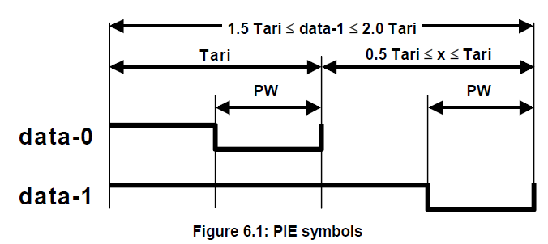
DL Control Modulation
WiFi reader sends out control info to AMP tag
  On-off keying (OOK) works for low power tag operation
  Pulse-Interval Encoding (PIE) [3] defined for UHF tag is preferred
    Enable the synergy with UHF tag for cost-effective design

Slide 11
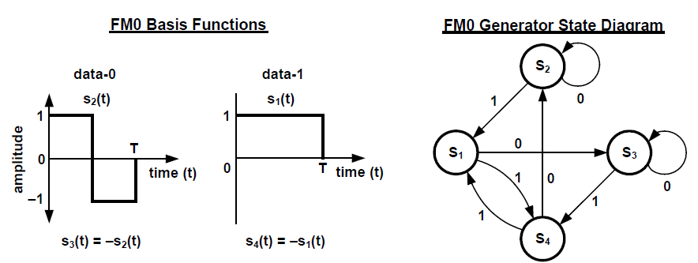
Tag Backscattering Modulation
WiFi reader energizes AMP tag to backscatter information
  On-off keying (OOK) works for low power tag operation
  FM0 and Miller coding [3] defined for UHF tag are preferred
    Enable the synergy with UHF tag for cost-effective design

Slide 12
Summary
Investigated the PPDU format and waveform needed for WiFi AMP tag reading functions.
Propose to use 11b-like PPDU as the “carrier” for backscattering communication.
Propose the preferred OOK modulation for both DL and UL
  Similar to UHF RFID standards

Slide 13
References
[1] 11-23/2038, Close Range AMP Backscattering in 2.4GHz
[2] 11-24/0836, Thoughts on AMP UHF RFID Tags
[3] EPC UHF Gen2 Air Interface Protocol | GS1

Slide 14
SP
Do you agree that 11bp to use 11b PPDU as the default PPDU to support close-range AMP tag backscattering?

Slide 15
SP
Do you agree that 11bp defines one mode of OOK modulation using pulse interval encoding (PIE) for the DL control in close-range backscattering?

Slide 16
SP
Do you agree that 11bp defines one mode of backscattering OOK modulation using FM0 encoding?

