Slide 1
Joint Medium Access and TXOP Sharing
Date: 2024-07-14
Authors:

Slide 2
Abstract
The 802.11 base standard defines mechanisms to access medium for UL/DL/P2P traffic.
There are UHR proposals to extend TXOP sharing for multi-user and UL/DL/P2P traffic.
This submission presents joint medium access and TXOP sharing:
Trigger/polling/ICF initiated by non-AP STA
TXOP sharing initiated by non-AP STA
Medium access for DL data initiated by non-AP STA

Slide 3
TXOP for UL/DL/P2P Traffic: Current Definition
There are existing mechanisms for medium access for UL/DL/P2P traffic
Each STA/AP tries to access the medium using CSMA and EDCA.
UL/DL/P2P traffic may be in the same TXOP,
for example, using TXS, RDG and MU cascading.
When AP obtains medium access:
it may initiate DL transmissions with certain STA(s).
it may use trigger frame to initiate UL transmissions with certain STA(s).
it may use TXS to allow the non-AP STA (as TXOP responder) to send UL data to AP (sharing mode 1) or send P2P data to another peer STA (sharing mode 2).
When non-AP STA obtains medium access:
it may initiate UL transmissions with AP or P2P transmissions with a peer STA.
it may use RDG to initiate DL transmissions with AP, although not widely used.

Slide 4
TXOP for UL/DL/P2P Traffic: UHR Proposals
There are proposals to extend TXOP sharing for multi-user and UL/DL/P2P traffic
When AP obtains medium access:
it may share the TXOP with multiple STAs and/or bidirectional traffic: MU-RTS TXS [1], multi-user TXS [2], TXOP for relay [3]
it may send advertisement of recommended P2P channels, e.g., time and channel info, for P2P group [5]
When non-AP STA obtains medium access:
it may share the TXOP for P2P and DL/UL traffic [4]
it may share the TXOP with AP: reverse TXOP Sharing [6], non-AP STA initiated TXOP sharing [7, 8]

Slide 5
TXOP for UL/DL/P2P Traffic: This Proposal
The main focus of this submission are:
non-AP STA initiating TXOPs
for a group of STAs, for example, P2P, relay, proxy, mesh, soft AP, multi-AP
for retrieving DL data from AP
AP as TXOP holder for AP-to-AP or P2P traffic
Proposal: joint medium access and TXOP sharing
Trigger/polling/ICF initiated by non-AP STA
TXOP sharing initiated by non-AP STA
It enables
medium access initiated by non-AP STA for
retrieving DL data from AP or P2P data from peer STA(s)
DL/UL/P2P/Relay transmissions in the same TXOP
medium access as a group for
trigger-based access within a group
TXOP sharing within a group

Slide 6
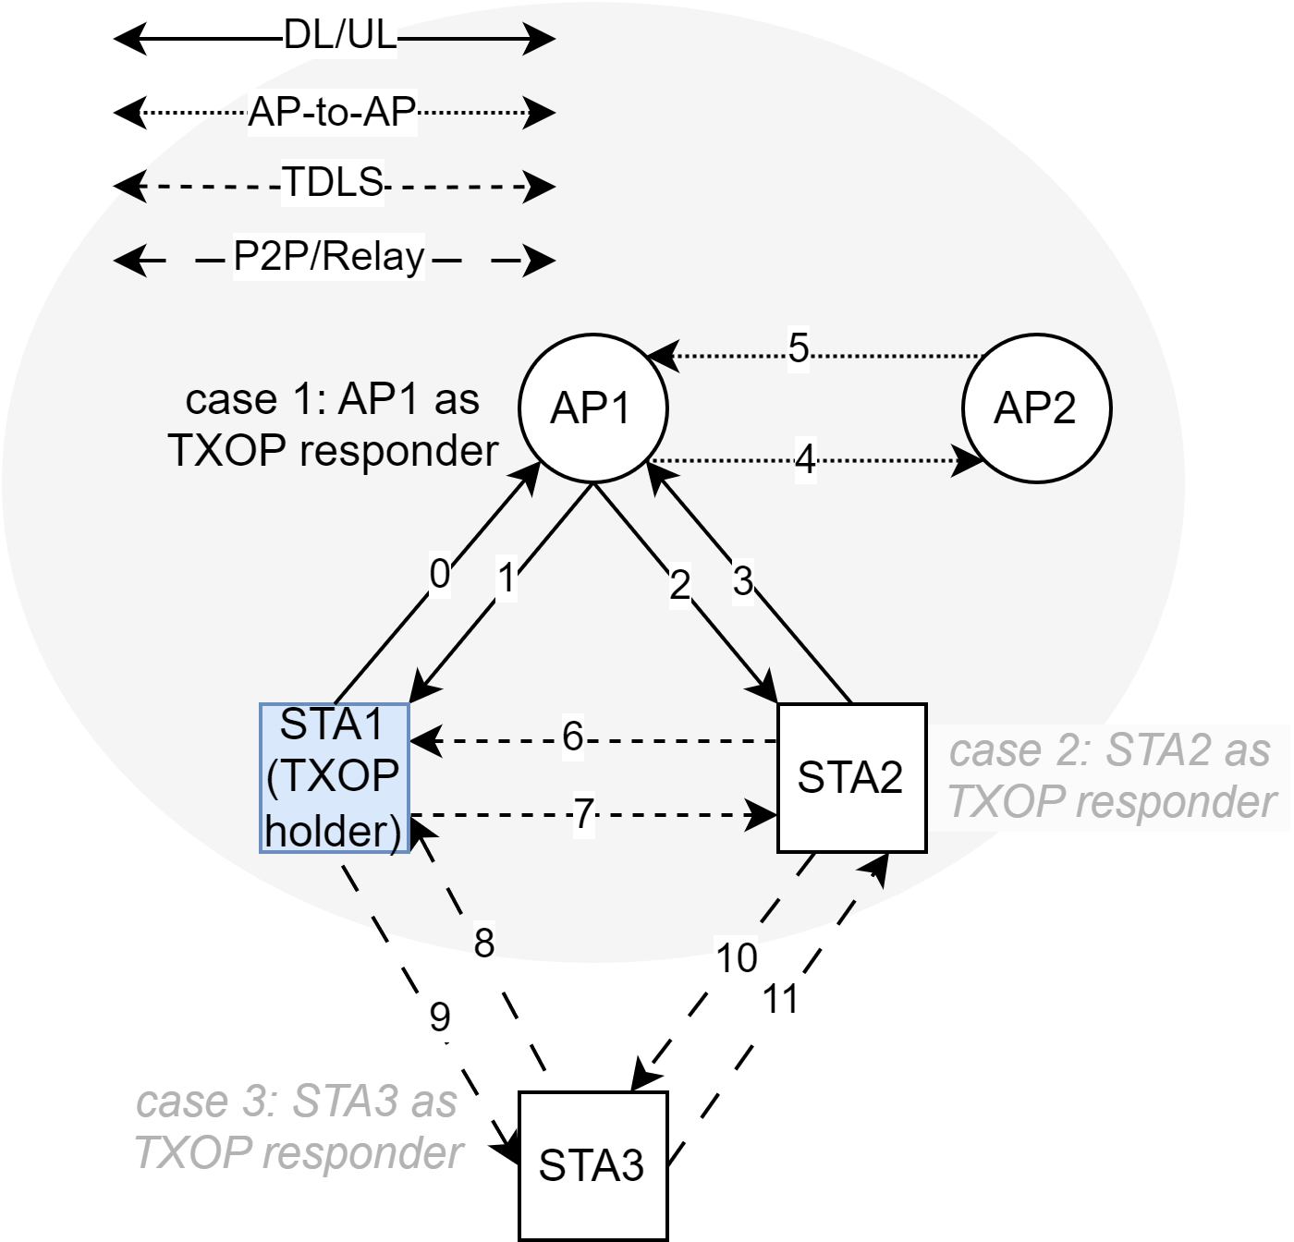
Non-AP STA Initiated TXOP Sharing
STA1 is the TXOP holder
AP1 as TXOP responder. STA1 shares TXOP with AP1. AP1 may initiate
DL transmissions with STA1
similar to RDG
DL/UL transmissions with STA2
e.g., for proxy use cases for VR/AR/XR
AP-to-AP transmissions with AP2
e.g., for multi-AP
STA2 as TXOP responder
TXOP shared with STA2 for transmissions with STA1, STA3, or AP1
STA3 as TXOP responder
TXOP shared with STA3 for transmissions with STA1 or STA2

Slide 7
Conclusion
This contribution presents joint medium access with three different mechanisms:
TXOP sharing initiated by trigger/polling/ICF by non-AP STA
DL data transmissions from AP, initiated by non-AP STA
It allows channel access being done in a semi-distributed way
It does not require initiation by the AP to get the TXOP and does not increase complexity for the AP: there is no need to decide when and how to share the AP’s TXOP.
It avoids in-group contention/backoff and hence avoids potential collisions and wasted TXOPs due to two levels of contention from both inter-group and intra-group STAs.
It provides additional options to get medium access for a group of STAs and can coexist with other options, e.g., EDCA, trigger-based access, TXS, and multi-STA TXOP sharing.

Slide 8
References
[1] 802.11-24/0403r0, Managed on-channel P2P communication, Inaki Val
[2] 802.11-24/0536r0, Multi-user triggered TXOP sharing, Ronny Yongho Kim
[3] 802.11-24/0105r0, TXOP for Relay communication in 11bn, Dongguk Lim
[4] 802.11-24/0668r1, Data Forwarding within TXOP for XR Use Cases, Seongho Byeon
[5] 802.11-24/0393r0, Enhancements on Off-Channel P2P Communications, Rubayet Shafin
[6] 802.11-23/1874r0, Reverse TXOP Sharing, Sindhu Verma
[7] 802.11-24/0686r0, STA initiated TXOP Sharing via Unicast CF-End, Pei Zhou
[8] 802.11-23/1847r0, Non-AP initiated TXOP sharing follow-up, Sanghyun Kim

Slide 9
Straw Polls
SP1: Do you support allowing a non-AP STA initiate TXOP sharing with its associated AP in TGbn?
A non-AP STA sends a TBD frame to the AP to initiate TXOP sharing.
Definitions and details of sharing modes are TBD, e.g., the AP may initiate
DL transmissions to the non-AP STA (similar to RDG)
DL/UL transmissions with another non-AP STA (for multi-STA/proxy transmissions such as in VR/AR/XR)
AP-to-AP transmissions with another AP (for multi-AP)
Results: Yes: , No: , Abstain:

Slide 10
Backup

Slide 11
Procedures and Examples
Each STA tries to access the medium by CSMA and EDCA.
Trigger/polling/TXOP sharing initiated by non-AP STA
TXOP is obtained and shared between a group of STAs.
The TXOP is initiated by ICF (initial Control frame).
If a certain STA, e.g., group leader, gets the TXOP, it may send ICF/trigger/polling frame and initiate transmissions with peer STA(s).
If a STA other than the group leader gets the TXOP, it may transfer/share the TXOP to group leader to initiate transmissions with peer STA(s).
Medium access initiated by non-AP STA to retrieve data from AP or peer STA
Non-AP STA as TXOP holder for receiving data from other STAs.
Non-AP STA needs to get DL data from the AP based on RX/L2 buffer status and other conditions.
Non-AP STA adds a request/trigger/polling frame in TX queue to get TXOP for DL data.

Slide 12
Trigger/Polling/ICF Initiated by Non-AP STA (1/2)
Medium access is performed in a semi-distributed way, sometimes distributed and sometimes scheduled
Distributed: each STA performs EDCA independently; TXS/control from AP is not needed
Scheduled/Controlled: trigger/polling/ICF to initiate transmissions among a group of STAs
This proposal does not require initiation by AP and does not increase the complexity for AP.
It does not use the AP’s TXOP that is acquired by contending with other STAs.
It does not rely on the AP for some of the non-AP STA’s transmissions.

Slide 13
Trigger/Polling/ICF Initiated by Non-AP STA (2/2)
It avoids in-group contention/backoff and hence avoids potential collisions and wasted TXOPs due to two levels of contention with both inter-group and intra-group STAs.
It can get channel access quicker for high priority STA/traffic and to have grouped DL/UL/P2P traffic in the same TXOP.
It provides additional options to gain medium access for a group of STAs and can coexist with other options, e.g., EDCA, trigger-based access, TXS, and multi-STA/-AP TXOP sharing.
It is scalable for a group of STAs in multi-link/-BSS/-AP scenarios.

Slide 14
Non-AP STA as TXOP Holder for DL Data (1/2)
Non-AP STA needs to retrieve DL data from the AP, based on RX/L2 buffer status at the non-AP STA or more DL data indication from the AP or non-AP STA.
Non-AP STA transmits a TBD frame that contains TXOP information (start time and duration) for DL data. It may be
a short frame, e.g., request to receive frame, similar to RTS or CTS-to-AP
a trigger/polling frame, e.g., as initial control frame
alternatively piggybacking onto UL data frames by modifying the TBD fields of the MAC header
It gives AP the indication of urgency of DL data that the non-AP STA is expecting.

Slide 15
Non-AP STA as TXOP Holder for DL Data (2/2)
After non-AP STA gets the TXOP and sends the request/trigger/polling frame to the AP:
If the AP is ready to transmit, it may send a newly-defined response frame, similar to CTS, or send DL PPDU directly to the non-AP STA.
If the AP is not ready to transmit, it may do nothing or send a response frame to the non-AP STA.
Other STAs set NAV based on the request frame from non-AP STA and/or the response frame/DL PPDU from the AP.
More data indication sent in the obtained TXOP, so AP/non-AP STA can take actions:
If multiple links are active, more data indication can be provided on one link and data is transmitted on another link.
More DL data indication may be in UL data (from non-AP STA) or BA (from AP).
The request/trigger/polling frame may also be sent on other links.

