Slide 1
Carrier PPDU Discussion for Long-range Backscatter Operation
July 2024
Date: 2024-07-18
Authors:
Name | Affiliations | Address | Phone | Email
Bin Qian | Huawei | Shenzhen, China |  | qianbin14@huawei.com
Lei Huang |  | Singapore
Panpan Li |  | Singapore
Wei Lin |  | Shenzhen, China
David, Xun Yang |  | Shenzhen, China
Notes:
September 2012

Slide 2
Abstract
July 2024
This contribution intends to discuss the Carrier PPDU used for AMP bi-static backscatter operation

Slide 3
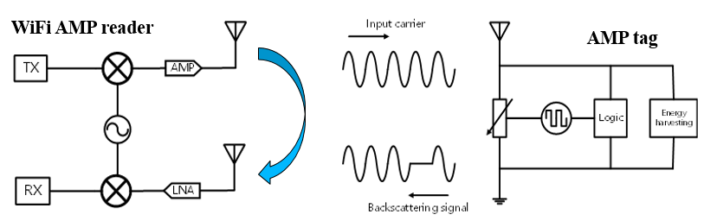
Recap: Close-range Backscatter in AMP
July 2024
The close-range backscatter use case has been discussed in [1-3]
  Mono-static: the Carrier Source and AMP reader are integrated
  Wi-Fi transceiver has 2+ antennas to support full-duplex operation
  Coverage: 10 cm - 20 cm
The transmitted input carrier can leak directly into the receiver, which can be significantly stronger than the backscattered signal from the tag
Leakage signal

Slide 4
Recap: Reader PPDU for Close-range Backscatter Operation
July 2024
An AMP Reader PPDU example structure is provided in [3]
  Wi-Fi Preamble is used to provide better coexistence with legacy Wi-Fi devices
  Reference Symbols are used by the AMP reader to estimate the Tx-Rx leakage channel to mitigate leakage by subtracting the leakage signal from the received signal
  Carrier Symbols are used by the AMP tag to generate the backscattered signals
The Reader PPDU is transmitted by the AMP reader
Note that the Reader PPDU is also called Energizer PPDU in [4]
Wi-Fi preamble | Reference Symbol(s) | Carrier Symbols

Slide 5
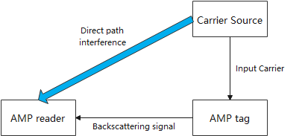
Bi-static Backscatter in AMP
July 2024
Another topology is also discussed in the group to support the long-range backscatter operation in AMP [5]
  Bi-static: the Carrier Source and AMP reader are separated, which results in half duplex operation
    Note that the Carrier Source is a non-AP STA
  Coverage: several meters [6]
This configuration suffers from the direct path interference problem. The direct signal component can be several orders of magnitude stronger than the backscattered signal

Slide 6
Carrier PPDU for Bi-static Backscatter Operation
July 2024
The Carrier PPDU (may also be called Energizer PPDU) for bi-static backscatter is transmitted by the Carrier Source
The Carrier PPDU has at least the following components and functions
  Wi-Fi Preamble: Provide the coexistence with legacy Wi-Fi devices
  Reference Symbols: Enable accurate estimation of the direct path to compensate the direct path interference to enhance the reader’s ability to detect and process the desired backscattered signals
  Carrier Symbols: Provide carrier symbols for the tag to modulate information
The Reference Symbols could be a part of Carrier Symbols
Field duration example
  Wi-Fi Preamble: 20 us; Reference Symbols: 8 us; Carrier Symbols: 640 us (20 octets at 250 kbps)

Slide 7
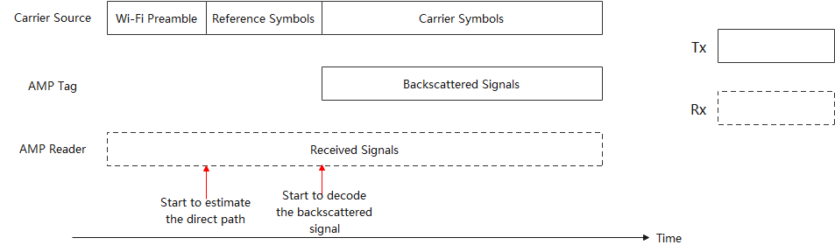
Start Time of Backscattered Signal
July 2024
In the bi-static backscatter use case, both the AMP reader and AMP tag need to synchronize the start time of the backscattered signal
  The AMP tag starts to modulate information on the carrier symbols after this point
  The AMP reader starts to decode the backscattered signal after this point

Slide 8
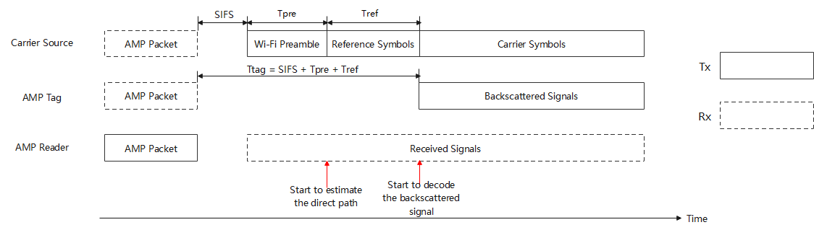
Start Time Indication of Backscattered Signal (1/6)
July 2024
An AMP packet is transmitted by the AMP Reader to trigger the transmission of the Carrier PPDU
The AMP tag detects this AMP packet and then waits for a certain duration (denoted as T_tag) to determine when the reference symbols end and the carrier symbols begin
Ideally, T_tag could be set as SIFS + T_pre + T_ref

Slide 9
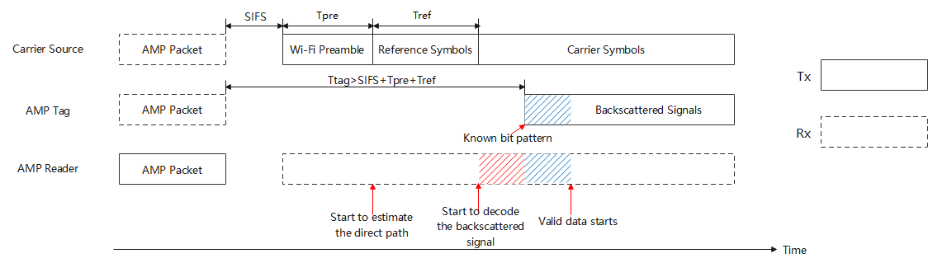
Start Time Indication of Backscattered Signal (2/6)
July 2024
However, due to the large clock error of the AMP tag, e.g., 10k ppm – 100k ppm, the time drift is significant
Case A: the actual value of T_tag is larger than (SIFS + T_pre + T_ref)
  A part of the decoded data at the AMP reader is not valid (red area)
  A known bit pattern, i.e., a delimiter (blue area), could be used at the beginning of the backscattered signal to indicate the start of the valid data

Slide 10
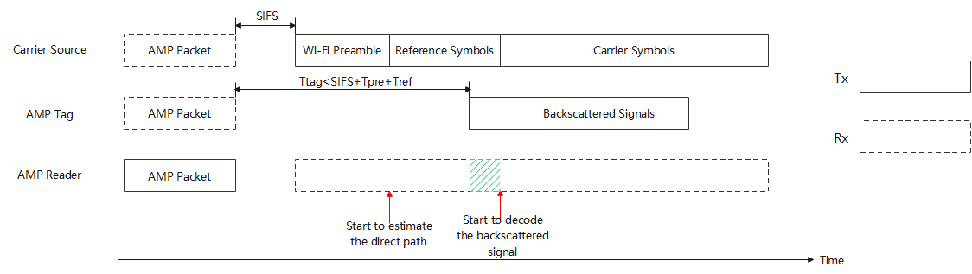
Start Time Indication of Backscattered Signal (3/6)
July 2024
Case B: the actual value of T_tag is smaller than (SIFS + T_pre + T_ref)
  A part of the valid backscattered signal (green area) is lost by the AMP reader

Slide 11
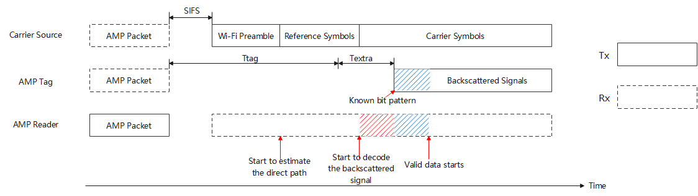
Start Time Indication of Backscattered Signal (4/6)
July 2024
Regarding Case B, besides T_tag, an extra duration T_extra could be preset by the AMP Tag to make sure the backscattered signals are generated by Carrier Symbols instead of Reference Symbols

Slide 12
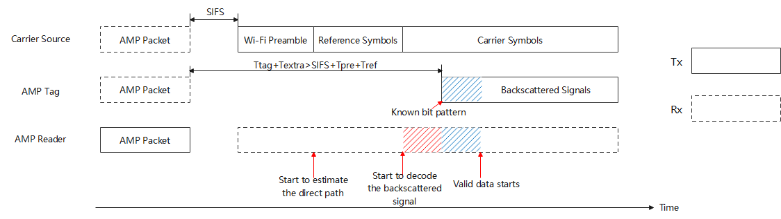
Start Time Indication of Backscattered Signal (5/6)
July 2024
Since the AMP Tag does not know it is Case A or Case B, the extra duration T_extra will be used in both cases
  T_extra is set such that even in the worst case, T_tag + T_extra > SIFS + T_pre + T_ref

Slide 13
Start time indication of the backscattered signal (6/6)
July 2024
Some observations about the bit pattern (i.e., delimiter) for the backscattered signal
Aspect | Comments
Complexity | Low: Simple delimiter pattern detection at the AMP reader side
Clock Accuracy Requirement | Low: Tolerant to clock drift
Robustness | High: Robust to timing inaccuracies, no cumulative errors
Implementation | Simple: requires delimiter detection at the AMP reader side
Use case | Most scenarios, especially with significant clock drift

Slide 14
Summary
July 2024
The Carrier PPDU (i.e., Energizer PPDU) for the bi-static backscatter operation is discussed
The time drift caused by the clock error of the AMP tag needs to be considered
A known bit pattern could be used at the beginning of the backscattered signal to indicate the start of the valid data

Slide 15
References
July 2024
[1] 11-23-2038-01-0amp-close-range-amp-backscattering-in-2.4ghz
[2] 11-24-0537-00-0amp-close-range-amp-wifi-reader-feasibility-study
[3] 11-24-0798-01-00bp-close-range-amp-wifi-reader-feasibility-study-followup
[4] 11-24-1236-00-00bp-close-range-backscattering-waveform-and-modulation
[5] 11-24-0867-00-00bp-thoughts-and-questions-on-amp-phy
[6] 11-24-1215-00-00bp-feasibility-study-on-long-range-backscatter-operation

