Slide 1
DRU Tone Plan for 11bn-Follow Up
Date: 2024-07-11
Authors:
Name | Affiliations | Address | Phone | Email
Shengquan Hu | Mediatek | 2840 Junction Ave. San Jose, CA, 95134 |  | shengquan.hu@mediatek.com
Jianhan Liu |  |  |  | jianhan.liu@mediatek.com
Thomas Pare

Slide 2
Introduction
We proposed the detailed DRU tone plan design in [1] for distribution BW20/40/80 by using 26-tone RU based method, our design:
  Achieve optimal power boost gain
  Preserve hierarchical structure for simpler scheduling & signaling
  Have better tone distribution pattern with either uniformly or near-uniformly distributed which makes channel smoothing easier and achieve better smoothing gains
  Tone indices generation with PAPR reduction
Contributions in [2~3] proposed DRU tone plans by tweaking or making some modifications on top of DRU tone plan we proposed in [1], the new tweaked/modified tone plans in [2,3] are either with tone distribution pattern not implementation friendly or introducing severe PD false detection issue
In this contribution, we will share our analysis and comparison of the DRU tone plans proposed in [1,2,3]

Slide 3
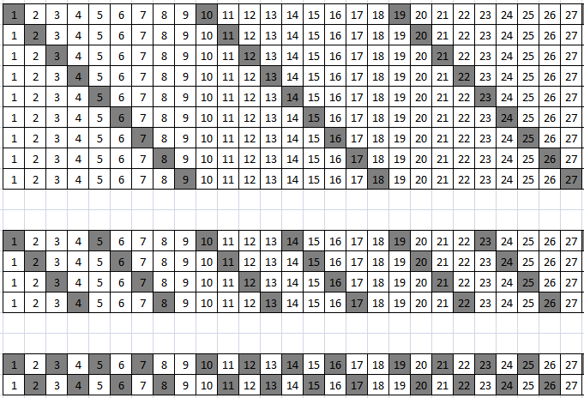
DRU Tone Pattern for BW20: Ref [1]
Data and pilot subcarrier indices for Distributed Tone RUs (DRUs) in a 20 MHz UHR PPDU
DRU type | DRU index and subcarrier range
26-tone DRU i=1:9 | DRU1 [-120:9:-12, 6:9:114] | DRU2 [-116:9:-8, 10:9:118] | DRU3 [-118:9:-10, 8:9:116] | DRU4 [-114:9:-6, 12:9:120] | DRU5 [-112:9:-4, 5:9:113]
 | DRU6 [-119:9:-11, 7:9:115] | DRU7 [-115:9:-7, 11:9:119] | DRU8 [-117:9:-9, 9:9:117] | DRU9 [-113:9:-5, 4:9:112]
52-tone DRU i=1:4 | DRU1 26-tone [DRU1, DRU2] |  | DRU2 26-tone [DRU3, DRU4]
 | DRU3 26-tone [DRU6, DRU7] |  | DRU4 26-tone [DRU8, DRU9]
106-tone DRU i=1:2 | DRU1 26-tone [DRU1~4], [-3, 3] |  | DRU2 26-tone [DRU6~9], [-2, 2]
Np=9
Np=9
DRU26_1
DRU26
DRU26_6
DRU26_3
The DRU index are carefully arranged to make sure:
  Same size DRU has the same distribution pattern
  Easier for channel smoothing design and optimization
  Tone distribution in repeat fashion
(1 tone in one repetition period)
DRU26_8
DRU26_2
DRU26_7
DRU26_4
DRU26_9
DRU26_5
Np=9
Np=9
DRU52
DRU52_1
(2 tones in one repetition period)
DRU52_3
DRU52_2
DRU52_4
DRU106
Np=9
Np=9
(4 tones in one repetition period)
DRU106_1
DRU106_2
(above just illustrates the distribution pattern with DRU tone relative position)
Slide 3
Shengquan Hu, Mediatek Inc.

Slide 4
DRU Tone Pattern for BW20: Ref [2]
Contribution [2] proposed DRU tone plan by reshuffling Ref [1] DRU26 assignments as below:
DRU26_1 (Ref[1]) → DRU26_1 (Ref[2]
DRU26_2 (Ref[1]) → DRU26_7 (Ref[2]
DRU26_3 (Ref[1]) → DRU26_3 (Ref[2]
DRU26_4 (Ref[1]) → DRU26_9 (Ref[2]
DRU26_5 (Ref[1]) → DRU26_6 (Ref[2]
DRU26_6 (Ref[1]) → DRU26_8 (Ref[2]
DRU26_7 (Ref[1]) → DRU26_2 (Ref[2]
DRU26_8 (Ref[1]) → DRU26_5 (Ref[2]
DRU26_9 (Ref[1]) → DRU26_4 (Ref[2]
Reshuffling Ref [1]’s DRU26 by Ref [2]:
  Doesn’t provide any performance benefit
  Will cause different distribution patterns for same size DRU52 and DRU106
  This will make channel smoothing design more challenging
  Claimed mirror-symmetric in [2] does not provide any performance benefit, instead, it introduces design difficulty
Slide 4
Shengquan Hu, Mediatek Inc.

Slide 5
DRU Tone Pattern for BW20: Ref [2]
DRU26_1 (Ref[1]) → DRU26_1 (Ref[2])
DRU26_2 (Ref[1]) → DRU26_7 (Ref[2])
DRU26_3 (Ref[1]) → DRU26_3 (Ref[2])
DRU26_4 (Ref[1]) → DRU26_9 (Ref[2])
DRU26_5 (Ref[1]) → DRU26_6 (Ref[2])
DRU26_6 (Ref[1]) → DRU26_8 (Ref[2])
DRU26_7 (Ref[1]) → DRU26_2 (Ref[2])
DRU26_8 (Ref[1]) → DRU26_5 (Ref[2])
DRU26_9 (Ref[1]) → DRU26_4 (Ref[2])
Data and pilot subcarrier indices for Distributed Tone RUs (DRUs) in a 20 MHz UHR PPDU
DRU type | DRU index and subcarrier range
26-tone DRU i=1:9 | DRU1 [-120:9:-12, 6:9:114] | DRU2 [-116:9:-8, 10:9:118] | DRU3 [-118:9:-10, 8:9:116] | DRU4 [-114:9:-6, 12:9:120] | DRU5 [-112:9:-4, 5:9:113]
 | DRU6 [-119:9:-11, 7:9:115] | DRU7 [-115:9:-7, 11:9:119] | DRU8 [-117:9:-9, 9:9:117] | DRU9 [-113:9:-5, 4:9:112]
52-tone DRU i=1:4 | DRU1 26-tone [DRU1, DRU2] |  | DRU2 26-tone [DRU3, DRU4]
 | DRU3 26-tone [DRU6, DRU7] |  | DRU4 26-tone [DRU8, DRU9]
106-tone DRU i=1:2 | DRU1 26-tone [DRU1~4], [-3, 3] |  | DRU2 26-tone [DRU6~9], [-2, 2]
Ref [1]
Reshuffling Ref[1]’s DRU26
Data and pilot subcarrier indices for Distributed Tone RUs (DRUs) in a 20 MHz UHR PPDU
DRU type | DRU index and subcarrier range
26-tone DRU i=1:9 | DRU1 [-120:9:-12, 6:9:114] | DRU2 [-115:9:-7, 11:9:119] | DRU3 [-118:9:-10, 8:9:116] | DRU4 [-113:9:-5, 4:9:112] | DRU5 [-117:9:-9, 9:9:117]
 | DRU6 [-112:9:-4, 5:9:113] | DRU7 [-116:9:-8, 10:9:118] | DRU8 [-119:9:-11, 7:9:115] | DRU9 [-114:9:-6, 12:9:120]
52-tone DRU i=1:4 | DRU1 26-tone [DRU1, DRU2] |  | DRU2 26-tone [DRU3, DRU4]
 | DRU3 26-tone [DRU6, DRU7] |  | DRU4 26-tone [DRU8, DRU9]
106-tone DRU i=1:2 | DRU1 26-tone [DRU1~4], [-3, 2] |  | DRU2 26-tone [DRU6~9], [-2, 3]
Ref [2]
Slide 5
Shengquan Hu, Mediatek Inc.

Slide 6
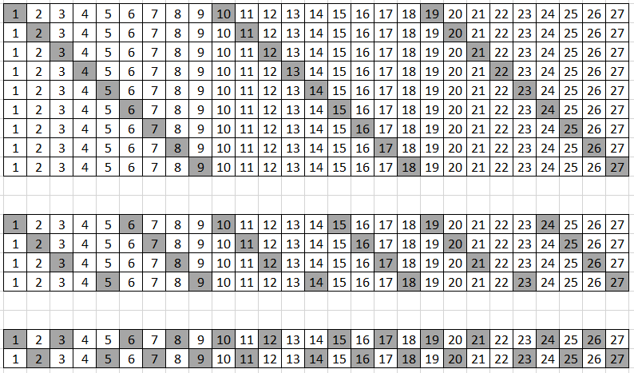
DRU Tone Pattern for BW20: Ref [2]
  In Ref [2], different distribution patterns for same size DRU52 and DRU106, for an example:
DRU52_1,2,4 distribution pattern: 4 3 4 3 4 3 …..
DRU52_3 distribution pattern: 3 4 3 4 3 4 …..
DRU26_1
DRU26
DRU26_8
DRU26_3
(1 tone in one repetition period)
DRU26_5
DRU26_7
DRU26_2
DRU26_9
DRU26_4
DRU26_6
Np=9
DRU52
DRU52_1
(2 tones in one repetition period)
DRU52_4
DRU52_2
DRU52_3
Same size DRU has different tone pattern within a repetition period
Make channel smoothing design more challenging
DRU106
DRU106_1
(4 tones in one repetition period)
DRU106_2
Np=9
Np=9
Slide 6
Shengquan Hu, Mediatek Inc.

Slide 7
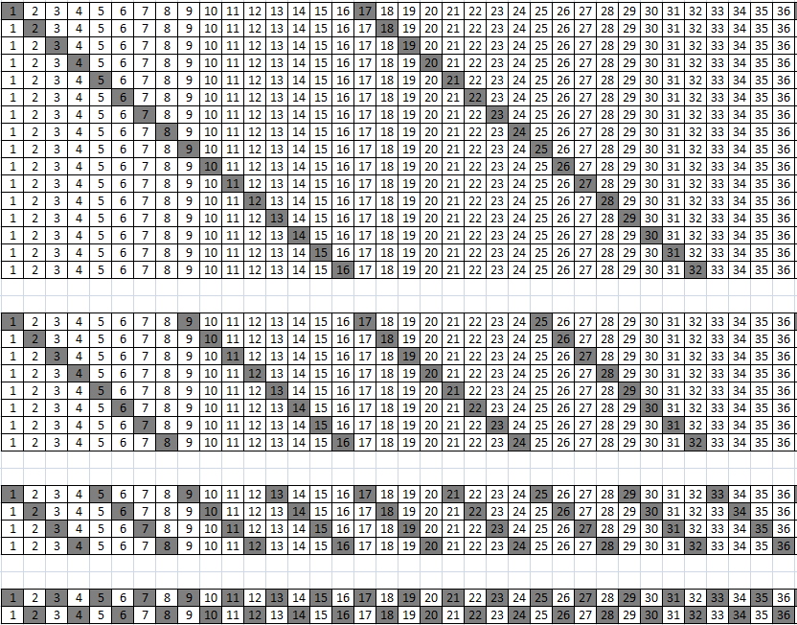
DRU Tone Pattern for BW80: Ref [1]
We proposed DRU tone plan for BW80 in [1], the tone plan was well designed to:
  Achieve optimal power boost gain
  Perfect uniformly distributed for larger DRU242/484 to harvest best smoothing gain & achieve low PAPR
  Tone pattern was carefully arranged for DRU52 to break 0.8us periodic pattern to avoid PD false detection issue, meanwhile near-uniformly distributed for both DRU52 & DRU106 for easier channel smoothing design
Np=36
DRU52
(2 tones in one repetition period)
Break 16 16 16 16 16 … pattern to avoid PD false detection issue
Np=36
DRU106
(4 tones in one repetition period)
Near-uniformly distributed
DRU242
Np=36
(9 tones in one repetition period)
DRU484
Np=36
Perfect uniformly distributed
(18 tones in one repetition period)
(above just illustrates the distribution pattern with DRU tone relative position)
Slide 7
Shengquan Hu, Mediatek Inc.

Slide 8
DRU Tone Pattern for BW80: Ref [3]
DRU tone plan for BW80 in [3]:
  Keep DRU242 & DRU484 same as in Ref [1]
  Modify DRU52 and DRU106 tone distribution
  DRU106 is uniformly distributed
  DRU52 is near-uniformly distributed with long 16 16 16 … 16 repetition pattern ➔ cause PD false detection
52-tone DRU i=1:16 | DRU1 [-471:16:-391, -367:16:-159, -135:16:-55, 41:16:121, 145:16:353, 377:16:457] | DRU2 [-463:16:-383, -359:16:-151, -127:16:-47, 49:16:129, 153:16:361, 385:16:465] | DRU3 [-467:16:-387, -363:16:-155, -131:16:-51, 45:16:125, 149:16:357, 381:16:461] | DRU4 [-459:16:-379, -355:16:-147, -123:16:-43, 53:16:133, 157:16:365, 389:16:469]
 | DRU5 [-465:16:-385, -361:16:-153, -129:16:-49, 47:16:127, 151:16:359, 383:16:463] | DRU6 [-457:16:-377, -353:16:-145, -121:16:-41, 55:16:135, 159:16:367, 391:16:471] | DRU7 [-469:16:-389, -365:16:-157, -133:16:-53, 43:16:123, 147:16:355, 379:16:459] | DRU8 [-461:16:-381, -357:16:-149, -125:16:-45, 51:16:131, 155:16:363, 387:16:467]
 | DRU9 [-470:16:-390, -366:16:-158, -134:16:-54, 42:16:122, 146:16:354, 378:16:458] | DRU10 [-462:16:-382, -358:16:-150, -126:16:-46, 50:16:130, 154:16:362, 386:16:466] | DRU11 [-466:16:-386, -362:16:-154, -130:16:-50, 46:16:126, 150:16:358, 382:16:462] | DRU12 [-458:16:-378, -354:16:-146, -122:16:-42, 54:16:134, 158:16:366, 390:16:470]
 | DRU13 [-464:16:-384, -360:16:-152, -128:16:-48, 48:16:128, 152:16:360, 384:16:464] | DRU14 [-456:16:-376, -352:16:-144, -120:16:-40, 56:16:136, 160:16:368, 392:16:472] | DRU15 [-468:16:-388, -364:16:-156, -132:16:-52, 44:16:124, 148:16:356, 380:16:460] | DRU16 [-460:16:-380, -356:16:-148, -124:16:-44, 52:16:132, 156:16:364, 388:16:468]
106-tone DRU i=1:8 | DRU1 [-471:8:-383, -367:8:-47, 41:8:361, 377:8:465] | DRU2 [-467:8:-379, -363:8:-43, 45:8:365, 381:8:469] | DRU3 [-465:8:-377, -361:8:-41, 47:8:367, 383:8:471] | DRU4 [-469:8:-381, -365:8:-45, 43:8:363, 379:8:467]
 | DRU5 [-470:8:-382, -366:8:-46, 42:8:362, 378:8:466] | DRU6 [-466:8:-378, -362:8:-42, 46:8:366, 382:8:470] | DRU7 [-464:8:-376, -360:8:-40, 48:8:368, 384:8:472] | DRU8 [-468:8:-380, -364:8:-44, 44:8:364, 380:8:468]
242-tone DRU i=1:4 | DRU1 [-499:4:-19, 17:4:497] |  | DRU2 [-497:4:-17, 19:4:499]
 | DRU3 [-498:4:-18, 18:4:498] |  | DRU4 [-496:4:-16, 20:4:500]
484-tone DRU i=1:2 | DRU1 [-499:2:-17, 17:2:499] |  | DRU2 [-498:2:-16, 18:2:500]
Same as Ref [1]
Slide 8
Shengquan Hu, Mediatek Inc.

Slide 9
DRU Tone Pattern for BW80: Ref [3]
DRU tone plan for BW80 in [3]:
  DRU52 is near-uniformly distributed with long 16 16 16 … 16 repetition pattern, i.e. near 0.8us periodicity ➔ cause PD false detection under multipath channels
Ref [3] | 16 | 16 | 16 | 16 | 16 | 24 | 16 | 16 | 16 | 16 | 16 | 16
Ref [1] | 16 | 20 | 16 | 20 | 16 | 20 | 16 | 20 | 16 | 20 | 16 | 20
16 | 16 | 16 | 16 | 16 | 16 | 16 | 24 | 16 | 16 | 16 | 16 | 16
16 | 20 | 16 | 20 | 16 | 20 | 16 | 20 | 16 | 20 | 16 | 20 | 16
96 | 16 | 16 | 16 | 16 | 16 | 24 | 16 | 16 | 16 | 16 | 16 | 16
52 | 16 | 20 | 16 | 20 | 16 | 20 | 16 | 20 | 16 | 20 | 16 | 20
16 | 16 | 16 | 16 | 16 | 16 | 16 | 24 | 16 | 16 | 16 | 16 | 16
16 | 20 | 16 | 20 | 16 | 20 | 16 | 20 | 16 | 20 | 16 | 20 | 16
Slide 9
Shengquan Hu, Mediatek Inc.

Slide 10
PD False Detection Issue for DRU52 on 80MHz by Ref [3]
The simulations confirm DRU tone plan by Ref [3] has PD false detection issue under multipath fading channels:
  B-LOS
  20dB SNR
  QPSK
PD
L-STF | L-LTF | L-SIG | RL-SIG | U-SIG | UHR-STF | UHR-LTF | UHR-LTF | DATA | DATA | ---------------- | DATA
DRU52 Index | PD False Detect Rate
 | Ref [1] | Ref [3]
1 | 0.004 | 0.412
2 | 0.002 | 0.420
3 | 0.002 | 0.406
4 | 0.002 | 0.424
5 | 0.002 | 0.416
6 | 0.002 | 0.430
7 | 0.002 | 0.410
8 | 0.002 | 0.428
9 | 0.002 | 0.406
10 | 0.002 | 0.418
11 | 0.004 | 0.406
12 | 0.006 | 0.432
13 | 0.002 | 0.416
14 | 0.002 | 0.442
15 | 0.002 | 0.408
16 | 0.002 | 0.428
Average | 0.0025 | 0.4189
Slide 10
Shengquan Hu, Mediatek Inc.

Slide 11
Summary
In this contribution, we have shared the analysis and comparison of the DRU tone plan proposed in [1] vs [2] & [3]:
  [1] vs [2] of DRU tone plan on BW20:
    [2] tweaked [1] design by reshuffling DRU26
    In [2], different tone distribution pattern for same size DRU makes design such as channel smoothing more challenge
  [1] vs [3] of DRU tone plan on BW80:
    [3] keeps same tone plan for DRU242 & DRU484 as [1]
    BUT, DRU52 tone plan by [3] cause severe PD false detection issue

Slide 12
Reference
  [1]. 11-24-0468-02-00bn-dru-tone-plan-for-11bn
  [2]. 11-24-1096-00-00bn-mirror-symmetric-20-mhz-dru-tone-plan-within-242-rru-boundary
  [3]. 11-24-0799-00-00bn-dru-tone-plan-from-the-perspective-of-papr
Slide 12
Shengquan Hu, Mediatek Inc.

Slide 13
Straw Poll #1
Do you agree to include the following text to the 11bn SFD?
  Data and pilot subcarrier indices for DRUs in a 20 MHz UHR PPDU are defined in following table:
Data and pilot subcarrier indices for Distributed Tone RUs (DRUs) in a 20 MHz UHR PPDU
DRU type | DRU index and subcarrier range
26-tone DRU i=1:9 | DRU1 [-120:9:-12, 6:9:114] | DRU2 [-116:9:-8, 10:9:118] | DRU3 [-118:9:-10, 8:9:116] | DRU4 [-114:9:-6, 12:9:120] | DRU5 [-112:9:-4, 5:9:113]
 | DRU6 [-119:9:-11, 7:9:115] | DRU7 [-115:9:-7, 11:9:119] | DRU8 [-117:9:-9, 9:9:117] | DRU9 [-113:9:-5, 4:9:112]
52-tone DRU i=1:4 | DRU1 26-tone [DRU1, DRU2] |  | DRU2 26-tone [DRU3, DRU4]
 | DRU3 26-tone [DRU6, DRU7] |  | DRU4 26-tone [DRU8, DRU9]
106-tone DRU i=1:2 | DRU1 26-tone [DRU1~4], [-3, 3] |  | DRU2 26-tone [DRU6~9], [-2, 2]
Slide 13
Shengquan Hu, Mediatek Inc.

Slide 14
Straw Poll #2
Do you agree to include the following text to the 11bn SFD?
  Data and pilot subcarrier indices for DRUs in a 40 MHz UHR PPDU are defined in following table:
Data and pilot subcarrier indices for Distributed Tone RUs (DRUs) in a 40 MHz UHR TB PPDU
DRU type | DRU index and subcarrier range
26-tone DRU i=1:18 | DRU1 [-242:18:-26, 10:18:226] | DRU2 [-233:18:-17, 19:18:235] | DRU3 [-238:18:-22, 14:18:230] | DRU4 [-229:18:-13, 23:18:239] | DRU5 [-225:18:-9, 27:18:243] | DRU6 [-240:18:-24, 12:18:228]
 | DRU7 [-231:18:-15, 21:18:237] | DRU8 [-236:18:-20, 16:18:232] | DRU9 [-227:18:-11, 25:18:241] | DRU10 [-241:18:-25, 11:18:227] | DRU11 [-232:18:-16, 20:18:236] | DRU12 [-237:18:-21, 15:18:231]
 | DRU13 [-228:18:-12, 24:18:240] | DRU14 [-234:18:-18, 18:18:234] | DRU15 [-239:18:-23, 13:18:229] | DRU16 [-230:18:-14, 22:18:238] | DRU17 [-235:18:-19, 17:18:233] | DRU18 [-226:18:-10, 26:18:242]
52-tone DRU i=1:8 | DRU1 [-242:9:-17, 10:9:235] |  | DRU2 [-238:9:-13, 14:9:239] |  | DRU3 [-240:9:-15, 12:9:237]
 | DRU4 [-236:9:-11, 16:9:241] |  | DRU5 [-241:9:-16, 11:9:236] |  | DRU6 [-237:9:-12, 15:9:240]
 | DRU7 [-239:9:-14, 13:9:238] |  | DRU8 [-235:9:-10, 17:9:242]
106-tone DRU i=1:4 | DRU1 26-tone [DRU1~4], [-8,5] |  | DRU2 26-tone [DRU6~9], [-6,7] |  | DRU3 26-tone [DRU10~13], [-7,6]
 | DRU4 26-tone [DRU15~18], [-5,8]
242-tone DRU i=1:2 | DRU1 106-tone [DRU1~2],26-tone DRU5, [-244,-4,3,9] |  | DRU2 106-tone [DRU3~4],26-tone DRU14, [-243,-3,4,244]
Slide 14
Shengquan Hu, Mediatek Inc.

Slide 15
Straw Poll #3
Do you agree to include the following text to the 11bn SFD?
  Data and pilot subcarrier indices for DRUs in an 80 MHz UHR PPDU are defined in following table:
Data and pilot subcarrier indices for Distributed Tone RUs (DRUs) in a 80 MHz UHR TB PPDU
DRU type | DRU index and subcarrier range
52-tone DRU i=1:16 | DRU1 [-483:36:-51, 17:36:449],[-467:36:-35, 33:36:465] | DRU2 [-475:36:-43, 25:36:457],[-459:36:-27, 41:36:473] | DRU3 [-479:36:-47, 21:36:453],[-463:36:-31, 37:36:469] | DRU4 [-471:36:-39, 29:36:461],[-455:36:-23, 45:36:477]
 | DRU5 [-477:36:-45, 23:36:455],[-461:36:-29, 39:36:471] | DRU6 [-469:36:-37, 31:36:463],[-453:36:-21, 47:36:479] | DRU7 [-481:36:-49, 19:36:451],[-465:36:-33, 35:36:467] | DRU8 [-473:36:-41, 27:36:459],[-457:36:-25, 43:36:475]
 | DRU9 [-482:36:-50, 18:36:450],[-466:36:-34, 34:36:466] | DRU10 [-474:36:-42, 26:36:458],[-458:36:-26, 42:36:474] | DRU11 [-478:36:-46, 22:36:454],[-462:36:-30, 38:36:470] | DRU12 [-470:36:-38, 30:36:462],[-454:36:-22, 46:36:478]
 | DRU13 [-476:36:-44, 24:36:456],[-460:36:-28, 40:36:472] | DRU14 [-468:36:-36, 32:36:464],[-452:36:-20,48:36:480] | DRU15 [-480:36:-48, 20:36:452],[-464:36:-32, 36:36:468] | DRU16 [-472:36:-40, 28:36:460],[-456:36:-24, 44:36:476]
106-tone DRU i=1:8 | DRU1 52-tone [DRU1~2], [-495, 485] | DRU2 52-tone [DRU3~4],[-491, 489] | DRU3 52-tone [DRU5~6],[-489, 491] | DRU4 52-tone [DRU7~8],[-493, 487]
 | DRU5 52-tone [DRU9~10],[-494, 486] | DRU6 52-tone [DRU11~12],[-490,490] | DRU7 52-tone [DRU13~14],[-488,492] | DRU8 52-tone [DRU15~16],[-492,488]
242-tone DRU i=1:4 | DRU1 [-499:4:-19, 17:4:497] |  | DRU2 [-497:4:-17, 19:4:499]
 | DRU3 [-498:4:-18, 18:4:498] |  | DRU4 [-496:4:-16, 20:4:500]
484-tone DRU i=1:2 | DRU1 [-499:2:-17, 17:2:499] |  | DRU2 [-498:2:-16, 18:2:500]
Slide 15
Shengquan Hu, Mediatek Inc.

