Slide 1
Reference model of AMP only IOT devices
Date: 2024-07-11
Authors:

Slide 2
Abstract
In this contribution, a reference model of an AMP only IOT devices is proposed and analyzed.

Slide 3
AMP IoT device types
Different types of AMP devices have been identified and analyzed in previously presented and published contributions [1] and [2]. There are AMP-only IoT devices vs AMP-assisted IoT devices.
The AMP-only IoT device are characterized as ultra-low complexity, ultra-low power consumption, very small form factor and battery-less (i.e., not using conventional battery).
An AMP-assisted IoT device may be similar to a legacy 802.11 (e.g., 802.11n/11ah) device, it can reuse the current PHY design but with enhanced MAC features to adapt to operation with a specific kind of ambient power. Since the ambient power is very limited and sometimes unstable and uncontrollable, the enhanced power saving and power management can be adapted for the unstable and uncontrollable ambient power.
Two types of the AMP-only IoT devices are identified: Type 1- RF powered AMP device; Type 2- non-RF powered AMP device, e.g., thermal, solar, etc.

Slide 4
Preliminary conclusion
The requirements presented in [2] applies to all identified use cases of the AMP-only IoT devices. The use cases are characterized by very specific limitations of Maximum payload size (very short), and Peak device power consumption (very low)
In this contribution, we explore a reference model that meets these requirements

Slide 5
Two approaches
Exchange of information between tag and interrogator via MAC SAP
  Delivering information through the data link layer to the MAC SAP
  Management by SME
Exchange of information between tag and interrogator via SME
  Delivery of information to SME
  Management by SME

Slide 6
AMP-only IoT Reference model (Option 1)
802.11full stack compliant STA

Slide 7
AMP-only IoT Reference model (Option 2)
Block level 802.11 compliant STA

Slide 8
Data delivery (Option 1)
Interrogator
Tag

Slide 9
Data delivery (Option 2)
Interrogator
Tag

Slide 10
Example of how the SME is used in the 802.11bf amendment
The amendment 802.11bf (Enhancements for Wireless LAN Sensing) is a good example of how SMEs can be used to perform functions that also include data exchange.
WLAN sensing uses certain IEEE 802.11 PHY and MAC features to make environmental measurements that could be useful to estimate the range, velocity, and motion of objects in an area of interest. Measurements obtained with WLAN sensing might support applications such as presence detection, motion detection, and gesture classification.
Among the functions specified in the amendment and performed by SMEs of the STAs are:
AP triggered delivery of the information collected by the non-AP STAs.
non-AP STA triggered delivery of the information collected by other non-AP STAs.
The exchange of collected information between applications via the Internet is carried out in a standard way and does not require a new specification. Thus, the 802.11bf amendment does not define this communication.

Slide 11
Example of reporting data exchange in the 802.11bf amendment

Slide 12
802.11bf MLME primitives

Slide 13
Example of inventory and command (based on [3])
None of the exchanges in the diagram use data type frames. Therefore, MAC SAP is not used.

Slide 14
Example of inventory and command in Option 2
MLME-AMPQUERY.request - initiates an exchange of inventory frames.
MLME-AMPQUERY.indication – delivers UII and parameters to the interrogator SME.
MLME-AMPQUERY.confirm - delivers the tag handle to the interrogator SME.
MLME-AMPCOMMAND.request – initiates a tag access command.
1.Interrogator issues a Query
3.Interrogator acknowledges Tag by issuing ACK with the same RN16
5.Interrogator issues Req_RN containing same RN16
7. Interrogator accesses Tag. Each command uses handle as a parameter

Slide 15
Optimization of Tag inventory and data delivery
MLME-AMPQUERY.response - Measurement data is stored in the tag's SME. This primitive delivers stored data to the tag's MLME for inclusion in the response frame.
MLME-AMPQUERY.confirm - Delivers the tag UII and measurement data to the interrogator SME.

Slide 16
Tag requirements for Option 1 that are not required for Option 2
The recipient (AP STA) of the MPDU sent by the Tag shall be able to extract a spec-compliant MA-UNITDATA parameters from this MPDU.
The transmitter (AP STA) sending frames to a tag shall be able to uniquely identify the tag using the MA-UNITDATA parameters
It means that the Tag shall have unique MAC address
Note that the 802.11 data link layer is designed to allow a station to support various higher layer protocols. Such as TCP/IP, DHCP, ARP. This in turn increases the size of the MSDU, for example an IPV6 address is 128 bits long. Processing these protocols may require a significant amount of RAM.
Using a unique MAC address for Tags may compromise privacy because the tag inventory is visible to any observer.
Fulfilling these requirements may require a significant increase in the energy consumed by the AMP tag, which in turn will greatly reduce its range of action.
Option 1 cannot be implemented by AMP-only IoT devices

Slide 17
References
11-23-0436-00-0amp-technical-report-on-support-of-amp-iot-devices-in-wlan
11-23-1005-00-0amp-discussion-on-requirements-for-amp-use-cases
ISO/IEC 18000-63:2021(E)
IEEE P802.11-REVme/D6.0, June 2024
IEEE P802.11bf/D4.0, April 2024

Slide 18
Straw Poll
SP#1
Do you agree that the use of MLME primitives is relevant for providing communication with AMP-only IoT devices?
Yes
No
Abstain

Slide 19
Straw Poll
SP#2
Do you agree that 802.11bp shall define MLME primitives to provide communication with AMP devices?
Yes
No
Abstain

Slide 20
Backup

Slide 21
AMP-only IoT device vs AMP-assisted IoT device
“In the first category of use cases, such as logistics/warehouse and smart home, object identification is one of the main functionalities provided by the AMP IoT devices. The essential information transmitted to the AP reader is the ID of the devices/tags that requires low peak data rate only (e.g., less than 100kbps). Since the devices/tags should be attached to all the objects within the service area, huge amount of such devices/tags is needed. In this regard, manual operation of the devices/tags is extremely difficult and simple maintenance or even maintenance-free feature is necessary. In some of the use cases requiring environmental monitoring and sensor data reporting, such as smart manufacturing, smart home, etc., only small packet (e.g., less than 200 bits) and infrequent sensor data reporting (e.g., one packet per minute) are needed, e.g., temperature sensing and reporting.
In these use cases, the devices/tags should have the features such as ultra-low complexity, ultra-low power consumption, very small form factor and battery-less (i.e., not using conventional battery). This device type is defined as AMP-only IoT device.” [1]

Slide 22
Requirements [2]
 | Coverage (dBm) | Maximum payload size (bit) | Peak device power consumption (mWatts) | Device density (per m²) | Horizontal Positioning accuracy (m) | Peak data rate (Kbps) | Others
UC1: Smart Manufacturing | Type1: -30 Type2: -82 | 256 | 1 | 1.5 | 3 | 51.2 kbps
UC2: Data Centre | Type1: -30 Type2: -82 | 256 | 1 | 3 | 1-3 | 51.2 kbps
UC3: Smart Home | Type1: -30 Type2: -82 | 256 | 1 | 0.25 | 1-3 | 51.2 kbps
UC4: Logistics and Warehouse | Type1: -30 Type2: -82 | 256 | 1 | 1.5 | 3 | 51.2 kbps
UC5: Smart Agriculture | Type1: -30 Type2: -82 | 256 | 1 | 1 | 10 | 51.2 kbps
UC6: Indoor Positioning | Type1: -30 Type2: -82 | 256 | 1 | 0.25 | 1-3 | 51.2 kbps
UC7: Smart Power Grid | Type1: -30 Type2: -82 | 256 | 1 | 10⁻² | 10 | 51.2 kbps
UC8: Fresh Food Supply Chain | Type1: -30 Type2: -82 | 256 | 1 | 1.5 | 3 | 51.2 kbps
Note 1: Coverage is calculated based on AWGN Channel Note 2: Type 1: RF powered AMP device; Type 2: non-RF powered AMP device, e.g., thermal, solar, etc. Note 3: Others include requirements only applicable to a subset of use cases

Slide 23
AMP-only IoT device vs AMP-assisted IoT device (cont.)
“An AMP-assisted IoT device may be similar to a legacy 802.11 (e.g., 802.11n/11ah) device, it can reuse the current PHY design but with enhanced MAC features to adapt to operation with a specific kind of ambient power. Since the ambient power is very limited and sometimes unstable and uncontrollable, the enhanced power saving and power management can be adapted for the unstable and uncontrollable ambient power.” [1]

Slide 24
RF powered AMP only IOT device
“Type 1: RF powered AMP device; Type 2: non-RF powered AMP device, e.g., thermal, solar, etc” [2]
“The main advantage of RF-based energy harvesting is its availability in indoor environments and the fact that RF power is controllable (e.g., power can be sent by a transmitter on demand or periodically). Potential applications include logistics/warehouse, manufacturing, smart homes, health monitoring, and environmental monitoring etc.” [1]

Slide 25
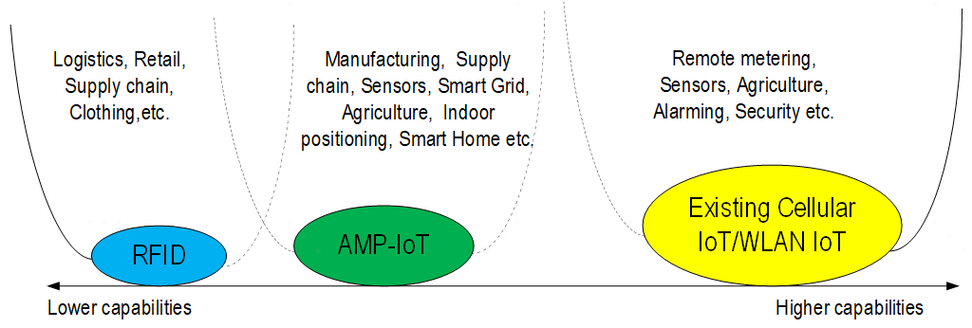
Figure 7-1 Expectation of AMP-IoT [1]

Slide 26
ISO/IEC ISO/IEC Standards

