Slide 1
Headroom Reason Reporting
Aug 2024
Authors:
Name | Affiliation | Phone | email
Brian Hart | Cisco Systems |  | brianh@cisco.com
Pelin Salem | Cisco Systems
Binita Gupta | Cisco Systems
Malcolm Smith | Cisco Systems
Juan Carlos Zuniga | Cisco Systems
Stephen Orr | Cisco Systems
Jerome Henry | Cisco Systems

Slide 2
Executive Summary
Situation
In TB PPDUs, client TX power is subject to 1) Trigger-based controls and 2) Local max TX power level (Local TPC) for spatial reuse, among other constraints
Problem
AP cannot determine when these two controls are clashing
When clashing, the client may transmit TB PPDUs at lower-than-requested powers, with a lowered reliable MCS and thence lower throughput
The AP is unable to determine the trade-off between link-level throughput and spatial reuse
Solution
Enable the client to signal whenever a Local max TX power level is causing the TB PPDU Headroom to be 0 dB

Slide 3
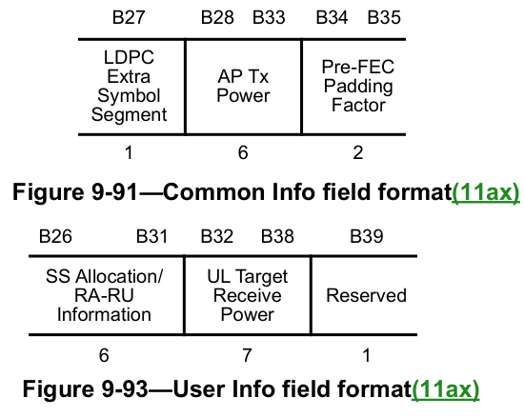
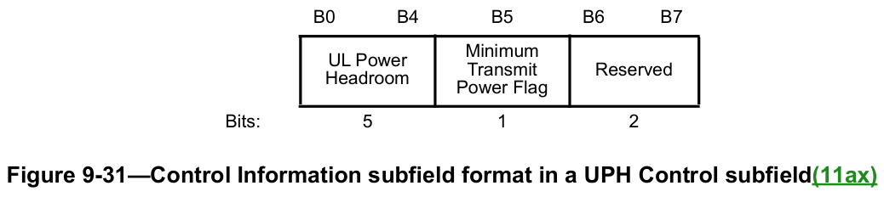
Situation – AP triggers a client at an implied transmit power level, but the client cannot always achieve the power level
APs influence client transmission power in TB PPDUs via two fields in the
Trigger frame:
  AP Tx Power field // from which clients can determine pathloss
  UL Target Receive Power field // given this and the pathloss, a client can determine
  its TX power
The client has minimum and maximum power limits for a given transmission:
  “The transmit power of the HE TB PPDU is further subject to a STA’s minimum and
  maximum transmit power limit due to hardware capability, regulatory requirements, and local maximum transmit power levels (see 11.7.5 (Specification of regulatory and local maximum transmit power levels)) as well as non-IEEE-802.11 in-device coexistence requirements”
The client can signal when a max/min limit is reached via the UPH Control subfield (in A-Control):
  UL Power Headroom field (0 indicates no headroom)
  Minimum Transmit Power Flag field (Boolean)
See 26.5.2.4 (A-MPDU contents in an HE TB PPDU),
27.3.15.2 (Power precorrection), 9.2.4.7.5 (UPH Control) [1]

Slide 4


Situation – Traditional Power Control remains pre-eminent in dense deployments
Although 802.11ax added the BSS Color concept to the mainstream 802.11 bands and defined the several Spatial Reuse mechanisms, the customer experience has been disappointing
  With little adoption; in a loose sense the Multi-AP Coordination (MAPC) area is an attempted do-over
In the meantime, dense networks in the same administrative domain continue to use the traditional techniques:
  Each AP “unilaterally” lowers its power from its maximum so neighboring cochannel BSSs avoid CCA-based deferral (i.e., enables spatial reuse), and thereby the AP promotes less interference, lower latency, greater QoS and higher system throughput when needed
  … While maintaining enough power for good AP coverage overlap to provide continuous coverage for roaming
  APs broaden the spatial use opportunities by sending Local max TX power level to clients
    Signaled via Transmit Power Envelope elements
  See 11.7.5 (Specification of regulatory and local maximum transmit power levels), 11.7.6 (Transmit power selection), 9.4.2.160 (Transmit Power Envelope element)
(1) Lowered AP power so APs see each other at < -82 dBm / P20 for Spatial Reuse
(2) Local TPE elements so BSSs see each other at < -82 dBm / P20
(2) Local TPE elements so BSSs see each other at < -82 dBm / P20
(3) Broadened availability
of Spatial Reuse

Slide 5
Problem – The AP’s local maximum transmit power level and UL Target Receive Power field can be inconsistent
On the one hand, in a Trigger frame, the AP might solicit a client to transmit at an implied power level (via the AP Tx Power field and UL Target Receive Power fields)
On the other hand, the AP’s Local max TX power level signaling might preclude use of that implied power level
Problem: the AP is left in the dark.
(1) 60 dB pathloss;
Max AP antenna gain = 5dB, actual AP antenna gain towards client = 4 dB // the difference is not important here
max client antenna gain = 2 dB, actual client antenna gain towards AP = 1 dB // the difference is not important here
(2) Local TPE indicates 5 dBm EIRP
(3) AP Tx Power = 0 dBm conducted,
UL Target RSSI Power = -45 dBm
(4) Client measures RSSI = 0+4-60+1=-55 dBm; calculates PL = pathloss (less actual antenna gains) as 0 - -55 = 55 dB.
Thus, Trigger frame asks client to transmit at -45 + 55 = 10 dBm conducted.
(5) Thus, requirements of Trigger frame and Local TPE clash; Local TPE tells client to not transmit at greater than 5-2 = 3 dBm conducted.
(6) UL TB PPDU sent at 3 dBm conducted << 10 dBm conducted sought.

Slide 6
Solution – Enable the Client to report whenever 0 dB of headroom is due to the Local max TX power level
We propose that the Client should be enabled to report whenever 0 dB of headroom is due to the Local max TX power level
… Via allocating a reserved bit in the UPH Control subfield
Enables the AP to better understand how to balance the benefits from spatial reuse versus reduced UL power (and thence reduced UL MCS)
 | B0 B4 | B5 | B6 | B6-B7
 | UL Power Headroom | Minimum Transmit Power Flag | Zero Headroom Due To Local Max TX Power | Reserved
Bits: | 5 | 1 | 1 | 21

Slide 7
Summary
We show that the AP is flying blind when trying to balance:
  Improved system throughput via Local max TX power level
  Improve link level throughput via a higher UL Target RSSI Power
UL Power Headroom does not report a reason when 0 dB of headroom is reached
  Which is mostly fine: the AP can’t change the client HW or regulations, etc
But when the reason for 0 dBm headroom is the AP’s Local max TX power level signaling (via TPE elements), there should be a way for the client to notify the AP so the AP can better understand and optimize the impact of its Local max TX power level and UL Target RSSI Power signaling
We show this gap can easily and naturally be addressed via assigning a reserved bit in the UPH Control subfield

Slide 8
References
[1] 802.11REVme Draft 5.0

Slide 9
Strawpoll 1
Do you agree to add the following text to the 11bn SFD:
  The 802.11bn amendment will define a way for a non-AP STA to notify an AP when the STA’s 0 dB of UL power headroom is due to the STA’s Local max TX power level.
Y / N / A

Slide 10
Backup

Slide 11
When it works and doesn’t work …
(1) 50 dB pathloss;
Max AP antenna gain = 5dB, actual AP antenna gain towards client = 4 dB // the difference is not important here
max client antenna gain = 2 dB, actual client antenna gain towards AP = 1 dB // the difference is not important here
(2) Local TPE indicates 5 dBm EIRP
(3) AP Tx Power = 0 dBm conducted,
UL Target RSSI Power = -45 dBm
(4) Client measures RSSI = 0+4-50+1 = -45 dBm; calculates PL = pathloss (less actual antenna gains) as 0 - -45 = 45 dB.
Thus, Trigger frame asks client to transmit at -45 + 45 = 0 dBm conducted.
(5) Requirements of Trigger frame and Local TPE are consistent (since Local TPE tells client to not transmit at greater than 5-2 = 3 dBm conducted).
(6) UL TB PPDU sent at 0 dBm conducted as sought.
(1) 60 dB pathloss;
Max AP antenna gain = 5dB, actual AP antenna gain towards client = 4 dB // the difference is not important here
max client antenna gain = 2 dB, actual client antenna gain towards AP = 1 dB // the difference is not important here
(2) Local TPE indicates 5 dBm EIRP
(3) AP Tx Power = 0 dBm conducted,
UL Target RSSI Power = -45 dBm
(4) Client measures RSSI = 0+4-60+1 = -55 dBm; calculates PL = pathloss (less actual antenna gains) as 0 - -55 = 55 dB.
Thus, Trigger frame asks client to transmit at -45 + 55 = 10 dBm conducted.
(5) Thus, requirements of Trigger frame and Local TPE clash; Local TPE tells client to not transmit at greater than 5-2 = 3 dBm conducted.
(6) UL TB PPDU sent at 3 dBm conducted << 10 dBm conducted sought.

