Slide 1
June 2024
Considerations on NPCA for reliability
Date: 2024-06-05
Authors:
Name | Affiliations | Address | Phone | email
Si-Chan Noh | Newracom |  |  | sc.noh@newracom.com
Joonsoo Lee |  |  |  | js.lee@newracom.com

Slide 2
Introduction
In 802.11bn, many contributions have been discussed to improve reliability, reduce latencies, increase throughput at different SINR levels, and reduce power consumption
The Non-Primary Channel Access (NPCA) has been proposed and details are still under discussed to increase medium efficiency with increasing operating bandwidth [1-10]
It can increase BW efficiency by allowing STAs to Tx/Rx in np-channels when the p-channel is BUSY
This contribution discuss some considerations in the context of reliability on NPCA
Frequent channel switching
Identify BW of OBSS TXOP
NPCA p-channel (i.e., NPCA back-off channel) is BUSY

Slide 3
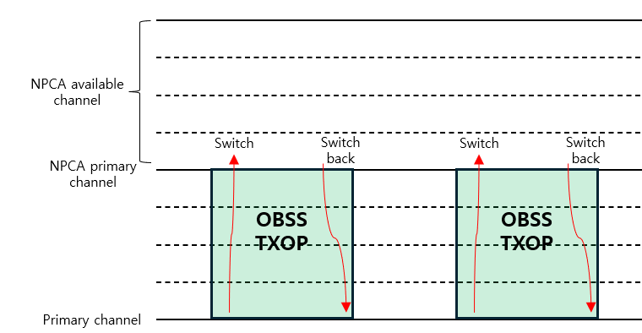
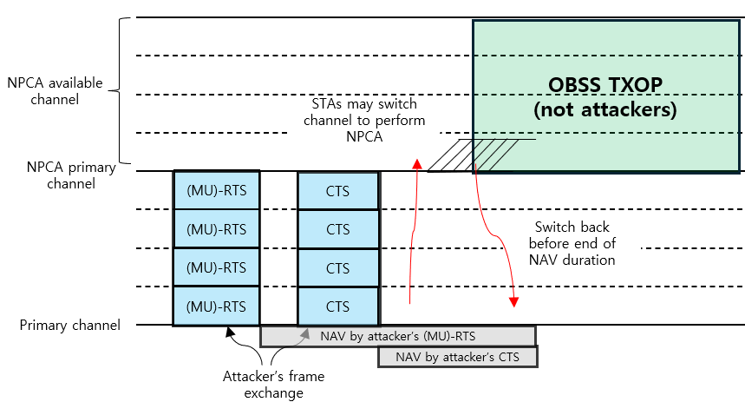
Frequent channel switching on NPCA
When a STA try to perform NPCA, frequent channel switching may lead to power drainage of STA and increase power consumption
Prospective scenarios of frequent channel switching :
STA do channel switch when p-channel is BUSY without any conditions
When NAV duration of p-channel is too short, it may switch back to p-channel rapidly
Attacker initiate an attack for the purpose of ‘Power drainage’ of STAs which have capable of performing NPCA
Improper cases that misleading the STAs to perform NPCA

Slide 4
Frequent channel switching on NPCA
Potential approaches :
Set the criteria of NAV duration
Ex) When the STAs overhearing OBSS’s (MU)-RTS/CTS, compared the estimated NAV duration with the criteria
Estimated NAV duration of OBSS’s signal >= criteria : move to np-channels to perform NPCA
Estimated NAV duration of OBSS’s signal < criteria : staying in p-channel
It may prevent STAs frequent channel switching and lead to power saving
STAs switch to the np-channels when overhearing signals from reliable OBSS AP’s listings
Ex) APs configured a Multi-AP coordination set can be one of the reliable OBSS AP’s listing
When the STAs overhear frames from reliable OBSS APs listing, it can move to np-channels
When the STAs overhear frames from other APs not on the reliable OBSS AP’s listing, staying in p-channel
It may shrink the recognition of fake p-channel BUSY state due to attackers and prevent frequent channel switching which save STA’s power consumption

Slide 5
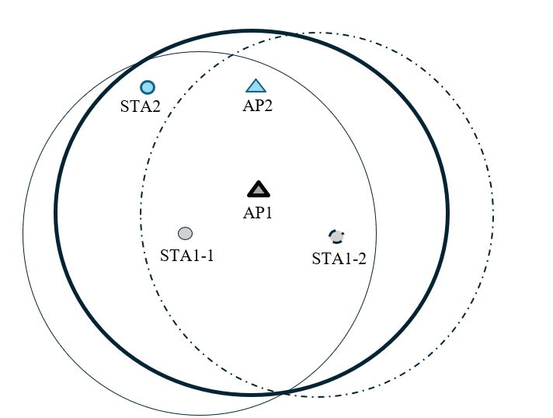
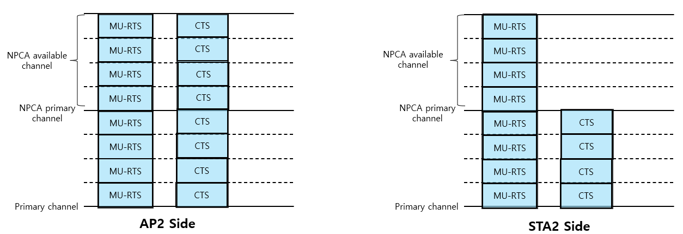
Identify BW of OBSS TXOP on NPCA
The STAs have different views of channel when switching to NPCA p-channel after a control frame exchange(e.g., MU-RTS/CTS) of an OBSS
When the AP1 transmits control frame on 160MHz BW to STA1-1 and STA1-2
The STA1-1 transmits 80MHz CTS
The STA1-2 transmits 160MHz CTS
The view of channel status at AP2 and STA2 side
Through the current baseline :
The AP2 may not to perform NPCA due to the NPCA available channel is BUSY from the OBSS control frame exchange
The STA2 may think it is possible to perform NPCA and switching channel due to only P80 is protected from the OBSS control frame exchange
Potential approach :
When the information of UL BW subfield in MU-RTS cover NPCA p-channel, do not perform NPCA

Slide 6
BUSY NPCA p-channel
When the both p-channel and NPCA p-channel is BUSY due to OBSS signals, the STAs may not perform NPCA
However, do not perform NPCA due to the NPCA p-channel is being BUSY may not align with the purpose of the NPCA which is discussed to enhance BW efficiency
Potential approaches :
Designate NPCA primary channel to minimize that the NPCA primary channel is covered by OBSS PPDU
Regardless of how much the remaining BW is available for potential NPCA operation, do no perform NPCA when NPCA p-channel is BUSY due to the OBSS signals as like baseline
How to designate NPCA primary channel to increase BW efficiency is TBD

Slide 7
Summary
We discuss some considerations in terms of reliability when performing NPCA
Frequent channel switching
Identify BW of OBSS TXOP
BUSY NPCA p-channel
We need to consider how to allow reliable NPCA align with the goals of UHR

Slide 8
Reference
[1] 23/0961r0, UHR Secondary Channel Access
[2] 23/2005r1, Non-Primary Channel Access (NPCA)
[3] 24/0495r0, Non-Primary Channel Access (NPCA) - Follow up
[4] 24/70r2 Some details about non-primary channel access
[5] 24/538r1 SP-based non-primary channel access
[6] 23/0034r1, Non-Primary Channel Utilization
[7] 23/1288r0, Non-Primary Channel Utilization Follow-up
[8] 23/2023r1, Further discussion on Non-primary Channel Access
[9] 23/0631r1, Secondary channel usage and secondary 20MHz channel backoff
[10] 24/0496r1, Secondary Channel Usage Follow up

