Slide 1
Service Period based
Dynamic Subchannel Operation
Date: 2024-06-13
Name | Affiliations | Address | Phone | email
Seongho Byeon | Samsung Electronics |  |  | sh.byeon@samsung.com
Jack Jonghyo Lee
Jaheon Gu
Jinho Choi
Jonghoe Koo
Jungjun Kim
Mingyu Lee
Suhwook Kim
Taeyoung Ha
Youngwan So

Slide 2
Introduction
One of main objectives for UHR PAR
  At least one mode of operation capable of improving efficient use of the medium
Many Wi-Fi STAs do not support the full bandwidth option supported by the AP
  While APs may support up to 320 MHz, STAs may support only 80 MHz or 160 MHz
  Large portions of the operational bandwidth go underutilized, leading to poor spectral efficiency
[RECAP] Dynamic Subband/Subchannel Operation (DSO) discussed in TGbn
  An AP can dynamically allocate different parts of subchannels within its operating bandwidth to non-AP STAs depending on their operating bandwidth capabilities, channel conditions and QoS requirements within a TXOP [1-6]

Slide 3
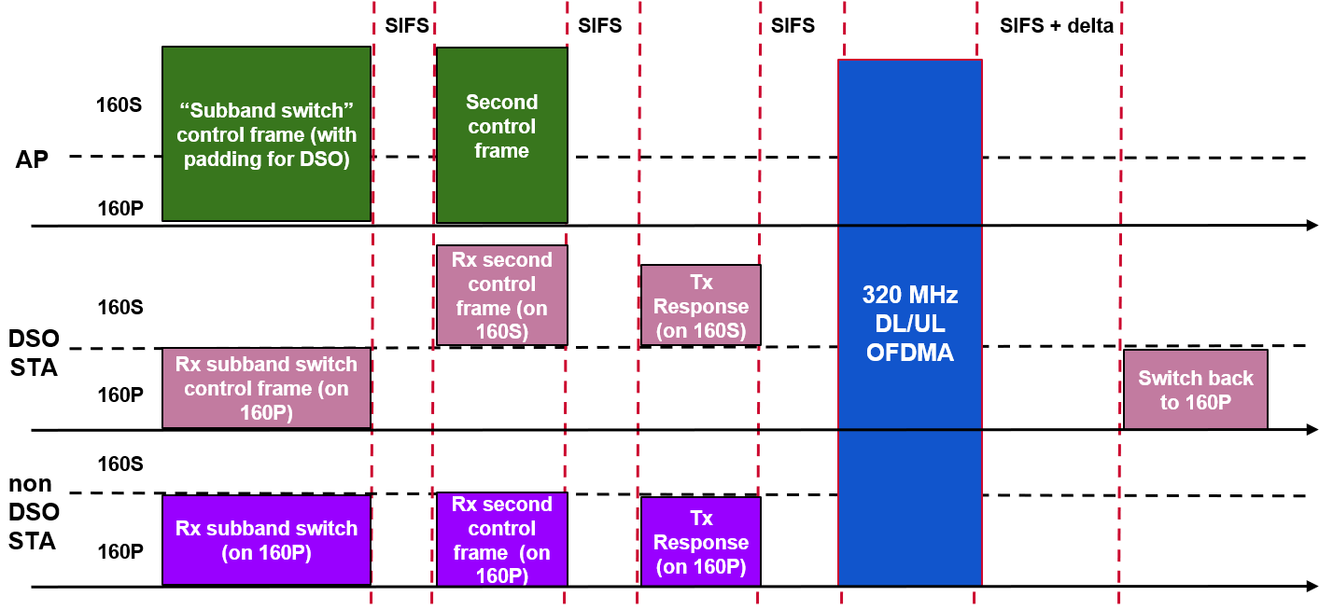
Introduction
General considerations on DSO
  An AP indicates to DSO STAs the subchannel on which they will be served within the TXOP in advance
  The AP initiates a TXOP and sends control frames (i.e., DSO ICF) to DSO STAs in order to provide a sufficient time, allowing them to perform the channel switch
    Mode of operation and required signaling: Enabling or disabling DSO mode, DSO subchannel, DSO switching latency capability, etc.
    Intermediate FCS for DSO ICF, depending on DSO STA’s switching latency [7]
    Second control frame for operation verification of DSO STA
  At the end of the TXOP,
  DSO STAs switch back to
  the primary channel

Slide 4
Some Thoughts on DSO
Operating bandwidth switching overhead [8]
  Expected padding delay required for DSO STAs: 80MHz+ devices: 32-64 𝜇s & 20MHz only devices: 500-1000 𝜇s
  In multi-user transmission, the required padding may be the largest among all the DSO STAs served
Some thoughts on TXOP-based DSO
  Discomforts for obtaining high efficiency
    Further usage of resources
      Intermediate-FCS and/or extra padding is required for the DSO ICF
      Additional frame exchange overhead (i.e., Second control frame and response to check whether DSO STAs change their operating bandwidth successfully or not) may be required in addition to DSO ICF
      Transition delay at the end of DSO when DSO STA moves its radio back on the primary channel
    Additional power consumption of DSO STAs is expected due to operating bandwidth switching
    Difficulty of fitting UL Target Received Power and CFO requirement [5]
    Due to the aperiodic operating bandwidth change of DSO STA, the complexity of channel estimation (i.e., MCS selection), MIMO operation (i.e., lack of sounding reference) or interference management increases
      If there is hidden interference outside the operating bandwidth of DSO STAs, a race condition may occur within the TXOP

Slide 5

Concept of Service Period (SP) based DSO
Add HE SST functionality to the existing Broadcast TWT ➔ SP-based DSO
  Each STA completes the operating bandwidth switching by the start point of the Broadcast (R-)TWT SP
  (NOTE: Nothing changes for the STAs which have 160 MHz operating bandwidth)
Trigger frame (e.g., MU-RTS, BSRP w/ UORA, Basic Trigger, etc.) can be used to
confirm the awake status of associated STAs and the subchannel on which the STAs stay
Trigger-enabled
Broadcast (R-)TWT SP
S160
Broadcast
TWT 1
Basic
TF
M-STABA
DL MU
PPDU
Basic
TF
M-STA
BA
AP
(320 MHz)
P160
Beacon
Broadcast TWT IE
DSO STA1
AID 8
(160 MHz)
S160
TB PPDU
doze
PS-P
BA
P160
After receiving the Broadcast (R-)TWT IE, STA1 transitions to the awake state exactly when the service period arrives and completes changing the operating bandwidth to S160
At the end of the SP, STA1 transitions to the doze state. For the next TBTT and corresponding awake state, it may configure the operating bandwidth set as P160 to receive Beacon
DSO
STA2
AID 9
(160 MHz)
S160
doze
P160
TB PPDU
QoS N
BA

Slide 6
Further Details of SP-based DSO
AP operates DSO within its (R-)TWT SP:
  Example of configuration of DSO information subfield
    Subchannel pool
    DSO on/off notification per Broadcast (R-)TWT SP
    DSO scheduling info in an individually assigned User Info field
    …
  STA can switch its operating bandwidth voluntarily or forcibly
    Each DSO STA can move to a randomly selected subchannel among candidates in the subchannel pool announced by the DSO Info field
    Or AP can assign subchannel(s) individually to each DSO STA
      Long-term: (Re)association response, probe response, or (unsolicited) TWT response frame
      Short-term: Broadcast TWT Parameter Set field format (individually assigned User Info field for DSO scheduling)
Request Type
Target Wake Time
Nominal Minimum TWT Wake Duration
TWT Wake Interval Mantissa
Broadcast TWT Info
Restricted TWT Traffic Info (optional)
DSO Info
(optional)
Octets:
2
2
2
2
2
0 or 3
0 or n
Extension of Figure 9-790 -- Broadcast TWT Parameter Set field format

Slide 7
Further Details of SP-based DSO
Advantages of SP-based DSO
  Through an increase in the efficiency of bandwidth utilization, the quality of service (QoS) requirements for R-TWT members can be more easily achieved
  Since STAs finish setting up the operating bandwidth at the start point of the SP, there is no waste of resources caused by the switching delay within the TXOP
  Similarly, when the STA wakes up from the doze state to the awake state, it sets up the operating bandwidth to be used during the SP, so that no additional power consumption due to frequent changes in the operating bandwidth does occur
  DSO can be effectively managed with just a few necessary pieces of information field added to the R-TWT framework, thus minimizing the amount of signaling overhead required
  At the beginning of the SP, the operating bandwidth switch has been completed, making it possible to achieve calibration easily, using a single ICF like the MU-RTS or BSRP/Basic Trigger frames
    Especially good combination w/ the trigger-based TXOP
    Easy to check DSO operation and awake state simultaneously using tools like UORA
  (Optional) If OBSS PPDU or TXOP is observed in the primary channel during the R-TWT SP, non-primary channel access (NPCA) can be easily applied

Slide 8
Conclusion
In this presentation, we propose a Service Period based Dynamic Subchannel Operation (SP-based DSO),
harnessing the combined potential of HE SST and Broadcast TWT
This allows the AP to provide a simpler and easier way to improve the efficient use of medium
The proposed SP-based DSO can coexist independently with DSO operating on a TXOP basis

Slide 9
Straw Poll
Do you support to define a mechanism in 11bn, enabling resource allocations to non-AP STAs beyond their current operational bandwidth and within the associated AP's BSS bandwidth on a per Broadcast TWT Service Period basis?
Y / N / A

Slide 10
References
[1] 11-23/2141r3 Further Discussion on Dynamic Subband Operation (Sindhu Verma, Broadcom)
[2] 11-23/2027r2 Considerations for DSO Sub-band switch delay (Vishnu Ratnam, Samsung)
[3] 11-23/1892r0 Thoughts on Dynamic Subchannel Operation (Gaurang Naik, Qualcomm)
[4] 11-24/0449r3 Considerations on Dynamic Subchannel Operation – Follow (Liuming Lu, OPPO)
[5] 11-24/0299r1 Initial ctrl frame for BW switching modes (Vishnu Ratnam, Samsung)
[6] 11-24/0493r2 Dynamic Channel Switch Operation (Liwen Chu, NXP)
[7] 11-24/0171r8 TGbn Motions List – Part 1 (Alfred Asterjadhi, Qualcomm)
[8] 11-24/0517r0 Pre-allocation of sub-band for DSO – follow up (Vishnu Ratnam, Samsung)

Slide 11
Backup

Slide 12
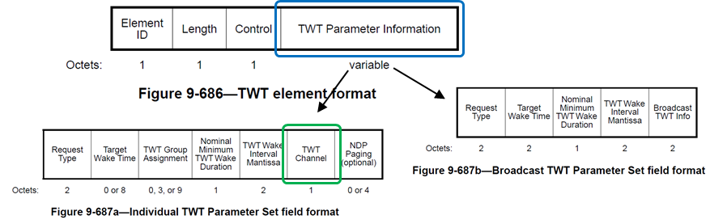
Recap
[11ax] HE SST using Individual TWT
  HE subchannel selective transmission (SST) operation
    SST setup by negotiation of individual TWT
      An HE SST non-AP STA and an HE SST AP set up SST operation by negotiating a individual trigger-enabled TWT
      TWT Channel field composed of 8 bits (each of 20 MHz channels) of the TWT element is used to indicate the secondary channel in TWT request/response
    Frame exchanges during SPs
      HE SST AP allocates individually addressed RUs to the HE SST non-AP STA that are within the subchannel(s) indicated in the TWT Channel field of the TWT response
      HE SST non-AP STA is available in the subchannel(s) indicated in the negotiated TWT Channel field at TWT SP start
[11be] Restricted TWT (R-TWT)
  Restricted TWT: Trigger-enabled Broadcast TWT operation
    To minimize medium contention and allow power saving STAs to reduce power consumption by explicitly identifying the time periods when they should be awake
    A non-AP EHT STA as a TXOP holder shall ensure the TXOP ends before the start time of any active R-TWT SPs

