Slide 1
EDCA Enhancement for Low latency Traffic
Date: 2024-05-11
Authors:
Name | Affiliation | Address | Phone | Email
Ja-Shun Wan | MediaTek |  |  | js.wan@mediatek.com
Yonggang Fang | MediaTek |  |  | yonggang.fang@mediatek.com
James Yee | MediaTek
Kaiying Lu | MediaTek
Li-Hsiang Sun | MediaTek
Frank Hsu | MediaTek
Gabor Bajko | MediaTek

Slide 2
Introduction
This contribution discusses the issues of existing EDCA mechanism and potential methods of reducing channel access collisions for low latency traffic.

Slide 3
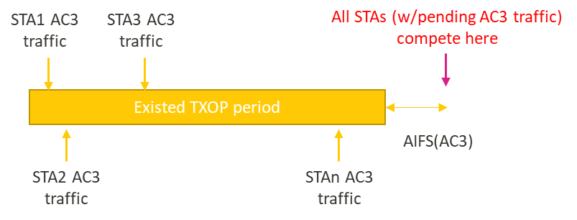
Problem Statement
  Issues of EDCA for Low latency Traffic (1)
  Collision could happen when multiple STAs complete backoff at same time and transmit frames together. For example, when the channel is busy, STAs suspend their backoff process till the channel becomes idle and resume at same time.
  Collision of AC3(AC-VO) data traffic could increase significantly when STAs contend for channel access simultaneously because of small size of CW.
  RTS/CTS is not mandated for AC3 data transmissions
3

Slide 4
Problem Statement
  Issues of EDCA for Low latency Traffic (2)
  The retry failure:
    Even EDCA provides retry for failed transmission, but the probability of retry failure is still significant high.
    For example, AC3: CW = 7 (CW_{min}=3, CW_{max}=7)
      If 3 STAs compete simultaneously, each retry has ~23% chance of collision (1-(7/8)^2).
      If 8 STAs compete simultaneously, each retry has ~60% chance of collision (1-(7/8)^7).
      If 16 STAs compete simultaneously, each retry has ~86% chance of collision (1-(7/8)^15).
  When a collision happen, a STA may still have a chance to miss to transmit a high priority AC data traffic in retries.
4

Slide 5
Possible Enhancement
  Proposal (1)
  Apply (transmit) high priority RTS/CTS frame exchange before transmitting high priority PPDU (e.g., AC3)
    High Priority RTS: use non-HT format with a fixed TBD data rate
    Use AIFSN=2, CW_{min} = 0 and CW_{max} = 7 for transmitting the RTS.
      CW_{min} =0 can make the initial BC=0 so that High Priority AC can always get channel access when competing with other AC.
      The STAs that sent RTS and collided can perform retry of RTS within EIFS period.
  If a RTS is received correctly, the responding STA sends a CTS.
  The RTS transmitter (i.e., TXOP owner) after receiving the CTS response
      shall suspend the EDCAF for TBD ms;
      after TBD ms, resets CW=CW_{min} and BC to a random number within [0, CW].
  A backoff suspended requesting STA during the contention resets CW = CWmin and BC to a random number within [0, CW], after receiving a CTS with FCS correctly.
5

Slide 6
Possible Enhancement
  Proposal (2)
  EIFS protection
    If RTSs from multiple STAs collide, EIFS rules will be automatically applied to protect the transmitting STAs for re-try of RTS
      A backoff suspended STA will not contend the medium in the EIFS period.
      An RTS requesting STA but not receiving CTS will increase the CW (limited by CW_{max}) and then back off again for re-transmitting RTS.
        CW = ([CW+1]*2 - 1) or 7
    The existing EIFS rules can make collisions converge in subsequent retries.
      Note: EIFS is mandatory in 802.11 baseline.
6

Slide 7
Possible Enhancement
  Benefits
  Reducing collisions of AC3 low latency data transmissions from multiple STAs.
  Reducing the number of retries, i.e., the collisions are converged in subsequent retries.
  Reducing the channel access latency tails of the low latency traffic.
  Simplifying implementation via reuse existing RTS frame formant with new setting, and no need to define a new frame.
7

Slide 8
An Example Frame Exchange
CW=0
BC=0
CW=1 (retry)
BC=0
CW=3 (retry)
BC=2
CW=0 (reset)
BC=0
STA3
(AC3)
RTS
RTS
RTS
CW=0
BC=0
CW=1(retry)
BC=0
CW=3
BC=1
STA2
(AC3)
RTS
RTS
RTS
PPDU
CTS
BA
EIFS Protection
EIFS Protection
Remaining
BC=3
Remaining
BC=3
Remaining
BC=3
STA1
Busy
Channel Acquisition Time
8

Slide 9
Convergence Simulation
  Objective
  Simulate convergence of RTS collisions during the retries and measure the channel acquisition time
  Channel Acquisition Time
    Starting time: CCA becomes idle
    End time: receiving CTS successfully
STA3
RTS
STA2
RTS
RTS
PPDU
CTS
BA
STA1
RTS
RTS
PPDU
CTS
BA
Busy
Channel Acquisition Time
Channel Acquisition Time
9

Slide 10
Convergence Simulation 1
  Setup
  8 STAs with full-buffered AC3 traffic.
  Perform EDCA for UL transmission
  Enhanced EDCA for AC3 traffic
    AIFSN = 2
    Initial CW = CWmin (0)
    Backoff Counter: random [0, CW]
    Retry (A) CW=(CW+1)*2-1 (B) CW=7
  Reference EDCA for AC3 traffic
    Follow 802.11 default setting
STA00
AP0
STA01
STA07
10

Slide 11
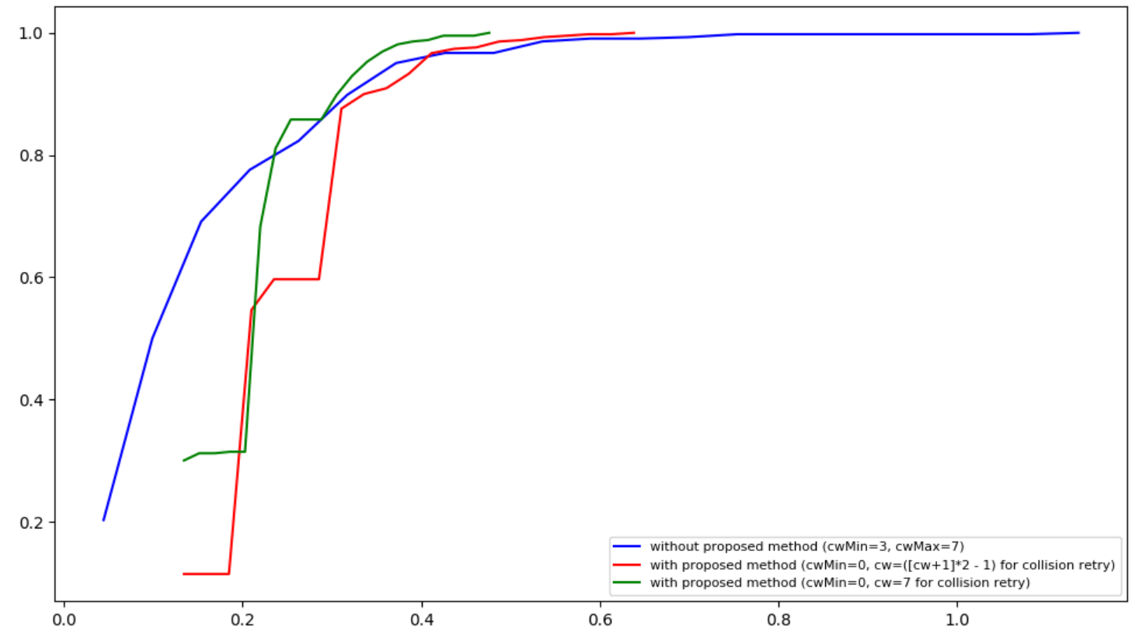
Convergence Simulation 1
  Result
  Channel Acquisition Time (CDF)
The proposed method can make collision convergence better than the reference EDCA for AC3 traffic
The proposed method with CW=7 for retry has better performance of the convergence tail
When multiple STAs perform backoff with CWmin=0 simultaneously, RTSs collide at beginning, but converge quickly after 200us.
channel acquisition time (ms)
11

Slide 12
Convergence Simulation 2
  Setup
  16 STAs with full-buffered AC3 traffic.
  Perform EDCA for UL transmission
  Enhanced EDCA for AC3 traffic
    AIFSN = 2
    Initial CW = CWmin (0)
    Backoff Counter: random [0, CW]
    Retry (A) CW=(CW+1)*2-1 (B) CW=7
  Reference EDCA for AC3 traffic
    Follow 802.11 default setting
STA00
AP0
STA01
STA15
12

Slide 13
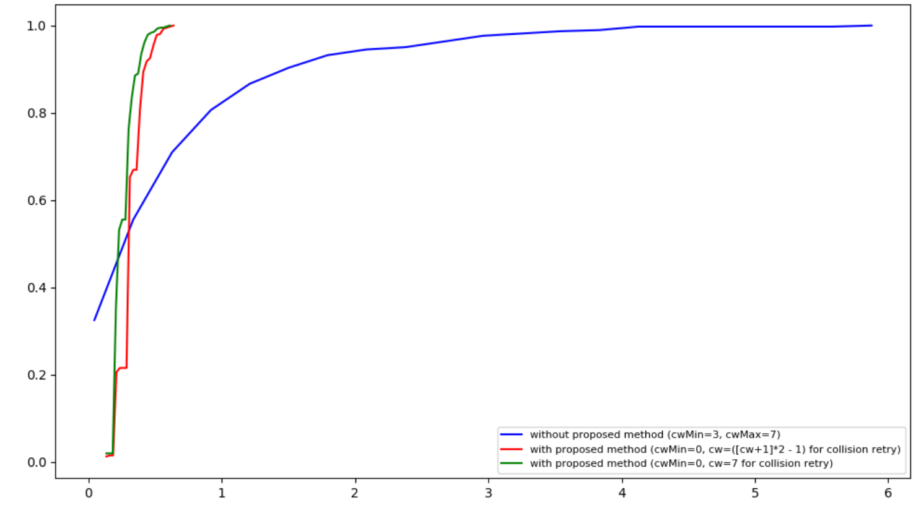
Convergence Simulation 2
  Result
  Channel Acquisition Time (CDF)
The proposed method can make collision convergence better than the reference EDCA for AC3 traffic
When multiple STAs perform backoff with CWmin=0 simultaneously, RTSs collide at beginning, but converge quickly after 200us.
channel acquisition time (ms)
13

Slide 14
E2E Delay Simulation
  Objective
  Simulate the E2E delay for low latency traffic transmission
    Starting time: receiving the packet from the upper layer
    End time: delivering the received packet to the upper layer
    AC1 TXOP: 5.484ms
Receiving time from upper layer
Delivering time to upper layer
Data
STA2
RTS
RTS
PPDU
CTS
BA
STA1
Busy
E2E Delay for AC3 traffic
14

Slide 15
E2E Delay Simulation 1
  Setup
  1 STA has AC3 traffic (1pkt/10ms) to AP
  7 STAs transmit full-buffered AC1 traffic to AP
  Simulate EDCA for UL transmission
  Enhanced EDCA for AC3 traffic
    AIFSN = 2
    Initial CW = CWmin(0)
    Backoff Counter: random [0, CW]
    Retry CW = 7
  Reference EDCA for AC1 and AC3 traffic
    Follow 802.11 default setting
STA00
AP0
STA01
STA07
Simulation Setup Topology
15

Slide 16
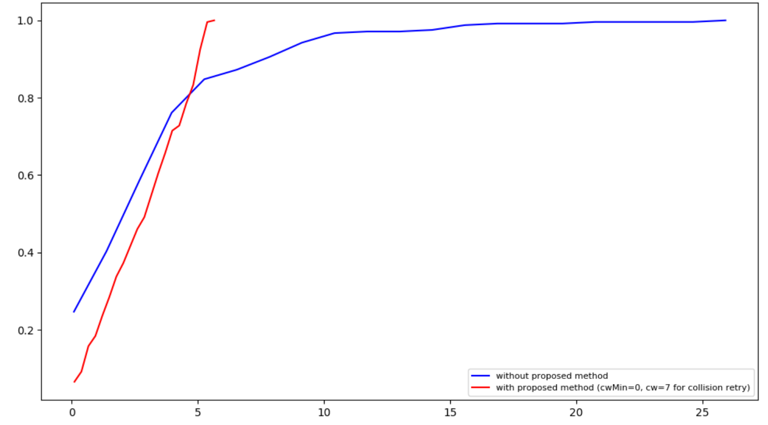
E2E Delay Simulation 1
  Result
  E2E application packet delay time (ms) for AC3 traffic
The simulation result shows RTS/CTS with (CWmin=0, CWmax=7) for retries has better performance of the latency tail.
The E2E traffic delay of using Enhanced EDCA worse than legacy AC3 traffic is caused by RTS/CTS before data transmission.
The E2E traffic delay is related to the receiving time of the low latency traffic from the upper layer during the channel busy period (TXOP) occupied by AC1 traffic.
The closer of the receiving time approaching to the end of TXOP, the less E2E delay the low latency traffic has.
The worst E2E delay is roughly equal to the time of TXOP occupied by AC1 traffic.
16

Slide 17
E2E Delay Simulation 2
  Setup
  1 STA has AC3 traffic (1pkt/10ms) to AP
  15 STAs transmit full-buffered AC1 traffic to AP
  Simulate EDCA for UL transmission
  Enhanced EDCA for AC3 traffic
    AIFSN = 2
    Initial CW = CWmin(0)
    Backoff Counter: random [0, CW]
    Retry CW = 7
  Reference EDCA for AC1 and AC3 traffic
    Follow 802.11 default setting
STA00
AP0
STA01
STA15
Simulation Setup Topology
17

Slide 18
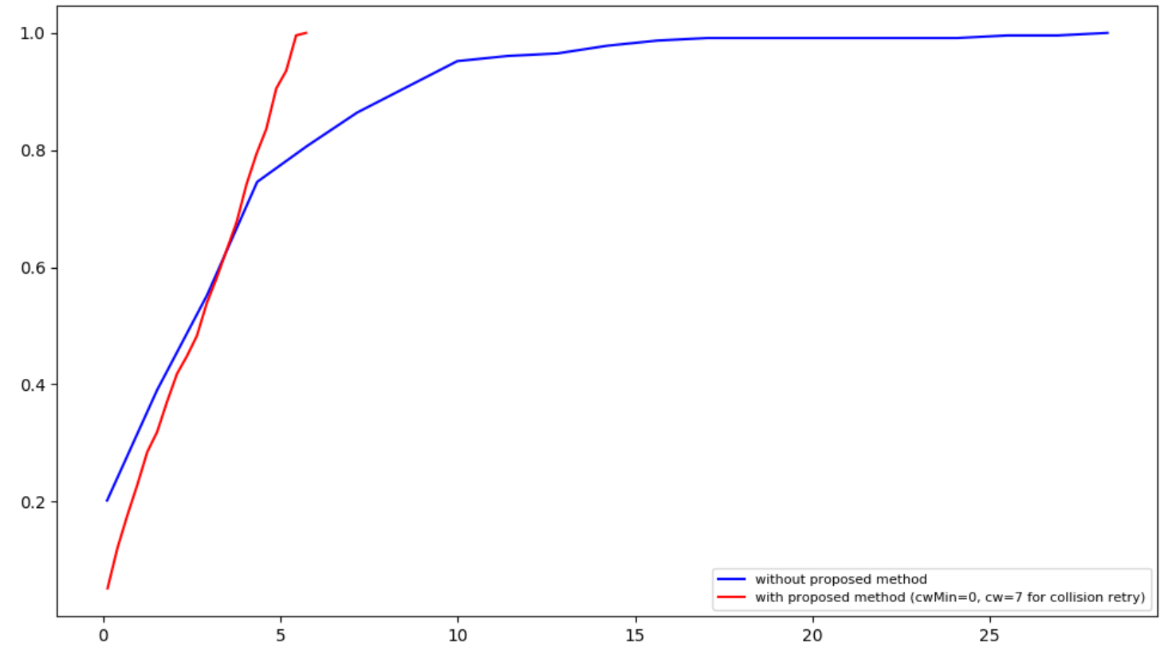
E2E Delay Simulation 2
  Result
  E2E application packet delay time (ms) for AC3 traffic
18

Slide 19
E2E Delay Simulation 3
  Setup
  8 STA has AC3 traffic (1pkt/10ms) to AP
  8 STAs transmit full-buffered AC1 traffic to AP
  Simulate EDCA for UL transmission
  Enhanced EDCA for AC3 traffic
    AIFSN = 2
    Initial CW = CWmin(0)
    Backoff Counter: random [0, CW]
    Retry CW = 7
  Reference EDCA for AC1 and AC3 traffic
    Follow 802.11 default setting
STA00
AP0
STA01
STA15
Simulation Setup Topology
19

Slide 20
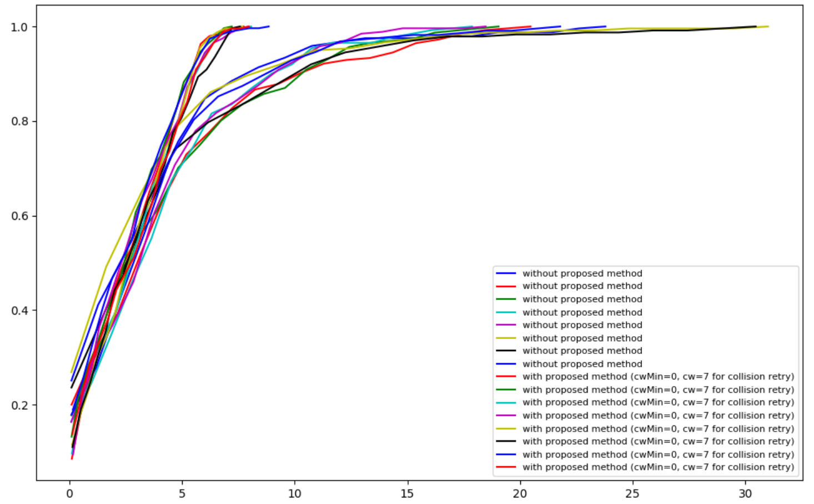
E2E Delay Simulation 3
  Result
  E2E application packet delay time (ms) for AC3 traffic
With the proposed method
Without the proposed method
20

Slide 21
  Summary
This contribution
  discusses the collision and retry issue of existing EDCA mechanism
  proposes a potential enhancement:
    reduce collisions of AC3 low latency data transmissions from multiple STAs.
    reduce the number of retries, i.e., the collisions are converged in subsequent retries.
    reduce the channel access latency tails of the low latency traffic.
21

Slide 22
  Straw Poll
SP1
  Do you agree with that a STA on TBD condition of pending low latency traffic transmits one or more high priority (HP) RTS frames and receives a CTS prior to transmitting the low latency traffic
    Low Latency traffic is set as AC_VO
    The format and the data rate of HP RTS are TBD
    The EDCA parameters for transmitting a HP RTS are TBD
    A responding STA sends a CTS if it receives the RTS correctly.
    An RTS requesting STA without receiving CTS will increase the CW to TBD value and then perform backoff again for re-transmitting HP RTS within EIFS period.
    A backoff suspended requesting STA during the contention, after it receive a CTS with FCS correctly, resets CW = CWmin and resets the backoff counter to a random number within [0, CW].
22

