Slide 1
MSK Performance For 802.11bp
Date: 2024-05-13
Authors:

Slide 2
Abstract
As modulation is one of the first decisions the 802.11bp PHY/MAC amendment is required to make, in this presentation, we discuss the advantages of MSK for uplink modulation for 802.11bp amendment for both active and backscatter transmitters.

Slide 3
Recap
In [1], we presented a comparison between possible modulations for AMP active devices (non-backscatter), as well as considered backscattered based.
According to analysis, BPSK and OFDM are no-go for energy harvesting active devices such as 802.11bp.
The power consumption and summary tables from [1] are given here for reference:
 | Examplary total AFE power consumption
OOK | 100uW
MSK/BFSK/4-FSK | 100uW
BPSK | 500uW
OFDM | 1.5mW
 | OOK | MSK/BFSK/4-FSK | BPSK | OFDM
TX complexity | Good | Good | Fair | Poor
Energy consumption | Poor [due to SNR] | Good | Poor | Poor
Link budget | Poor | Good | Good | Good

Slide 4
MSK Applicability
Nothing new: MSK is historically used by many standards for very long time.
  Extensive long products and standard history and knowledge availability
Besides OFDM systems that traditionally have higher quality hardware, most low power standards do not implement BPSK and use MSK or FSK due to its simplicity.
MSK for backscatter already reported (e.g. for BT [2]) as well.

Slide 5
Spectrum Comparison
SSB/DSB
  Simple active devices (with no more than 1 chain) can have SSB modulation for MSK,PSK,OOK
    SSB is favorable in terms of spectrum efficiency and interference.
  Backscatter devices usually implement DSB modulations for MSK,OOK,PSK, due to their simplicity and for distancing from CW.
  No pulse shaping is assumed, due to the simplicity of devices, nonlinearity of PA, etc.
10dB
CW
Continues phase vs discontinues-phase
  Continues phase signals like MSK have lower out-of-band emissions compared to non-continues phase like BPSK or OOK (w.o. pulse shaping). 10-15dB differences were noticed
15dB

Slide 6
Issues To Consider for Spectrum Comparison
It is important to allow spectrally efficient transmissions for 802.11bp devices
  Longer distances compared to RFID but with same density of devices results with more devices per reader.
  FDM should be considered for the expected amount of devices ([3])
  Energizing signals are broadcasted, so uplink is the bottleneck and FDM can be useful.
Minimal interference to/from legacy devices
  Eventhough the AIoT devices transmit with very low power, we still should aim to minimize interference for the busy 2.4 channel.

Slide 7
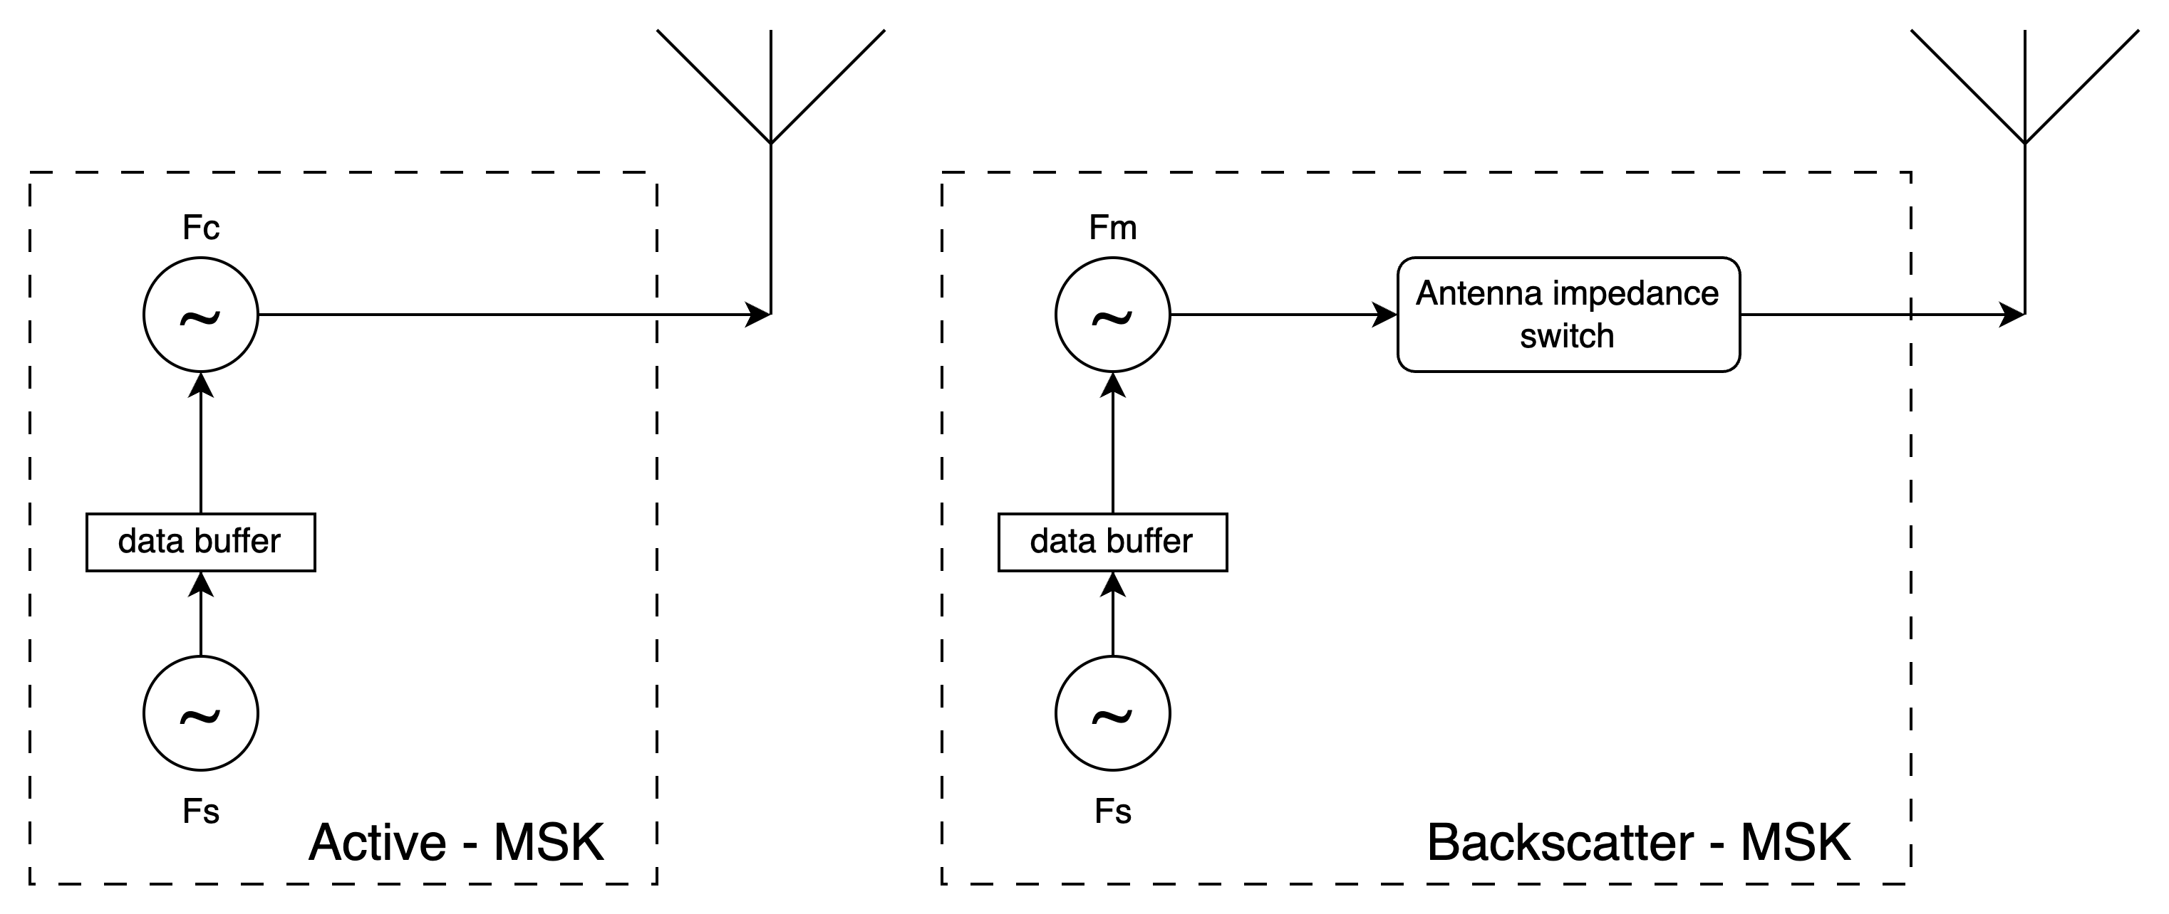
MSK Transmitter Examplery Implementations in Active and Backscatter Devices
Both active and backscatter MSK transmissions require 2 oscillators. One for the modulation and one for the symbol clock.
For the example from previous slide, the following values should be used in the schemes below: Fc = 2414.2/2409.8MHz, Fs=9MHz, Fm=11.25/6.75MHz
Our analysis shows <0.5% difference in power consumption and complexity between MSK to OOK-Miller2 transmitters for backscatter and active devices for the example

Slide 8
Performance Simulation
Performance of uncoded MSK/BPSK/OOK are presented below
AWGN
Optimal coherent reception of the uplink
signal is used
  Noncoherent reception reduces the performance
MSK allows the use of efficient coherent
demodulation
MSK and BPSK have the same performance
As expected, OOK is 3dB worse compared
to both MSK/BPSK due to non-antipodal signaling
OOK relies on energy levels and is thus sensitive to gain instabilities and interference
  Practical perfromance degradation vs MSK is more than 3dB

Slide 9
Summary
 | Backscatter | Active
TX Complexity + Power consumption | <0.5% difference between MSK/PSK/OOK | Only MSK and OOK are within limits
OOB emissions for FDM feasability and legacy interference | 10dB advantage to MSK over OOK/BPSK w. Miller | 15 dB advantage to MSK over BPSK/OOK
Performance | >3dB degradation of OOK compared to MSK/BPSK | >3dB degradation of OOK compared to MSK/BPSK
Should 802.11bp consider devices that can transmit MSK modulation
to the AMP-reader?

Slide 10
References
[1] “Uplink Modulations Comparison for AMP Devices”, Wiliot, 0112r0
[2] Harms O. “Modulation schemes in ambient backscatter communication” [Dissertation]. 2017. (IT), Uppsala University, Mathematics and Computer Science, Department of Information Technology.
[3] "Uplink FDM for AMP”, OPPO, 0851r0

