Slide 1
Low latency channel access
Date: 2024-05-06
Authors :

Slide 2
Problem statement and solution
EDCA is the main channel access mechanism of today (and future) WiFi standards
Provide channel access opportunities to any traffic type, which defines its weakness
  Cannot guarantee channel access. Even high priority access category may have difficulty obtaining TXOP in a competition among EDCAFs of a lower priority
  Existing EDCA parameters may not provide sufficient traffic separation
  AC_VO by design does scale to support sufficient number of LL streams
  All the above is a reason for the latency spikes
Idea:
  Separate STA(s) with traffic streams that require bounded latency/stringent ETE bounds from the rest of the contention crowd
  Allow such STA(s) to send special signal or MAC frame to announce (Hi)gh (P)riority EDCA contention PRIOR to regular contention start
  Allow such STA(s) to contend only among themselves during the immediately following HiP EDCA period

Slide 3
Illustration
Previous TXOP
EDCA contention period
TxOP gained by STA3
PIFS
SIFS
DIFS
Last frame of TXOP
STA1
Legacy
AIFSN
Idle
Busy
EIFS mode/NAV
Busy
STA2
Legacy
AIFSN
Busy
Idle
Busy
EIFS mode/NAV
Busy
DS
or
frame
STA3
PPDU transmission
BO: rand(0,7)=4
Busy
Idle
Idle
DS
or
frame
STA4
BO: rand(0,7)=5
Busy
Idle
Idle
Busy

Slide 4
Recap from previous contributions*
HiP EDCA contention allow to improve tail latency in both isolated and multi-BSS setup
  Provide 2x-4x latency improvements for LL traffic vs legacy EDCA
  Provide better traffic separation for LL traffic vs BE traffic
  Provide necessary scalability to serve larger number of LL clients vs legacy EDCA
  Naturally integrates into channel access state machine
Key findings from previous extensive simulations/experiments
  Better to exclude AC_BE/lower priority EDCAFs and focus of AC_VO\LL streams only:
    Implementation for BE is harder as it require complicated algorithms to balance UL and DL channel access
    Large number of BE clients make it difficult to control\provision the use of the feature
    Similar performance results can be achieved with less complicated schemes that involve only EDCA parameters optimization
    The repetition of DS signal (i.e. an AP reply with same DS signal) has limited affect on tail latency improvement
    For AC_BE “Unique” DS is better than the “Common
  When applied to AC_VO, HiP EDCA has limited impact on legacy devices performance
  Scales better than legacy EDCA AC_VO allowing to support for a larger LL clients
  For simplicity it is better to have DS signal it in a form of short MAC frame with duration field and TA address
    Using DS “signal” and relying only on a following EIFS approach may have issues with legacy devices not decoding preamble-only signal correctly and thus to setting EIFS
    MAC frame carry duration field that can be used to define upcoming HiP EDCA contention period
    Require no changes in PHY to support the feature
*11-23/2126r0, 11-23/1065r0 and 11-24/0467r1

Slide 5
Current proposal
Focus only on using HIP EDCA on AC_VO and possibly extend it to AC_VI for some SCS-negotiated traffic (that get authorization to use HIP EDCA if requested in SCS request and accepted by AP)
  AC_VO with its bounded Cw values may/will saturate quickly in a presence of multiple LL clients
  AC_VO may struggle to obtain the medium in contention with multiple BE contenders. We observe from multiple simulations that a single failure for AC_VO leads to increased chance of consecutive second failure. HiP EDCA help to control that as well as withstand saturation for longer
  Focusing on only AC_VO/LL streams will help to control number of clients eligible to use HiP EDCA
STA always use regular EDCA and can only send DS for the first retransmission
  we can also make it 2 retransmissions if we see that the gains are still good
Make DS a generic CTS frame that sets NAV for just the needed duration to protect HiP EDCA contention
  if necessary, we may add rules for further regulation, such as a minimum delay to wait before being allowed to send DS again, once a STA gains a TxOP with HIP EDCA or limit a number of attempts to announce HiP EDCA
If we see that we need to compensate AP access (currently we see not such need with AC_VO restrictions)
  a range of solutions exist, for example - reverse direction in TxOP gained by DS can be one of them
If we see that we need to ensure sync on overlapping DS, we can impose that DS is sent only when the STA detected the last PPDU from the previous TxOP

Slide 6
Issues or features than may require discussion/development
DS misalignment
  HiP EDCA start after transmission of DS frame. If DS signals sent by multiple clients are not properly aligned, an intended receiver may fail to received it and fail to start EIFS interval
Frequency of transmission
  Can STA send DS for every failure or just for only selected once?
  Should STA send it after first failure or after 2nd-3rd?
  Can STA request/announce HiP EDCA until it successfully start a TXOP or only send DS once?
What is potential impact on DL LL access performance?
AIFSN boundary for transmission
  DIFS or anything else? Random value?
Eligibility for transmission
  Should we extend HiP EDCA to VI or limit strictly to VO?
Abuse problem
  How to control or prevent STA from sending too often or for wrong traffic?
*11-23/2126r0, 11-23/1065r0 and 11-24/0467r1

Slide 7
New material:
DS misalignment
  what if DS send @ DIFS after last frame of the TXOP is not properly aligned, either in time or frequency
Previous sims were focusing on UL access
  What is the impact on DL access for the same AC
  Should AP send DS or not?
Random slot for DS transmission and what is the impact?
Performance impact if DS sent after 2nd failure vs. 1st

Slide 8
Simulation configuration
80meters
Enterprise-like layout
  1, 2 or 4 BSSes with variable number of STAs: 5,6,..,15, 16
  Out of which 2, 3 or 4 are ULL STAs
  Other STA has bidirectional full buffer BE traffic.
2x2x20Mhz @ MCS0 and @ MCS7
TXOP limit = uniform (1.5ms; 5ms)
  New TXOP limit is selected each time when STA/AP won contention
  Randomization is only to introduce “burstiness” and extra randomness into channel occupancy time
  STA Cw = 15/1023; AP Cw=15/63
  TxPower: STA = 17dBm; AP=23dBm
Location
  STAs assigned on a grid across four 4x4 cube islands, AP in the middle of the island
  Overall area size is 80x80meters
28m
D=9
50m
80meters
# STAs | 5 | 6 | 7 | 8 | 9 | 10 | 11 | 12 | 13 | 14 | 15 | 16
# of VO STAs | 2 | 2 | 2 | 2 | 3 | 3 | 3 | 3 | 4 | 4 | 4 | 4
% of VO STA | 40 | 33 | 29 | 25 | 33 | 30 | 27 | 25 | 31 | 29 | 27 | 25
31m
4
3
2
1

Slide 9
HiP EDCA for AC VO, Multi-BSS setup in 80x80 area
Traffic:
  VO traffic (LL) is in UL direction
    160 bytes every average 16ms =uniform (10ms, 22ms) ~ 96Kbps
    1600 bytes every average 16ms =uniform (10ms, 22ms) ~ 768Kbps
    16000 bytes every average 16ms =uniform (10ms, 22ms) ~ 7.6Mbps
    32000 bytes every average 16ms =uniform (10ms, 22ms) ~ 15.3Mbps
  BE traffic (legacy) is bi-directional full buffer traffic, TXOP = uniform (1.5ms, 5ms)
Three cases:
  1 BSS case with
    ULL use AC_VO legend: VO
    ULL use DS legend: DS
    Half of streams in a BSS use VO and the other one use DS legend: half-VO / half-DS
  2 and 4 BSS case
    All BSSes use AC_VO for ULL legend: VO
    All BSSes use DS for ULL legend: DS
    Half of BSSes use AC_VO and the other half – DS legend: BSS-VO / BSS-DS
    Half of streams in each BSS use VO and the other use DS legend: half-VO / half-DS
DS usage policy:
  An LL STA use regular AC_VO to deliver buffered traffic
  A STA is eligible to use DS if it experience 1 failure after obtaining EDCA TXOP
  A STA switches back to normal EDCA operation after it successfully obtained TXOP using HiP EDCA

Slide 10
Impact on unsuccessful reception of DS signal
It is different from the previous set of results in the following way:
  In previous set the assumption was that DS that are aligned in time with difference no more than 1us will be treated at the receiver as _one_ frame (i.e. as MuCTS response to an MuRTS)
  New results assume that when 2 or more DSes arrive to the receiver, even if perfectly aligned in time, the received will lock onto the first arriving DS and will treat the second one as interference. At the end of preamble of first DS SNIR will be calculated, and decision will be made if preamble of first DS is received or not. If not, an RxAbort is issued and no EIFS scheduled at the end of that DS. Receiver will start contending as soon as it determines medium to become idle. If preamble of OK -> EIFS will be scheduled

Slide 11
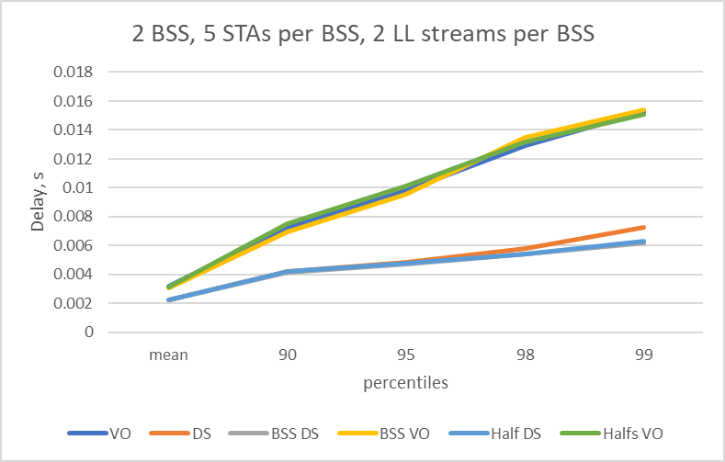
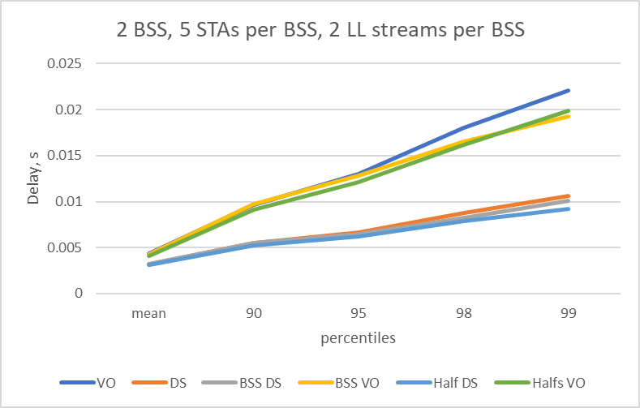
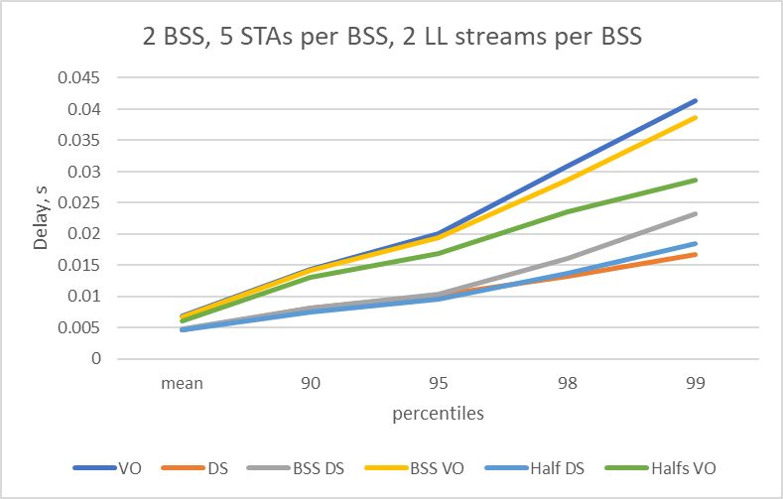
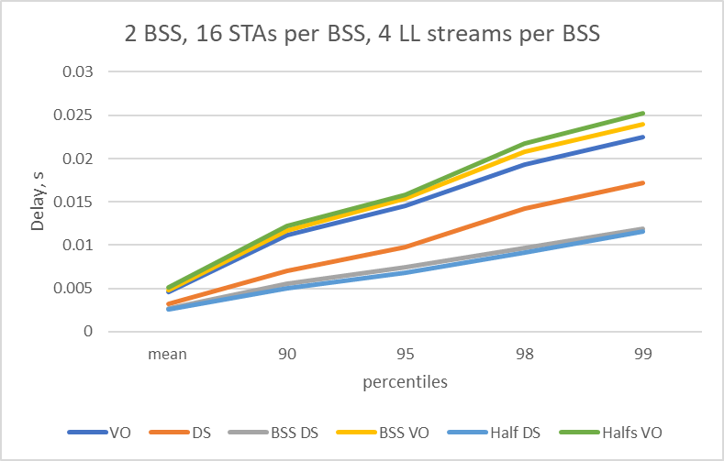
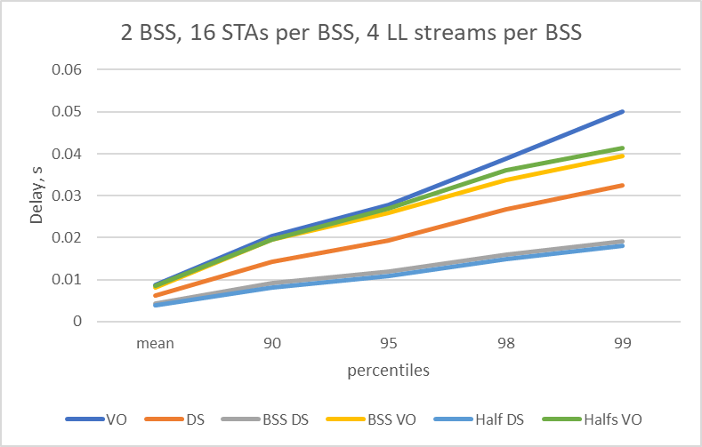
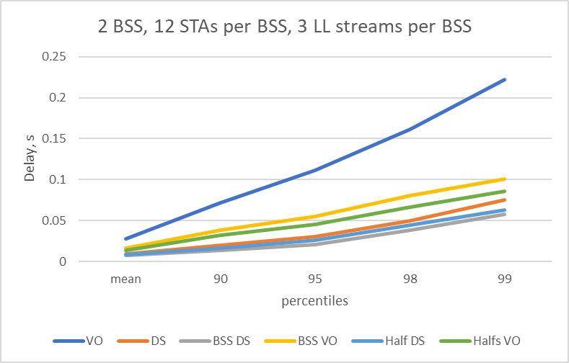
2 BSS case, variable LL packet size
LL size = 1600 LL size = 16000 LL size = 32000
VO – all ULL use legacy EDCA Half VO – half of ULL in a BSS use VO BSS VO – half of BSSes use VO
DS – all ULL use DS Half DS – half of ULL in a BSS use DS BSS DS – half of BSSes use DS

Slide 12
Observations
In extreme case (every simultaneous transmission of DS is treated as unsynchronized) we do observe an impact on overall ETE delay KPI
  Note: the situation when almost every DS going to collide is not typical, it practice we expect 3rd party receiver to successfully lock and receive multiple DSes and set NAV or to have regular erroneous reception EIFS assertion
The impact does not disrupt gains provided by HiP EDCA.

Slide 13
How DL access might be affected?
Same scenarios as before, but now AP also has LL streams in AC_VO, i.e. LL streams are now bi-directional
DS is sent after first retry
Case 1: legacy EDCA
Case 2: AP DOES NOT send DS (i.e. DS is only for UL traffic)
Case 3: AP SEND DS, i.e. both AP and STAs send DS

Slide 14
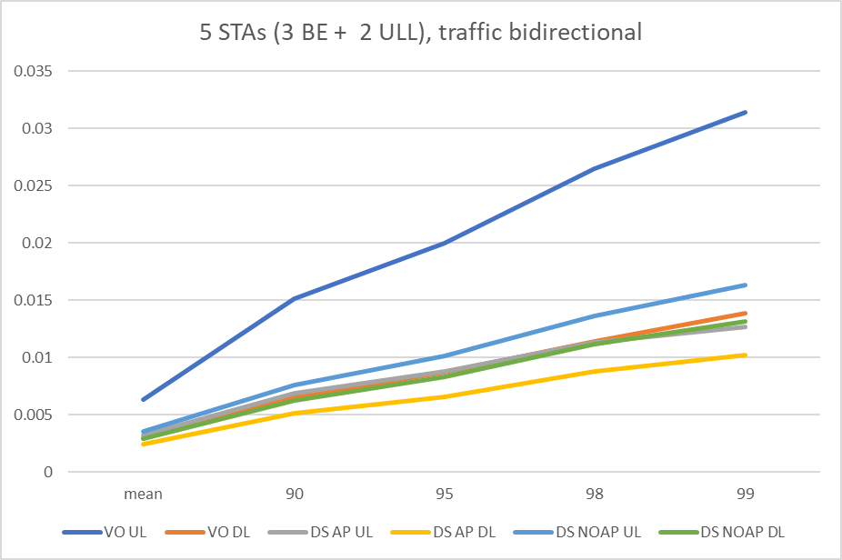
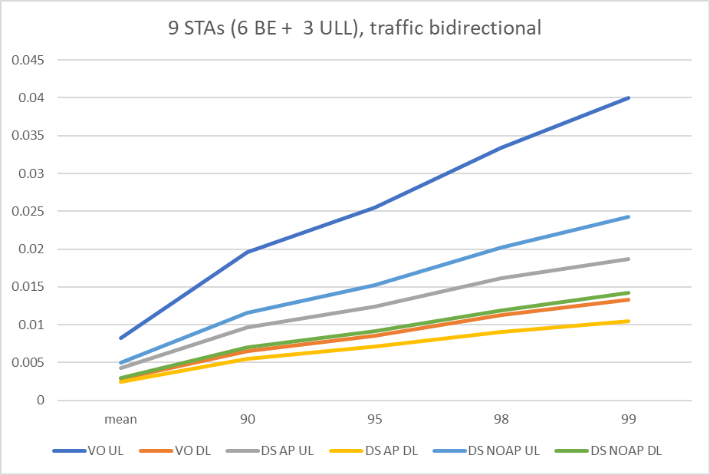
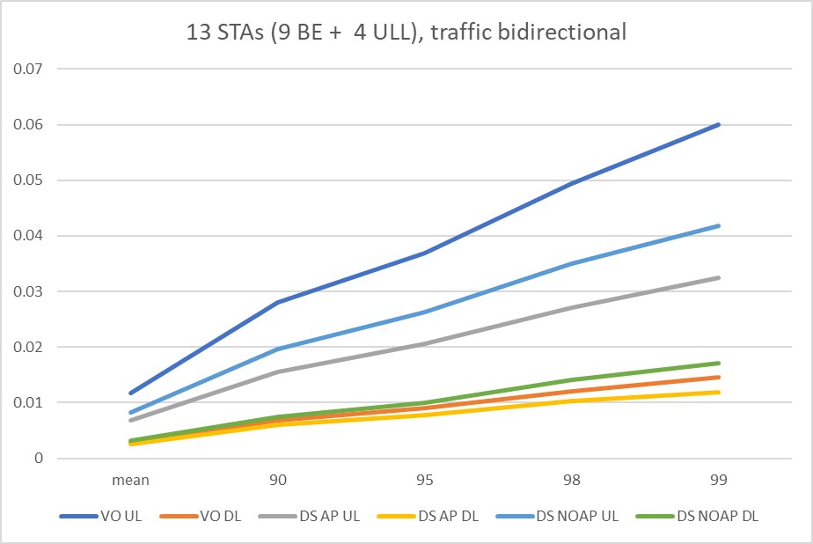
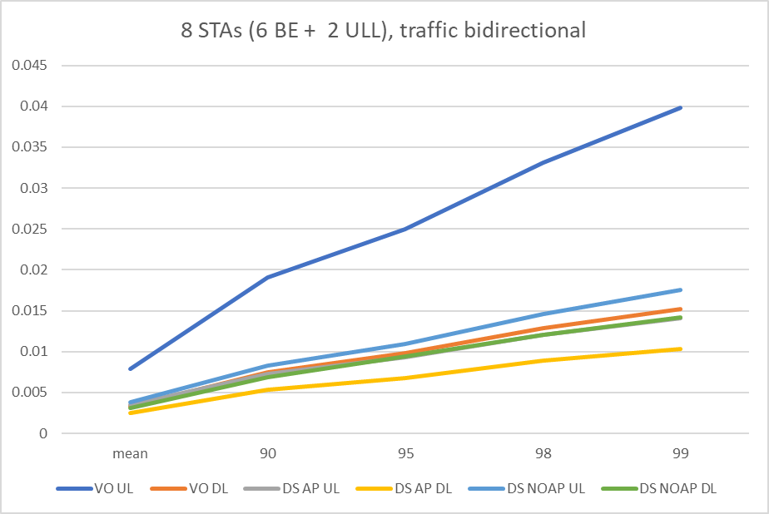
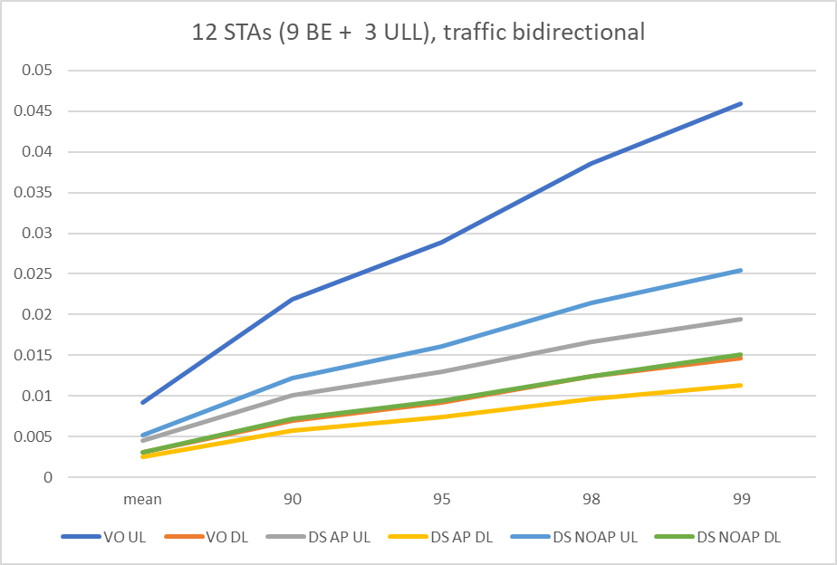

4 BSS case, LL packet size = 1600
VO UL – delay for Legacy UL DS AP UL – delay for UL when AP send DS DS no AP UL - delay for UL when AP NOT sending DS
VO DL – delay for Legacy DL DS AP DL – delay for DL when AP send DS DS no AP DL – delay for DL when AP NOT sending DS

Slide 15
Observations
We observe no substantial impact on DL channel access performance
There seems to be a minor gain for an AP if DS transmission/HiP EDCA announcement is enabled on AP side as well

Slide 16
Whether DS should be @ DIFS or randomized?
Initial design propose to use AIFSN = 2 = DIFS boundary for DS transmission
What if boundary is randomized?
  DS boundary randomly selected between 2 and 4

Slide 17
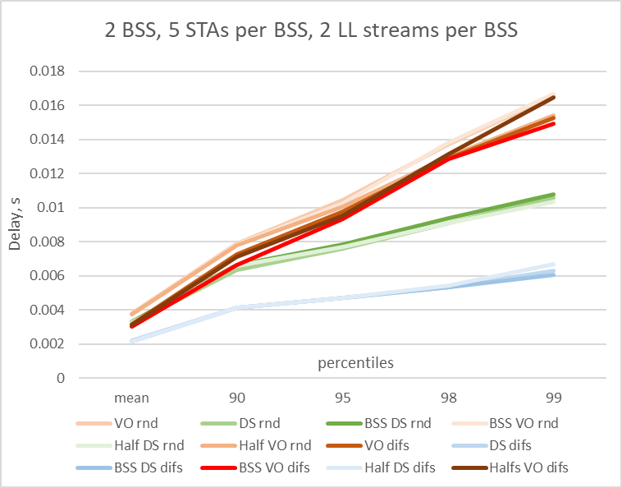
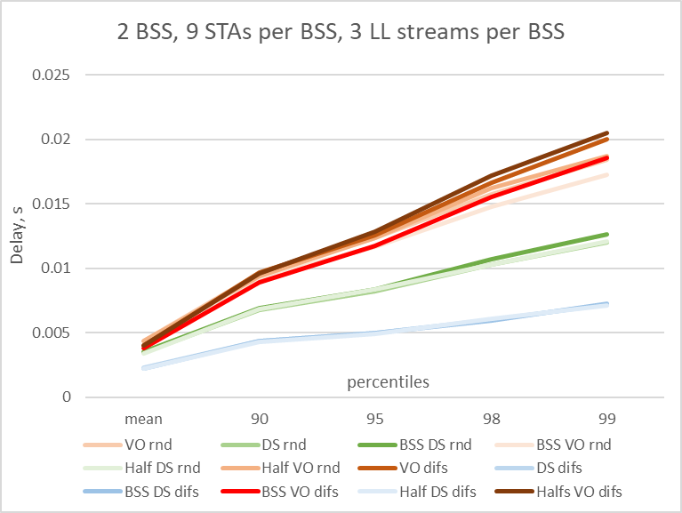
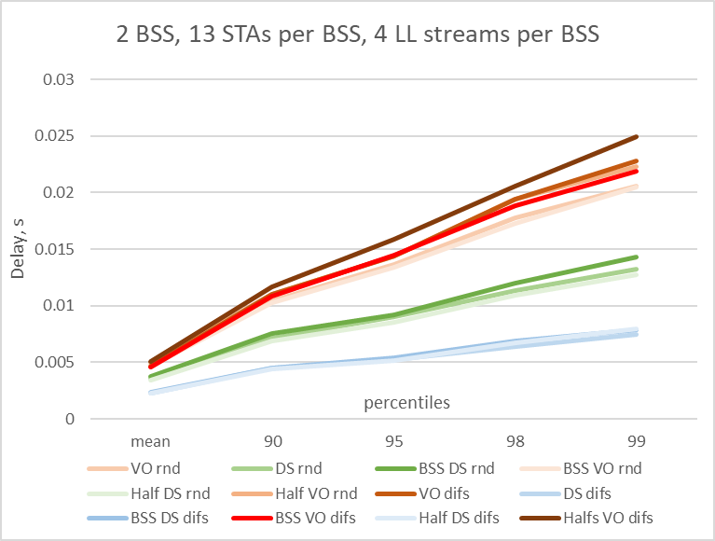
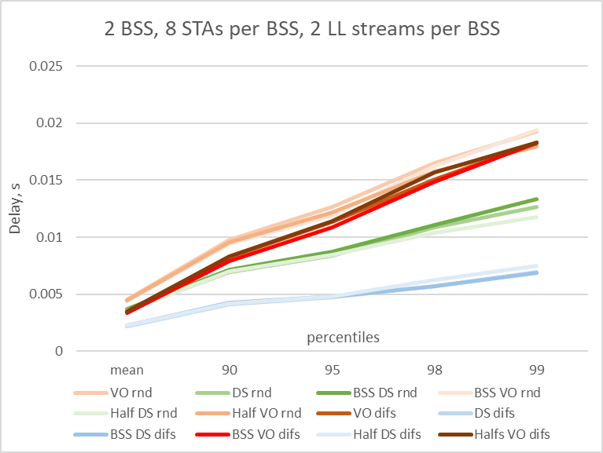
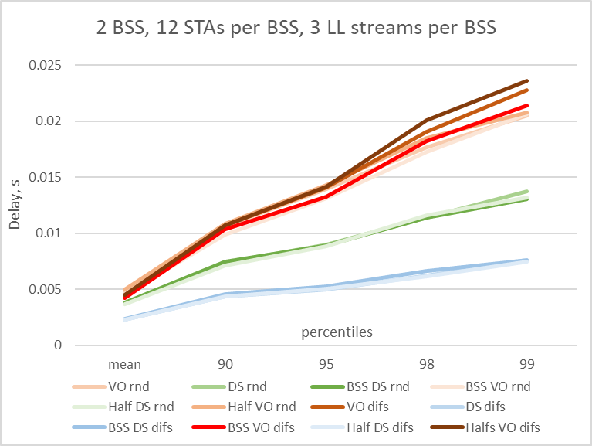
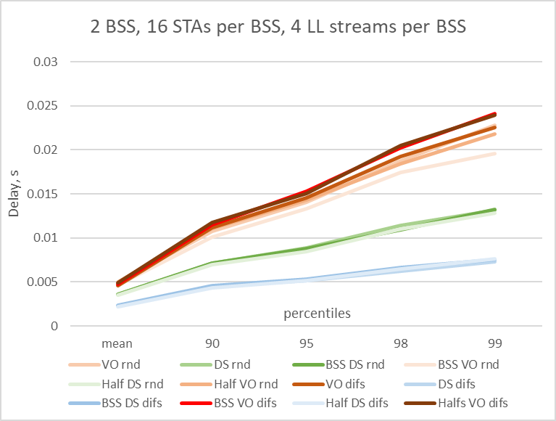
2 BSS case, LL packet size 1600 bytes
VO – all ULL use legacy EDCA Half VO – half of ULL in a BSS use VO BSS VO – half of BSSes use VO
DS – all ULL use DS Half DS – half of ULL in a BSS use DS BSS DS – half of BSSes use DS

Slide 18
Observations
Randomization of DS transmission time within limited interval decrease performance vs DS sent at fixed DIFS interval
We still observe improvements in comparison vs legacy EDCA mode of operation
This set of results is still in progress

Slide 19
Current proposal
Focus only on using HIP EDCA on AC_VO and possibly extend it to AC_VI for some SCS-negotiated traffic (that get authorization to use HIP EDCA if requested in SCS request and accepted by AP)
  AC_VO with its bounded Cw values may/will saturate quickly in a presence of multiple LL clients
  AC_VO may struggle to obtain the medium in contention with multiple BE contenders. We observe from multiple simulations that a single failure for AC_VO lead to increased chance of consecutive second failure. HiP EDCA help to control that as well as withstand saturation for longer
  Focusing on only AC_VO/LL streams will help to control number of clients eligible to use HiP EDCA
STA always use regular EDCA and can only send DS for the first retransmission
  we can also make it 2 retransmissions if we see that the gains are still good
Make DS a generic CTS frame that sets NAV for just the needed duration to protect HiP EDCA contention
  if necessary, we may add rules for further regulation, such as a minimum delay to wait before being allowed to send DS again, once a STA gains a TxOP with HIP EDCA or limit a number of attempts to announce HiP EDCA
If we see that we need to compensate AP access (currently we see not such need with AC_VO restrictions)
  a range of solutions exist, for example - reverse direction in TxOP gained by DS can be one of them
If we see that we need to ensure sync on overlapping DS, we can impose that DS is sent only when the STA detected the last PPDU from the previous TxOP

Slide 20
Straw poll
Do you agree to improve EDCA to reduce tail access delay of Low Latency traffic in multi-BSS dense scenarios in presence of best effort traffic?
  • The solution to improve EDCA is distributed
  • The impact on legacy device has to be balanced
  • Low Latency traffic is treated as AC_VO traffic. Other cases are TBD

Slide 21
backup

Slide 22
Impact on unsuccessful reception of DS signal
It is different from the previous set of results in the following way:
  In previous set the assumption was that DS that are aligned in time with difference no more than 1us will be treated at the receiver as _one_ frame (i.e. as MuCTS response to an MuRTS)
  New results assume that when 2 or more DSes arrive to the receiver, even if perfectly aligned in time, the received will lock onto the first arriving DS and will treat the second one as interference. At the end of preamble of first DS SNIR will be calculated, and decision will be made if preamble of first DS is received or not. If not, an RxAbort is issued and no EIFS scheduled at the end of that DS. Receiver will start contending as soon as it determines medium to become idle. If preamble of OK -> EIFS will be scheduled

Slide 23
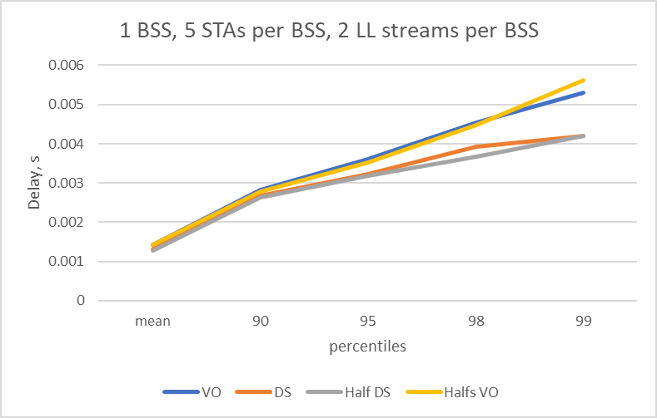
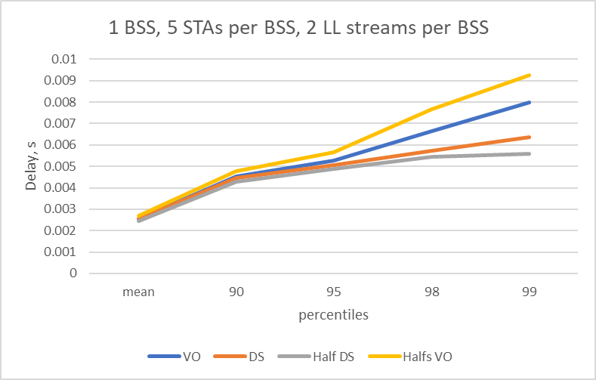
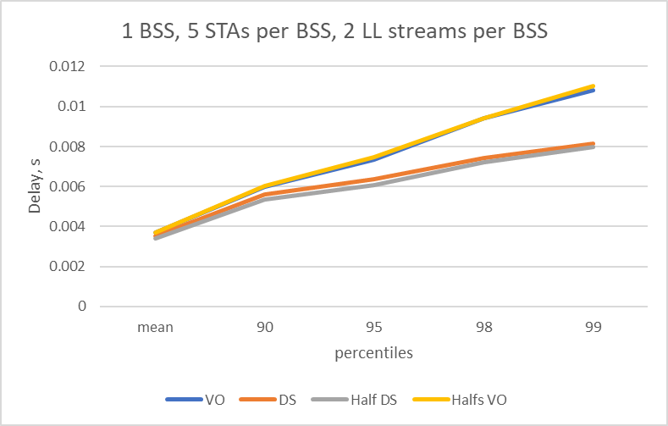
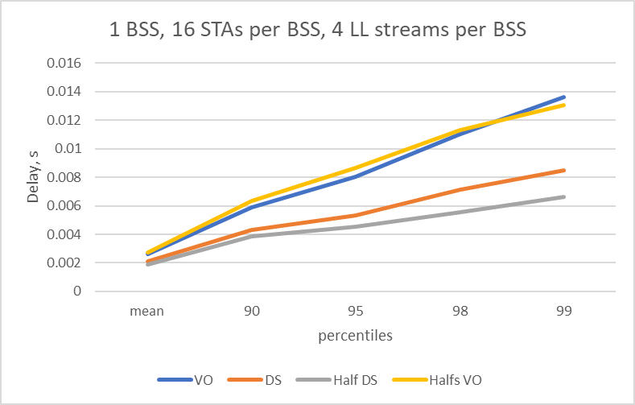
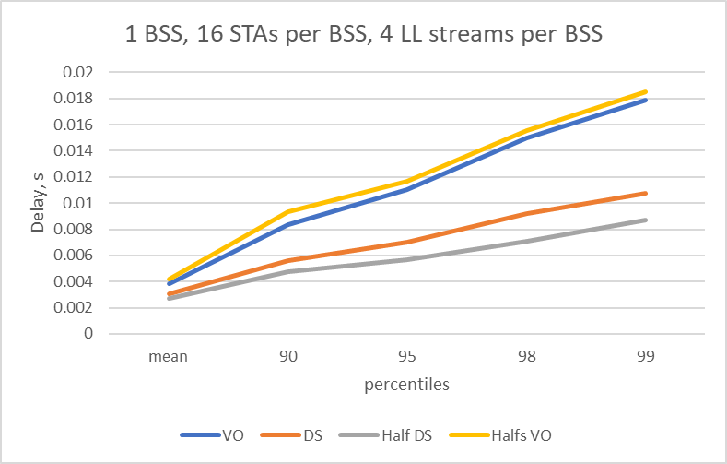
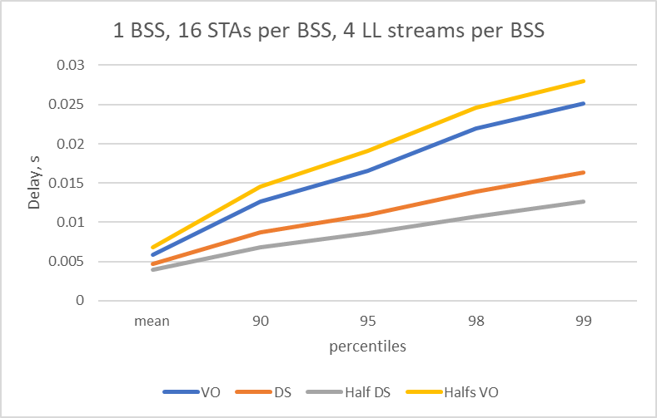
1 BSS case, various LL packet size
LL size = 1600 LL size = 16000 LL size = 32000
VO – all ULL use legacy EDCA Half VO – half of ULL use VO
DS – all ULL use DS Half DS – half of ULL use DS

Slide 24
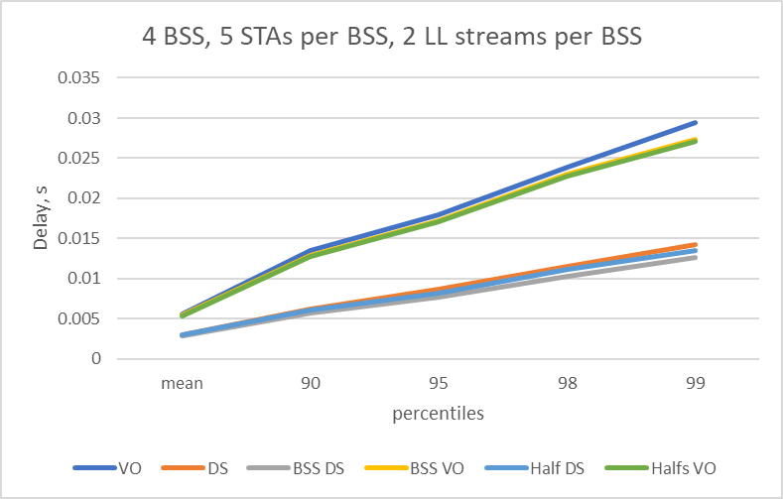
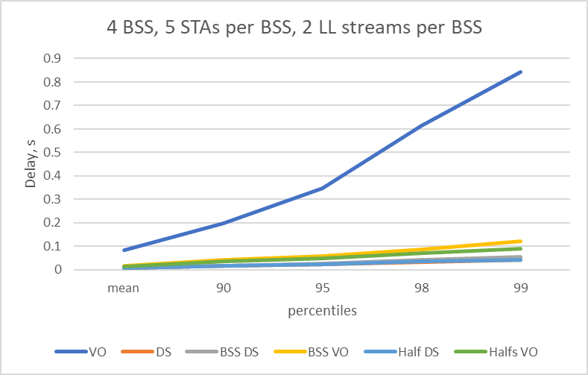
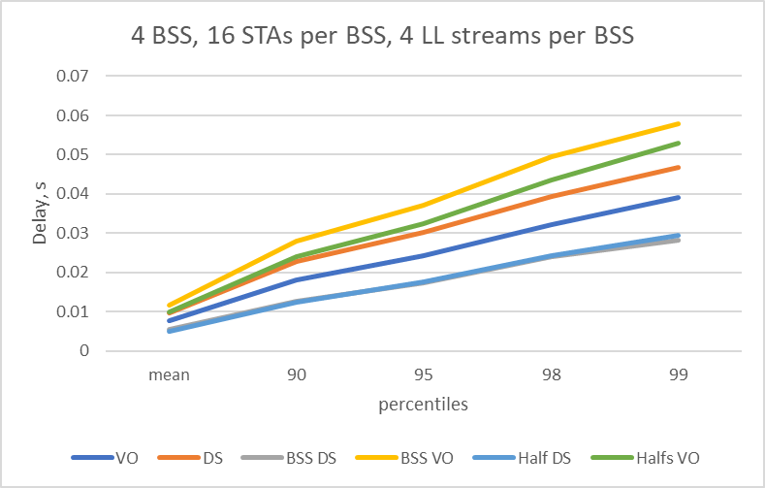
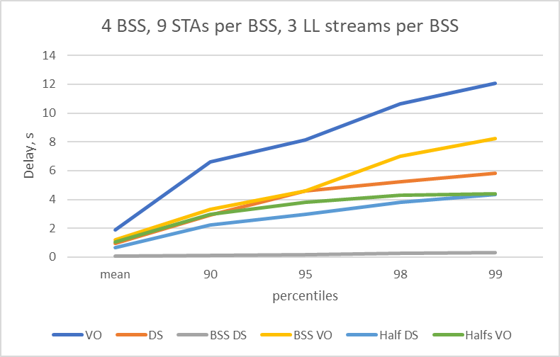
4 BSS case
LL size = 1600 LL size = 16000
VO – all ULL use legacy EDCA Half VO – half of ULL in a BSS use VO BSS VO – half of BSSes use VO
DS – all ULL use DS Half DS – half of ULL in a BSS use DS BSS DS – half of BSSes use DS

Slide 25
How DL access might be affected?
Same scenarios as before, but now AP also has LL streams in AC_VO, i.e. LL streams are now bi-directional
DS is sent after first retry
Case 1: legacy EDCA
Case 2: AP DOES NOT send DS (i.e. DS is only for UL traffic)
Case 3: AP SEND DS, i.e. both AP and STAs send DS

Slide 26
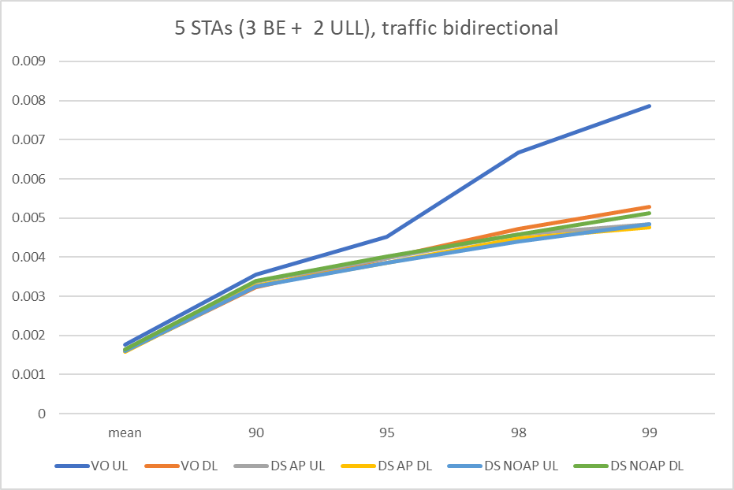
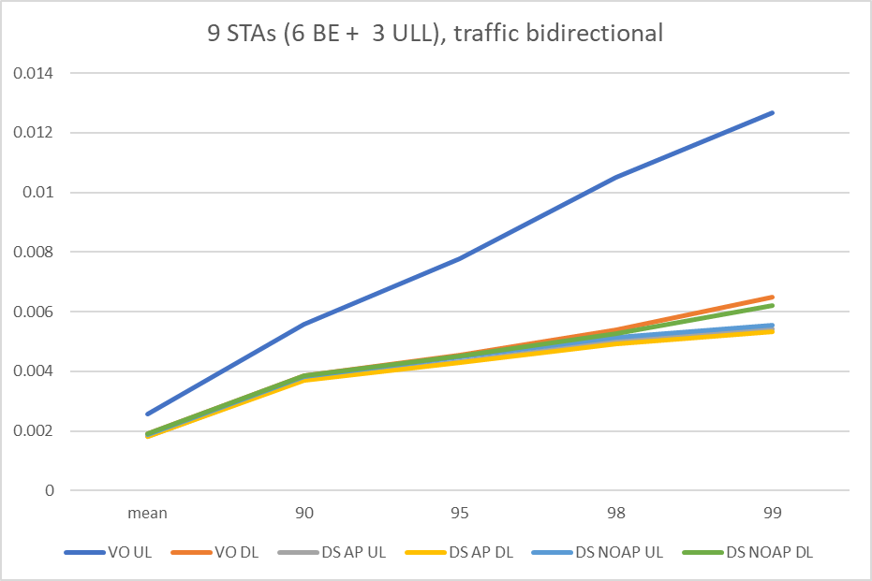
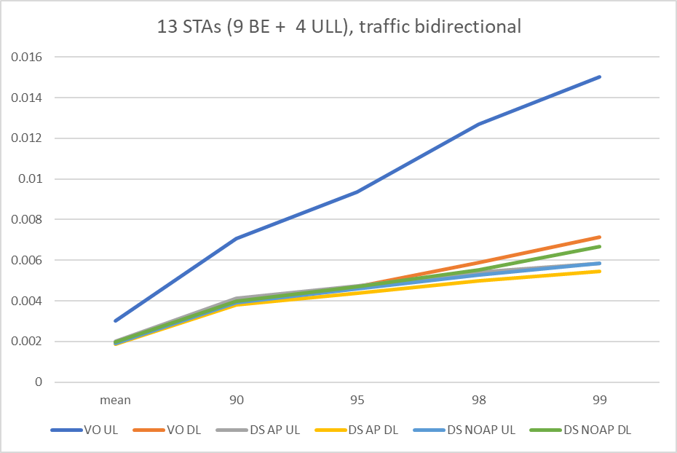
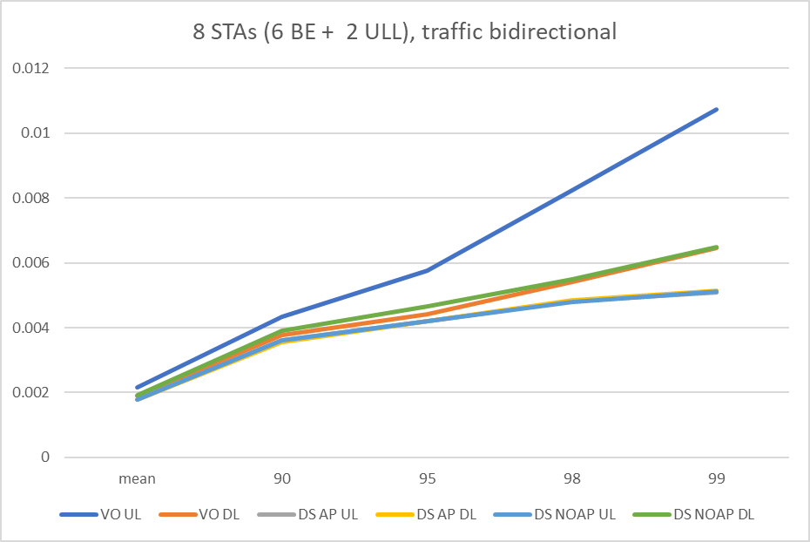
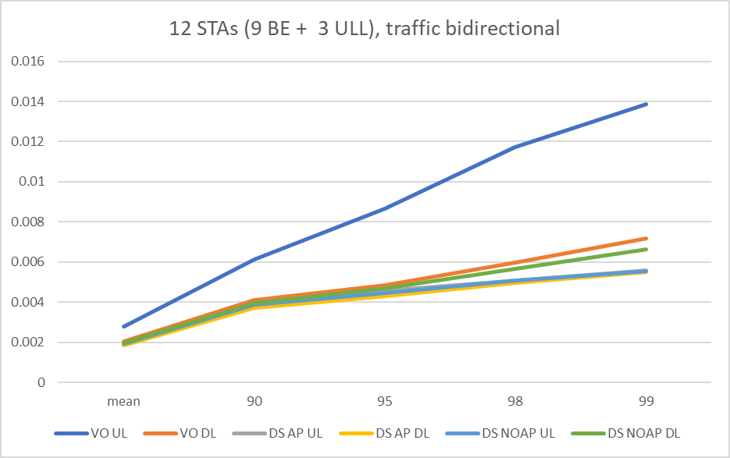
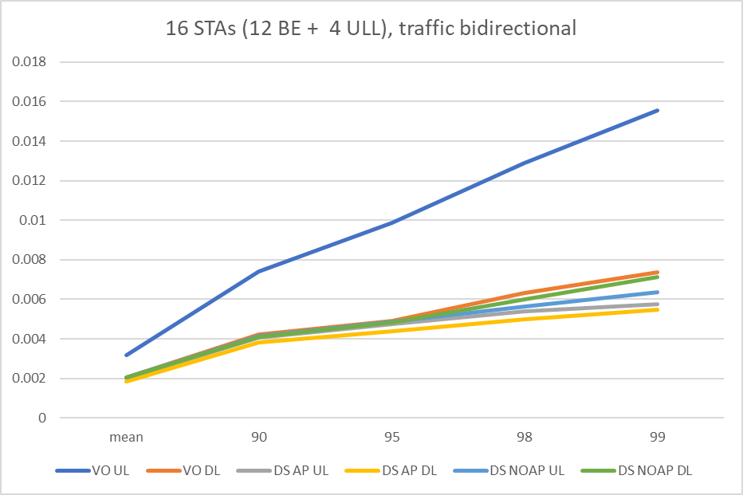
1 BSS case, LL packet size = 1600
VO UL – delay for Legacy UL DS AP UL – delay for UL when AP send DS DS no AP UL - delay for UL when AP NOT sending DS
VO DL – delay for Legacy DL DS AP DL – delay for DL when AP send DS DS no AP DL – delay for DL when AP NOT sending DS

Slide 27
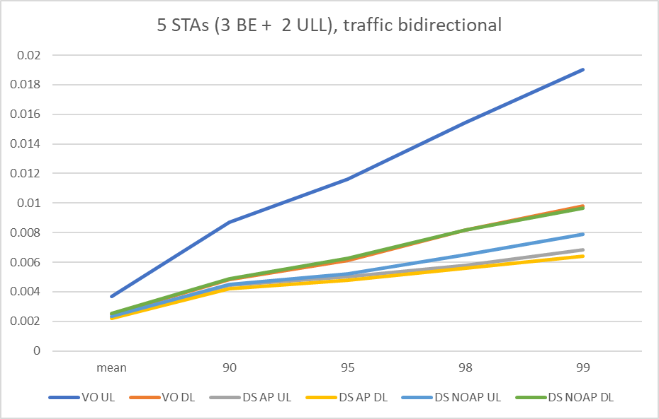
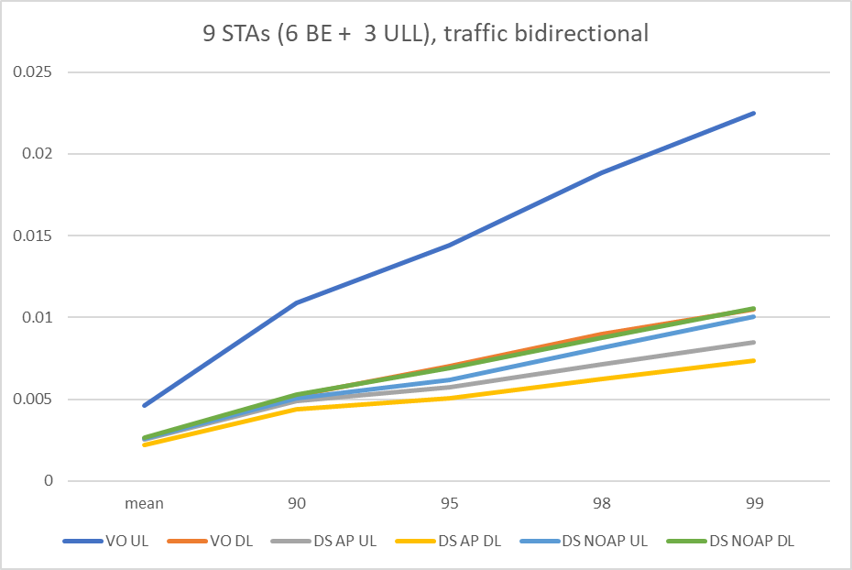
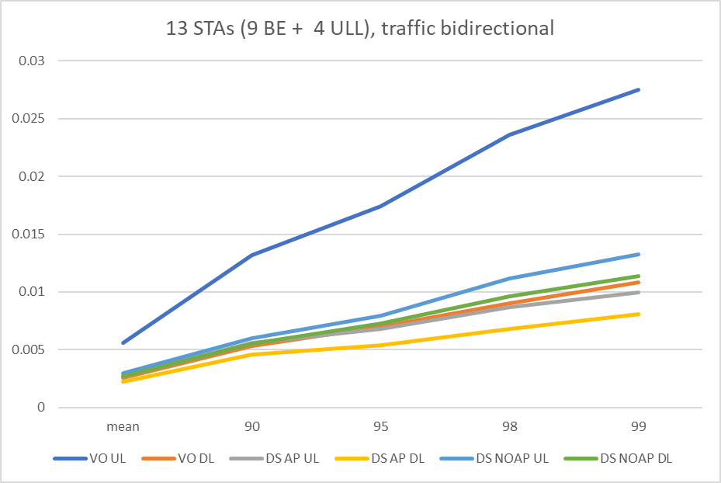
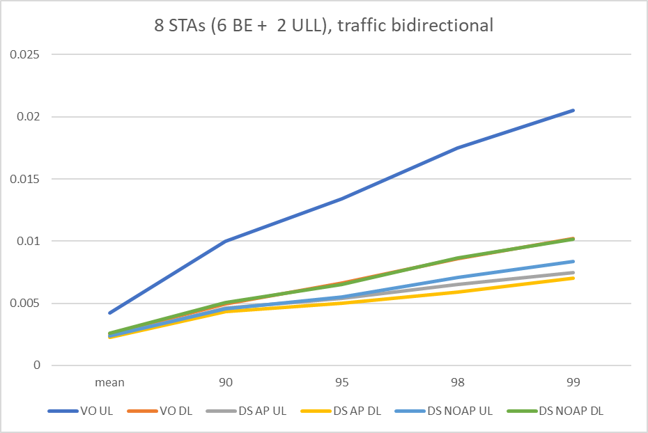
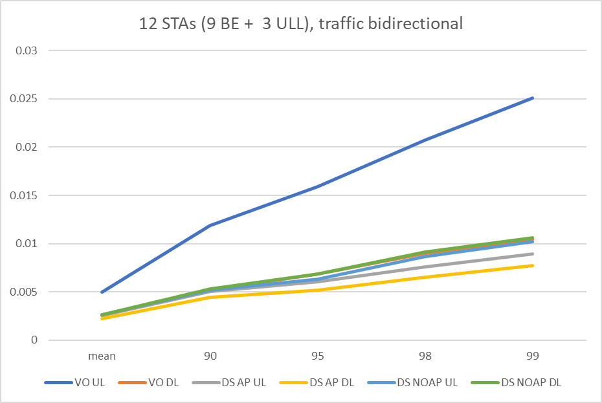
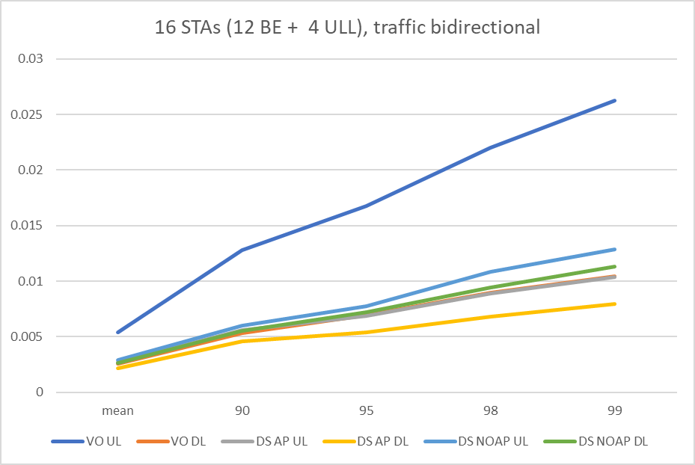
2 BSS case, LL packet size 1600 bytes
VO UL – delay for Legacy UL DS AP UL – delay for UL when AP send DS DS no AP UL - delay for UL when AP NOT sending DS
VO DL – delay for Legacy DL DS AP DL – delay for DL when AP send DS DS no AP DL – delay for DL when AP NOT sending DS

