Slide 1
Close-range AMP WiFi Reader Feasibility Study
Follow up
Date: 2024-05-09
Authors:

Slide 2
Introduction
The performance of AMP close-range backscattering tag reader was evaluated [1], considering
  Tag modulation noise, Tx waveform noise, Tx-Rx leakage noise floor, Rx ADC bitwidth, etc.
In this presentation,
  Performance evaluation considering the clock inaccuracy of the tag
  Discuss waveform/PPDU requirement for tag reading and writing.

Slide 3










Recap: use cases
10’s of billions of AMP+UHF tags can be read with a mobile device?
  UHF operation in sub-1GHz for 2B scenarios with 10+m range
  Consumer usage in 2.4GHz with WiFi device in close range
Read range requirement: 5~10cm

Slide 4
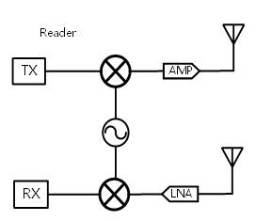
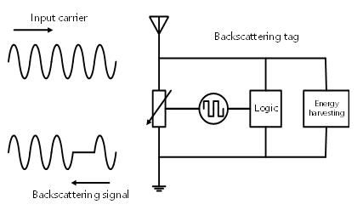
Recap: WiFi AMP Tag Reading
WiFi AMP reader
AMP tag
WiFi reader: WiFi transceiver with 2+ antennas
  One set of antennas send reading energizer/carrier signal and
  Second set of antennas decode the backscattered tag signal

Slide 5
WiFi Reader Rx Signal
Leakage signal
Backscattered signal
$$y=h_{lk}∗\left(x+w_{t}\right)+h_{bs}∗((x+w_{t})∙f\left[n\right]+w_{t,bs})+w_{r}$$
Tx-Rx leakage channel
transmitted waveform
transmit noise (TxEVM)
backscattered channel
modulated bit n
modulation noise (TxEVM)
receiver noise (SNR)
Note:
  Power difference between leakage and backscattered signal is modeled into the channel
  Backscattering modulation: OOK, tag modulation clock has up to ~100k ppm
 |  |  |  |  |  |  |  | …
Leakage signal
BS signal
0 0 1 0 1 0 1 1 0 1

Slide 6
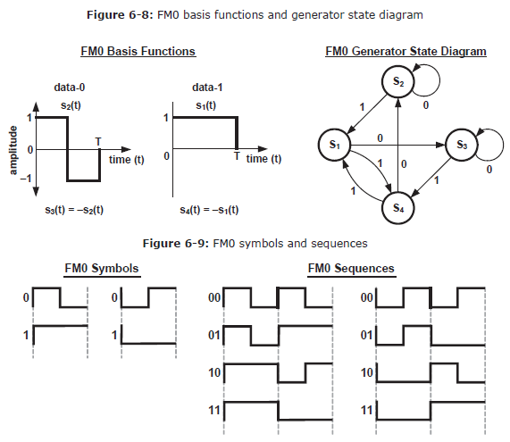
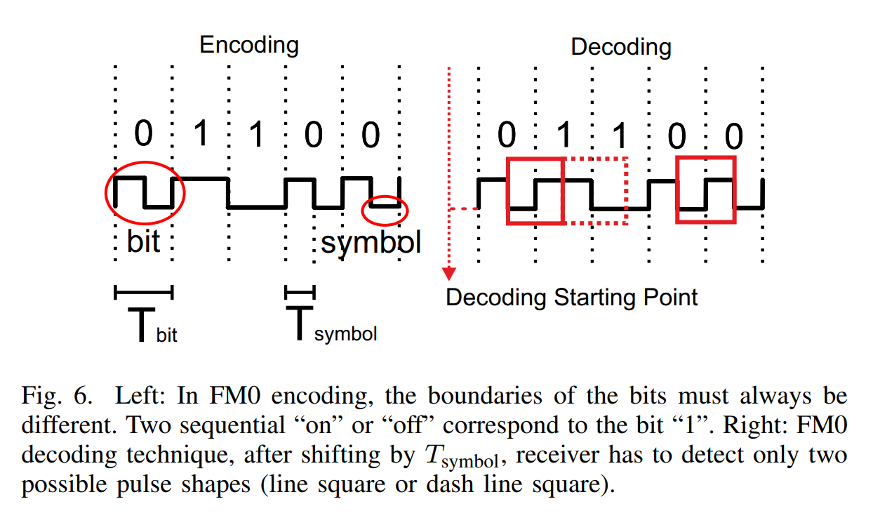
Tag Backscattering Modulation
Low-power and low-cost tag’s clock inaccuracy is relative high, e.g. up to 100,000ppm for UHF tag.
FM0 and Miller coding are specified for UHF tag modulation [3]
  Bit boundary is embedded in the signal transition, to assist Reader to resolve the high ppm.

Slide 7
AMP Reader PPDU
AMP Reader PPDU
  Fully coex with existing 802.11 devices
  Reuse existing 11b PPDU or OFDM PPDU (11a/g or later amendment)
  Example structure:
    WiFi preamble: provides coex and compatibility with other WiFi devices
    Reference symbol(s): Reader uses these symbols to estimate the reference for the leakage carrier symbol signal for direct Tx-Rx leakage cancellation
      e.g. LTF symbol or fixed loading data symbol
    Carrier symbols: tag will modulate information on these symbols
      The same waveform as reference symbol, may apply random phase for spectrum control
Payload/Data symbols
WiFi preamble | Reference Symbol(s) | Carrier Symbols

Slide 8
Simulation Settings
2x2 WiFi device in “1Tx + 1Rx” mode
  Antenna isolation is 20dB → Rx power of -20dBm
    Effective Rx noise floor varies from -35dBr to -50dBr
    Note: assume TxEVM after differential is below Rx NF
AMP tag backscattering data rate: 250kbps
  250kbps data rate, i.e. one-bit modulated on a 4us waveform
  FM0 modulation: -20 dBr Tx noise
  Payload: 1000 bits
WiFi reader Rx BW = 40MHz, 10-bit ADC
  Fixed AGC gain to get I/Q samples
  Leakage removal using reference symbols
  Matched filter to detect modulation boundary
Leakage signal: 0dBr
BS signal level: e.g. -30dBr
Rx noise floor: e.g. -45dBr

Slide 9
WiFi AMP tag reading performance
Pathloss modeling uses Friss model is as in [1]
  RxNF=-35dBr, read a tag within ~12cm with 100,000 ppm;
  RxNF=-40dBr, read a tag within ~16cm with 100,000 ppm;

Slide 10
WiFi AMP tag reading performance
  RxNF=-45dBr, read a tag within ~22cm with 100,000 ppm;
  RxNF=-50dBr, read a tag within ~26cm with 100,000 ppm;

Slide 11
Reader to Tag PPDU Discussions
For Reader to Tag communication,
  OOK is the only modulation feasible
  PPDU needs to coex with existing 802.11 devices
  Can reuse existing WUR PPDU or new PPDU with similar structure
  Example:
    Legacy preamble: provides coex and compatibility with other WiFi devices
    WUR/New preamble: to sync with tag
    Payload: information to be programmed to the tag
      Bit modulation can be similar to UHR Tag.
Legacy preamble | WUR/New preamble | OOK modulated payload

Slide 12
Summary
Continue the evaluation of WiFi AMP reader performance considering the tag clock inaccuracy.
  Tag reading is feasible, limitations in range for high ppm tag.
WiFi AMP reader carrier PPDU
  Reuse existing 11b or OFDM PPDU: fully coex with existing WiFi
  Redefine payload portion to support reading function
WiFi AMP reader to tag PPDU
  Need to fully coex with existing WiFi
  Can reuse PPDU format similar to existing 11ba WUR PPDU

Slide 13
References
[1] 11-23/2038, Close Range AMP Backscattering in 2.4GHz
[2] 11-24/0537, close-range-backscattering-feasibility-study
[3] EPC UHF Gen2 Air Interface Protocol | GS1

Slide 14
SP
Do you agree to add the following text to 11bp SFD?
11bp defines MAC and PHY for close-range backscattering communication with co-located Tx and Rx.

