Slide 1
CSMA with enhanced Collision Avoidance
Date: 5/2/2024
Authors:

Slide 2
Introduction
A previous submission [1] looked at collisions in CSMA/CA
For highly congested networks, collisions have a significant impact on performance
This submission introduces some modifications to enhance the inherent collision avoidance of CSMA

Slide 3
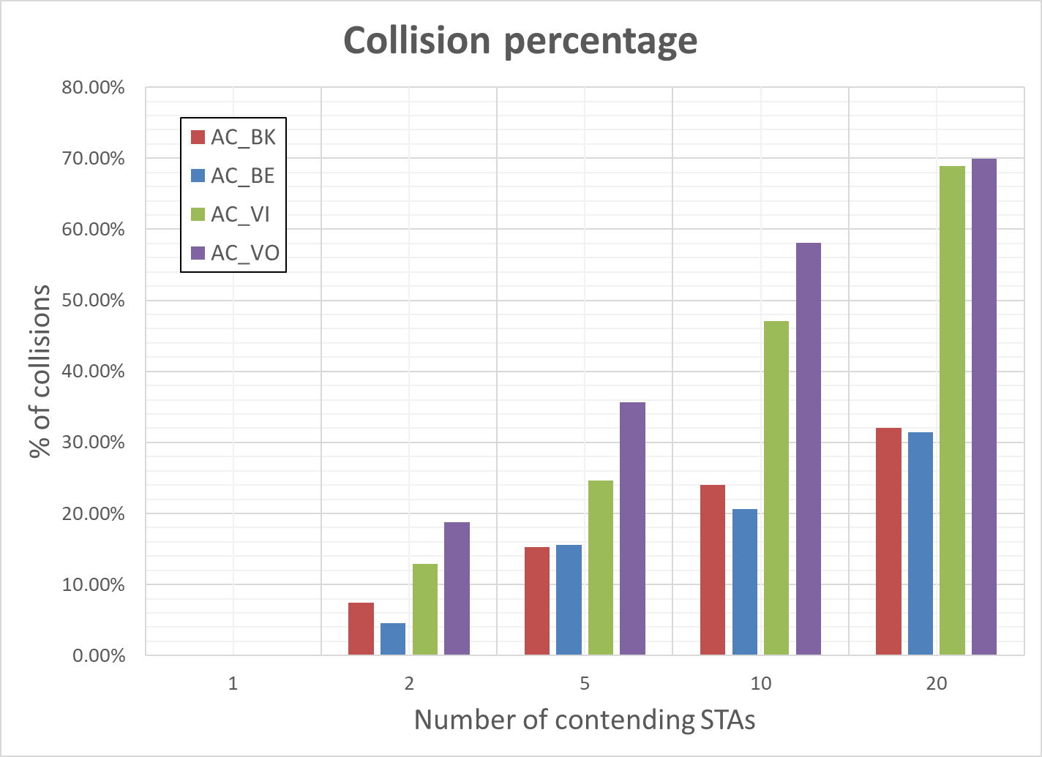
Collisions in CSMA/CA
Collisions in CSMA/CA are mitigated by random backoff and adaptive Contention Window (CW)
designed to reduce the collision probability
Collision probability increases with increasing number of contending STAs – see [1]

Slide 4
Addressing Collisions in CSMA
The cause of collisions is a too short CW for the number of contending STAs
Not enough distinct random values
Note: not considering hidden nodes in this submission
When a collision happens, the number of colliding devices is statically much lower than the total number of contending devices
Additional contention between those “surviving STAs” may be able to resolve the collision

Slide 5
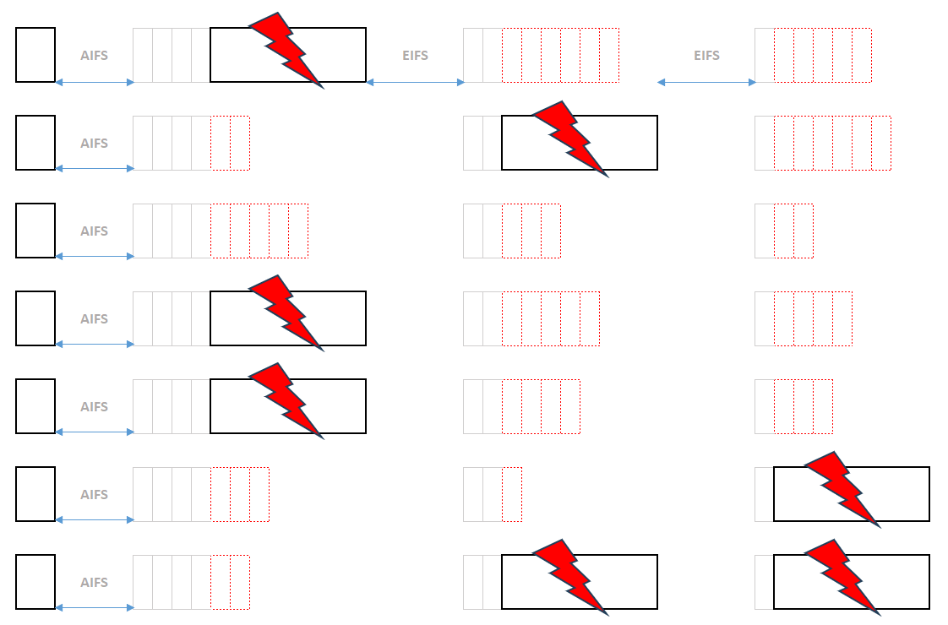
Collision Illustration

Slide 6
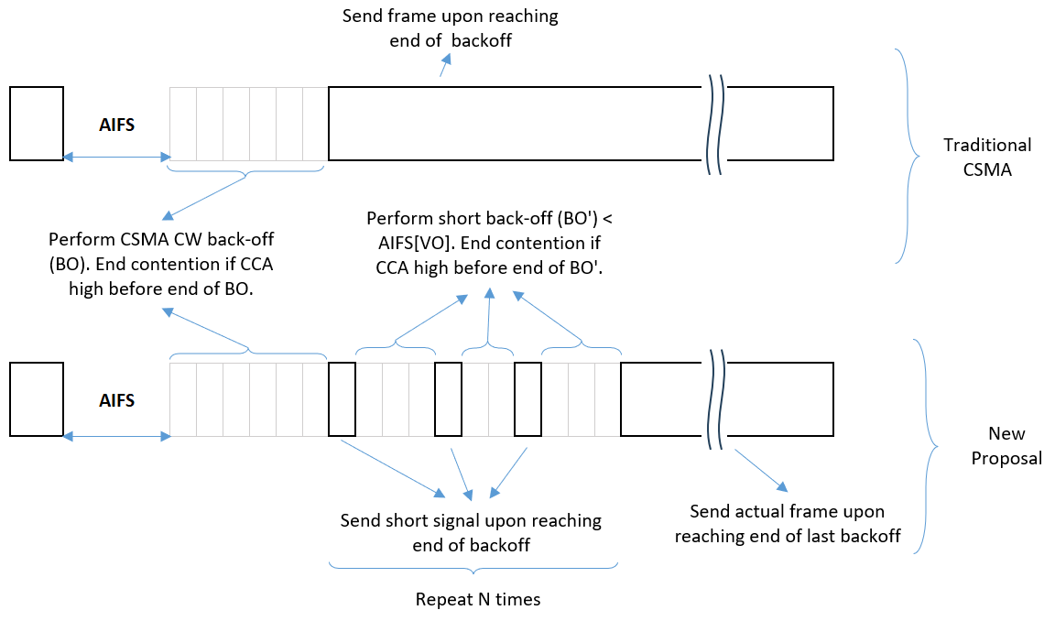
Proposal
Introduce a new “collision avoidance phase” after the transmitter gains access to the medium
In a way that is compatible with CSMA

Slide 7
Details
STAs perform CSMA to gain access to the medium
Any STA that gains access (there could be more than one) transmits only a short signal (e.g., L-STF)
sufficient for other STAs that are still contending to understand that the medium is busy
Surviving STAs (i.e. STAs that were able to complete the backoff) perform multiple short backoff rounds
Shorter than AIFS[VO] such that no other STA can gain access
Any STA that reaches the end of its backoff counter will again only send a short signal
Any STA that observes a busy medium prior to reaching the end of the countdown will abandon its attempt to access the medium
After the last “short contention”, STA can transmit

Slide 8
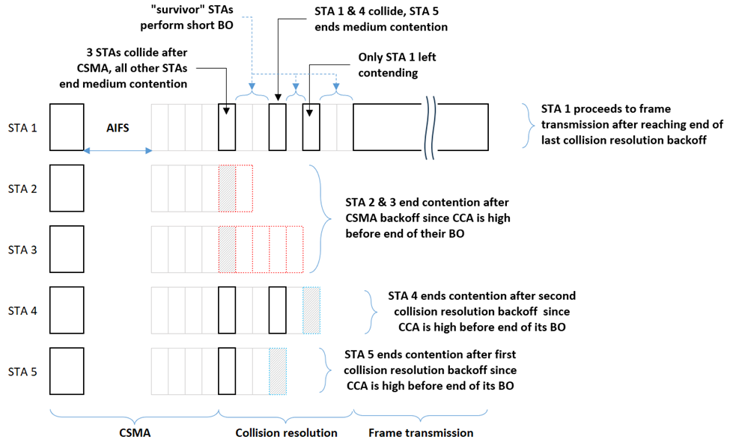
Collision resolution illustration

Slide 9
Notes
Note that none of the STAs knows whether there is more than one STA that gained access to the medium
Not a requirement
Each STA only knows that it was able to reach the end of its backoff counter without observing a busy medium
Number of rounds can be tuned to achieve a desired collision probability
The probability of collisions is reduced statistically.
There remains a non-zero (but significantly reduced) chance that multiple STAs will be in a “tie” during all short backoff rounds.

Slide 10
Simulations
Network simulation to assess performance
1 AP, N STAs with full-buffer uplink traffic
N: 1, 2, 5, 10, 20
Link: MCS 7, 1SS
Collisions are assumed to lead to loss of the packet

Slide 11
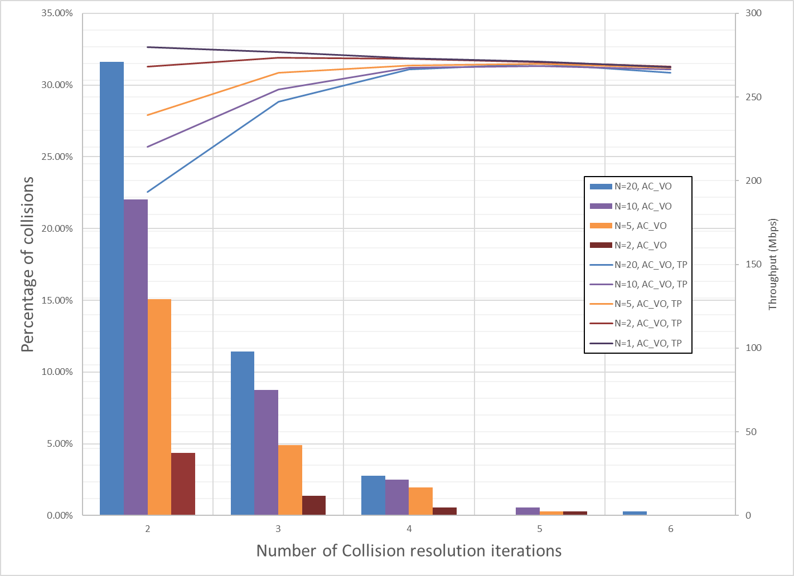
How many short contentions are needed?
Optimal number depends on network load
3-4 rounds looks appropriate considering all ACs and a wide range of network conditions

Slide 12
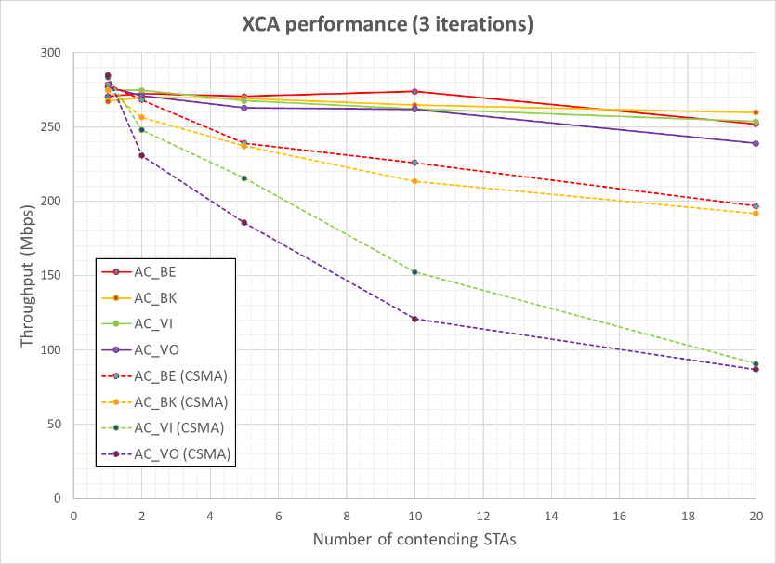
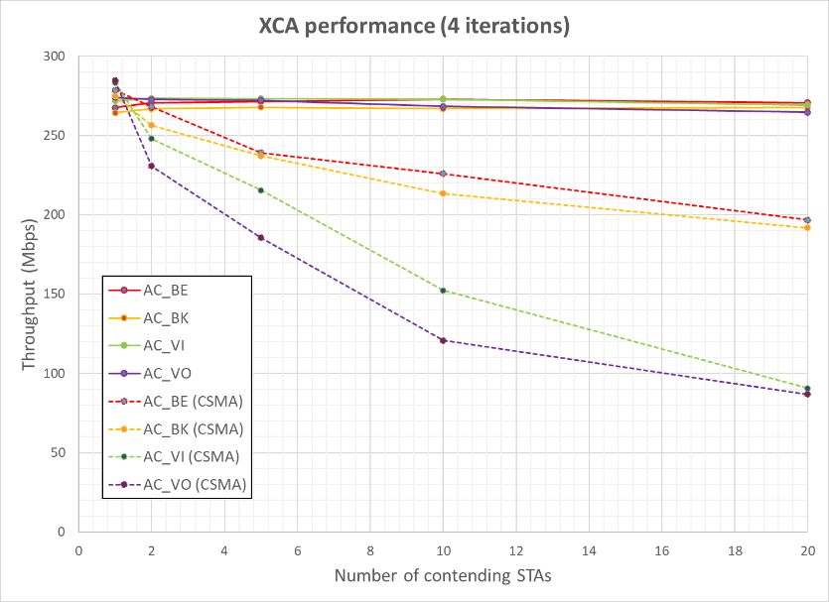
Throughput results
Significant improvement over CSMA (dashed curves)
4 rounds makes network throughput virtually independent of number of contending STAs

Slide 13
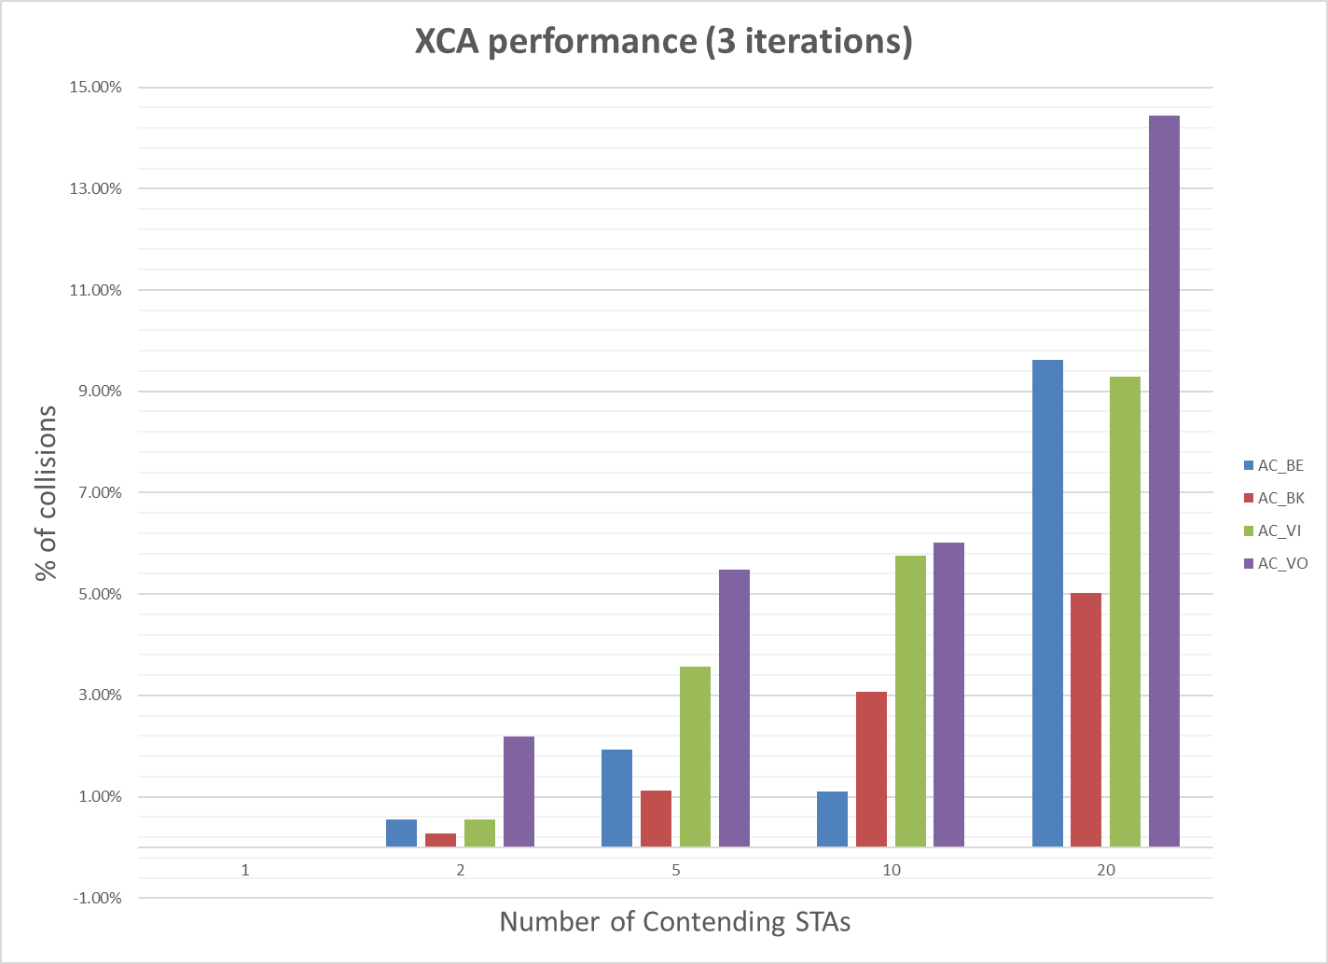
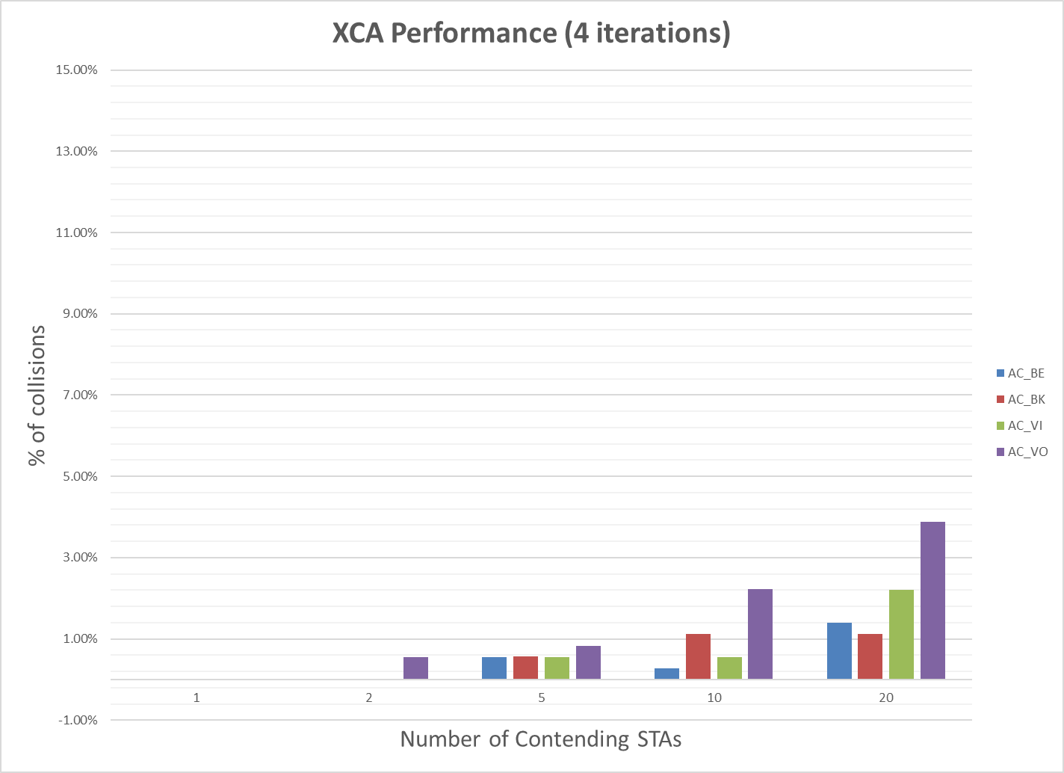
Collision percentages
Collisions virtually eliminated with 4 iterations

Slide 14
Visualization
Visual representation of simulation runs:
Results for CSMA and enhanced CSMA for N=20 STAs, AC_BE, 4 iterations

Slide 15
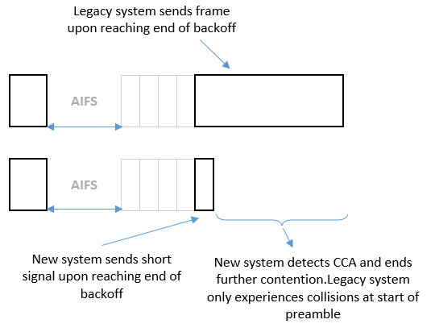
Backwards compatibility with legacy
Method is by design compatible with existing CSMA/CA
No unfair advantage in gaining access to the medium
New systems may be “friendlier” in collision than other legacy system

Slide 16
Other proposals
Other proposals [2, 3, 4] have attempted to address the collision issue in other ways
Similar concepts appear in some of these other proposals
Contention among reduced set of STAs [2]
Short “reservation signal” [2, 4]

Slide 17
Conclusions
We have presented a modified CSMA/CA method with enhanced collision avoidance
Compatible with existing CSMA/CA
The method significantly reduces the probability of collision in a highly congested environment

Slide 18
References
[1] CSMA Collision analysis , IEEE 802.11-23/0772
[2] Low latency channel access, IEEE 802.11-23/1065
[3] Deterministic Backoff, IEEE 802.11-24/0031
[4] Ultra-reliable PHY elements: Low latency, low collision, low power medium access, IEEE 802.11-24/0284

