Slide 1
CSMA Collision analysis
Date: 5/1/2024
Authors:

Slide 2
Introduction
The basic medium access protocol of 802.11 compliant systems (DCF) is based on CSMA/CA (Carrier Sense Multiple Access with Collision Avoidance)
Collisions are still statically possible and increase with network load
Goal of this submission is to present some simulation data and observations about collisions in CSMA/CA

Slide 3
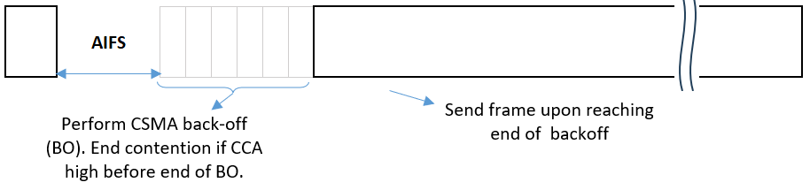
CSMA/CA basics
STAs determine the busy/idle state of the medium (“Carrier Sense”)
After detecting an idle medium, STAs defer before sending any transmission on the medium
Deferral period consists of a fixed backoff (AIFS[AC]) + random backoff
  Number of slots for random backoff chosen within the Contention Window (CW)
During deferral, STAs monitor CCA and end contention if at any time a busy medium is detected
STA is allowed to access the medium when the random backoff counter reaches zero

Slide 4
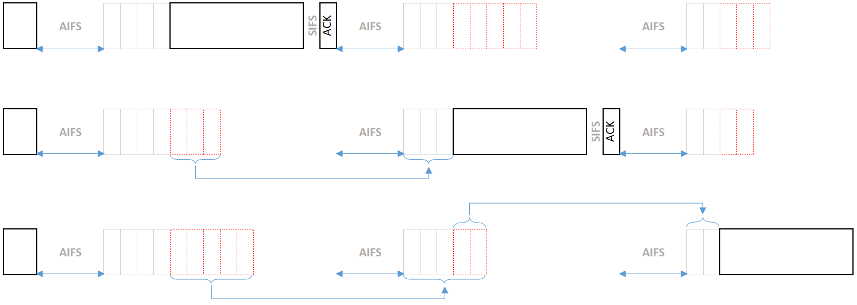
CSMA/CA basics
STAs for which backoff counter has not reached zero can continue counting down from the latest value of the counter for the next contention

Slide 5
EDCA
EDCA specifies AIFS and CW limits per AC
Each AC effectively performs independent CSMA/CA
AC | Traffic Type | CWmin | CWmax | AIFSN | AIFS (usec)
AC_BK | Background | 15 | 1023 | 7 | 79
AC_BE | Best Effort | 15 | 1023 | 3 | 43
AC_VI | Video | 7 | 15 | 2 | 34
AC_VO | Voice | 3 | 7 | 2 | 34

Slide 6
Collision avoidance
Introducing a random countdown reduces the likelihood that two STAs will try to access the medium at the same time
  It remains statistically possible for multiple STAs to access the medium at the same time, because the number of distinct random backoff values is limited by the Contention Window (CW).
If a transmitting STAs infers a collision (absence of ACK), it will increase (double) the CW for the next medium contention
  Up to a value CWmax[AC]
CW is reset upon completion of successful reception

Slide 7
Observations on Collision Avoidance
CW is only increased for STAs that experience a collision. It does not move the whole network to a different CW.
A collision event can result in a lot of lost airtime
After a successful transmission, the transmitting STA reverts back to the original CW window, which may not be appropriate for the network overall
Some ACs severely limit the value of CWmax
In highly congested networks collisions may have non-negligible impact

Slide 8
Simulations
Network simulation to assess performance
1 AP, N STAs with full-buffer uplink traffic
  N: 1, 2, 5, 10, 20
Link: MCS 7, 1SS
Collisions are assumed to lead to loss of the packet

Slide 9
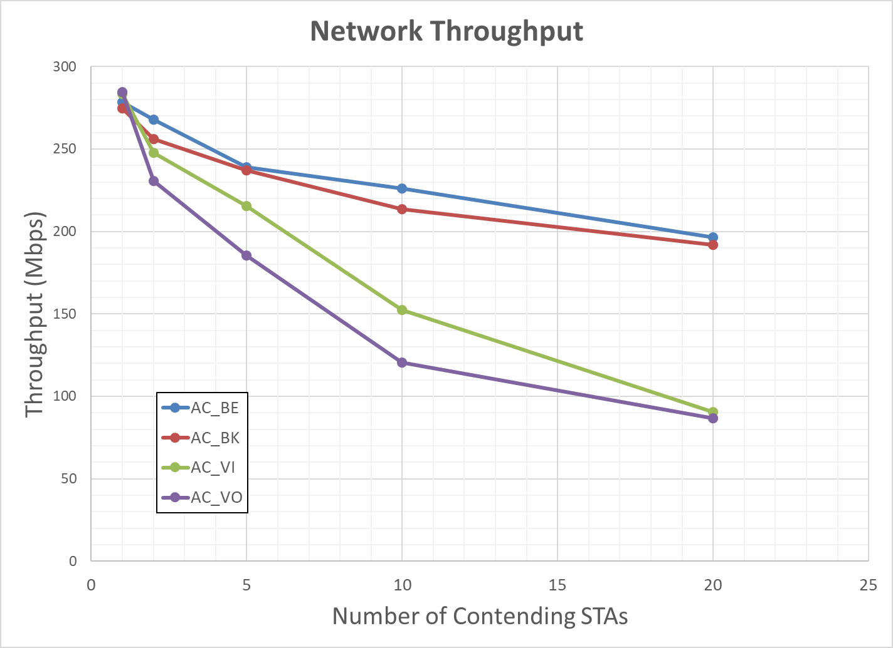
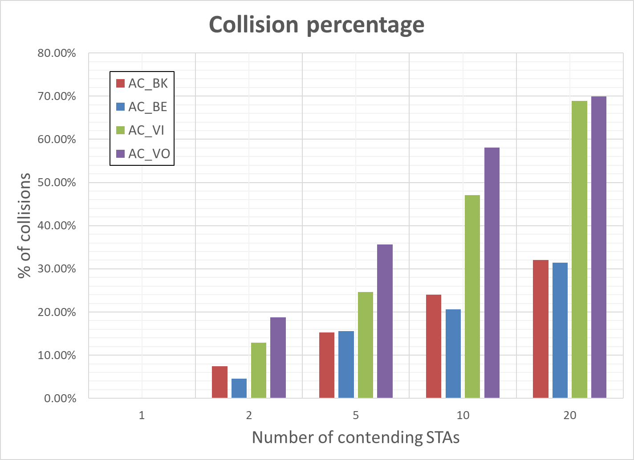
CSMA/CA in congested networks
Collisions (and resulting degradation of network throughput) are significant in congested networks
AC_VO and AC_VI relatively more impacted

Slide 10
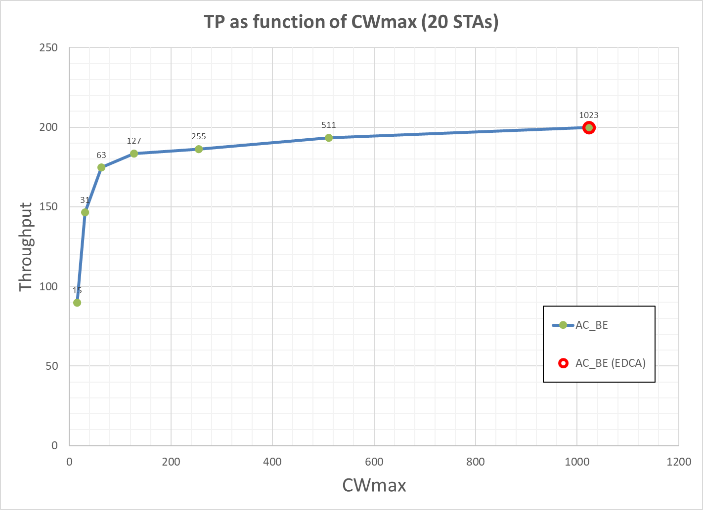
How well does Collision Avoidance work?
To evaluate the effectiveness of the adaptive CW, we simulate performance for different values of Cwmax for a network with 20 contending STAs
Adaptive CW helps mitigating the impact of collisions in AC_BE

Slide 11
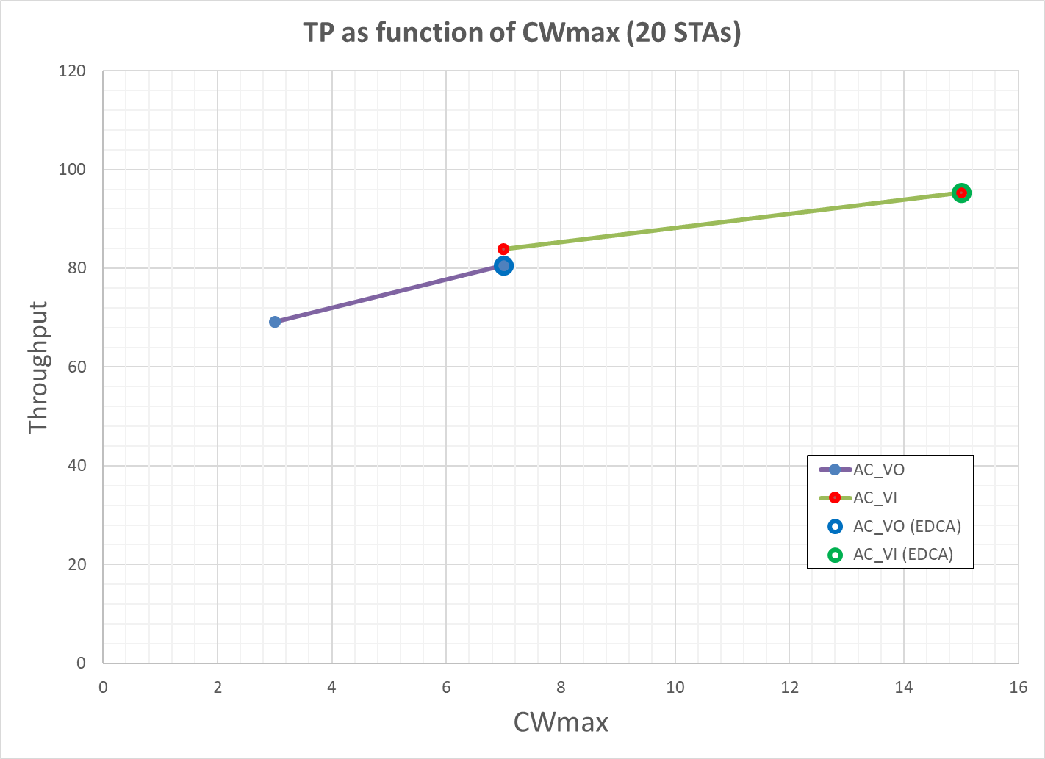
AC_VI and AC_VO
CA is less effective for AC_VI and AC_VO due to limits in CWmax

Slide 12
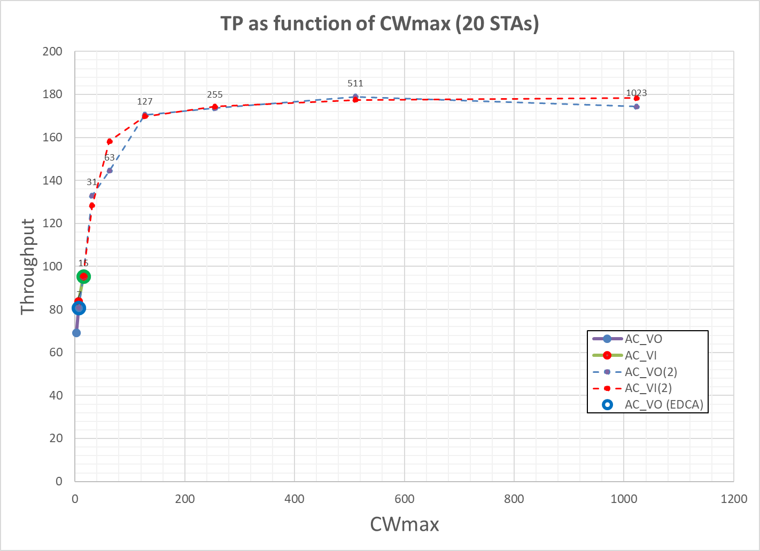
Increasing CWmax for AC_VO and AC_VI
Increased CWmax for AC_VO and AC_VI could further improve performance

Slide 13
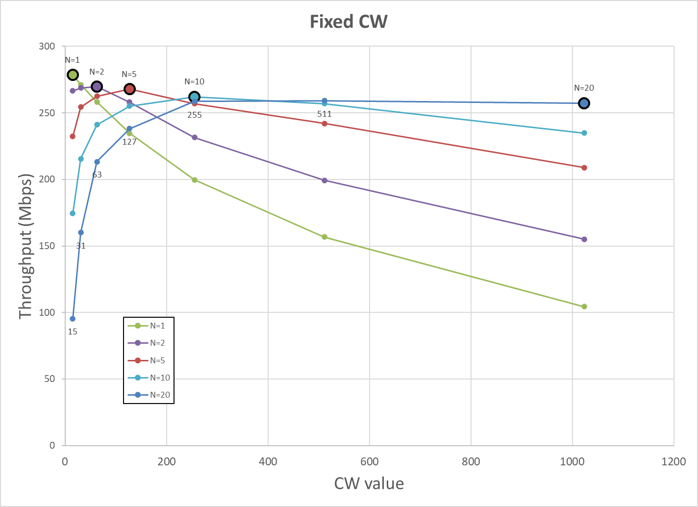
Experiment: Fixed CW per network
What if CW was fixed and set network-wide, not by individual STAs?
  The same value of CW is used all the time
Different network loads would have different optimal CW

Slide 14
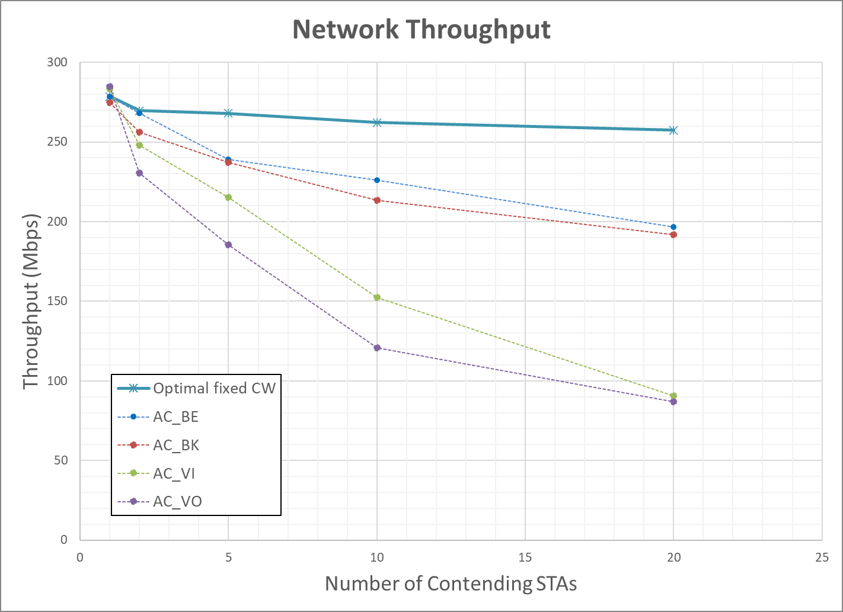
Fixed CW per network
Optimal fixed CW would significantly outperform current CSMA/CA
However, incompatible with current CSMA/CA and more difficult to manage

Slide 15
Conclusions
We reviewed current CSMA/CA and evaluated collision avoidance
Simulation results provide some insights into the effectiveness of current collision avoidance scheme
Collisions remain a problem within CSMA/CA in highly congested networks
In [1], we’ll explore a scheme to enhance the collision avoidance in CSMA

Slide 16
References
[1] CSMA with enhanced Collision Avoidance, IEEE 802.11-24/xxxx

