Slide 1
New MCS - Simulation Results
Date: 2024-05-14
Authors:
Name | Affiliations | Address | Phone | email
Ron Porat | Broadcom |  |  | ron.porat@broadcom.com
Qijia Liu | Broadcom

Slide 2
Introduction
[1]-[3] introduced four new MCS. We have previously simulated them as mentioned in [4] but didn’t provide our results
In this short contribution we provide our results for the new MCS and also investigate whether they are needed to improve the gains of UEQM over EQM
Revision r1 – added slide 8 showing benefit of new MCS also for UEQM

Slide 3
Simulation Assumptions
Nss=1 → focus of new MCS is on one stream where there is no benefit for UEQM
MIMO Config: 2x2
80MHz
DNLOS, 500 channel realizations for each MIMO config
Including RF impairments
PER and Gput curves
Not shown here but we have seen similar results for BLOS, open loop, 1x1 and 4x2 cases
Focus on low hanging fruit → new combinations of existing code rates and modulations

Slide 4
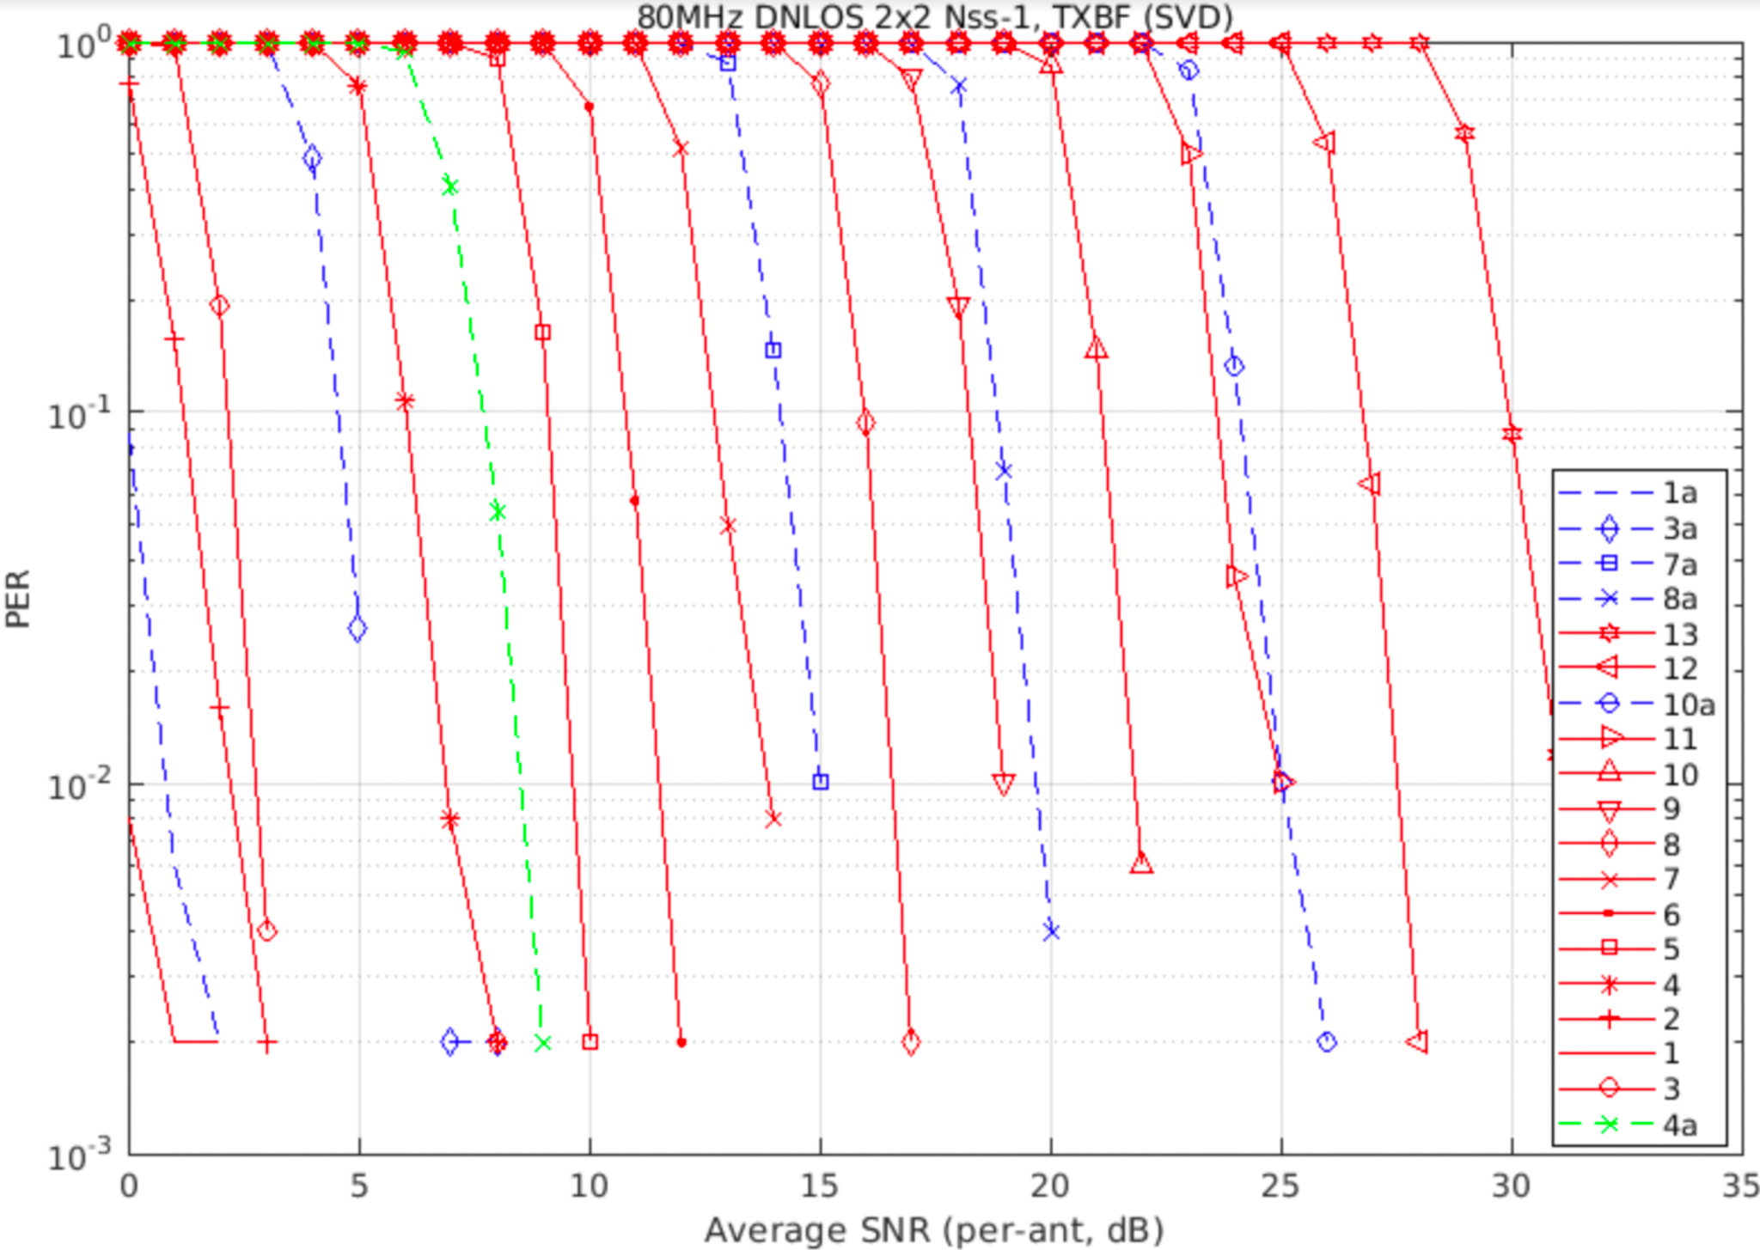
Nss-1: 80MHz 2x2 DNLOS TXBF
MCS | Modulation | Code rate | Goodput
0 | BPSK | 1/2 | 0.5
1 | QPSK | 1/2 | 1
1a | QPSK | 2/3 | 1.33
2 | QPSK | 3/4 | 1.5
3 | 16 | 1/2 | 2
3a | 16 | 2/3 | 2.67
4 | 16 | 3/4 | 3
4a | 16 | 5/6 | 3.33
5 | 64 | 2/3 | 4
6 | 64 | 3/4 | 4.5
7 | 64 | 5/6 | 5
7a | 256 | 2/3 | 5.33
8 | 256 | 3/4 | 6
8a | 1K | 2/3 | 6.67
9 | 256 | 5/6 | 6.67
10 | 1K | 3/4 | 7.5
10a | 4K | 2/3 | 8
11 | 1K | 5/6 | 8.33
12 | 4K | 3/4 | 9
13 | 4K | 5/6 | 10
1a 2 3 3a 4 4a 5 6 7 7a 8 9 8a 10 11 10a 12 13

Slide 5
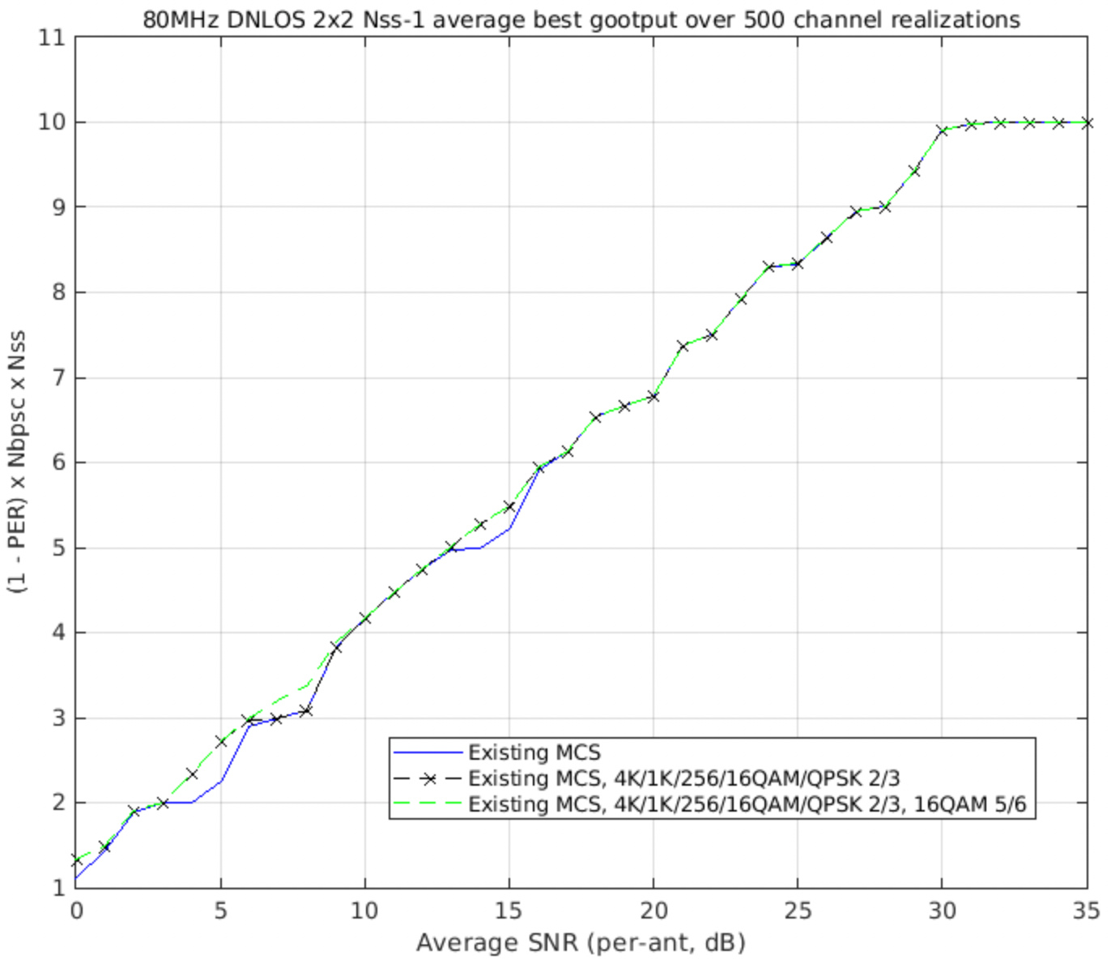
Nss-1: 80MHz 2x2 DNLOS TXBF
No use of 1K/4K QAM + 2/3 MCSs
256QAM + 2/3
16QAM + 5/6
16QAM + 2/3
QPSK + 2/3

Slide 6
Observations
Rate 2/3 with QPSK, 16QAM, 256QAM and rate 5/6 with 16QAM nicely close the large gaps between the existing MCS
Rate 2/3 with 1K and 4K QAM are too close to existing MCS

Slide 7
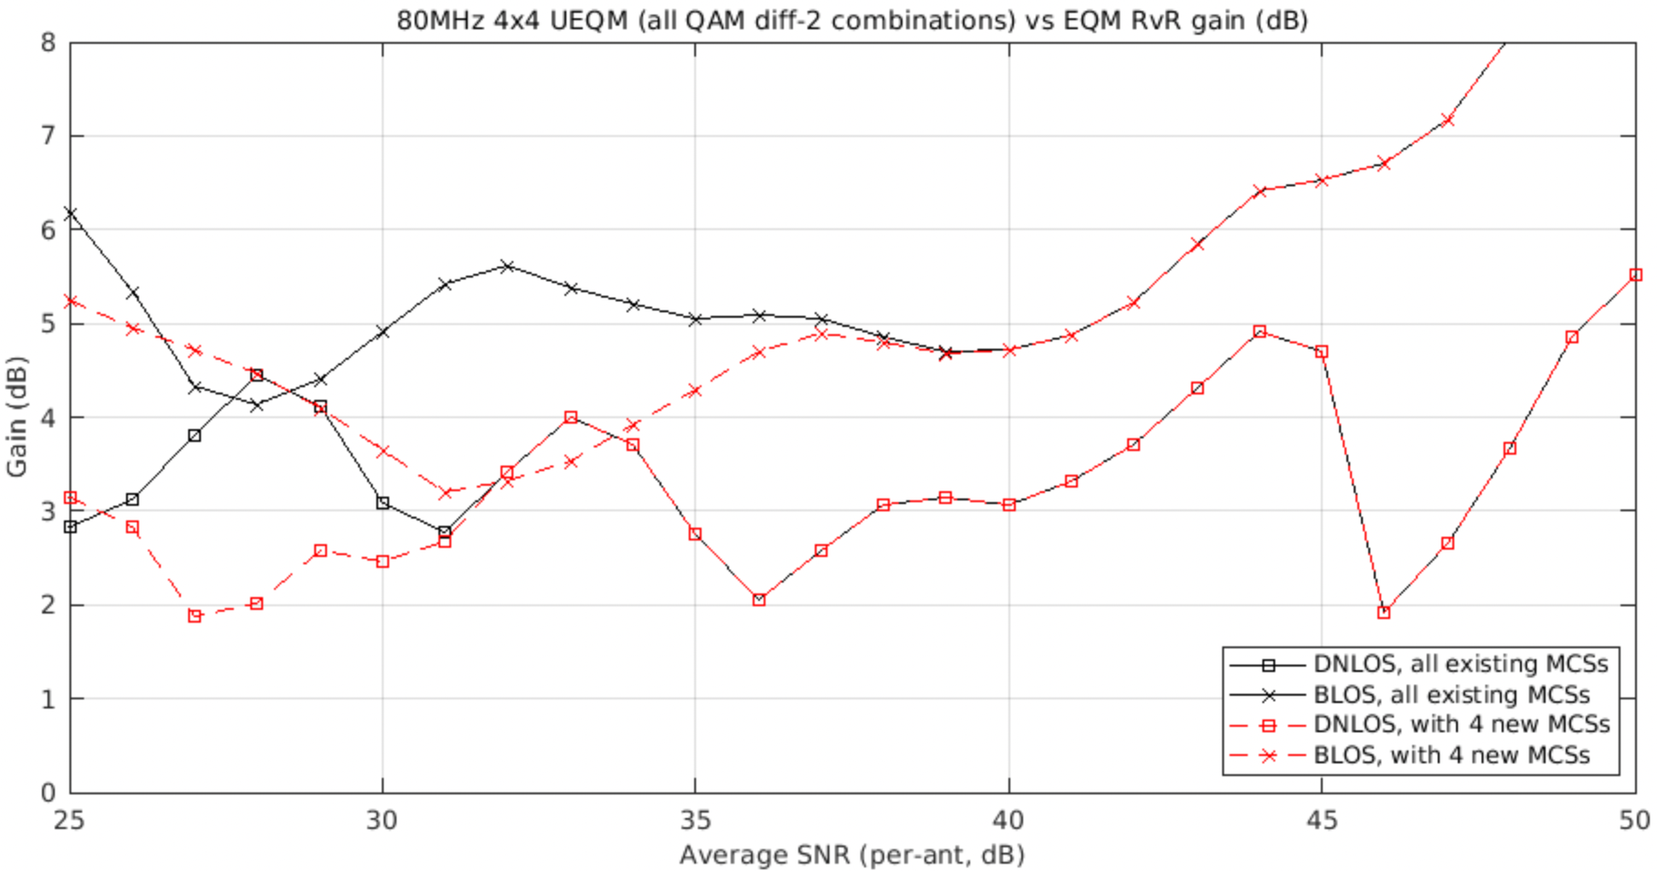
Do the New MCS Increase the Gains of UEQM over EQM?
No – the gain is smaller with the new MCS because the new MCS improves the baseline EQM performance

Slide 8
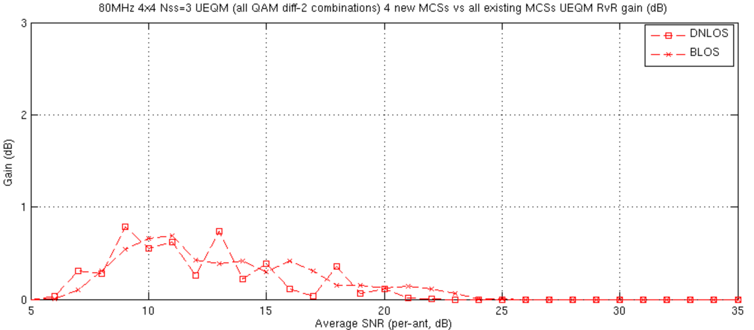
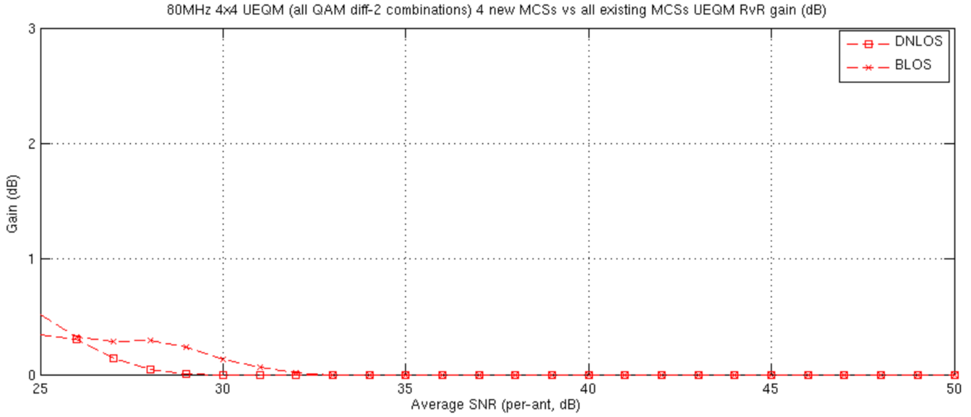
Do the New MCS also Increase the Gput of UEQM?
Yes - the 4 new MCS are targeting low to midrange SNR and their Goodput gains are seen for Nss=3 (top) and Nss=4 (bottom)

Slide 9
Conclusions
Adding new MCS provide value for Nss=1, open loop, MIMO with EQM and UEQM over SU BF.
We recommend adding the proposed 4 new MCS as their value is seen for many if not all transmission modes

Slide 10
References
[1] 11-24-0474-00-00bn-UHR unequal modulation pattern and new MCS
[2] 11-24-0498-00-00bn-Unequal Modulation in MIMO TxBF and New MCS for 11bn
[3] 11-24-0469-00-00bn-New MCSs for 11bn
[4] 11-24-0507-01 UEQM Further Details

Slide 11
SP #1
Do you agree to add to the 11bn SFD : 11bn supports the added new MCS for all transmission modes:
Rate 2/3 with QPSK, 16QAM, 256QAM
Rate 5/6 with 16QAM

