Slide 1
STF Design Consideration for DRU
Date: 2024-05-xx
Authors:
Name | Affiliations | Address | Phone | Email
Lin Yang | Qualcomm
Qifan Chen
Bin Tian
Youhan
Notes:
September 2012

Slide 2
UHR-STF in DRU Transmission
In DRU transmission, data portion transmits on the distributed tones over its distribution BW
For proper AGC gain setting, each user participating in the distributed OFDMA transmission needs to transmit UHR-STF signal across its distribution BW
STF property should be kept the same as RRU cases
We need proper design on the following aspects to accommodate UHR-STF transmission with DRU and fulfill its functionality
Occupied STF tones and STF sequence
CSD

Slide 3
Proposal for UHR-STF in DRU transmission
Prefer to use the same UHR-STF sequence as RRU cases
Well designed for its functionality
Unified design for simplicity
UHR-STF sequence for DRU is determined by PPDU BW
Occupied STF tones for DRU are the same as that of the largest RRU corresponding to the distribution BW within PPDU BW
Ex 1: 20MHz UHR TB PPDU
Ex 2: 160MHz UHR TB PPDU
Ex 3: 160MHz UHR TB PPDU
DRU 20MHz
DRU 80MHz
RRU 80MHz
DRU 40MHz
RRU 80MHz
DRU 20MHz
DRU26 assigned here: (Distribution BW = PPDU BW)
Transmit the same STF sequence as RRU242 in BW20;
Occupied STF tones for 20MHz spreading = that of RRU242
DRU106 assigned here:
Transmit the same STF sequence as RRU996_0 in PPDU BW160;
Occupied STF tones for 80MHz spreading = that of RRU996
DRU52 assigned here:
Transmit the same STF sequence as RRU242_0 in PPDU BW160;
Occupied STF tones for 20MHz spreading = that of RRU242

Slide 4
Unintentional BF Issue
Multiple DRUs over same distribution BW transmitting the same STF signal may cause unintentional beamforming, which is traditionally solved by applying Cyclic Shift Delay (CSD) to STF
For UL OFDMA with RRU transmission, each STA uses same local per stream CSDs as others, because its EHT-STF is transmitted over the STF tones within its allocated RRU
No channel colliding to foster unintentional BF
For UL MU MIMO, global CSD needs to be applied to reduce unintentional beamforming
For UL OFDMA with DRU transmission over the same distribution BW, global CSD is also needed

Slide 5
Global CSD for DRU
Similar to per ss global CSD in UL MUMIMO , we can define global CSD index for each DRU assignment
For a DRU assignment in a given distribution BW, it is assigned with a global CSD start index i
If Nss for this DRU is larger than 1, then it will use CSD[mod(i: i+Nss-1, 8)] for each ss
Re-use the existing 8 CSD table in the spec
In hybrid transmission of DRU and RRU, transmission of the RRU STF follows the exact same rule as if there is no DRU
RRU in UL OFDMA uses localized CSD index as existing
DRU in UL OFDMA uses global CSD index over its distribution BW

Slide 6
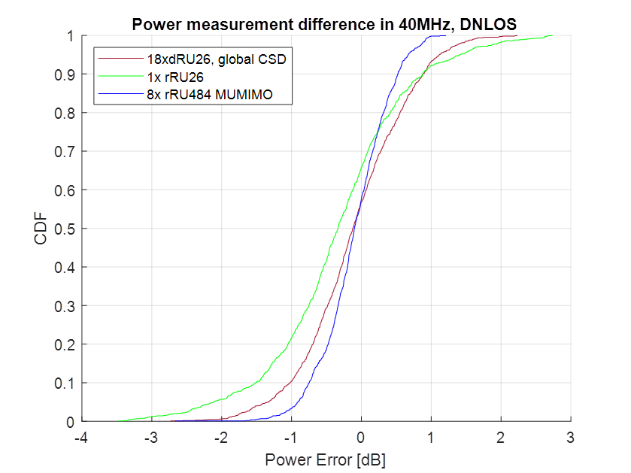
Power Measurement Performance Using Global CSD for DRU
Assume ideal global CSD assignment for DRUs
Using the proposed global CSD, DRU power measurement error is comparable to RRU cases

Slide 7
Summary
Propose to re-use the existing EHT-STF tone plan and sequence for DRU transmission
STF sequence depends on PPDU BW
Occupied STF tones depend on distribution BW
Global CSD is proposed to solve the unintentional BF issue in STF transmission for DRU
Applicable within each distribution BW

Slide 8
SP 1
Do you agree to add the following text to the TGbn SFD?
UHR-STF of DRU shall re-use the existing EHT-STF tone plan and sequence
STF sequence depends on PPDU BW
Occupied STF tones are the same as that of the largest RRU corresponding to the distribution BW within PPDU BW

Slide 9
SP 2
Do you agree to add the following text to the TGbn SFD?
Global CSD is used in DRU UHR-STF transmission to solve unintentional beamforming issue
Global CSD is applied in each distribution BW

Slide 10
SP 3
Do you agree to add the following text to the TGbn SFD?
DRU transmission reuses the existing 8 CSD table/values for global CSD allocation

Slide 11
SP 4
Do you agree to add the following text to the TGbn SFD?
In DRU transmission, global CSD defines CSD start index i for each DRU. If Nss for this DRU is larger than 1, then it will use CSD[mod(i: i+Nss-1, 8)] for each ss

